Slide 1
Network Operations & Predictive Intelligence System
From reactive network monitoring to proactive network intelligence

Slide 2
The Problem
Telecom networks generate massive amounts of activity data
Every hour, thousands of network cells generate data from:
SMS activity
Call activity
Internet usage
Geographic grid locations
Historical network behaviour

Slide 3
The challenge
Traditional network monitoring is largely reactive.
A network operations team often discovers an abnormal situation only after activity has already changed significantly.
This creates problems:
Delayed detection
Manual investigation
Difficulty identifying high-risk cells
Large volumes of data to monitor
Historical patterns are difficult to use operationally

Slide 4
Key question:
Can we predict which network cells are likely to experience unusually high activity before the NOC needs to investigate them?

Slide 5
The Product
Network Operations Intelligence Platform
A unified platform that transforms raw telecom activity data into:
Observe
Real-time network activity visibility
Detect
Historical anomaly detection
Predict
Machine-learning-based network risk prediction
Explain
AI-assisted operational insights
Act
Give the NOC actionable information instead of raw data

Slide 6
From Raw Data to Intelligence
Telecom Activity Data ->
Data Ingestion ->
Data Cleaning & Standardization ->
Spark Processing ->
MySQL Analytical Warehouse ->
ML Features ->
ML Prediction & Anomaly Detection ->
API Layer ->
React Dashboard ->
Claude AI Assistant
Question | Component
What happened? | Spark / Analytics
Where? | GeoJSON + Map
Is it unusual? | Alerts / Anomaly Detection
How risky is it? | ML
Is our data trustworthy? | Pipeline Status
What should I investigate? | Claude
Why does Claude believe that? | Tool calls + Evidence

Slide 7
Six behavioural features
Average Activity
How active has the grid been recently?
Activity Growth
Is activity increasing compared with the previous period?
Active Hours
How consistently active is the grid?
Peak Ratio
How strong are peaks compared with the average?
Variability
How much does activity fluctuate?
Internet Share
How much of the activity comes from internet usage?
Plus time-of-day features
hour_sin
hour_cos

Slide 8
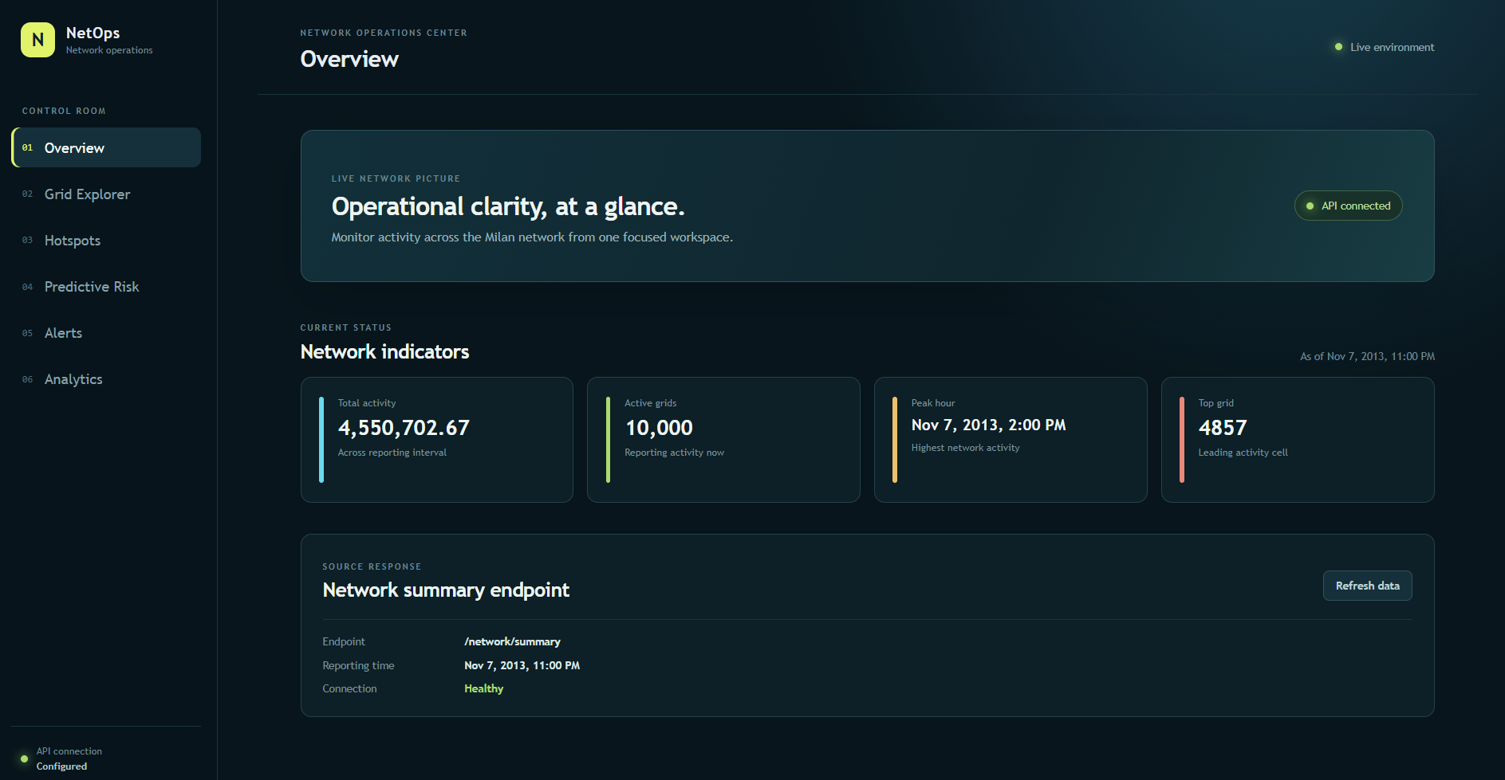
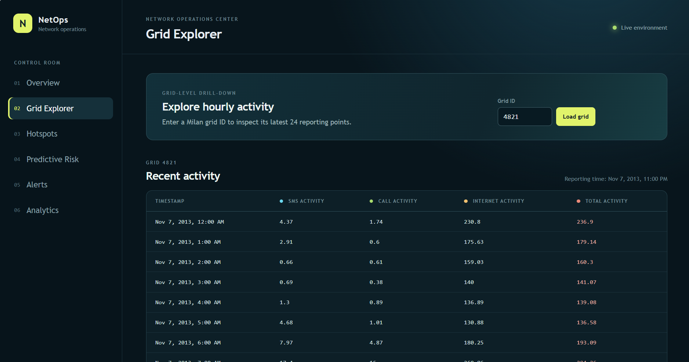
NOC Dashboard
One Operational View
The React dashboard brings the different intelligence layers together.
Dashboard capabilities:
Network Overview
Total activity
Active grids
Network statistics
Grid Monitoring
Individual grid activity
Historical behaviour

Slide 9
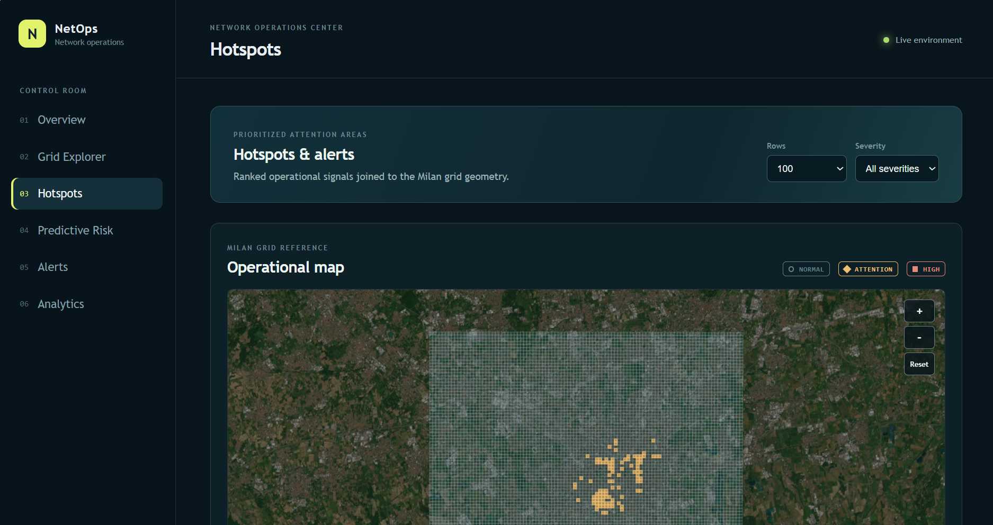
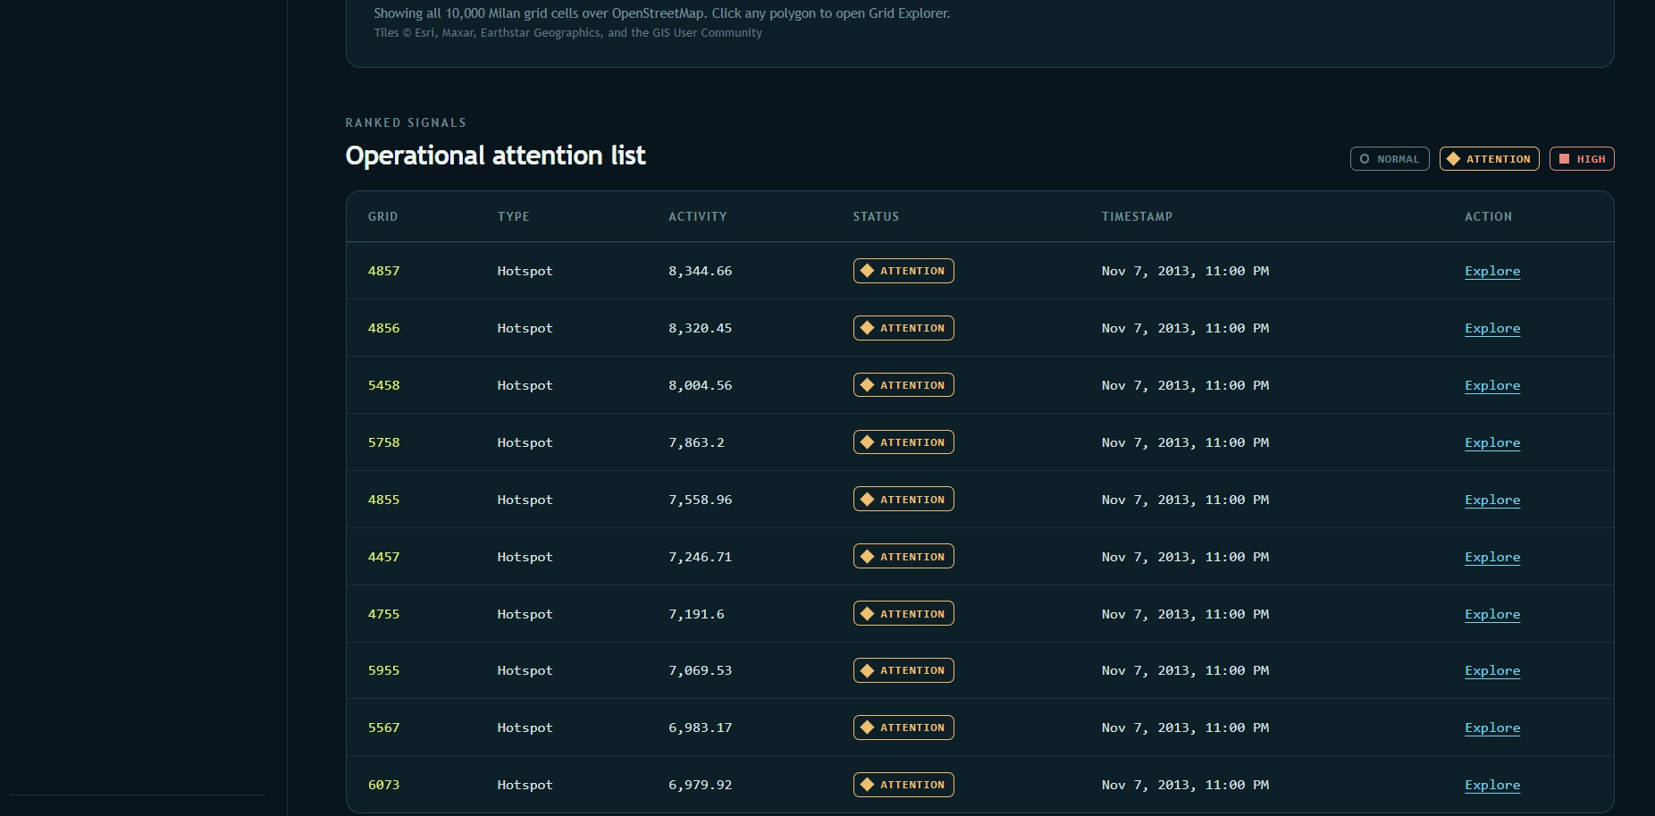
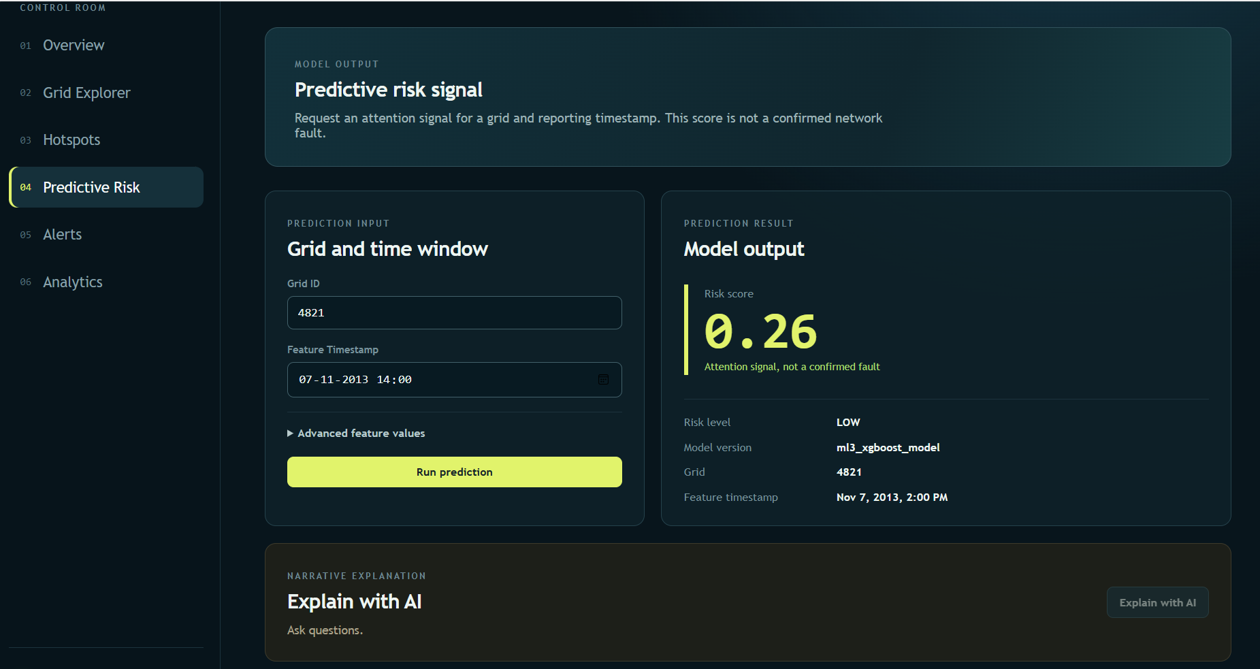
Hotspots​
Highest activity grids ​
Alerts
Network alerts
Historical anomalies
Predictive Risk
Select grid
Select timestamp
Receive ML prediction

Slide 10
AI Assistant
Claude-Powered Network Assistant
Instead of forcing an operator to manually interpret multiple screens and datasets, the AI assistant provides a natural-language interface.
Example questions
"Why is Grid 4821 high risk?"
"What happened to this grid historically?"
"Which grids should I investigate?"
"Is this activity unusual for this time of day?"

Slide 11
Value to Network Operations
Faster detection
Quickly surface unusual areas.
Better prioritization
Focus operators on the grids that need attention.
Geographic awareness
Connect analytical results to physical locations.
Evidence-based investigation
Claude works from actual platform evidence.
Operational transparency
Pipeline health and uncertainty are visible instead of hidden.

