Slide 1
Customer Churn Intelligence Platform
An end-to-end data and machine learning platform for identifying customers at risk of churn

Slide 2
The Problem
Telecom companies have large volumes of customer, service and billing data, but identifying which customers are likely to leave is difficult.
Challenges:
Customer information is spread across multiple data layers.
Manual rule-based identification does not capture complex patterns.
Not every high-risk customer is obvious from a single attribute.
Retention teams need prioritized customers, not just raw data.
Predictions must be accessible through an application, not only a notebook.

Slide 3
Business Question
“Which customers are most likely to churn, and who should the retention team prioritize?”

Slide 4
The Solution: Customer Churn Intelligence Platform
An end-to-end platform that transforms raw customer data into actionable churn risk intelligence.
What it does
1. Ingest
Collect and validate customer data.
2. Clean & Transform
Standardize data and handle missing/invalid values.
3. Engineer Features
Create meaningful behavioral and customer-level features.
4. Analyze
Identify high-risk customer segments.
5. Predict
Use ML to calculate individual churn probability.
6. Visualize
Expose insights through APIs and a React dashboard.
Outcome: From raw customer records → prioritized retention actions

Slide 5
Product Workflow
Customer Data
↓
File Ingestion
↓
Schema & Data Quality Validation
↓
Data Cleaning
↓
Feature Engineering
↓
MySQL Curated Data
↓
ML Model
↓
Customer Risk Score
↓
FastAPI
↓
React Dashboard

Slide 6
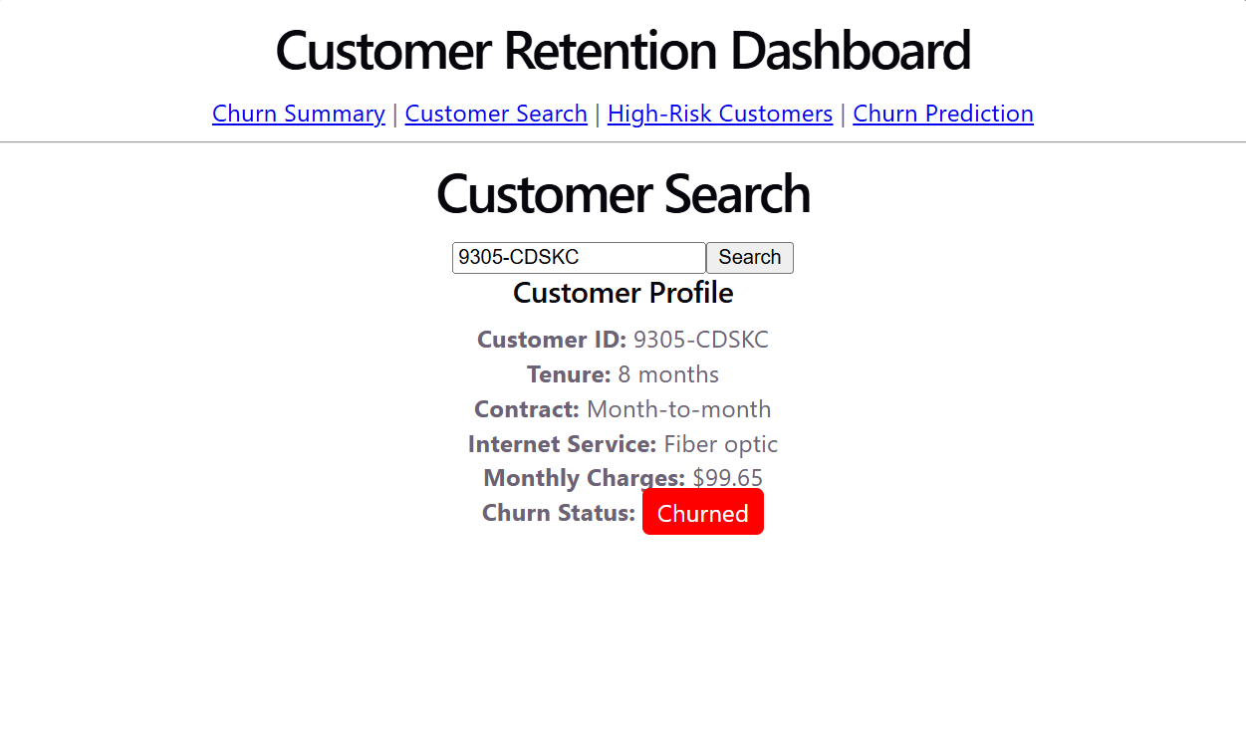
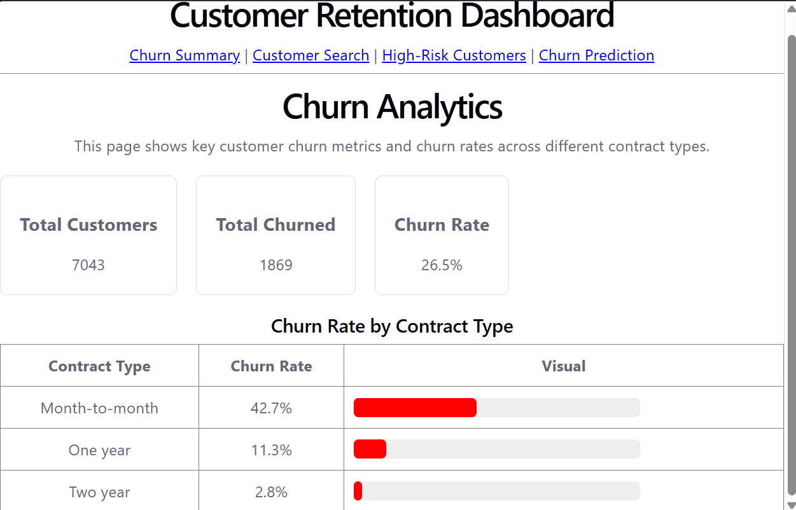
Product Features
Customer Search
Search for an individual customer and view:
Tenure
Contract
Internet service
Monthly charges
Current churn status
Churn Analytics
View:
Total customers
Total churned
Overall churn rate
Churn rate by contract
Churn rate by internet service

Slide 7
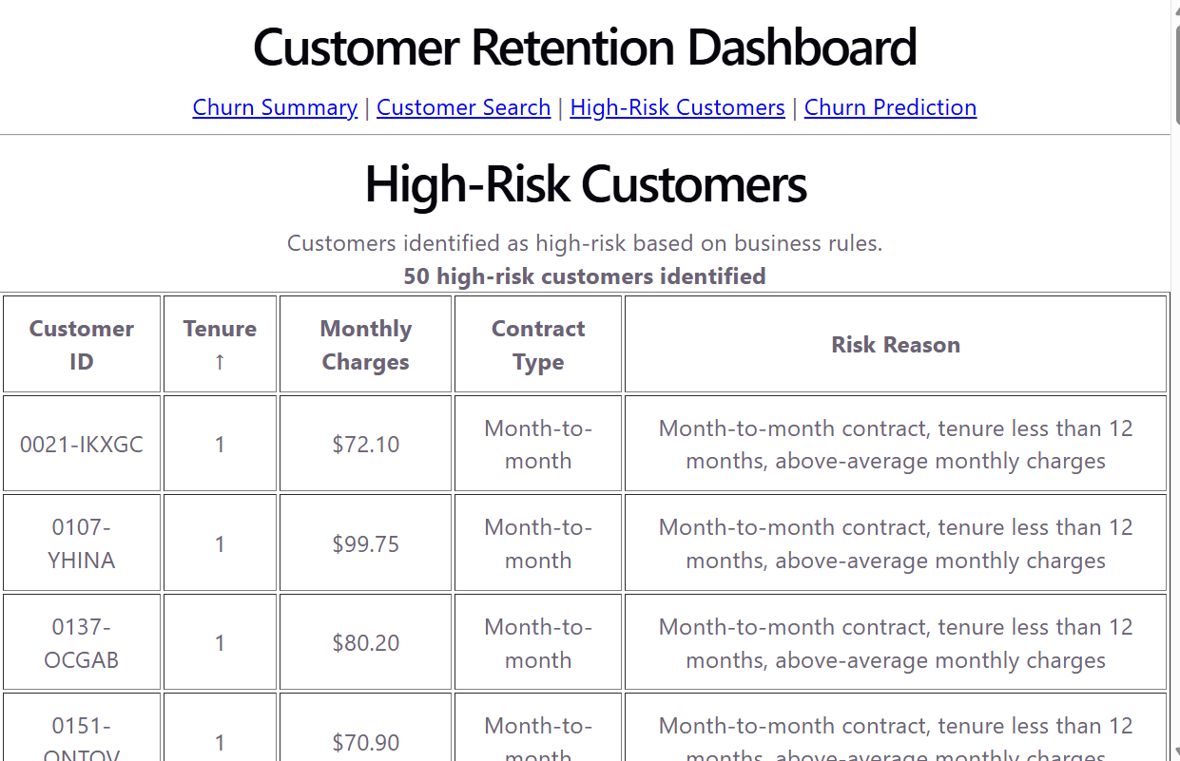
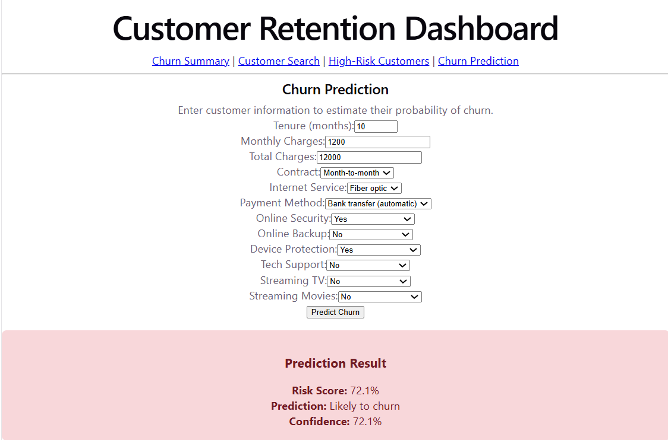
Product Features
High-Risk Customers
View customers identified by business rules with:
Risk reason
Contract
Tenure
Monthly charges
Churn Prediction
Enter customer information and receive:
Risk score
Prediction
Confidence
Visual risk indicator

