Slide 1
FRB host GALFIT verification
Population diagnostics → 51 confirmed panels (science cut: mag ≤ 22, b/a > 0.2)
Full-resolution PNGs embedded at 200 DPI

Slide 2
Population-level tests (in_53)
Source: outputs/tables/population_summary.json + outputs/plots/
PSF leakage null tests
Spearman(q, e_PSF) = 0.066 (p = 0.638) — no amplitude correlation
KS(|ΔPA|/90 vs Uniform) p = 0.851 (median |ΔPA| = 46.0°) — flat PA alignment
Geometry agreement (production metrics)
sky Δq median [p16, p84] = 0.004 [0.001, 0.055]
AstroPhot Δq median = -0.006 · iso Δq(2Re) median = -0.026
Fourier δq median = -0.034 (includes unreliable / unresolved hosts)
Photometry / cleanliness
Δm vs Re slope significance = -6.3σ (strong size–mag systematic)
RFF(2Re) median = -0.001 · χ²/ν(2Re) median = 1.05
Next slides: one diagnostic figure each. Then confirmed host panels.

Slide 3
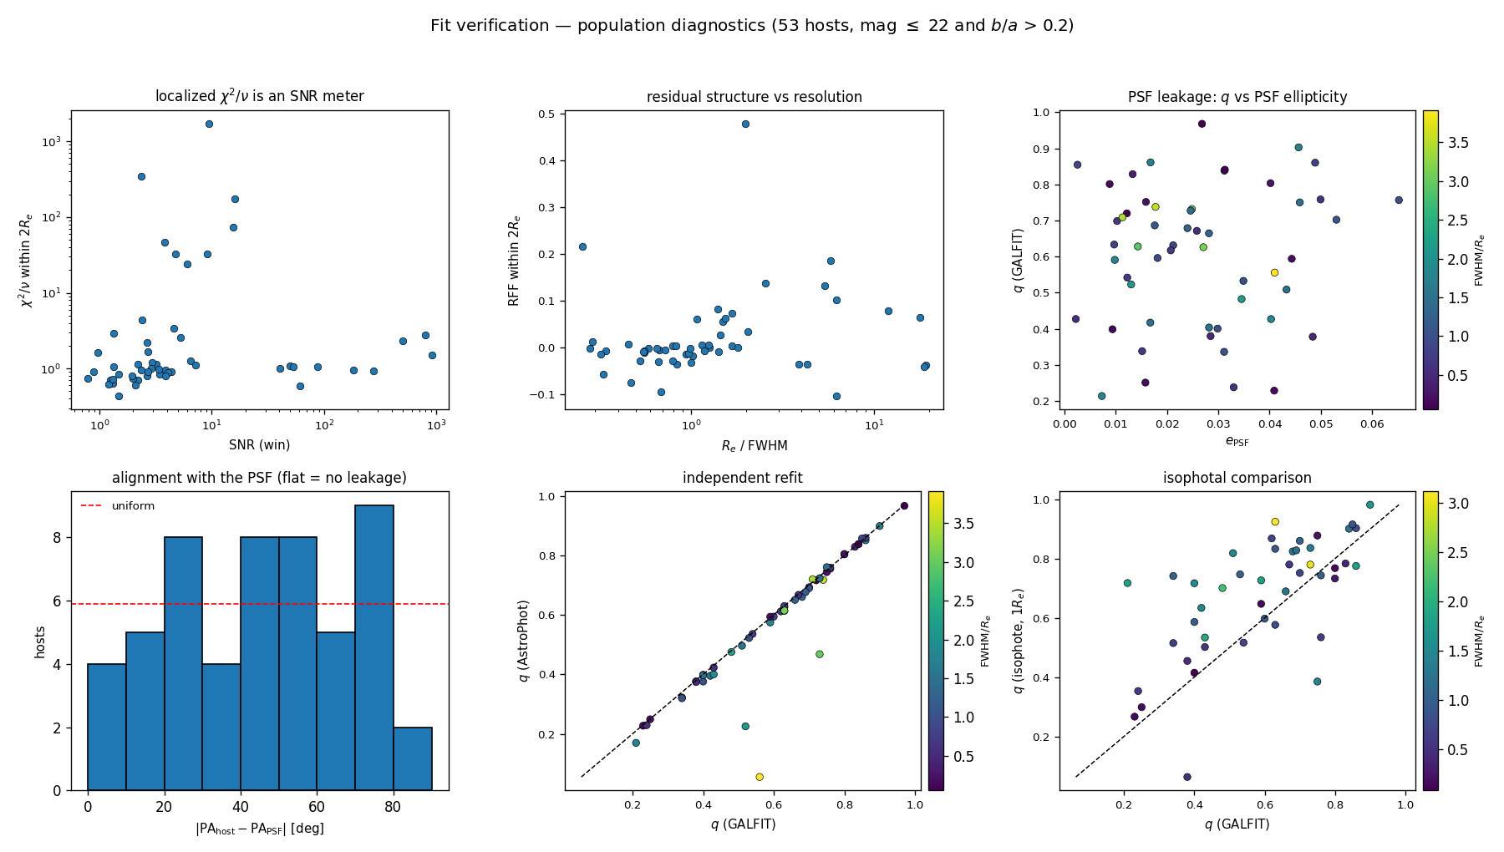
Population diagnostics (science cut)
χ² vs SNR · RFF vs Re/FWHM · q vs e_PSF · |ΔPA| · AstroPhot vs GALFIT · isophote vs GALFIT

Slide 4
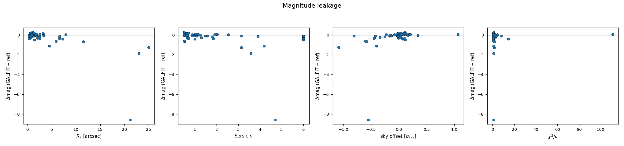
Magnitude leakage (cohort OLS)
Δm vs Re, n, sky offset, χ² — strong Δm–Re trend is the main photometric systematic

Slide 5
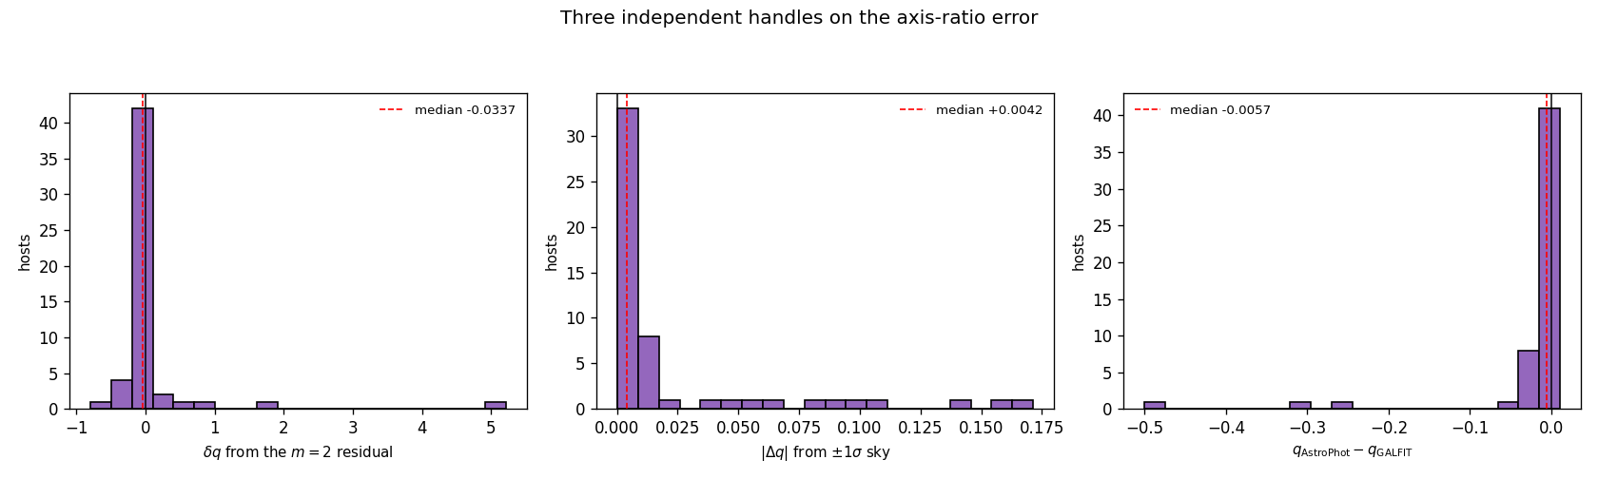
Geometry Δq distributions
Fourier δq · sky ±1σ Δq · AstroPhot Δq (production metrics; not alternate-leg)

Slide 6
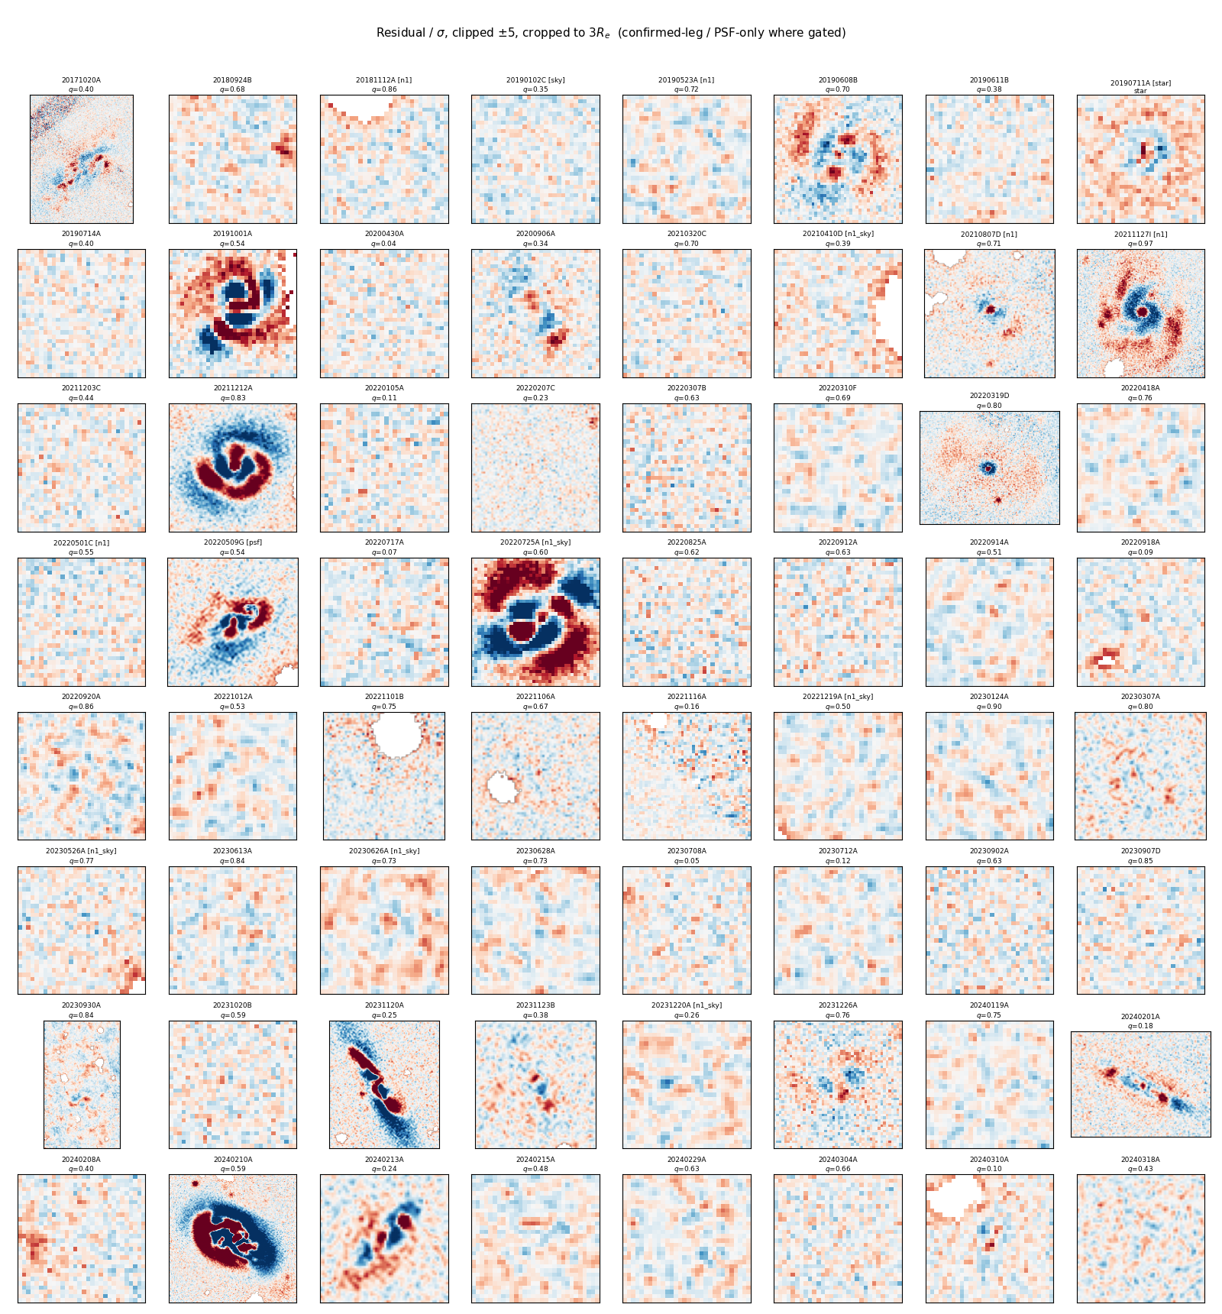
Residual contact sheet (all 64)
Confirmed-leg / PSF-only residuals where gated; production otherwise. ±5σ, crop 3 Re

Slide 7
Confirmed host panels
51 in-cut confirmed · then rejected in-cut hosts

Slide 8
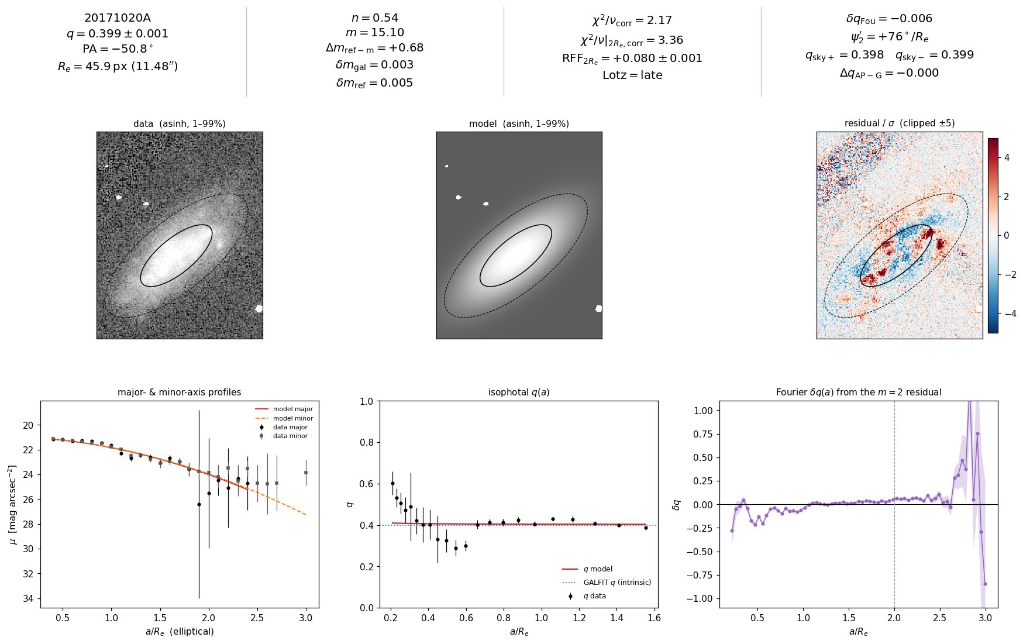
1/51 20171020A [production]

Slide 9
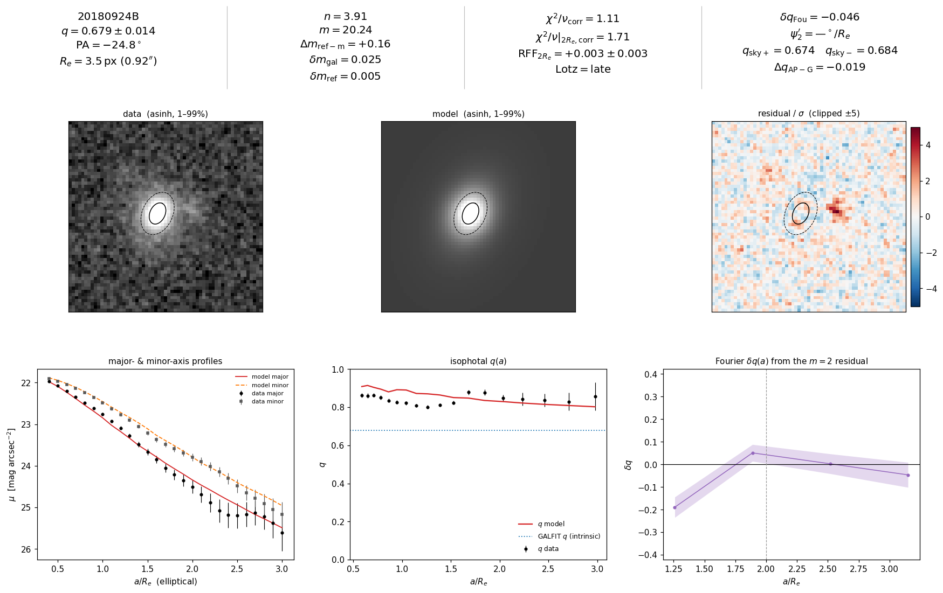
2/51 20180924B [production]

Slide 10
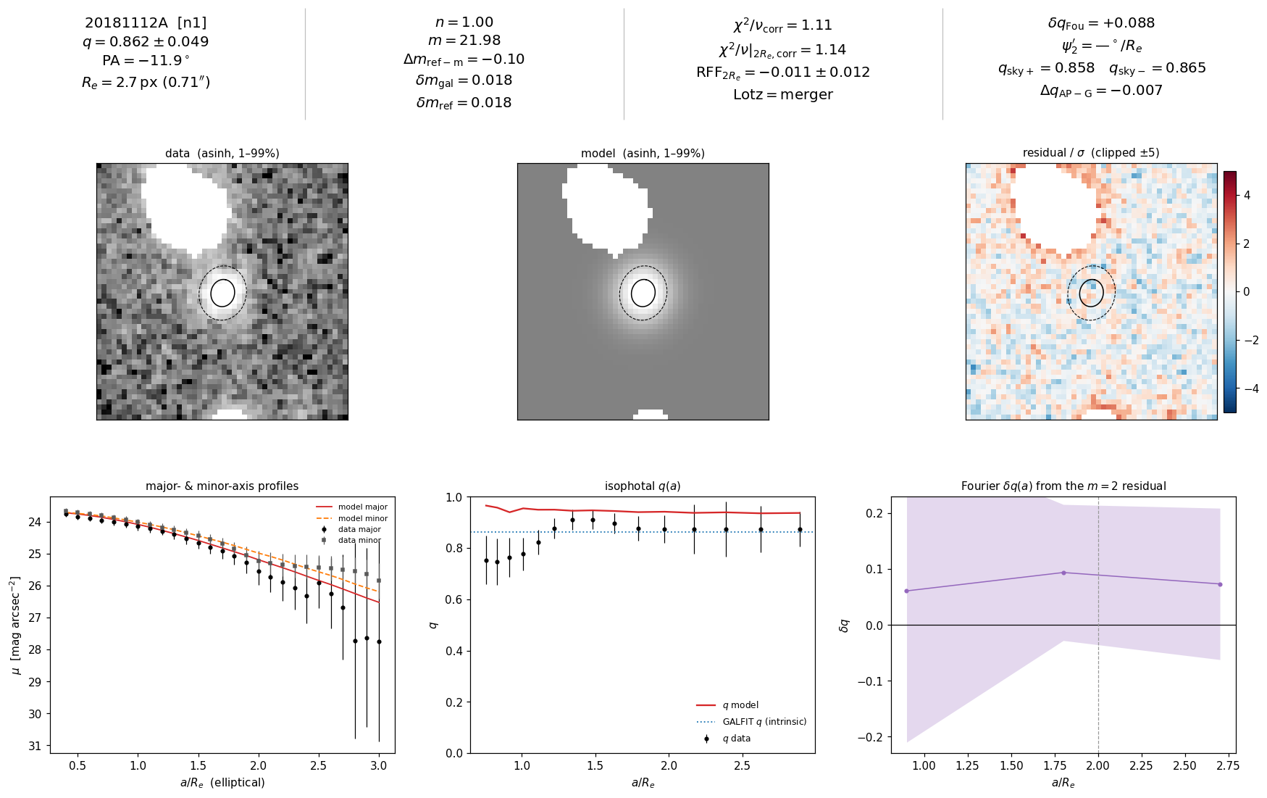
3/51 20181112A [n1]

Slide 11
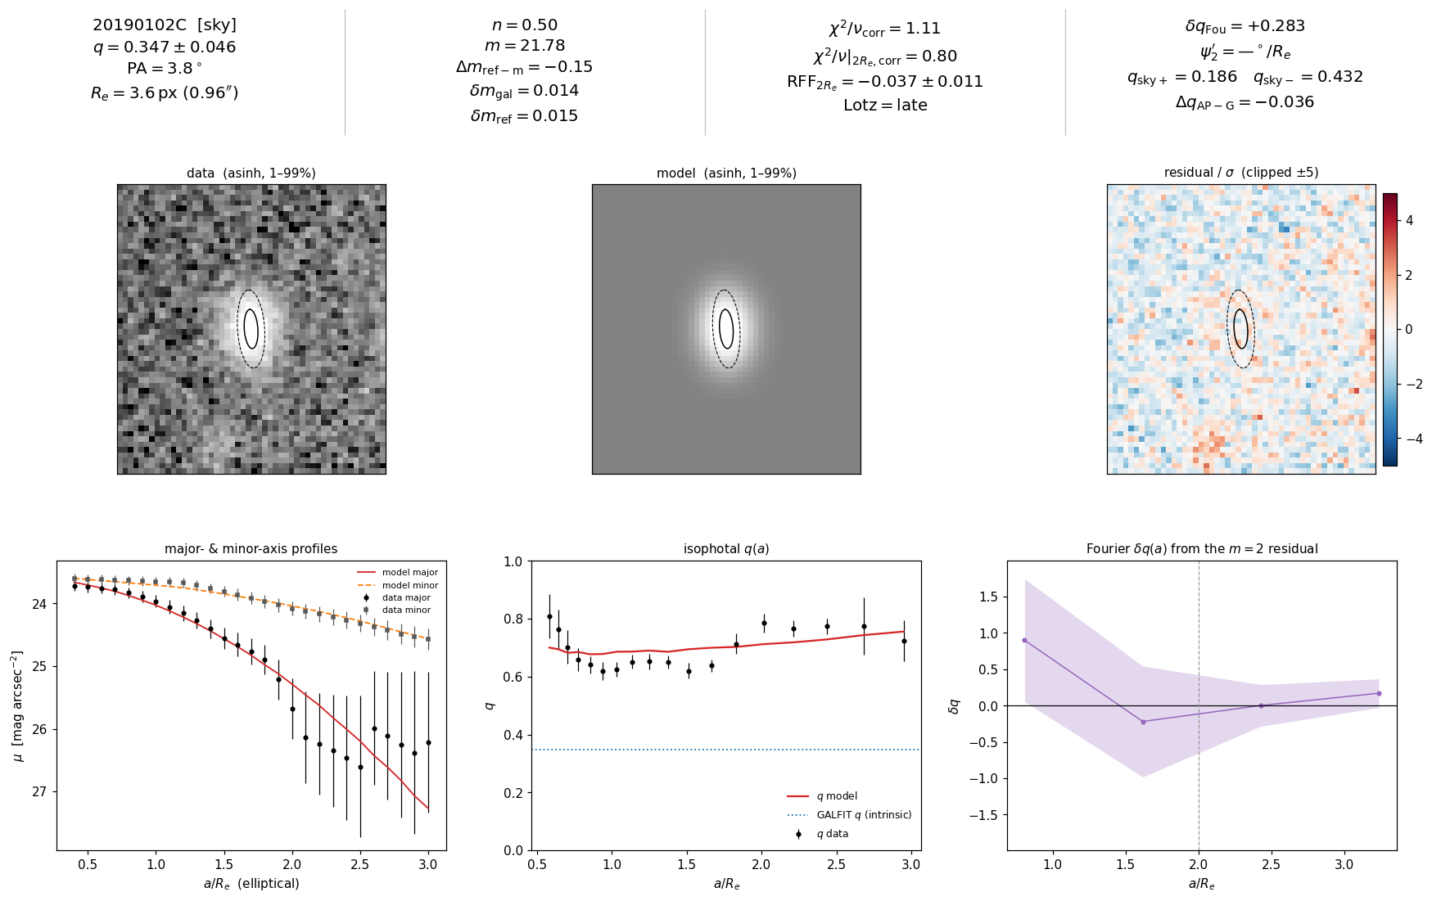
4/51 20190102C [sky]

Slide 12
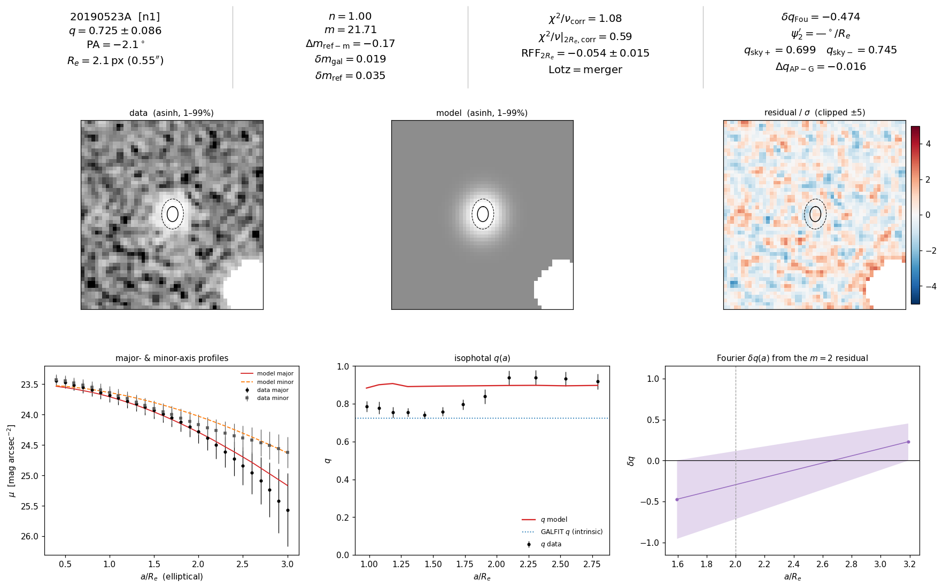
5/51 20190523A [n1]

Slide 13
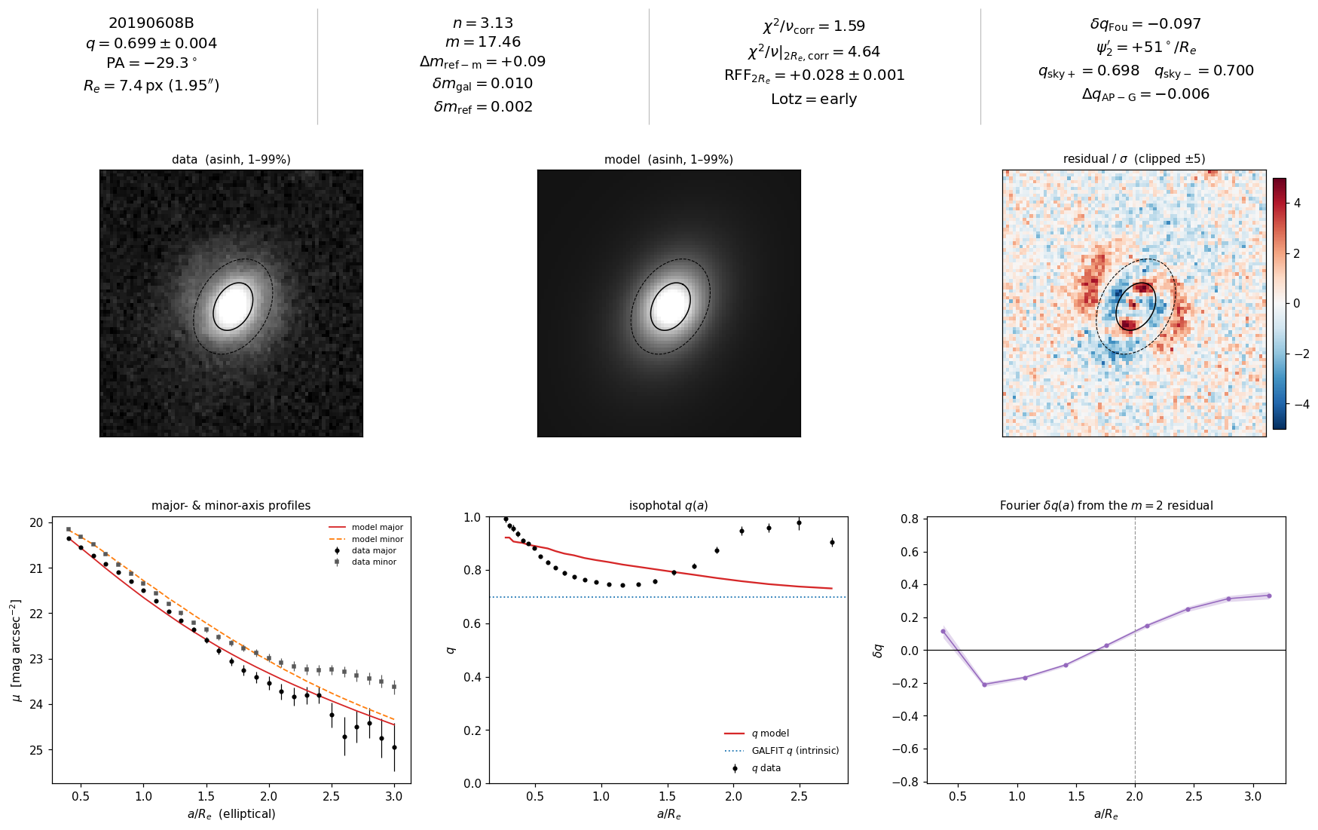
6/51 20190608B [production]

Slide 14
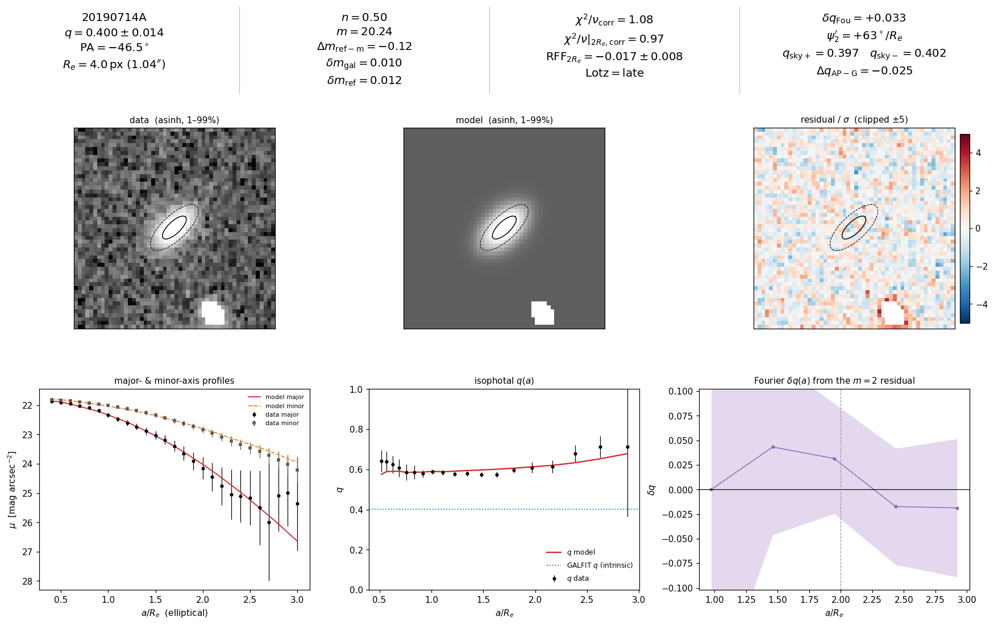
7/51 20190714A [production]

Slide 15
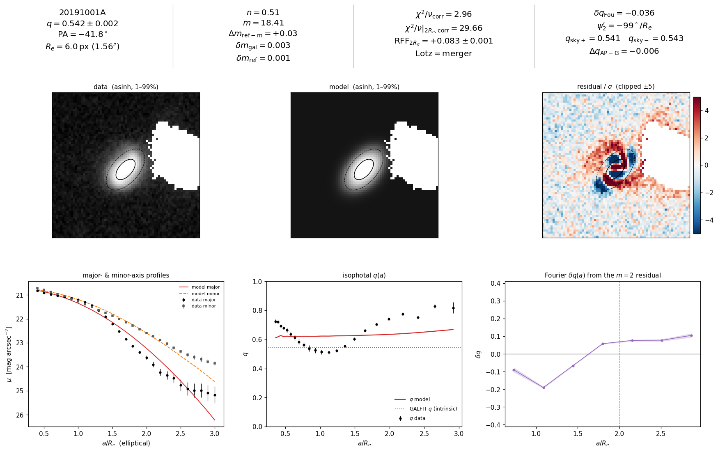
8/51 20191001A [production]

Slide 16
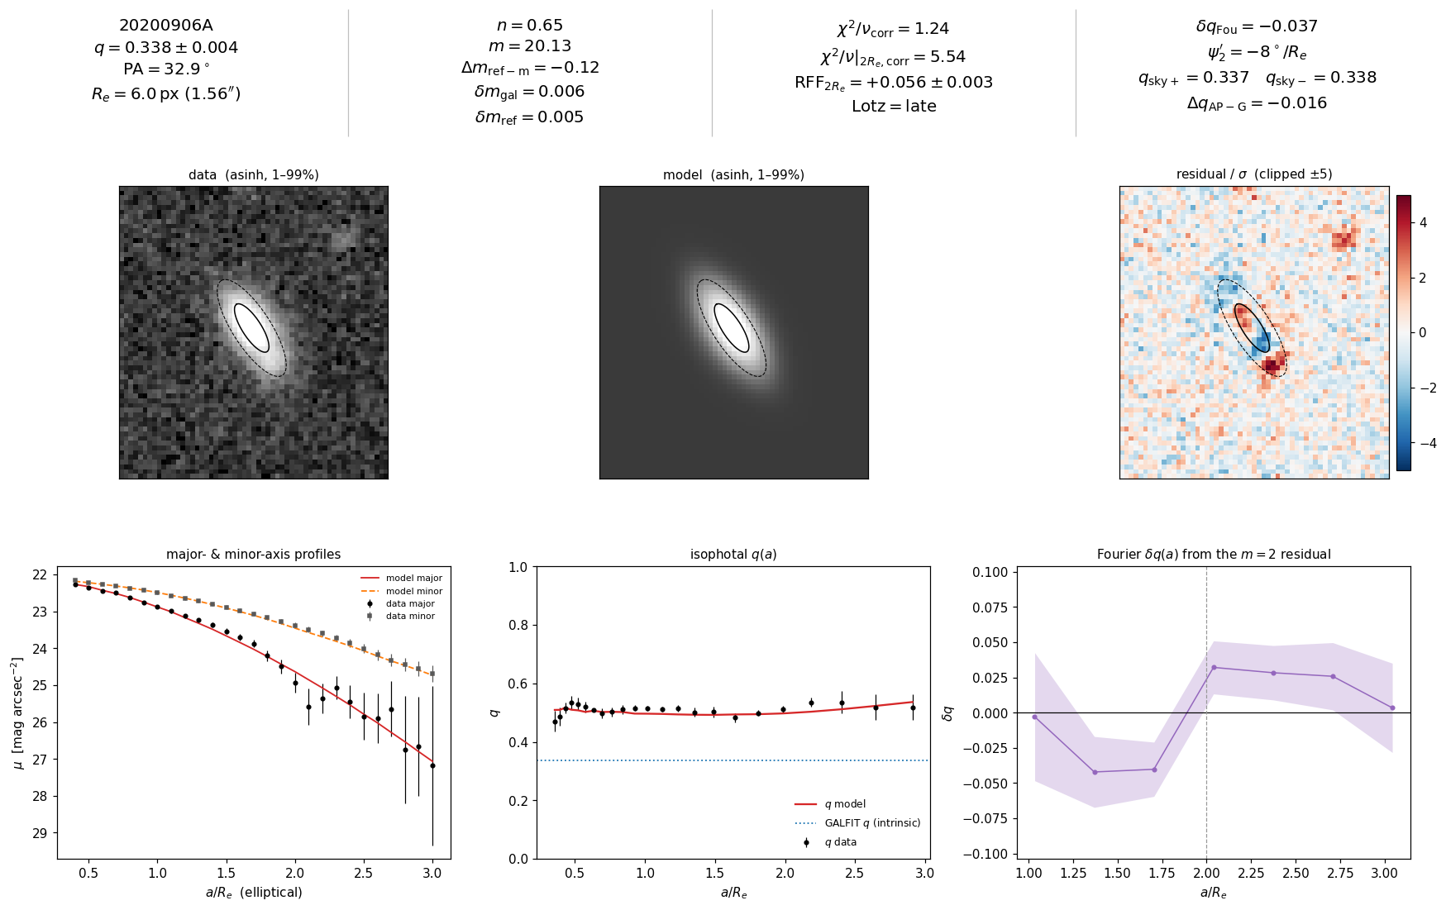
9/51 20200906A [production]

Slide 17
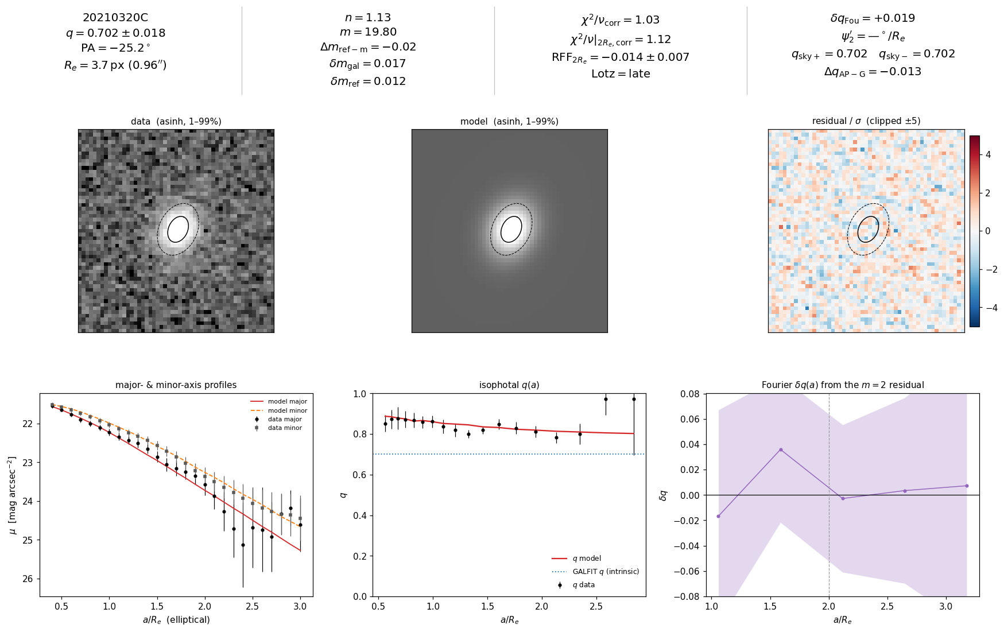
10/51 20210320C [production]

Slide 18
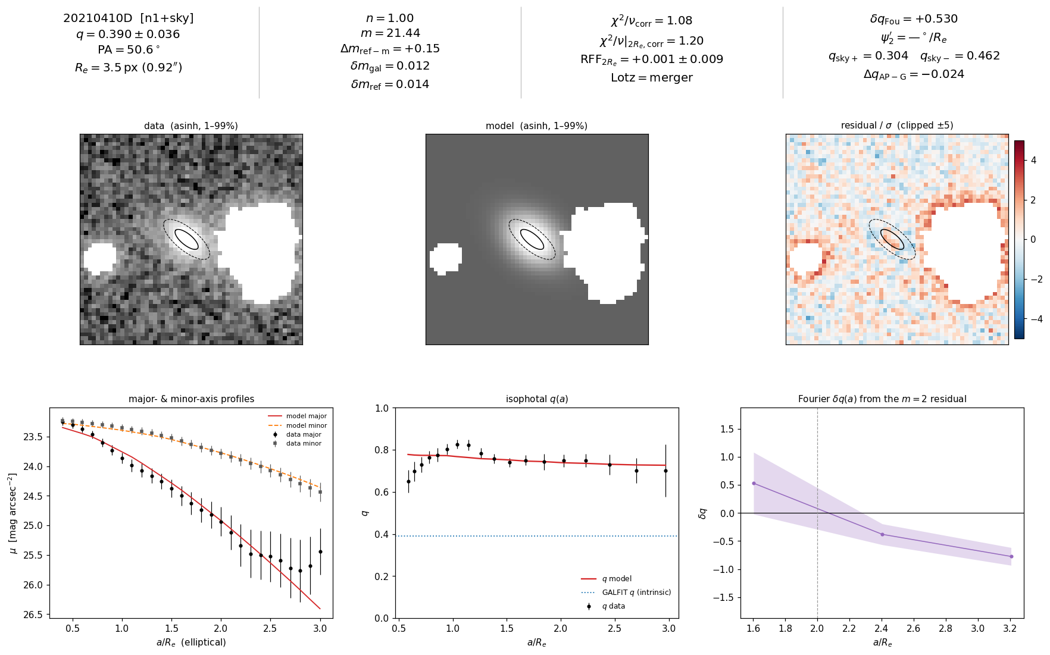
11/51 20210410D [n1_sky]

Slide 19
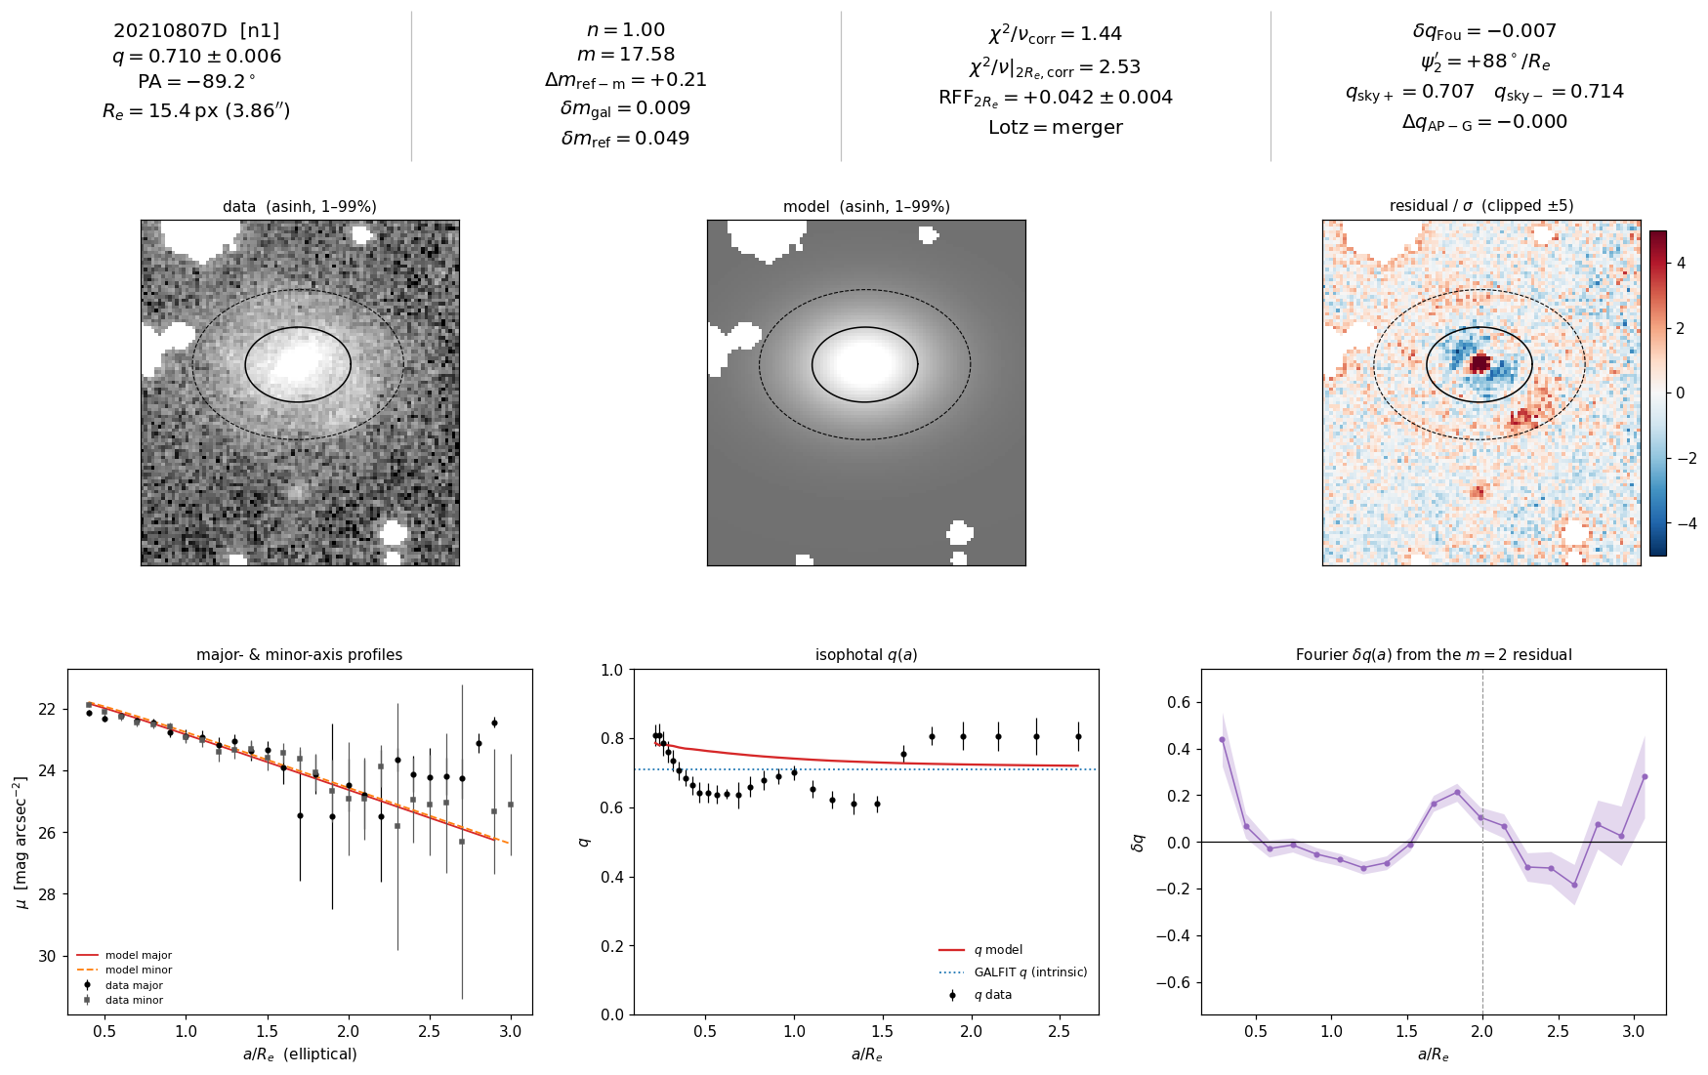
12/51 20210807D [n1]

Slide 20
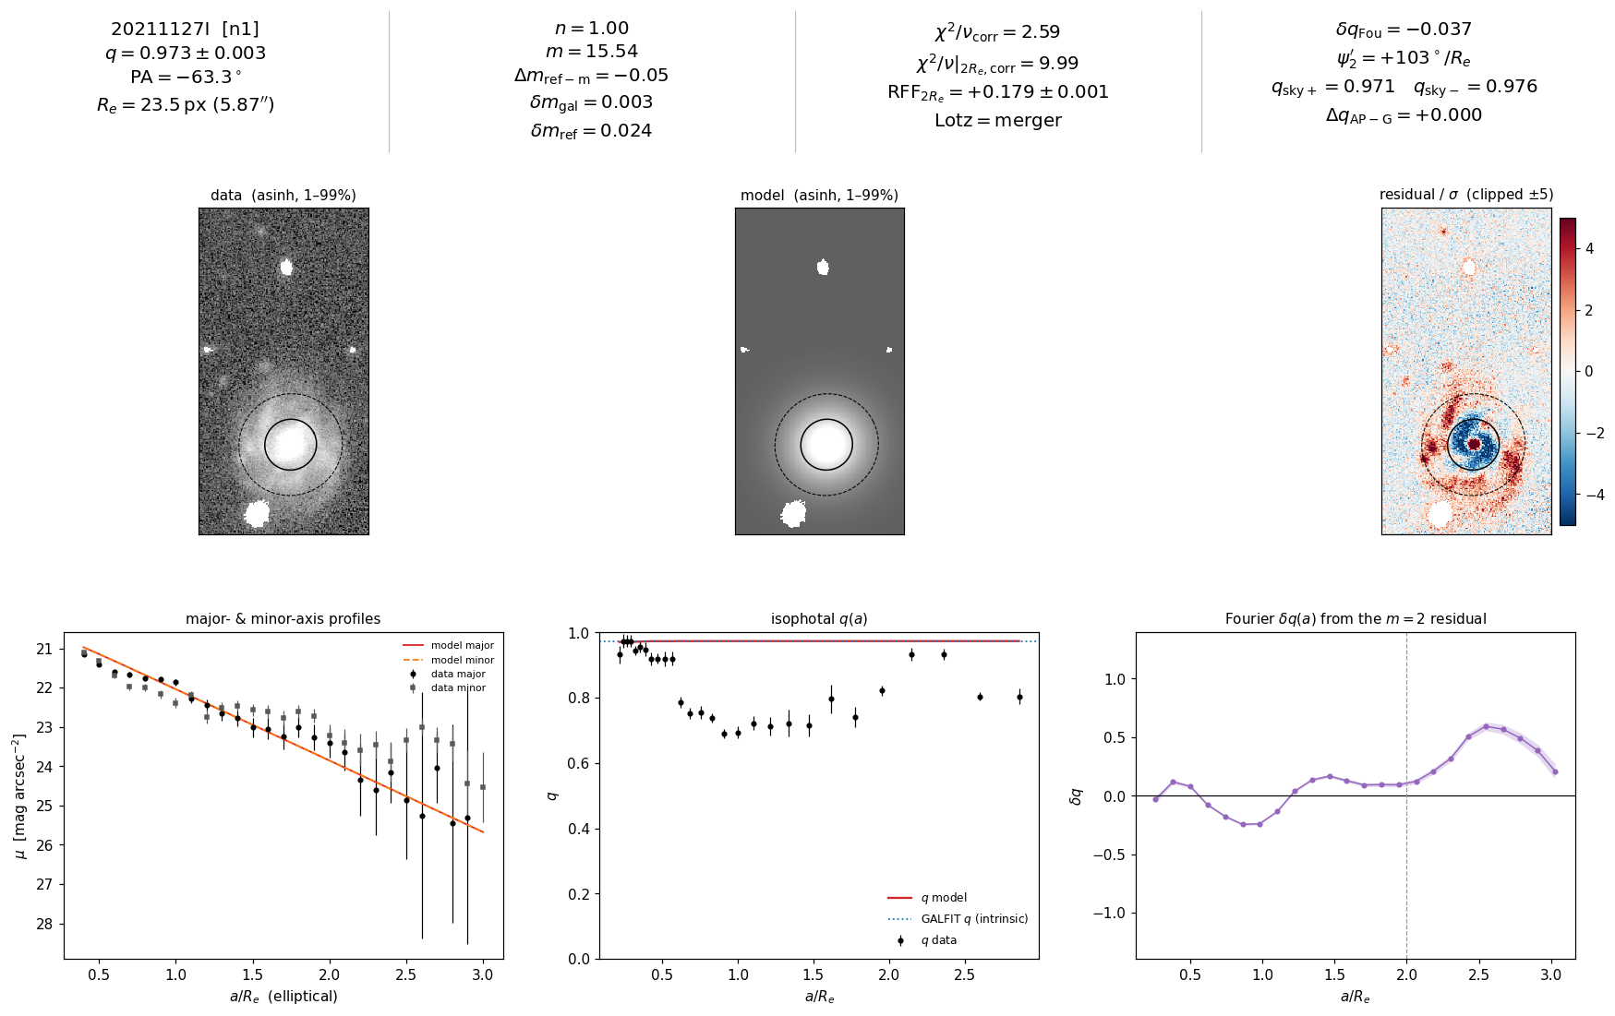
13/51 20211127I [n1]

Slide 21
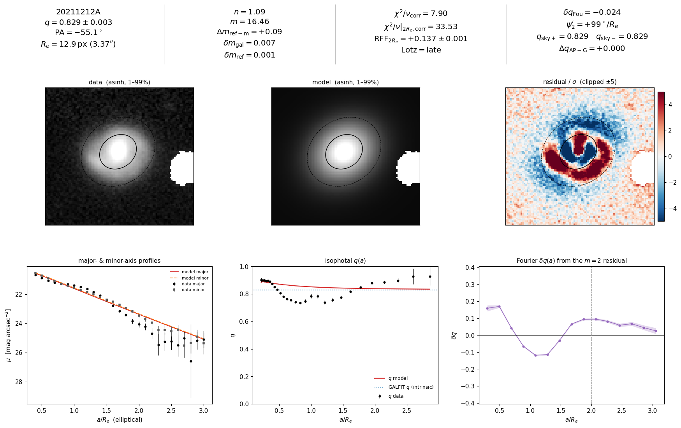
14/51 20211212A [production]

Slide 22
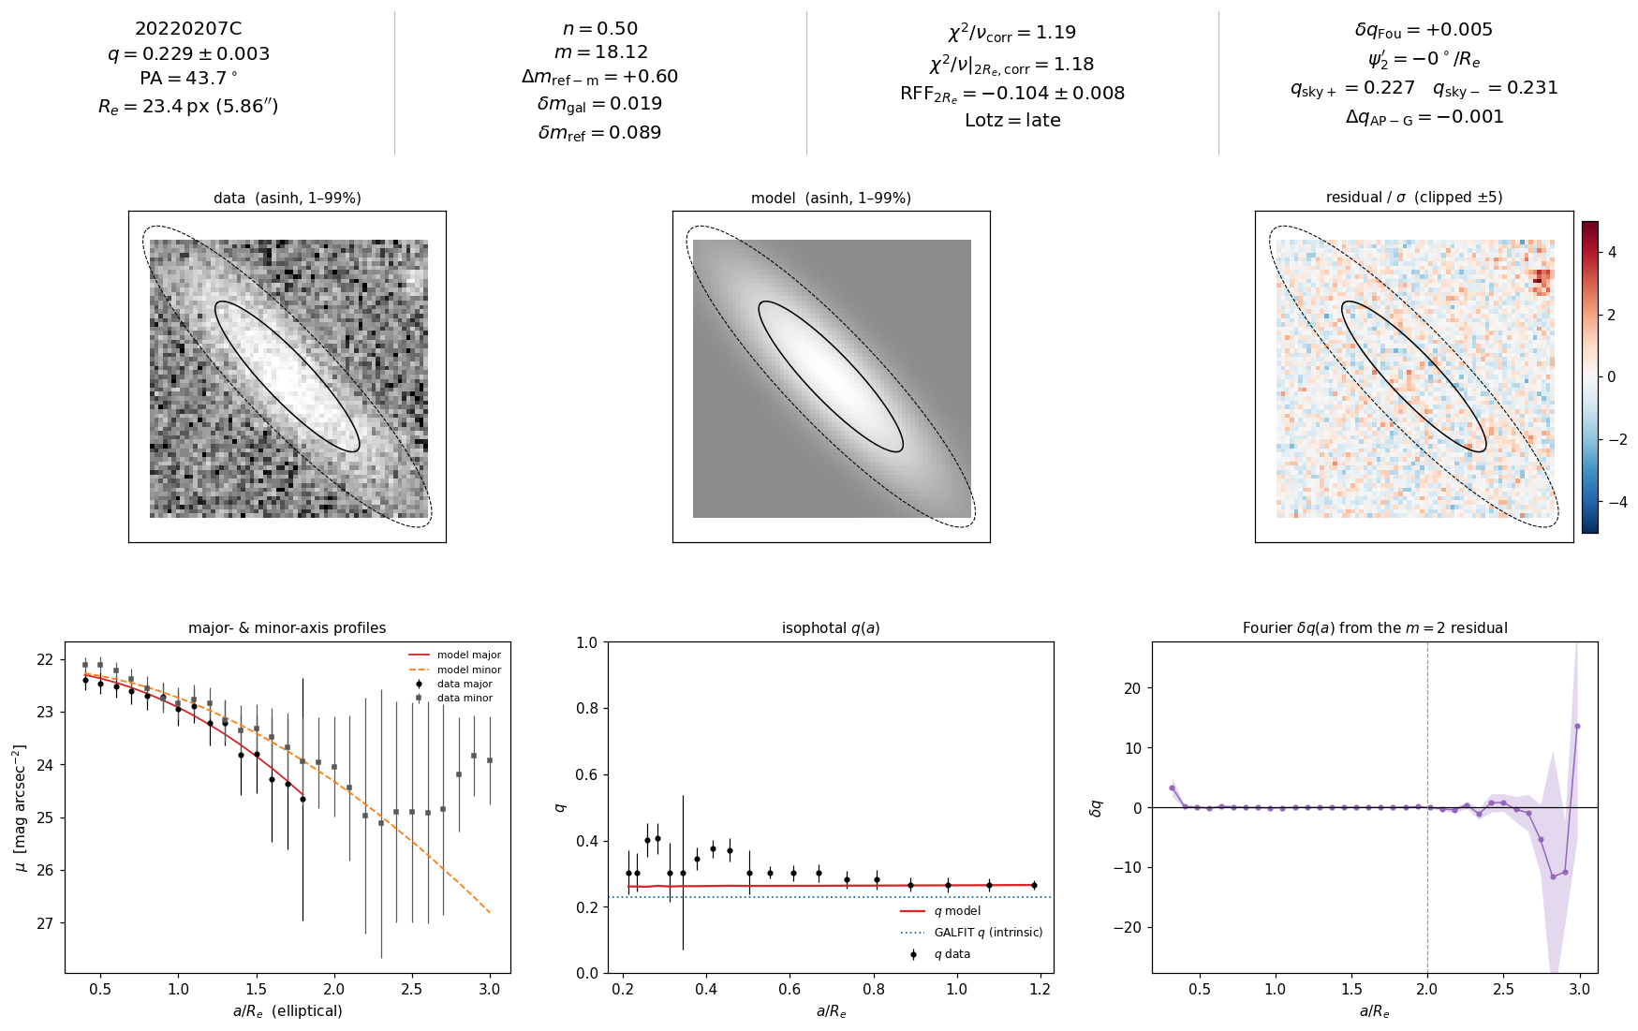
15/51 20220207C [production]

Slide 23
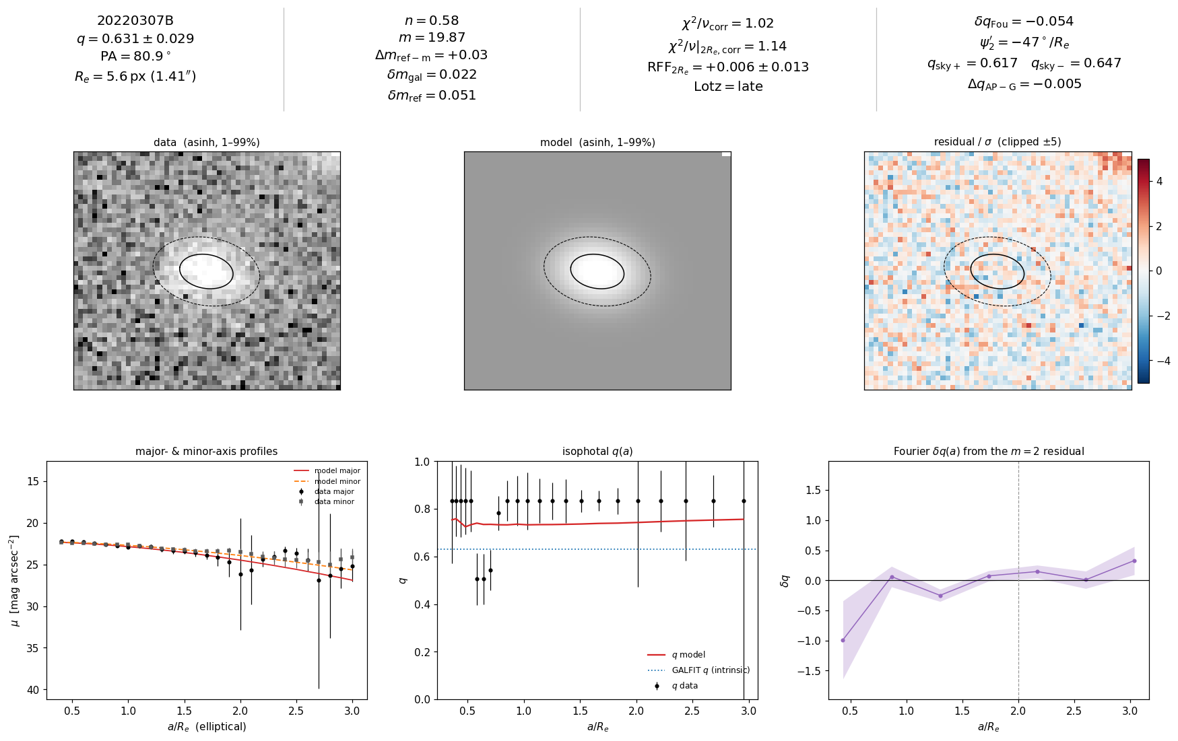
16/51 20220307B [production]

Slide 24
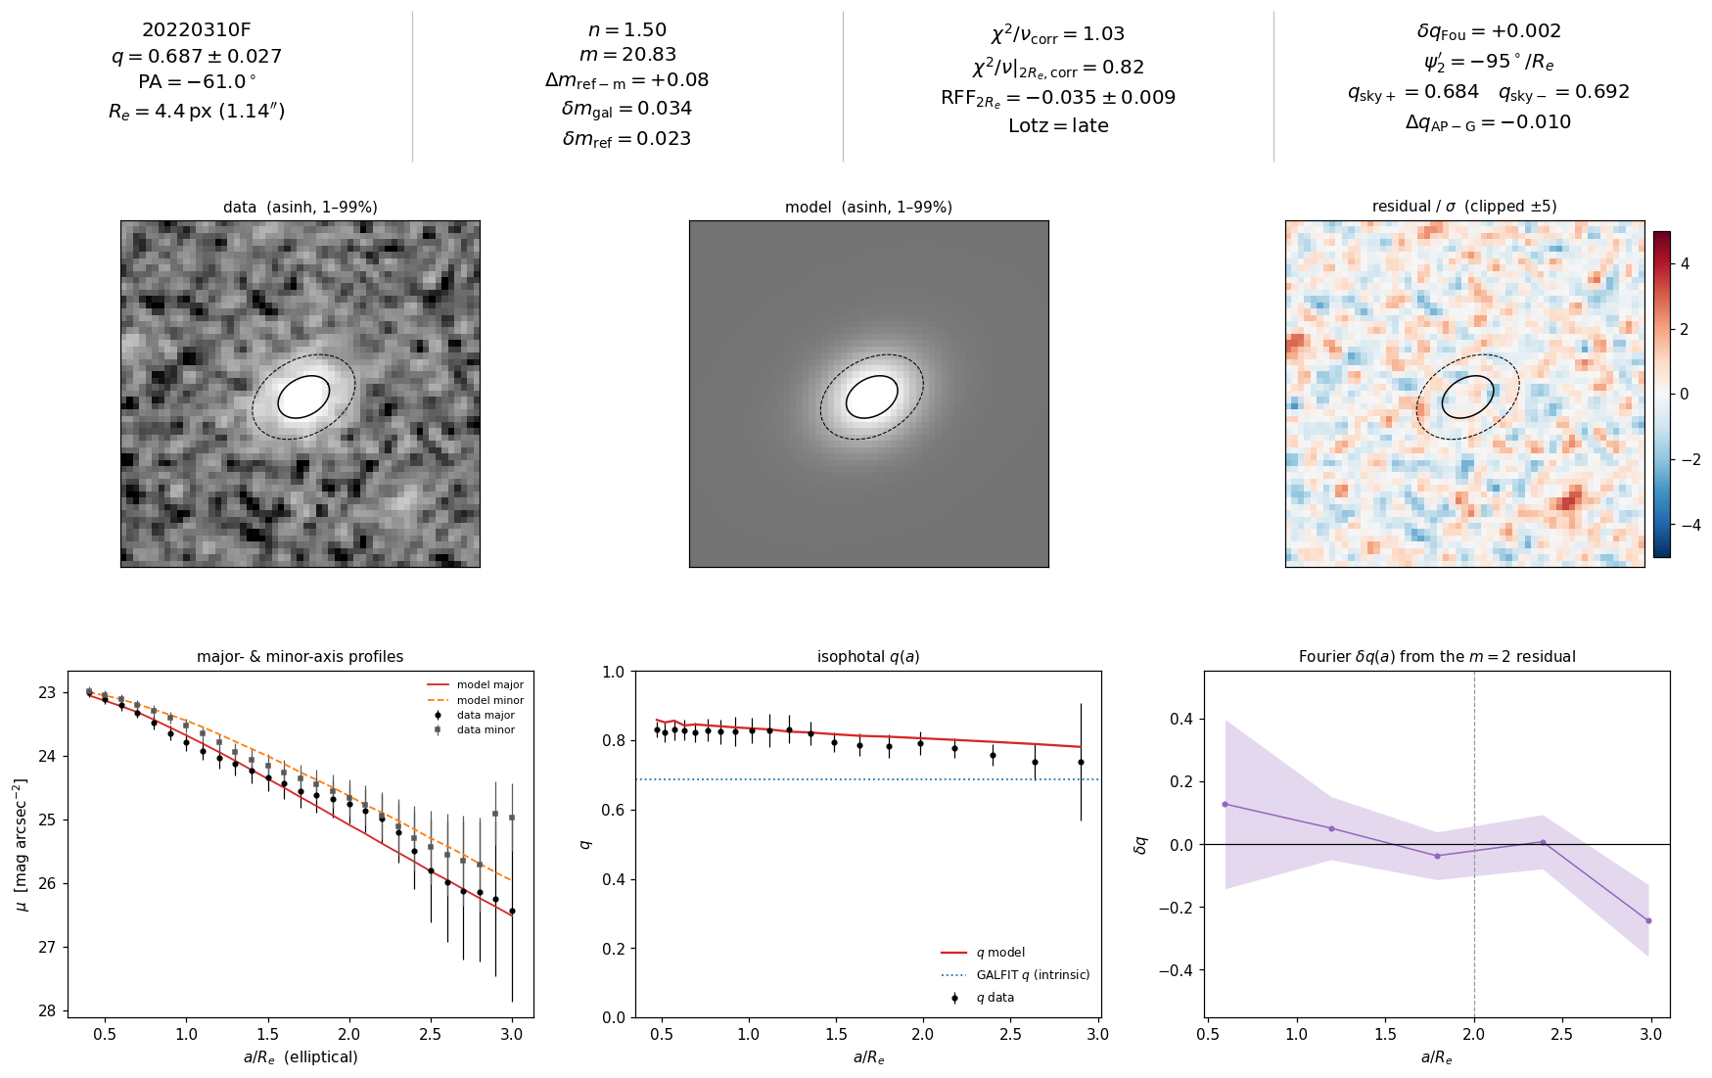
17/51 20220310F [production]

Slide 25
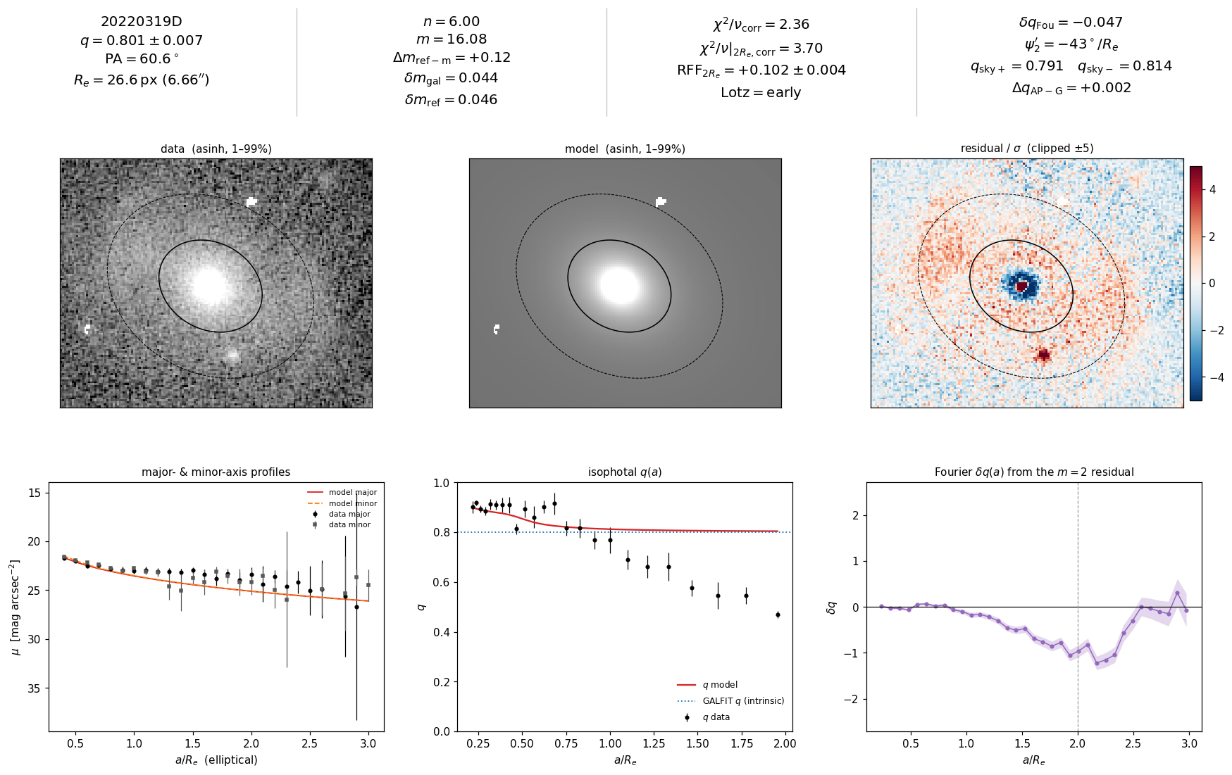
18/51 20220319D [production]

Slide 26
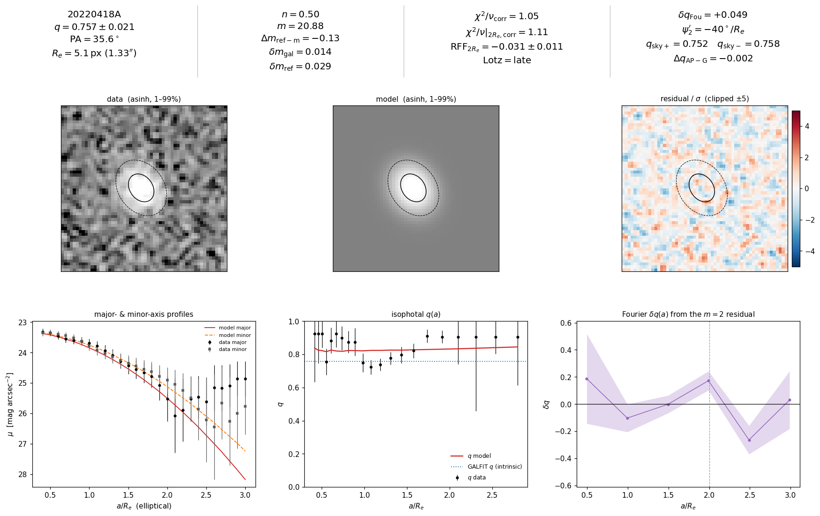
19/51 20220418A [production]

Slide 27
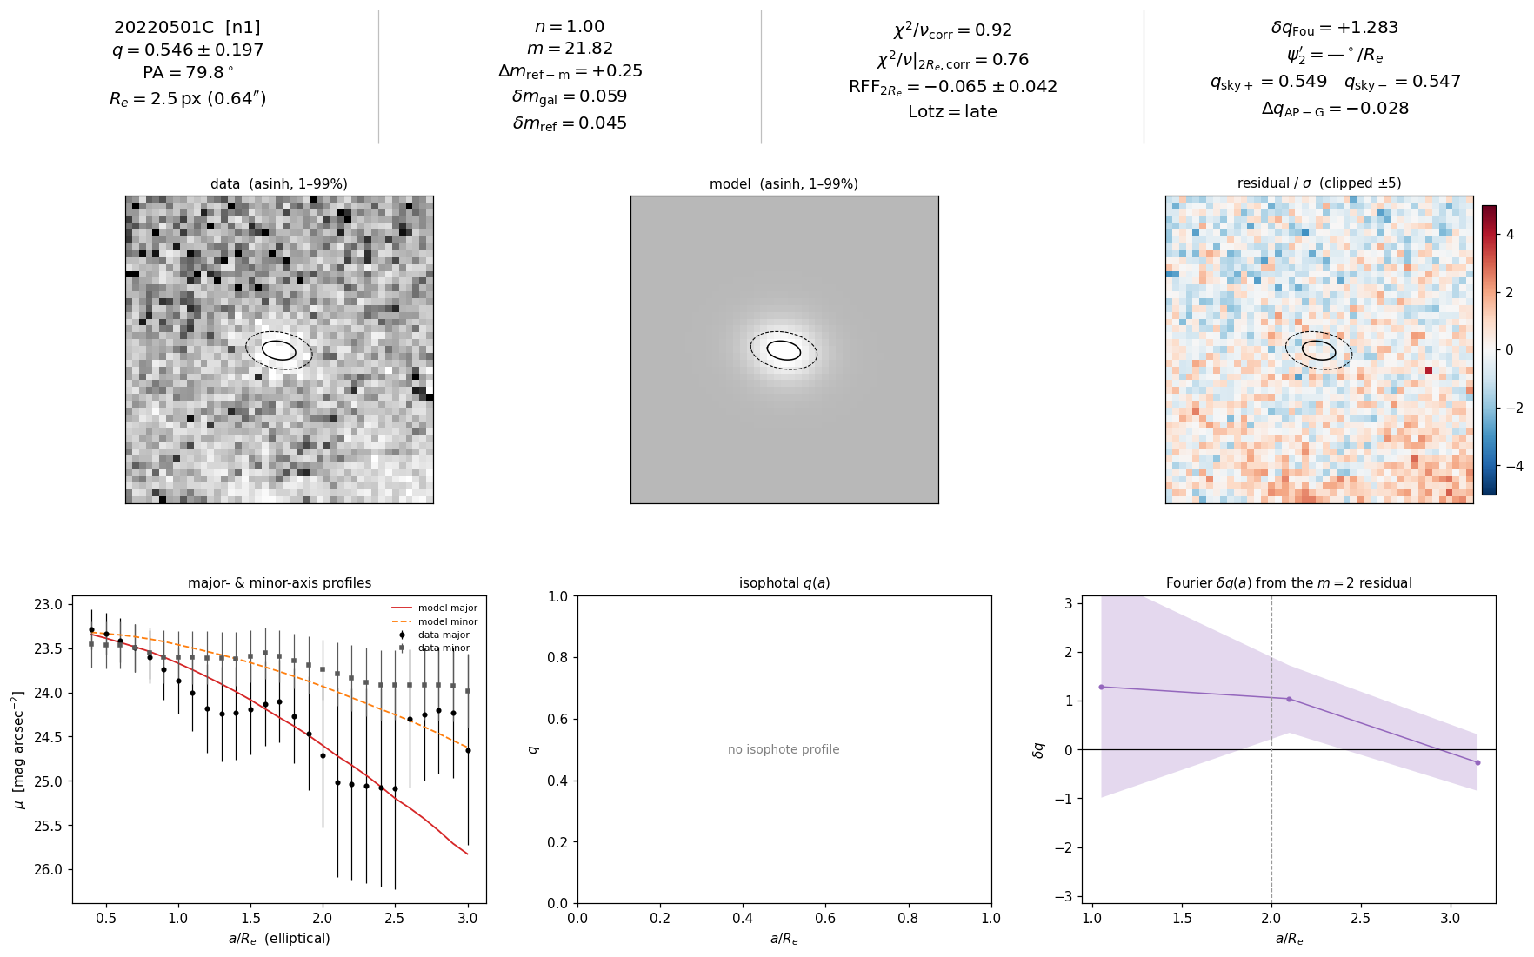
20/51 20220501C [n1]

Slide 28
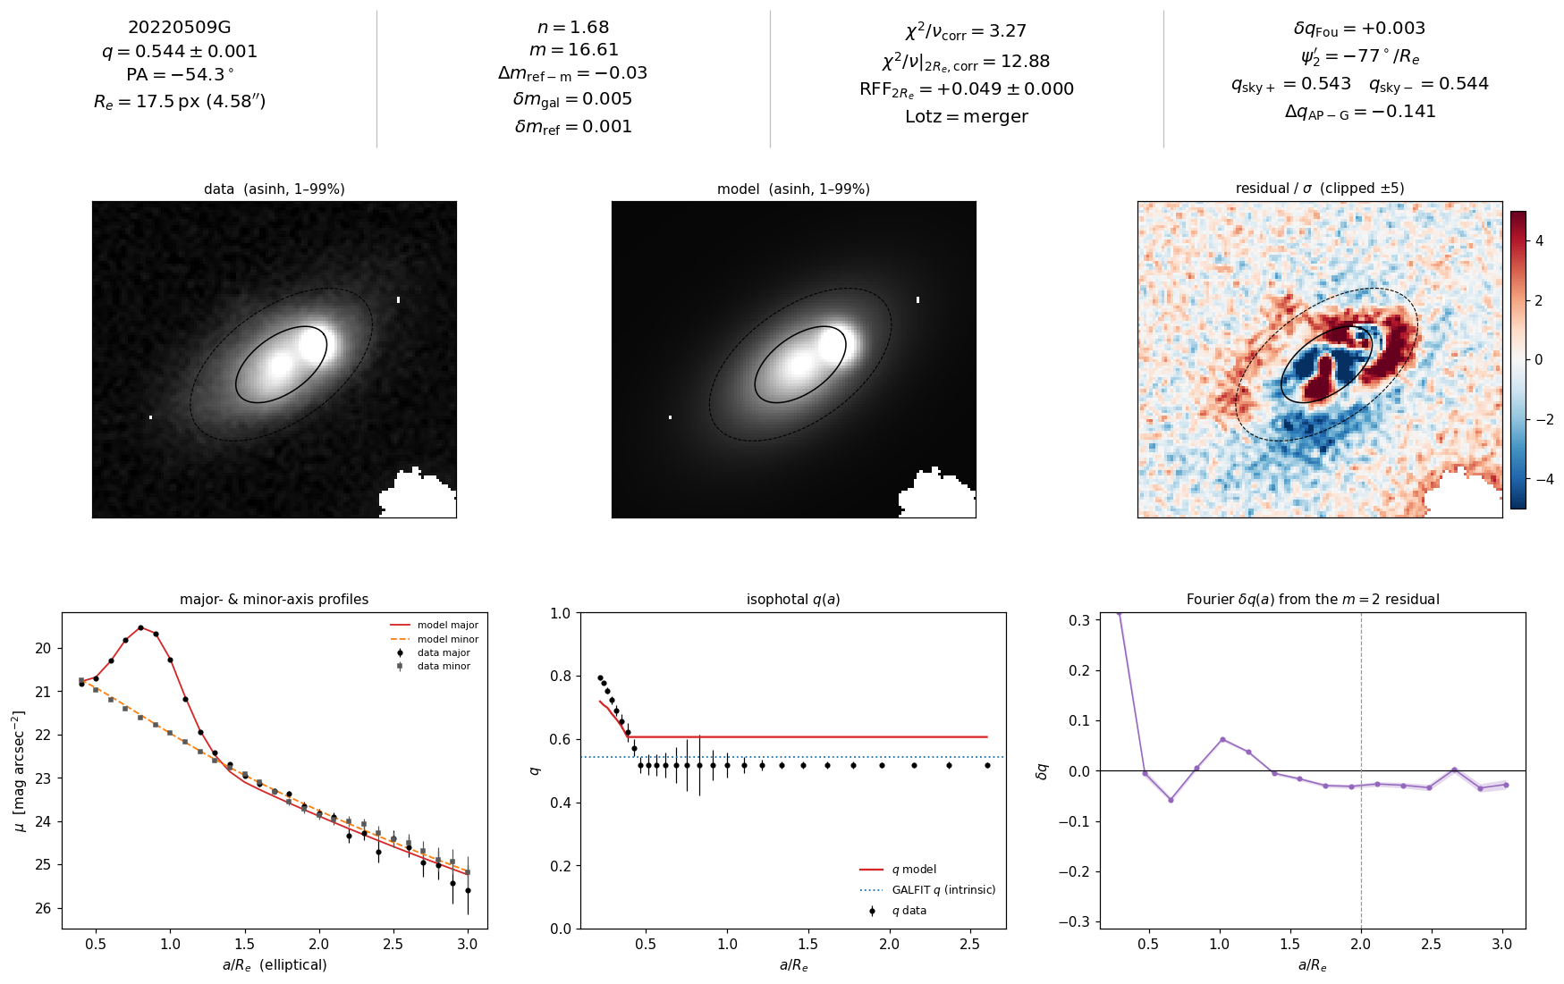
21/51 20220509G [psf]

Slide 29
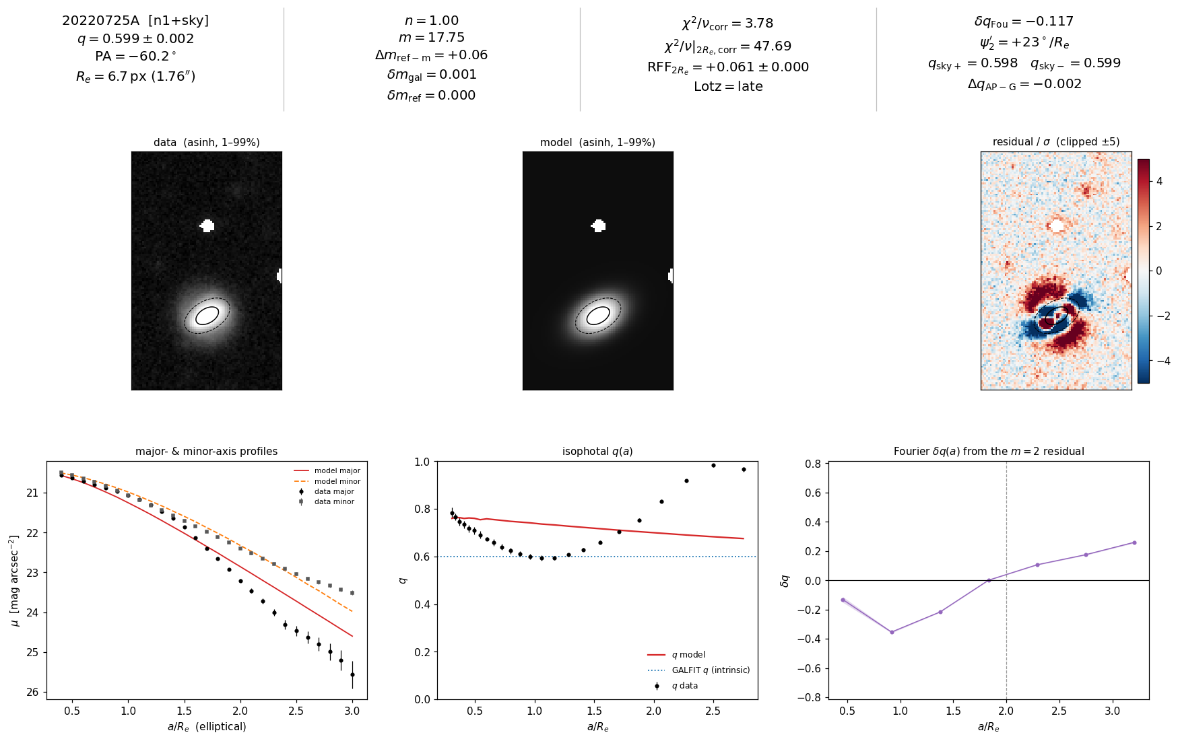
22/51 20220725A [n1_sky]

Slide 30
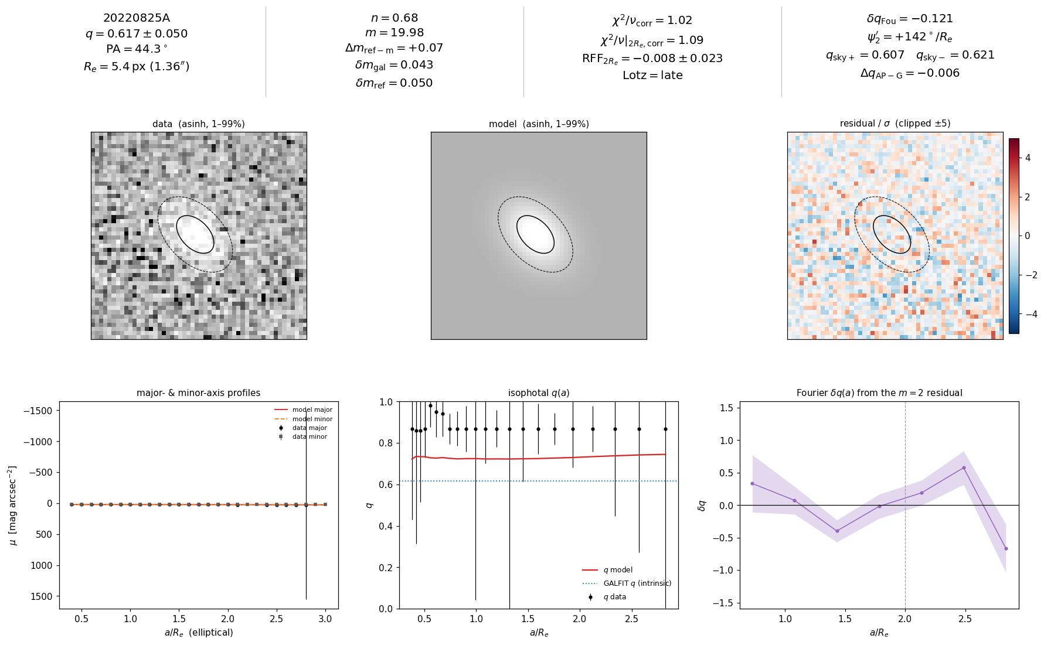
23/51 20220825A [production]

Slide 31
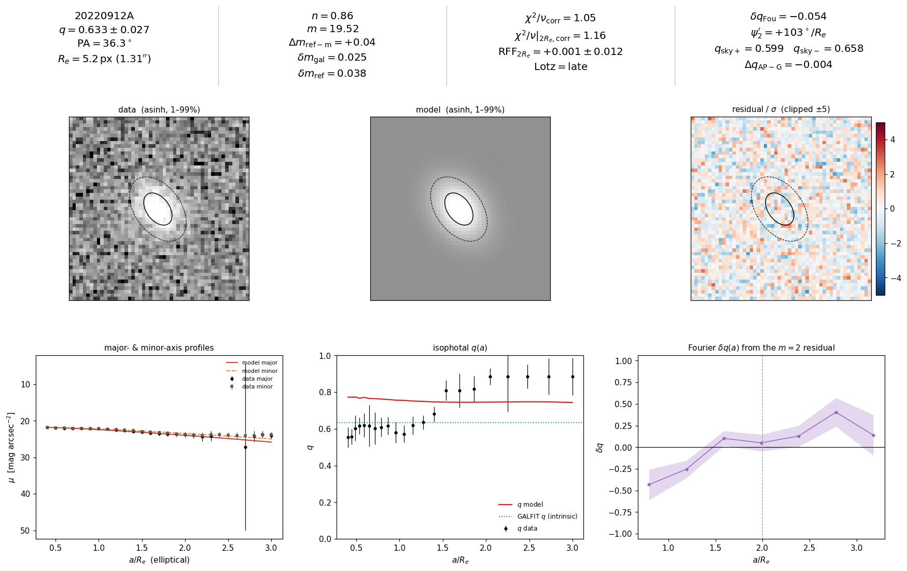
24/51 20220912A [production]

Slide 32
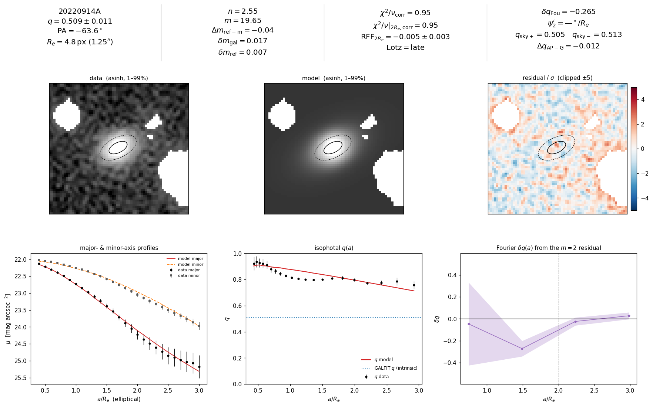
25/51 20220914A [production]

Slide 33
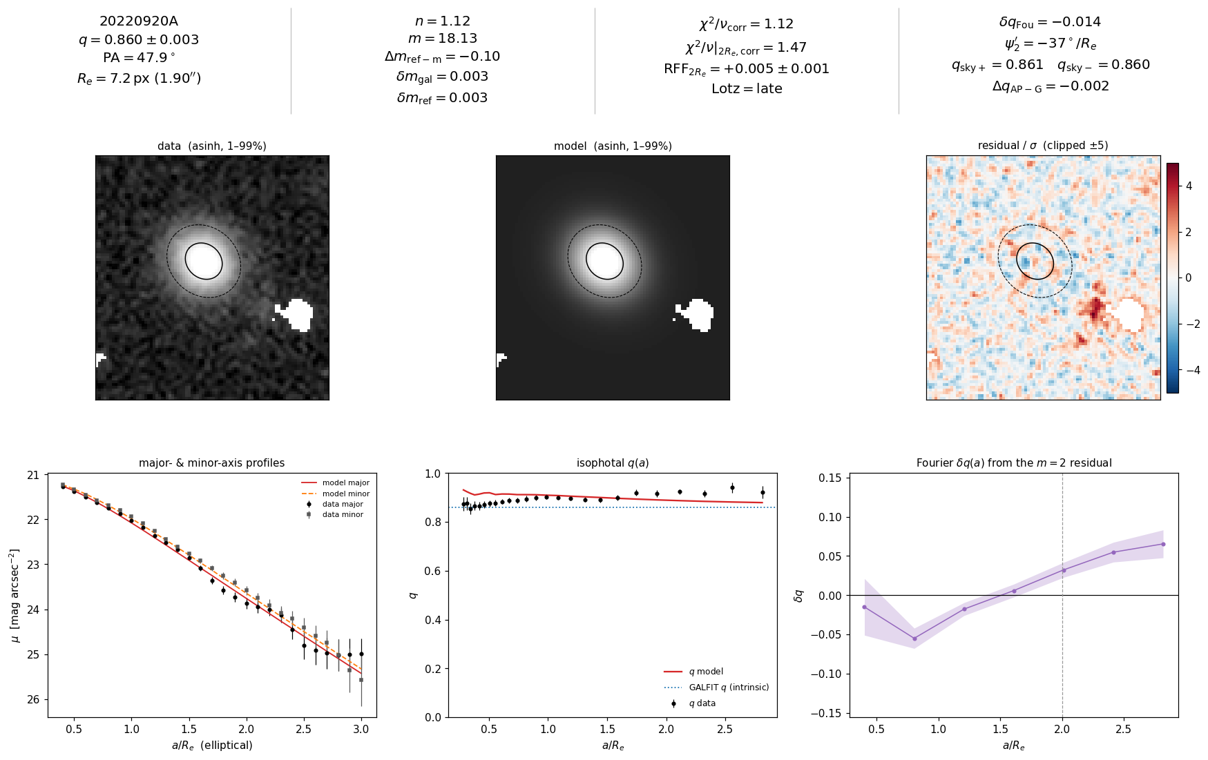
26/51 20220920A [production]

Slide 34
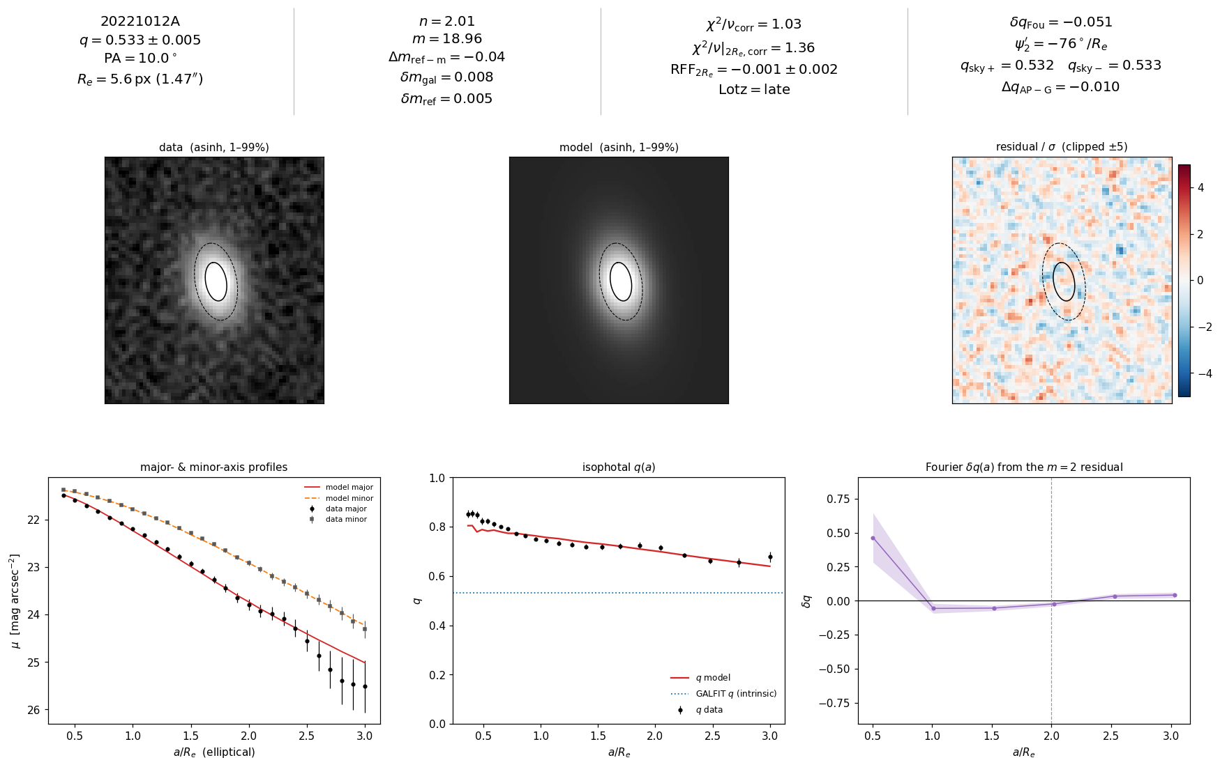
27/51 20221012A [production]

Slide 35
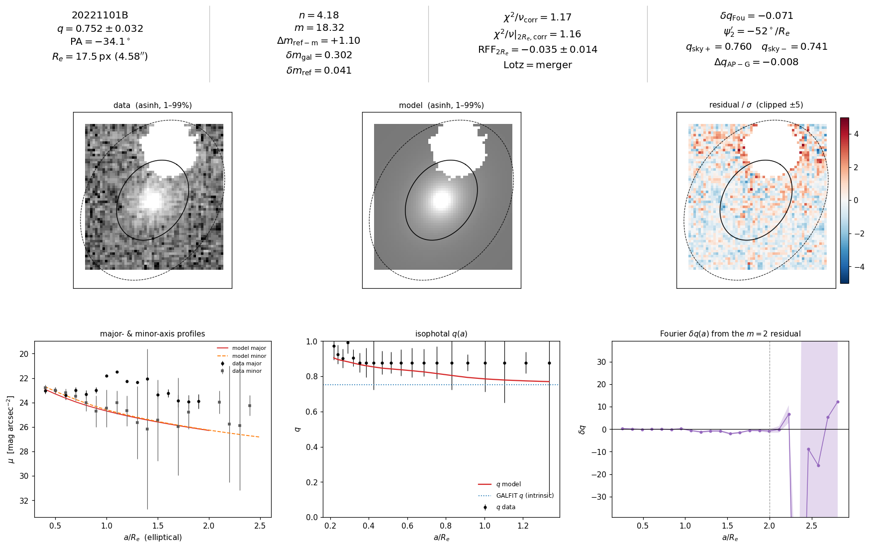
28/51 20221101B [production]

Slide 36
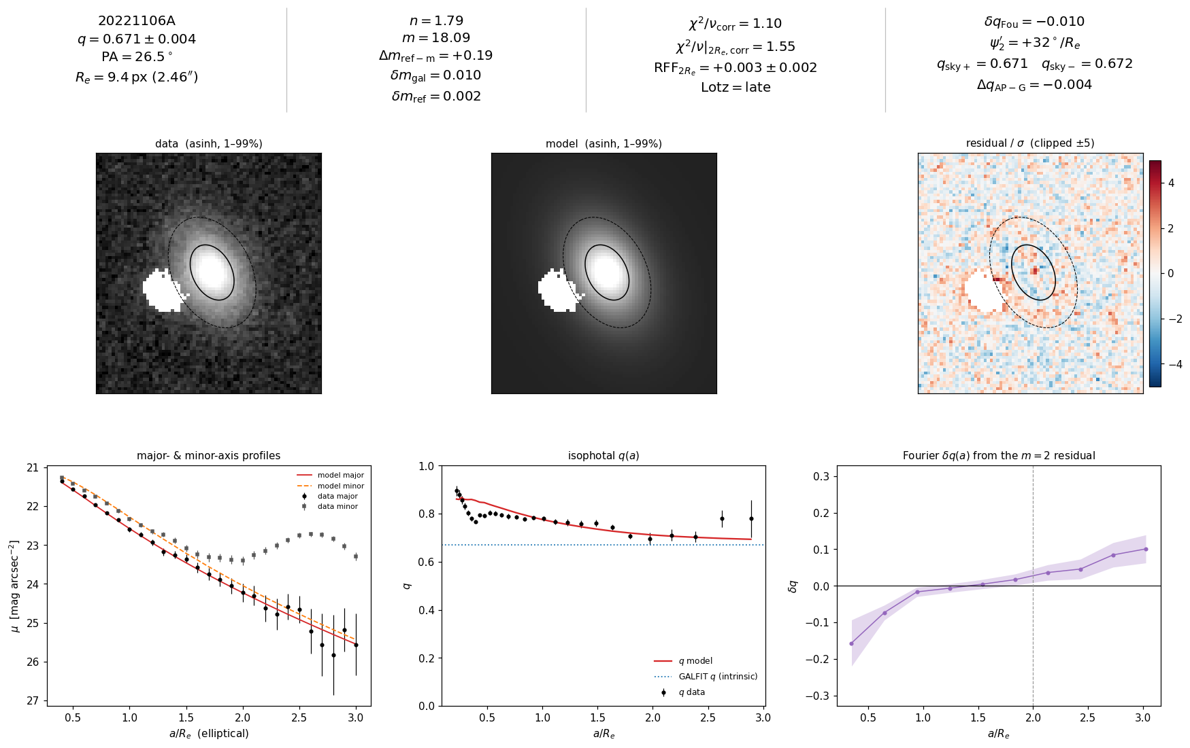
29/51 20221106A [production]

Slide 37
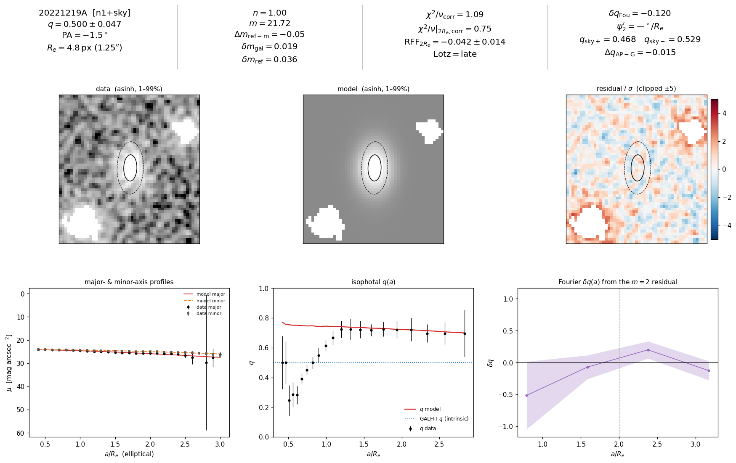
30/51 20221219A [n1_sky]

Slide 38
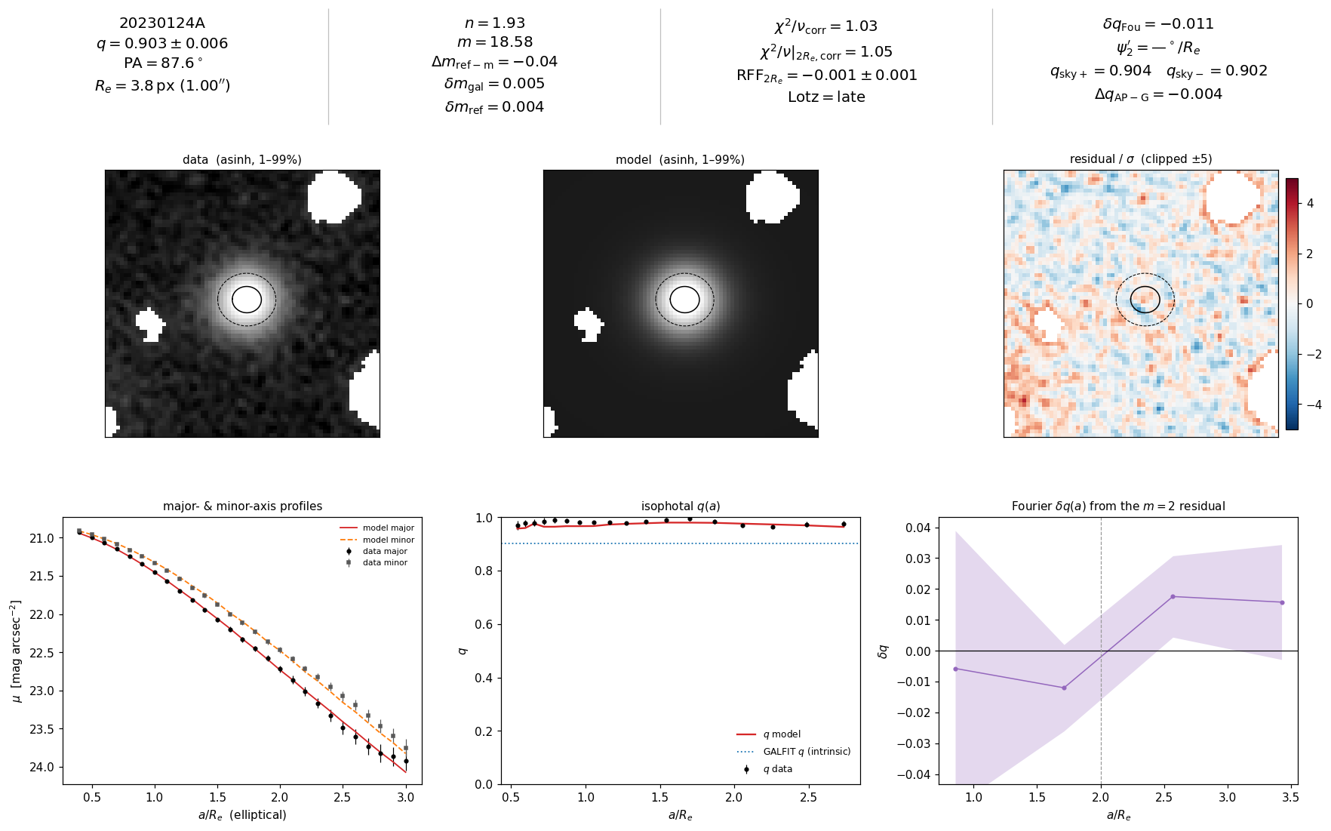
31/51 20230124A [production]

Slide 39
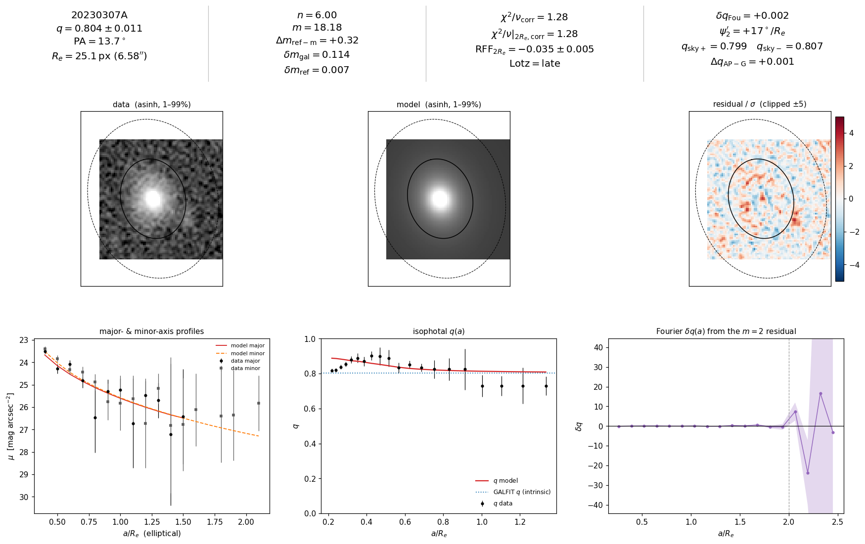
32/51 20230307A [production]

Slide 40
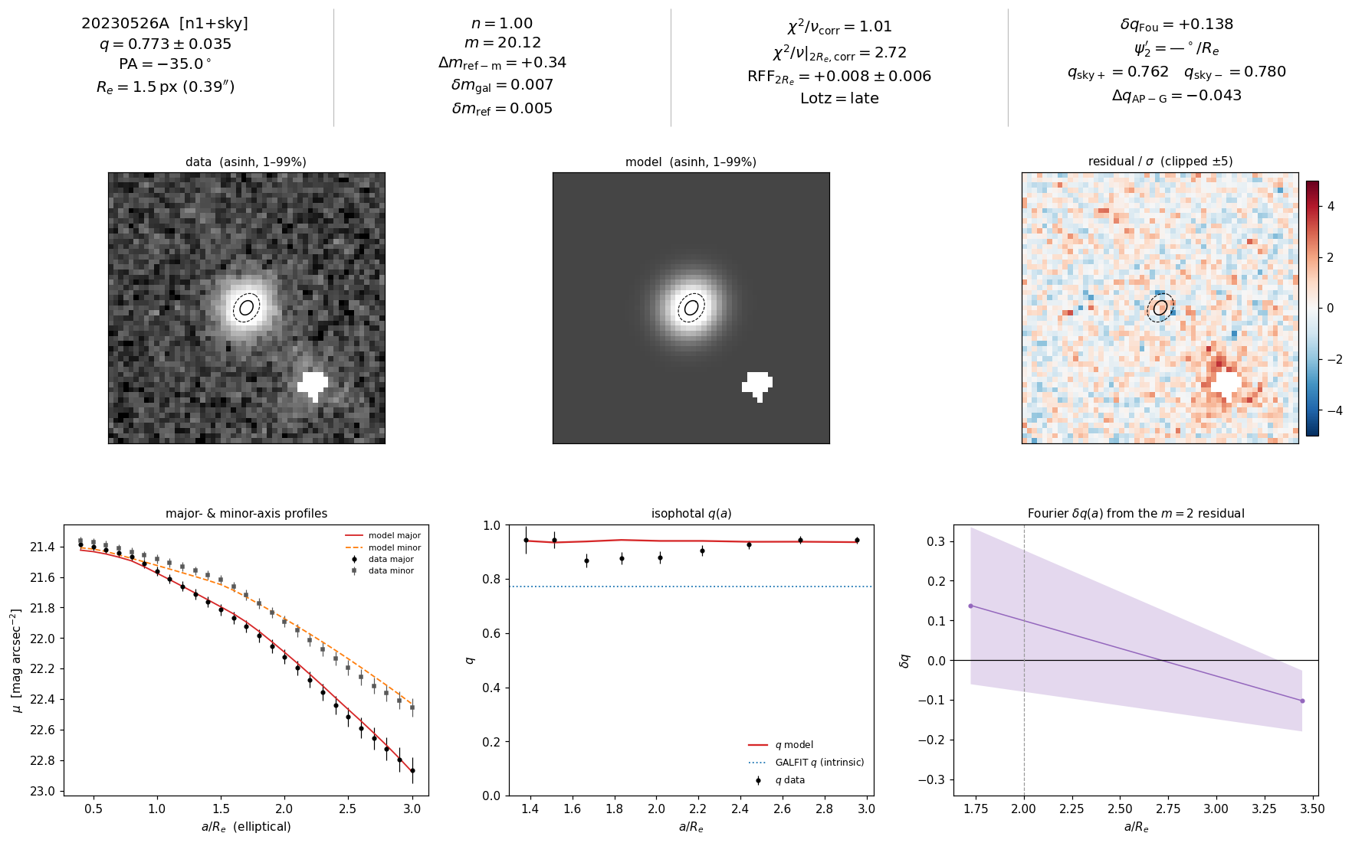
33/51 20230526A [n1_sky]

Slide 41
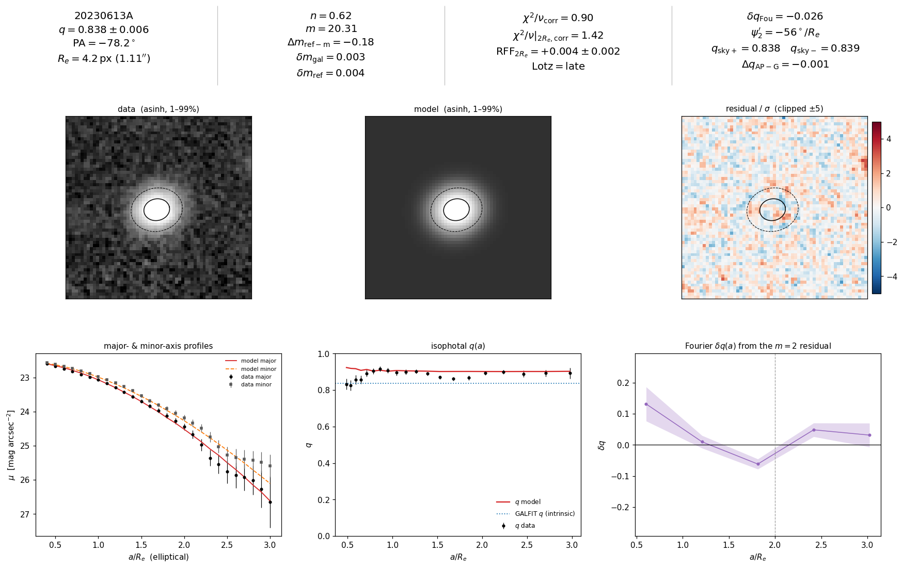
34/51 20230613A [production]

Slide 42
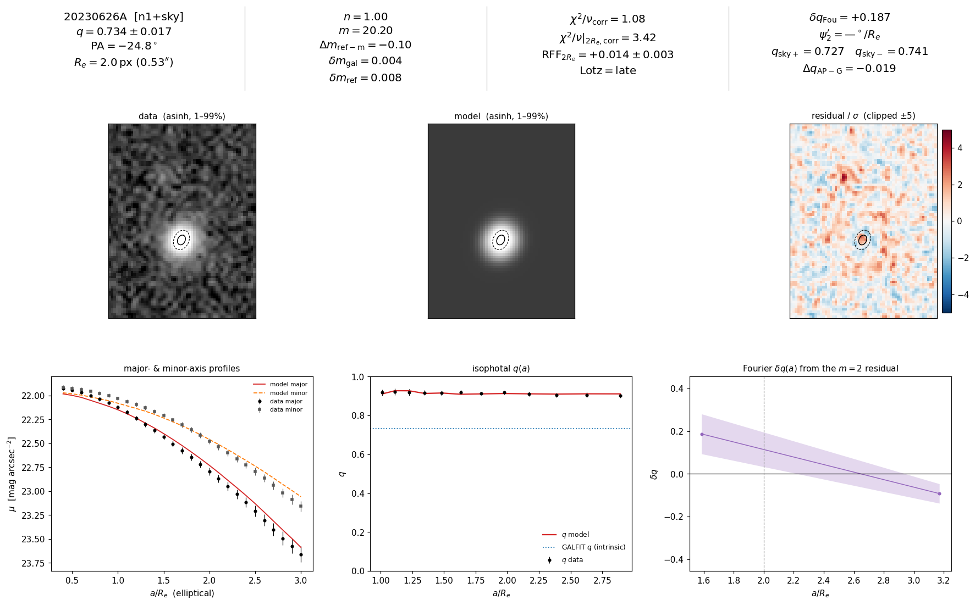
35/51 20230626A [n1_sky]

Slide 43
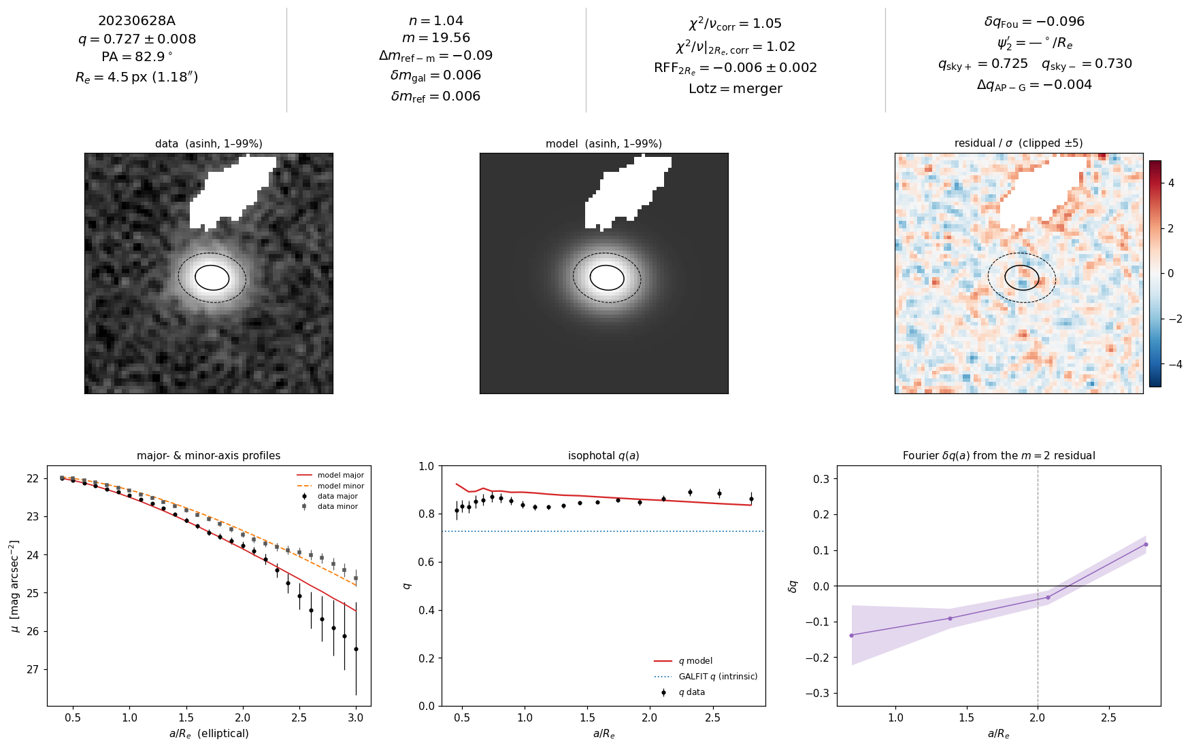
36/51 20230628A [production]

Slide 44
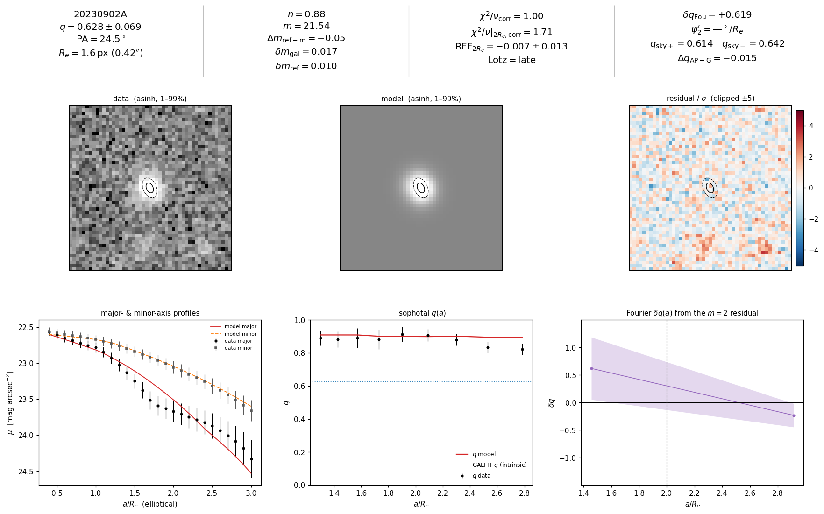
37/51 20230902A [production]

Slide 45
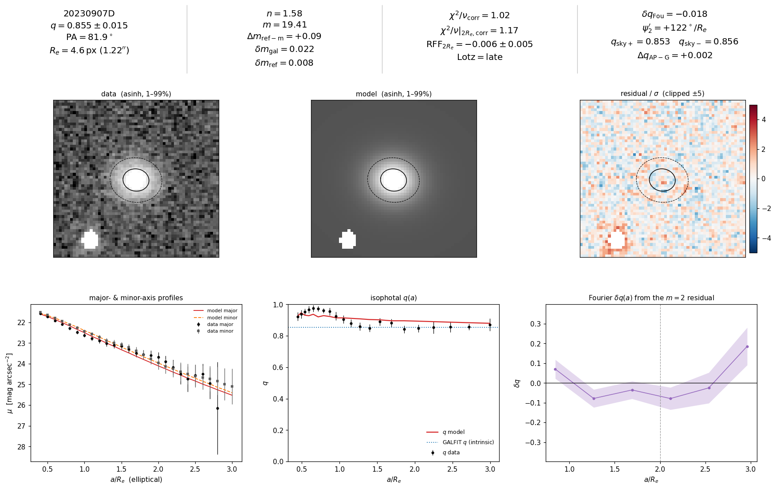
38/51 20230907D [production]

Slide 46
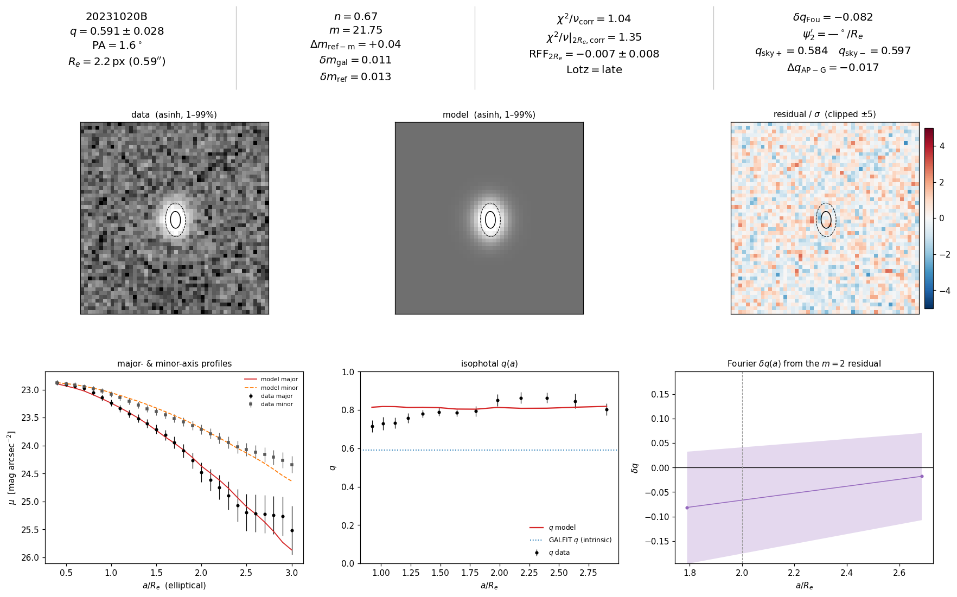
39/51 20231020B [production]

Slide 47
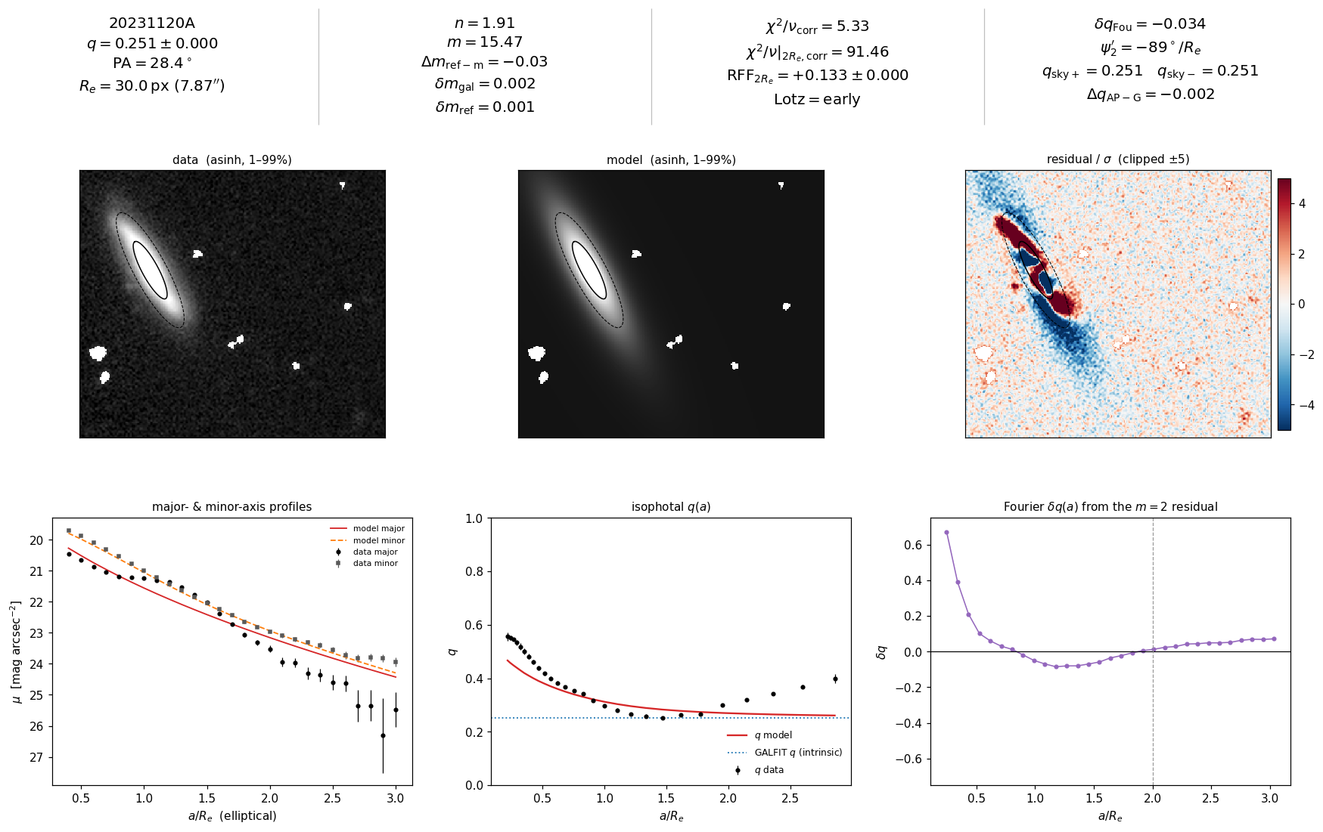
40/51 20231120A [production]

Slide 48
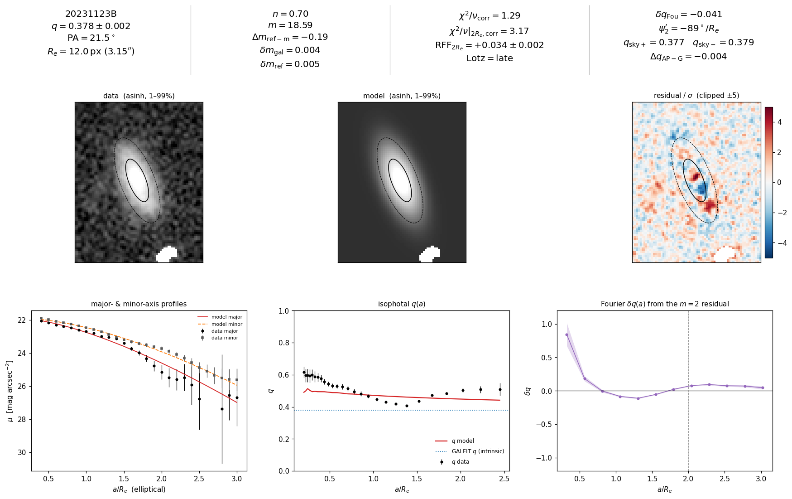
41/51 20231123B [production]

Slide 49
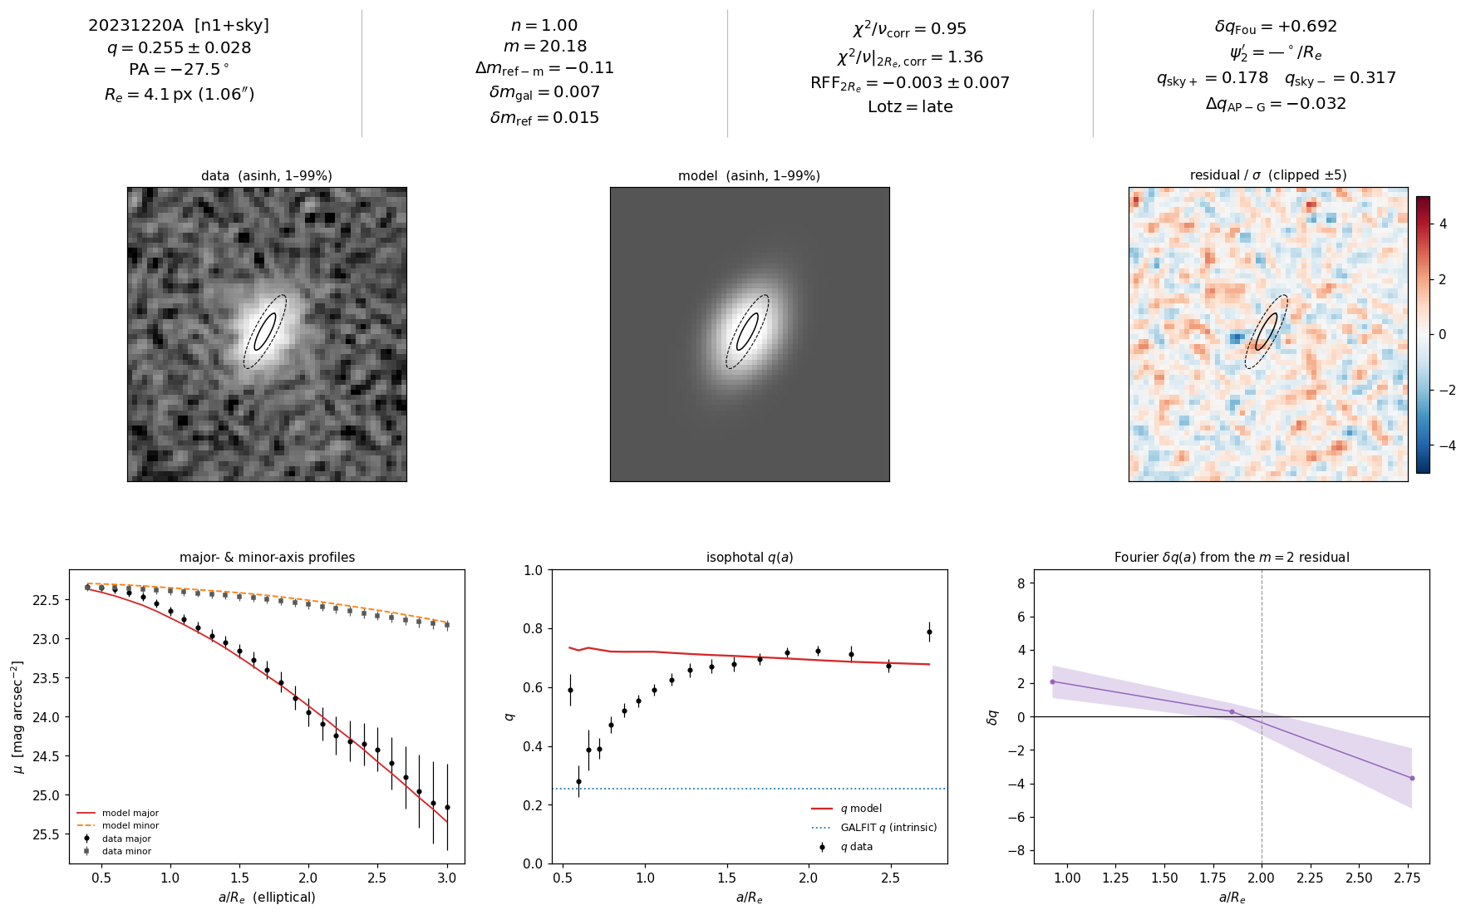
42/51 20231220A [n1_sky]

Slide 50
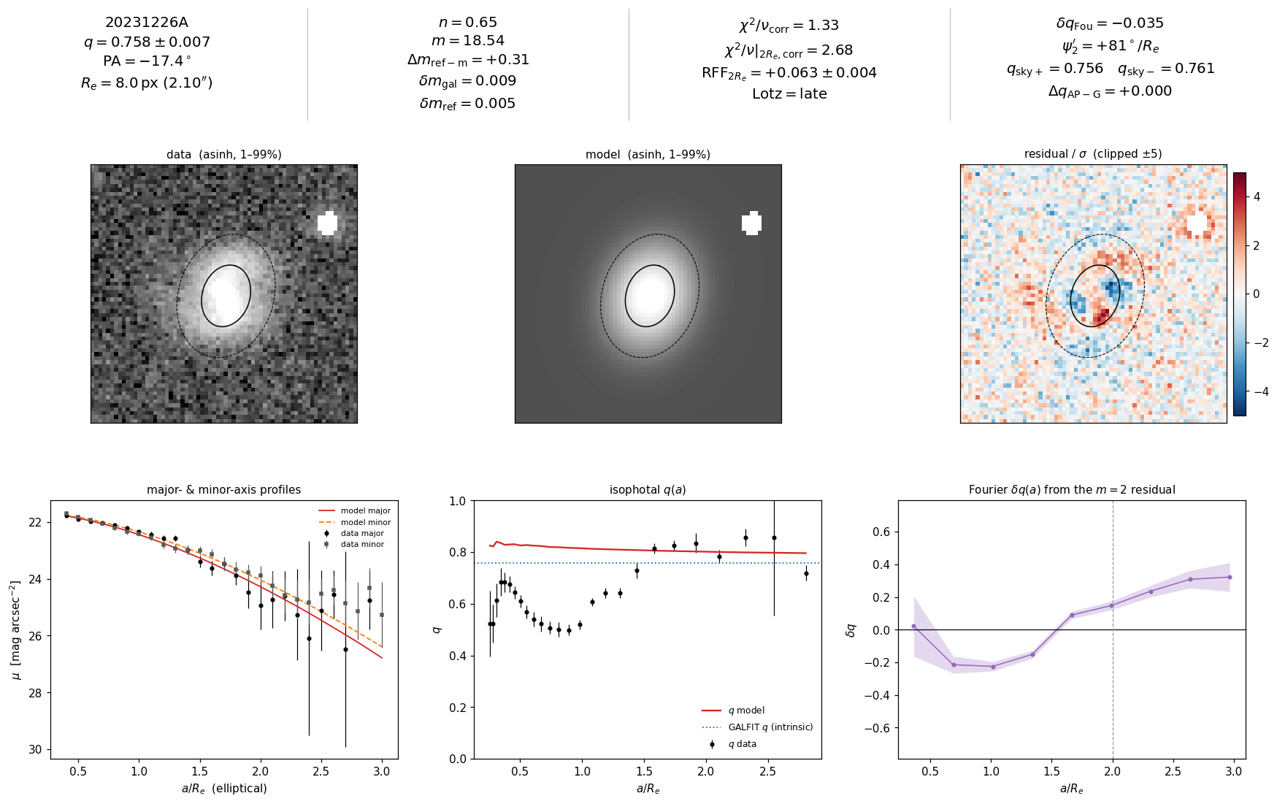
43/51 20231226A [production]

Slide 51
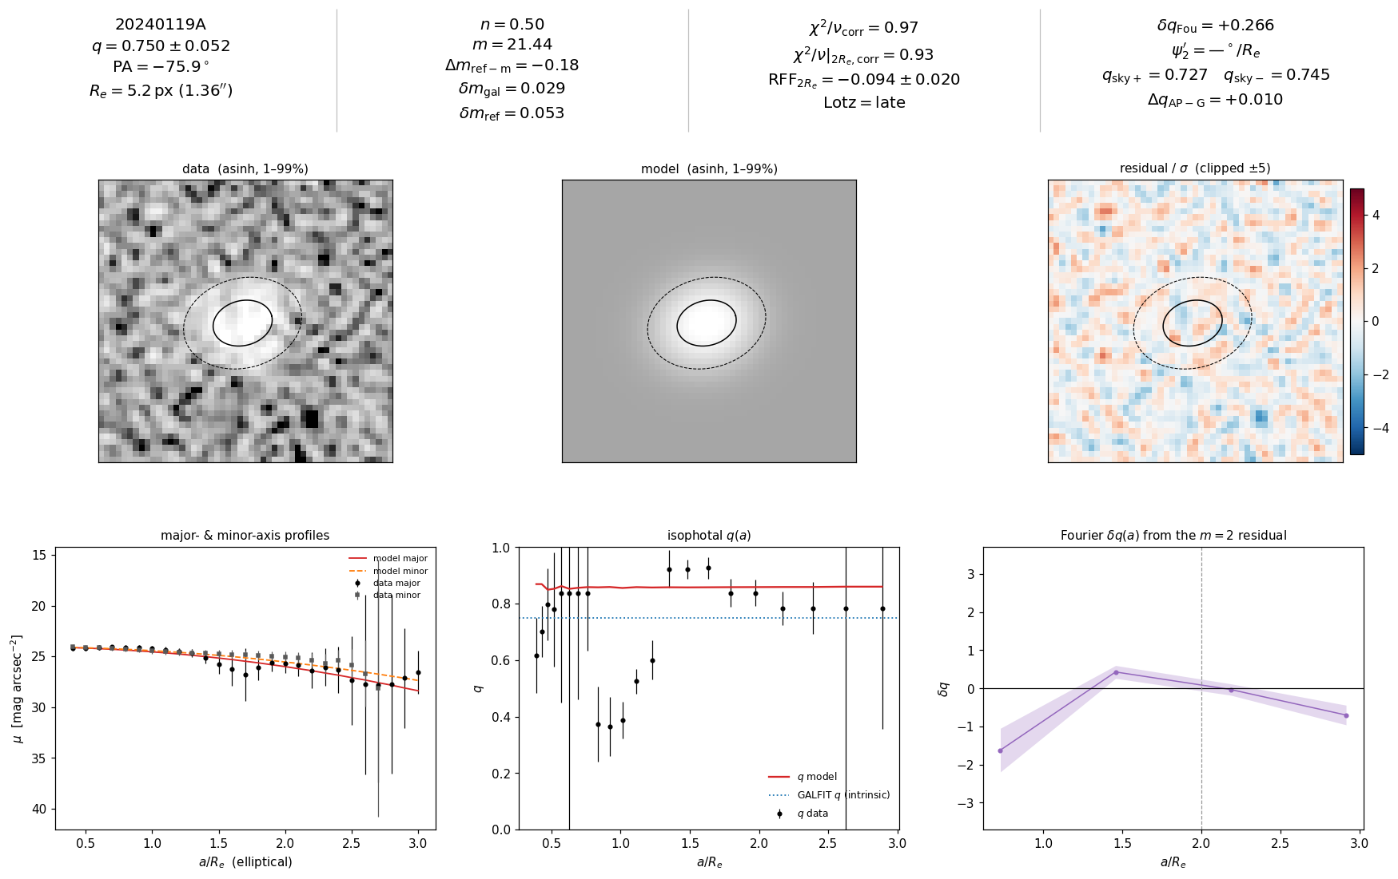
44/51 20240119A [production]

Slide 52
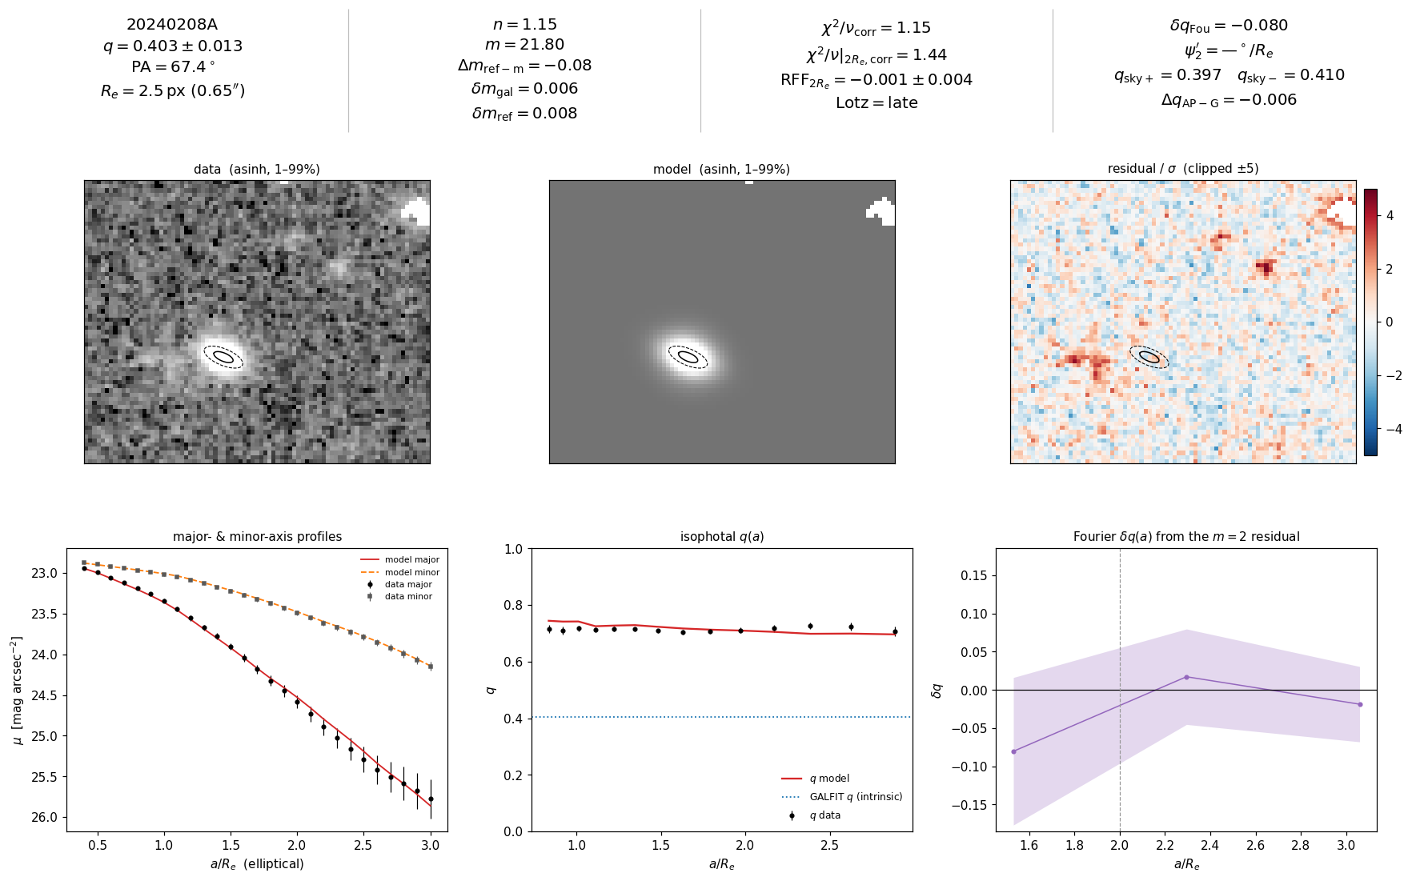
45/51 20240208A [production]

Slide 53
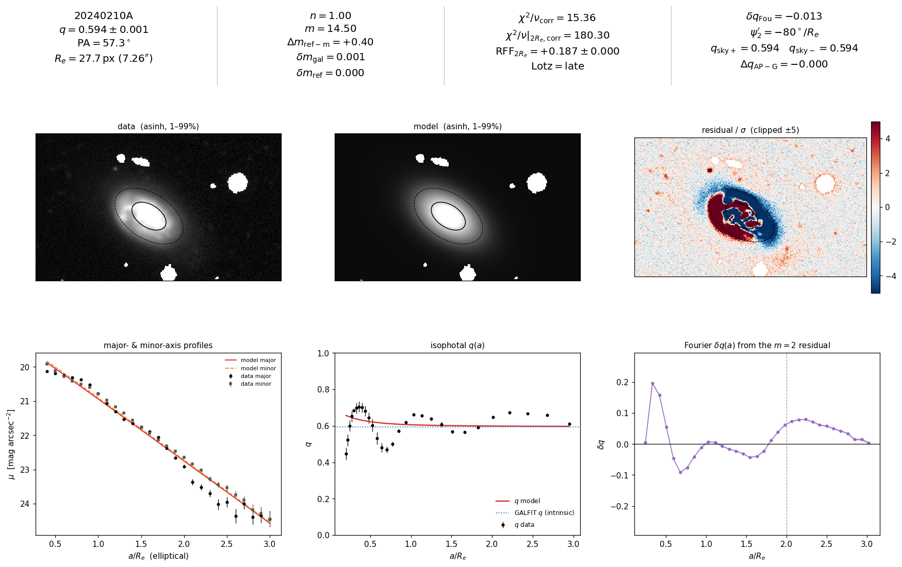
46/51 20240210A [production]

Slide 54

47/51 20240213A [production]

Slide 55

48/51 20240215A [production]

Slide 56

49/51 20240229A [production]

Slide 57

50/51 20240304A [production]

Slide 58

51/51 20240318A [production]

Slide 59

20190711A REJECTED — not in confirmed sample
REJECTED - star; PSF-only chi2/nu=0.94 vs Sersic 1.64 (dchi2=-2508); Re-fits/20190711A/psf_only

Slide 60

20230930A REJECTED — not in confirmed sample
REJECTED - whole lotta diffuse light / structured background; bad sky (unusable for inclination)

