Slide 1
Automation using ansible playbook

Slide 2
Final scripts for tomcat start , stop & restart:
-tomcat-start.yaml
-tomcat-stop.yaml
-tomcat-restart.yaml
-master.yaml (Single Master playbook which calls individually the above playbooks based on the requirement)

Slide 3
Extra variables:
1 –start ,2 – stop ,3 – restart.
Master.yaml playbook is executed by passing extra variable based on the requirement.
e= 1 or 2 or 3
Master.yaml pulls the respective playbook based on the condition.

Slide 4
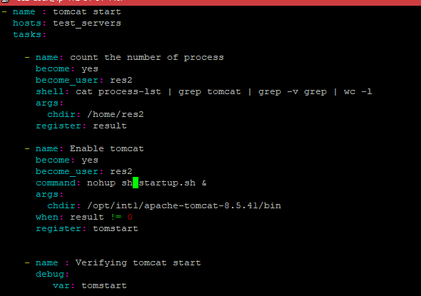
tomcat-start.yaml

Slide 5
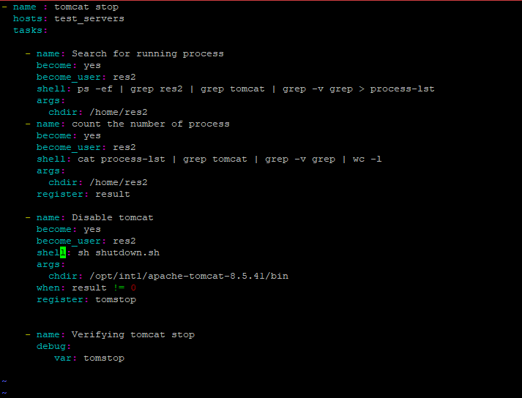
tomcat-stop.yaml

Slide 6
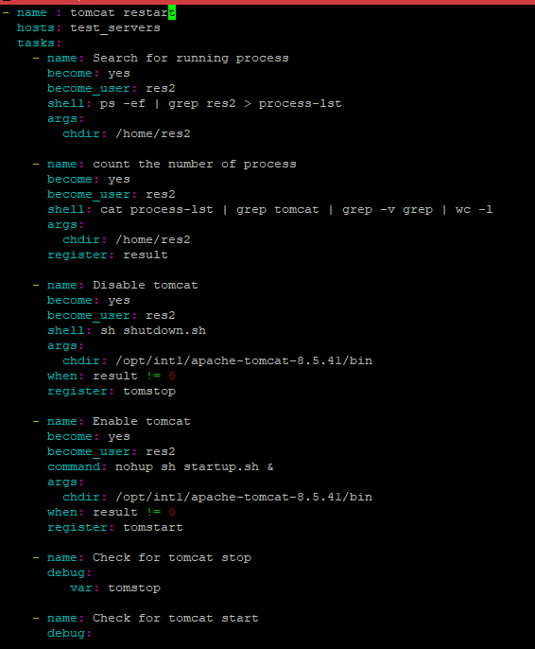

tomcat-restart.yaml

Slide 7
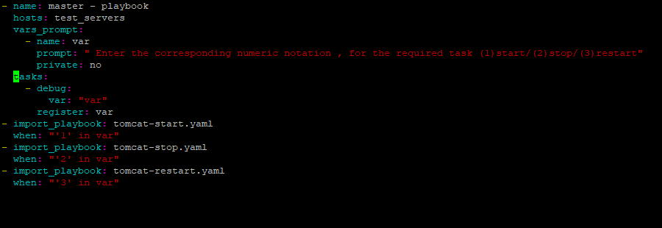
master.yaml
Extra variables:
1-start
2-stop
3-restart
Master.yaml playbook executed with the respective extra variable
Based on the required task to be executed.

Slide 8
Restarting tomcat
ansible-playbook master.yaml --limit 172.31.44.199 -e var=3 -k
Corresponding notation for restart is 3.
Tomcat restart is done by passing the extra variable (e=3) , when executing the master.yaml.
Master.yaml pulls tomcat-restart.yaml based on the condition and executes the required task.

Slide 9
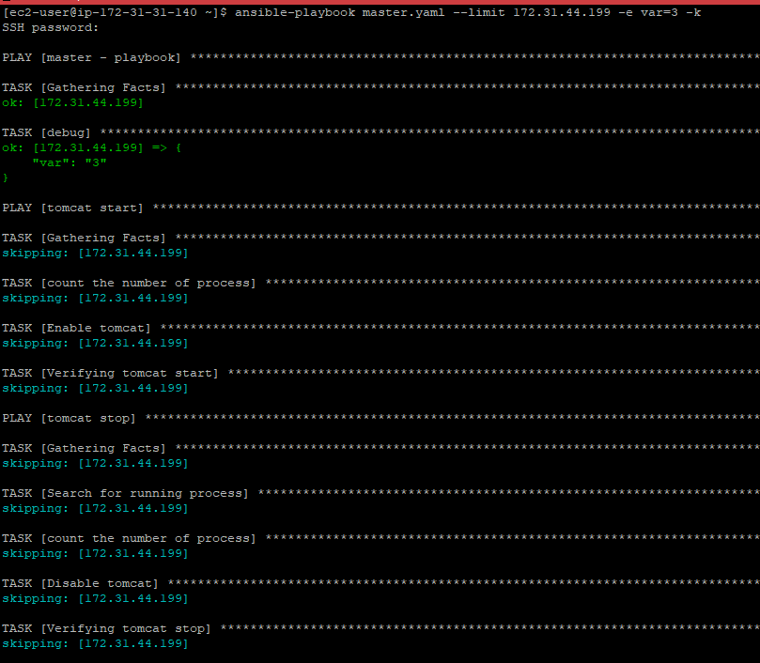

Slide 10
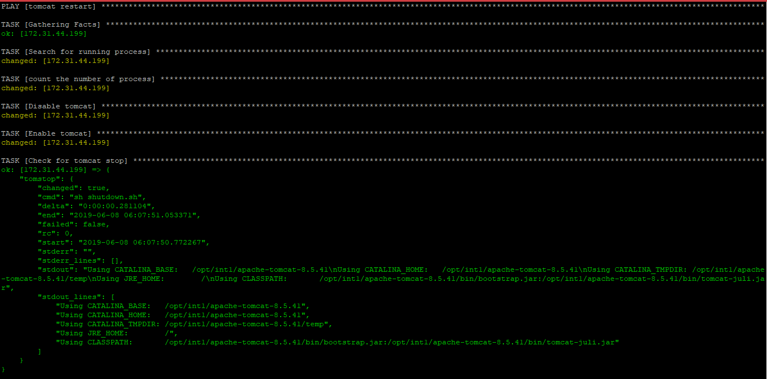

Slide 11
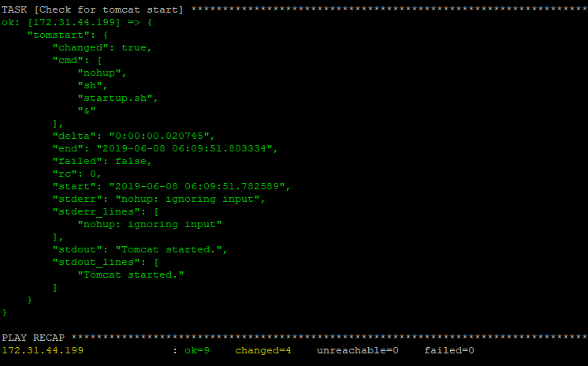

Slide 12
Stopping tomcat
ansible-playbook master.yaml --limit 172.31.44.199 -e var=2 -k
Corresponding notation for stop is 2.
Tomcat restart is done by passing the extra variable (e=2) , when executing the master.yaml.
Master.yaml pulls tomcat-stop.yaml based on the condition and executes the required task.

Slide 13
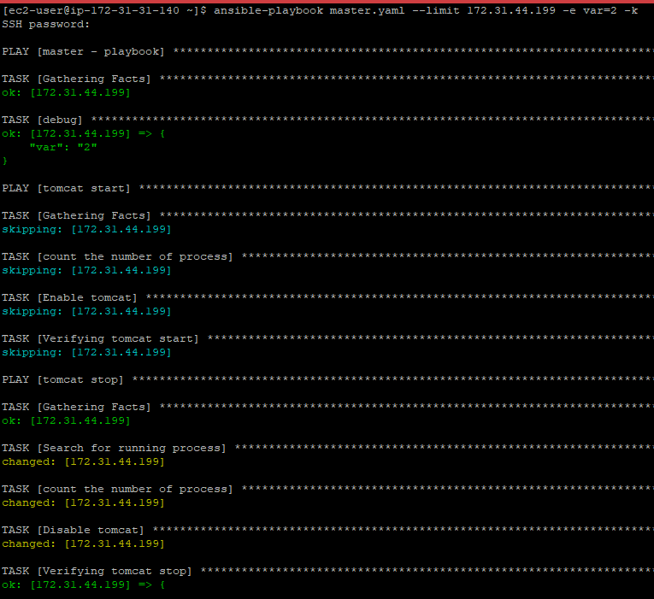

Slide 14
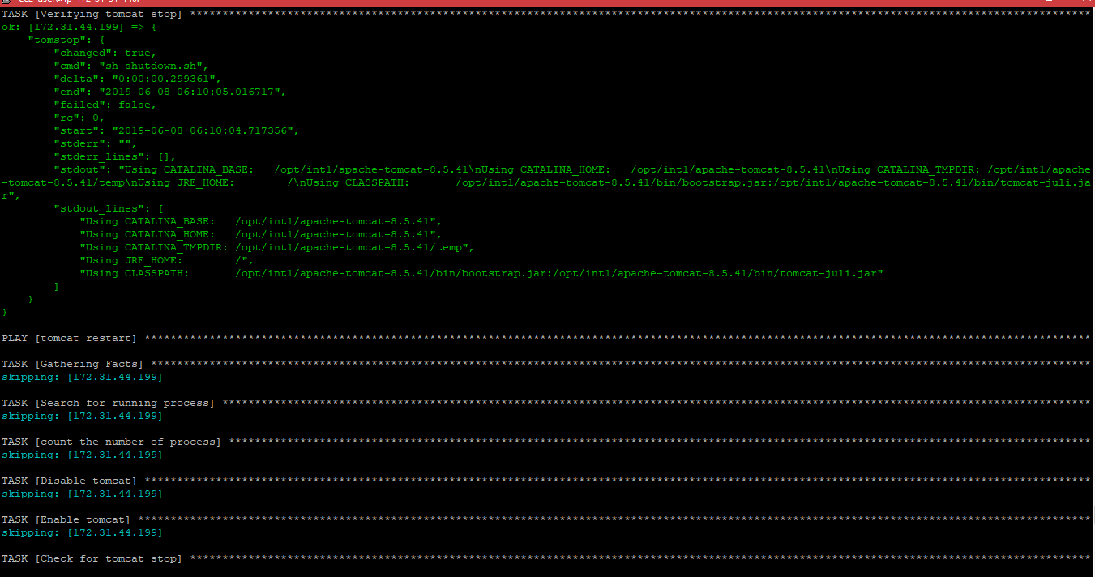

Slide 15
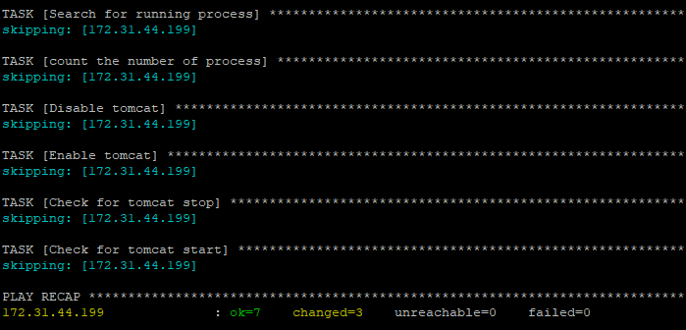

Slide 16
Starting tomcat
ansible-playbook master.yaml --limit 172.31.44.199 -e var=1 -k
Corresponding notation for start is 1.
Tomcat restart is done by passing the extra variable (e=1) , when executing the master.yaml.
Master.yaml pulls tomcat-start.yaml based on the condition and executes the required task.

Slide 17
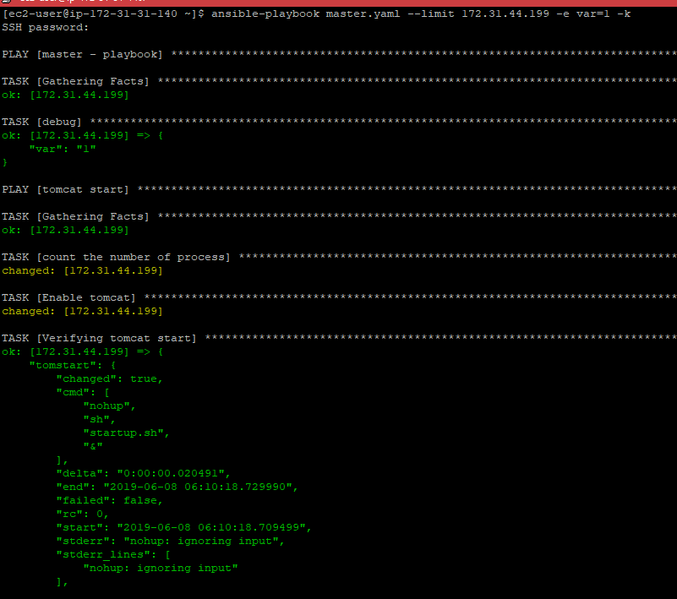

Slide 18
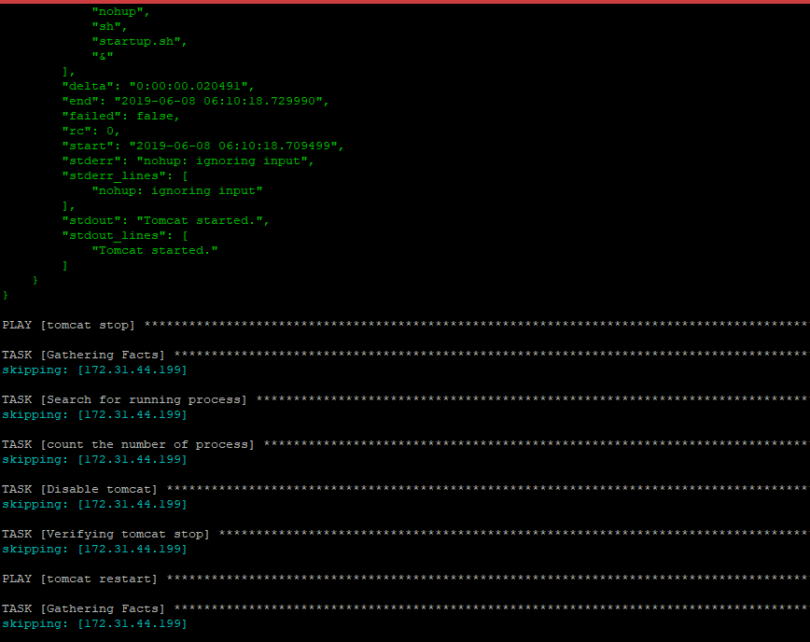

Slide 19
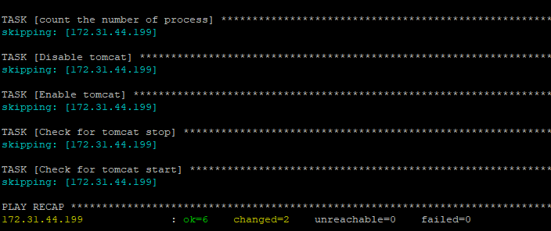

Slide 20
END OF THE SLIDE

