Slide 1

Category Management Pipeline
Imperial Dade | Advent Data Science
September 3

Slide 2

Process Overview
Run the process through 4 notebooks, which call functions housed in the Function Files
Taxonomy
Organize Data
Suggested Sub
Use the attributed data to find potential matching items
Feedback
Incorporate ID Feedback on Suggested Subs
Pull relevant attributes out of product descriptions
Surface matches to ID
Generate new matches based on feedback
Optimization
Using ID Cost Analysis methodology and the matches, identify optimal subs to make
*Open AI Code
We have a code base set up to utilize OpenAI/ChatGPT through Microsoft Azure’s OpenAI API. I included our code in the OpenAI folder in the repo. Essentially the project’s code creates prompts that calls the API through the code base. To replicate this functionality, you would have to get your own API key or rejig the code to send request to a different AI API endpoint

Slide 3
Data Inputs
1. Required at the Outset
Sales Data
ID has been supplying L6M Sales Data
Important Features include PL Flag, POD Flag, Qty, Net Cost, etc.
Salsify
Attribution data for S2K items
Item Master
Used specifically for the PO cost column
Supplied by ID
Supplied by ID
2. Potential Additions for Optimization Stage
Customer/Vendor Exclusions
Items can’t be swapped if they are from an excluded vendor or go to an excluded customer
Rebates
Vendor Rebates
List supplied by ID
List supplied by ID

Slide 4



Taxonomy
Taxonomy
Suggest Subs
Incorporate Feedback
Optimization
1. Inputs
2. LLM Tagging
LLM tagging pulls out key attributes from SKU descriptions to fill out missing data
Item Level Data
Salsify Attributes
Sales Data
Entity—Item | Description
1--176023BJ | VB BLK FORK PP WRAPPED MED-WT
VB BLK FORK PP WRAPPED MED-WT
Entity—Item | Subcategory | Grouping | Color | Material | Weight
1--176023BJ | Fork | Wrapped | Black | Polypropylene | Medium
3. Output Taxonomy
Entity | Entity--Item | Subcategory | Grouping | Color | Material | Weight | Case Pack | Qty
1 | 1--.6505BK | Soupspoons | Bulk | Black | No Material | No Weight | 200 | 269
1 | 1--.K5BW | Knives | Bulk | White | Polypropylene | Light | 1000 | 451
1 | 1--.SP-CS-3 | Teaspoons | Bulk | No Color | No Material | No Weight | 3000 | 842
1 | 1--02099 | Kits | Wrapped | White | Polylactic Acid | No Weight | 1000 | 35,529
1 | 1--088 | Teaspoons | Bulk | Clear | Polystyrene | No Weight | 6800 | 5,035
1 | 1--102806098 | Kits | Wrapped | Black | Polystyrene | Heavy | 500 | 858
1 | 1--102BL | Serving Utensils | Wrapped | Black | Polystyrene | No Weight | 144 | 5,265
1 | 1--10471FORK | Forks | Bulk | Natural | Wood | No Weight | 1000 | 2,633
1 | 1--10481TEASP | Teaspoons | Bulk | Natural | Wood | No Weight | 1000 | 6,930
1 | 1--10491KNIFE | Knives | Bulk | Natural | Wood | No Weight | 1000 | 961

Slide 5
Suggest Subs
Taxonomy
Suggest Subs
Incorporate Feedback
Optimization
1. Create Embeddings
Entity--Item | Subcategory | Grouping | Color | Material | Weight | Case Pack | Qty
1--.6505BK | Soupspoons | Bulk | Black | No Material | No Weight | 200 | 269
1--.K5BW | Knives | Bulk | White | Polypropylene | Light | 1000 | 451
1--.SP-CS-3 | Teaspoons | Bulk | No Color | No Material | No Weight | 3000 | 842
1--02099 | Kits | Wrapped | White | Polylactic Acid | No Weight | 1000 | 35,529
1--088 | Teaspoons | Bulk | Clear | Polystyrene | No Weight | 6800 | 5,035
1--102806098 | Kits | Wrapped | Black | Polystyrene | Heavy | 500 | 858
1--102BL | Serving Utensils | Wrapped | Black | Polystyrene | No Weight | 144 | 5,265
1--10471FORK | Forks | Bulk | Natural | Wood | No Weight | 1000 | 2,633
1--10481TEASP | Teaspoons | Bulk | Natural | Wood | No Weight | 1000 | 6,930
1--10491KNIFE | Knives | Bulk | Natural | Wood | No Weight | 1000 | 961
Embeddings
[-0.029972001910209656, …
[-0.014966517686843872, …
[-0.0018909231293946505, …
[-0.786543567898765731, …
[-0.029481579043681290, …
[-0.24854289160346914, …
[-0.020240129503951063, …
[-0.4501496114371101050,…
[-0.017320968210697174,…
[-0.1341390503591031030,…
2. Generate Prompts for each Item
3. Generate Matches
Is it a Match?
“ You are a CM – are these items a match
Target Item
Attributes
Top Similar Items from Embeddings
Attributes ”
Matches
['5--056905', '9--WST-PM-S10WCJ45', '9--SAF-C3526', '6--5240730']
['13--122380']
['5--048931', '5--1101314', '5--030863', '1--PSMMSPN']
['1--CH56NSPC7', '1--5PBAHFNTSN250']
['1--266', '6--5240771']
['9--WST-PM-S10WCJ45', '3--KAR-C9095']
['6--5240771', '1--STNJM2601003C']
['1--FH207', '1--AHF']
['1--P1001', '1--IPWF', '1--3640F', '1--312WFA1']
['5--055353', '6--4920350', '1--RPPS1308FW', '1--25851']

Slide 6
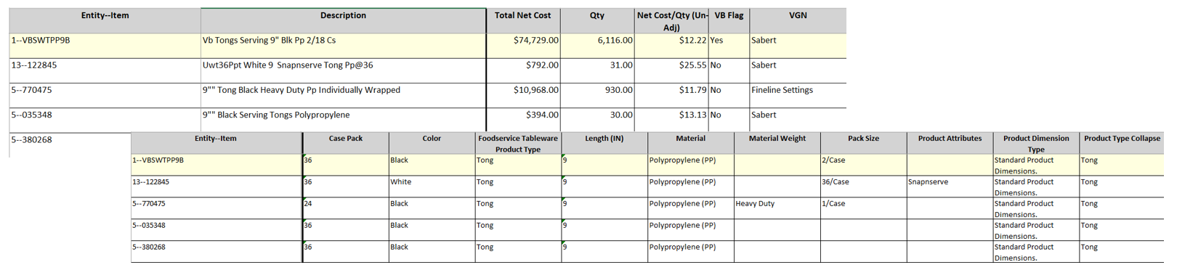
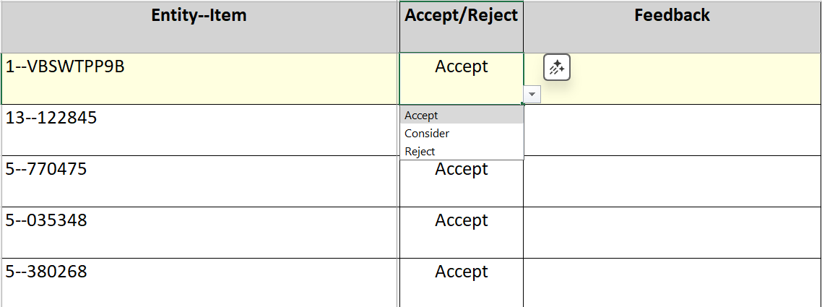
Suggest Subs Output
Taxonomy
Suggest Subs
Incorporate Feedback
Optimization
Outputs an Excel of recommendations that
a CM can review.
Each sheet represents
a different Items’
matches – equipped with information and
attributes of each Item
Key Columns are Accept/Reject and Feedback,
where a CM Accepts or Rejects a swap, and gives a reasoning to a Reject

Slide 7
Incorporate Feedback
Taxonomy
Suggest Subs
Incorporate Feedback
Optimization
1. Ingest Feedback
Target Item | Sub Item | Accept/ Reject | Feedback
1--VBSWTPP9B | 1--088 | Accept
1--VBSWTPP9B | 1--102806098 | Accept
1--VBSWTPP9B | 1--102BL | Accept
1--VBSWTPP9B | 1--10471FORK | Reject | Individually Wrapped vs Bulk
Summarized
Feedback
2. Revised Prompts Based on Feedback
3. Revised Matches
Is it a Match?
“ You are a CM – are these items a match
Target Item
Attributes
Top Similar Items from Embeddings
Attributes
Also here’s some feedback to keep in mind …”
Matches
['5--056905', '9--WST-PM-S10WCJ45', '9--SAF-C3526', '6--5240730']
['13--122380']
['5--048931', '5--1101314', '5--030863', '1--PSMMSPN']
['1--CH56NSPC7', '1--5PBAHFNTSN250']
['1--266', '6--5240771']
['9--WST-PM-S10WCJ45', '3--KAR-C9095']
['6--5240771', '1--STNJM2601003C']
['1--FH207', '1--AHF']
['1--P1001', '1--IPWF', '1--3640F', '1--312WFA1']
['5--055353', '6--4920350', '1--RPPS1308FW', '1--25851']

Slide 8
Incorporate Feedback - Iterate
Taxonomy
Suggest Subs
Incorporate Feedback
Optimization
Cutlery Results – Initial Results vs Incorporating Feedback
97%
100%
100%
90%
Consider
+9.5% Accept/Consider Improvement with Feedback
71%
63%
62%
Accept
35%
Forks
Spoons
Kits
Overall

Slide 9

Optimization
Taxonomy
Suggest Subs
Incorporate Feedback
Optimization
Matches
Cost Data
Matches
['5--056905', '9--WST-PM-S10WCJ45', '9--SAF-C3526', '6--5240730']
['13--122380']
['5--048931', '5--1101314', '5--030863', '1--PSMMSPN']
['1--CH56NSPC7', '1--5PBAHFNTSN250']
['1--266', '6--5240771']
['9--WST-PM-S10WCJ45', '3--KAR-C9095']
['6--5240771', '1--STNJM2601003C']
['1--FH207', '1--AHF']
['1--P1001', '1--IPWF', '1--3640F', '1--312WFA1']
['5--055353', '6--4920350', '1--RPPS1308FW', '1--25851']
PO Cost | Gross Cost | Net Cost | Qty | POD
$ 4.00 | 16 | 18 | 4 | N
$ 5.75 | 23 | 18 | 4 | Y
$ 6.50 | 13 | 16 | 2 | N
$ 4.00 | 32 | 36 | 8 | N
$ 43.00 | 43 | 43 | 1 | N
$ 44.00 | 220 | 220 | 5 | N
$ 44.00 | 44 | 44 | 1 | N
$ 44.00 | 132 | 132 | 3 | N
$ 19.33 | 58 | 51 | 3 | Y
$ 14.50 | 29 | 34 | 2 | N
Optimization reworked to align with Category Management team’s methodology
Optimal Subs to Make
Originating | Receiving | Savings
5--056905 | 1--266 | $2,775.47
13--122380 | 1--FH207 | $78.91
1--CH56NSPC7 | 1—AHF | $2,010.58

Slide 10

Zoom in on the optimization
Taxonomy
Suggest Subs
Incorporate Feedback
Optimization
Objective
Constraint: Volume Redistribution Limits
Maximize gross margin while consolidating vendors
A vendor can only take on a limited amount of additional volume to what they currently supply – set at 50% increase in our current set up
Constraint: Volume Conservation
Constraint: Must Keep SKUs
All a SKU’s volume must be accounted for, even if we are swapping that volume to a matching SKU
Any SKU marked ‘Must Keep’ must be kept. This means if a SKU goes to a non-addressable customer, is supplied by a non-addressable vendor, or is Victoria Bay we can mark in ‘Must Keep’
Constraint: Swap Feasibility
Constraint: One-to-One Swaps
We can only swap volume between matching SKUs
Swaps must send the complete volume of one SKU to another SKU. There will be no partial or split swaps.
For our Cutlery optimization, we have made Direct Link and Carryout Bags’ SKUs must keep, as well as SKUs from Non-Addressable vendors like Essity and Clorox
Constraint: Number of Suppliers
Optionally, we can set a maximum number of suppliers
Change constraint

Slide 11
Optimization Results Example
Taxonomy
Suggest Subs
Incorporate Feedback
Optimization
Example Results From Cutlery
SKU Count
Vendor Count
Cost Savings
75.2M
73.3M
25%
11%
1.9M
Decrease in SKU count
Decrease in Vendor count
In Cost Savings
Current
Optimized

Slide 12
Optimization Output
Taxonomy
Suggest Subs
Incorporate Feedback
Optimization
Suggest Swaps
List of Suggested Swaps between an Originating SKU and Receiving SKU.
These Swaps can also be Accepted/Rejected with Feedback and the optimization rerun without the newly rejected subs
Vendor Summary
List of all Vendors with their Qty of Category orders effected
SKUs will not be swapped out if:
They are from a preferred vendor
They go to a preferred customer
They go to a redistributor
Customer Summary
List of all Customers with their Qty of Category orders effected
Qty Affected will be 0 for Excluded Customer and Redistributors
Qty Affected will be 0 for Excluded/Preferred Vendors
Change constraint

