Slide 1

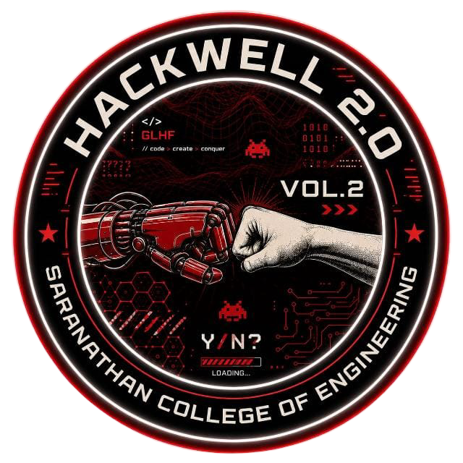
HACKWELL 2.0
PROJECT SUBMISSION TEMPLATE
TEAM NAME
The Knowledge Knights
TEAM ID
CDT-09
PROBLEM STATEMENT NUMBER (PS ID)
CDT-09 - FarmChain AI: Blockchain-Based Transparent Marketplace
DOMAIN / THEME
Cybersecurity & Digital Trust
TEAM MEMBERS
1. Team Lead: Harish Raghavendra V
Batch: 261223 | Dept: CSE(AIML) | Year: IV
2. Member: Shanmugasundaram G
Batch: 261095 | Dept: CSE | Year: IV (Sec B)
3. Member: Radhika S
Batch: 261238 | Dept: CSE(AIML) | Year: IV
4. Member: Sujith Chavan
Batch: 281107 | Dept: CSE | Year: II (Sec B)
HACKWELL 2.0 - SARANATHAN COLLEGE OF ENGINEERING
01 / 07

Slide 2
SECTION 01
Problem Statement
Clearly frame the problem you are solving
What exact problem are you solving?
• Farmers lose 40–60% of crop value to predatory middlemen and opaque commissions.
• Arbitrary spot rates force distress sales without real-time mandi benchmark transparency.
• Produce counterfeiting and lack of provenance risk consumer health with zero accountability.
Problem Impact & Scale
Who is most affected?
140M+ Indian smallholder farmers & millions of retail consumers nationwide.
Key Data Point:
40–60% crop value lost to middlemen; 0% escrow security in traditional trade.
Frequency / Urgency:
Occurs daily across harvest cycles, causing severe farmer debt & food fraud.
Who is affected by this problem?
• 140M+ Indian smallholder farmers facing low realization and delayed payment settlements.
• Millions of retail consumers paying inflated prices for unverified, potentially fake produce.
• Honest retailers & aggregators unable to prove authenticity or quality compliance.
Current Solutions & Limitations
• APMC Mandis: Complex multi-middlemen cartels with non-transparent price manipulation.
• Centralized E-commerce: High commission cuts (15–30%) with zero escrow payment security.
• Paper Quality Certificates: Easily forged with no tamper-proof cryptographic audit trail.
HACKWELL 2.0 - SARANATHAN COLLEGE OF ENGINEERING
02 / 07

Slide 3
SECTION 02
Proposed Solution
Your idea, in plain terms
Briefly explain the proposed solution — what it is and how it works
FarmChain AI is a decentralized Web3 agritech trust protocol combining EVM Solidity smart contracts, live eNAM/AgMarkNet Mandi price oracles, vernacular voice crop registration, and cryptographic QR provenance.
Describe how it directly addresses the problem stated earlier
• Trustless Escrow automatically splits revenue (60% Farmer / 20% Trader / 15% Retailer / 5% Platform) upon delivery.
• Vernacular Voice AI enables rural farmers to register crops speaking naturally in Hindi, Tamil, or English.
• Cryptographic QR codes eliminate counterfeit produce with instant mobile verification alerts.
Unique Selling Proposition/Novelty of your Solution
• Dual-Trust Protocol: Cryptographic anti-tamper QR provenance + Live APMC Mandi fair benchmark oracle.
• Real-Time Anomaly & Fraud Detection Engine flagging predatory price spikes (>50% above fair benchmark).
• Public Testnet Explorer Verification (Etherscan/Basescan) for 100% transparent digital trust.
CORE FEATURE
Decentralized Escrow Protocol with automated 60/20/15/5% split, Vernacular Voice AI crop listing, and tamper-proof QR provenance tracking.
KEY BENEFITS
+40% higher farmer revenue realization, 0% payment default risk, real-time fair Mandi pricing, and 100% end-to-end food traceability.
TARGET USER
Smallholder Farmers, Agri Intermediaries, Supermarket Retailers, and Health/Quality-conscious Consumers.
HACKWELL 2.0 - SARANATHAN COLLEGE OF ENGINEERING
03 / 07

Slide 4
SECTION 03
Methodology & Tech Stack
How will it work end to end?
How will the solution work, step by step?
1. Farmer registers crop via Vernacular Voice AI in native language (HI/TA/EN).
2. Mandi Oracle benchmarks fair spot price & mints batch on EVM blockchain.
3. Consumer/Buyer places order -> Smart Escrow locks payment funds.
4. QR scanned across logistics -> Delivery scan triggers instant 60% farmer payout.
TECH STACK
UI / Frontend
Vite + Vanilla JS, Web Speech API (Voice AI), Lucide Icons, Glassmorphic CSS
Technologies / tools / frameworks used
• Web3: Solidity 0.8.20, Hardhat, Ethers.js, Sepolia Testnet
• Frontend: Vite, Vanilla JS, Web Speech API (Voice AI), Responsive CSS
• Backend: Node.js, Express.js, Socket.io (2-event real-time sync)
• AI/ML: APMC Mandi Spot Rate Predictor & Real-Time Fraud Spike Detector
Backend & Real-Time
Node.js, Express.js, Socket.io (Live Sync), eNAM & AgMarkNet Mandi Oracles
Database & Ledger
Ethereum Sepolia / EVM Ledger, LocalStorage Cache, In-Memory State
Development approach - Implementation Strategy
• Modular smart contract suite with OpenZeppelin security standards.
• Resilient local caching for zero-freeze live Mandi demo reliability.
• Strict Role-Based Access Control (RBAC) protecting all 5 dashboards.
Core Logic (AI & Web3)
Solidity Escrow & Quality Contracts, APMC Price ML, Fraud Anomaly Detector
HACKWELL 2.0 - SARANATHAN COLLEGE OF ENGINEERING
04 / 07

Slide 5
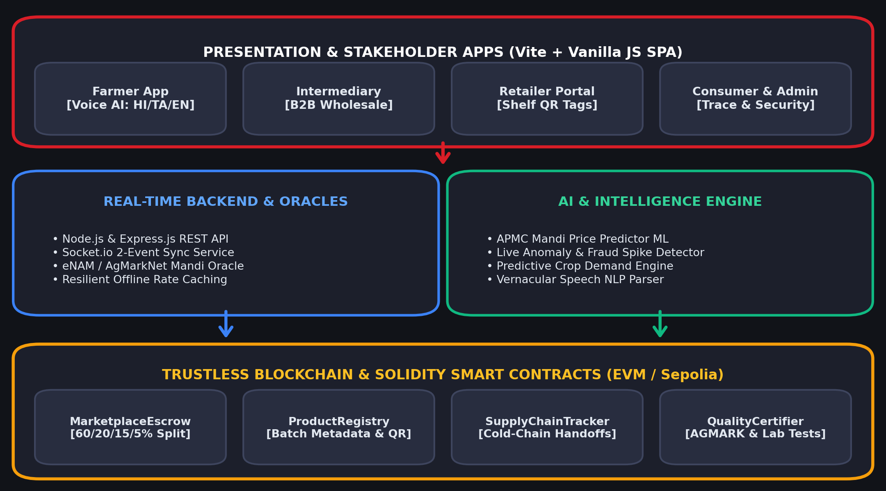
SECTION 04
System Architecture
Show us how the pieces fit together
SYSTEM HIGHLIGHTS
Basic Workflow & System Flow
Seamless pipeline from vernacular voice listing to automated escrow lock, real-time tracking, and instant cryptographic settlement upon QR delivery scan.
Data Flow Between Components
Real-time bidirectional WebSocket events (ORDER_PLACED, ORDER_STATUS_CHANGED) coupled with immutable on-chain state updates.
Feasibility & Live Prototype
Fully functional live working prototype on Sepolia testnet, with live Etherscan verification, zero paid API dependencies, and offline resilience.
HACKWELL 2.0 - SARANATHAN COLLEGE OF ENGINEERING
05 / 07

Slide 6
SECTION 05
Impact & Viability
Who benefits, and how?
EXPECTED IMPACT
Who will benefit from this solution?
• 140M+ Indian smallholder farmers gain direct market access, fair pricing, and immediate digital payment settlements.
• Consumers get 100% verified, authentic produce with full farm-to-table transparency and zero counterfeit risk.
Social, Economic & Environmental Impact
• Economic: Eliminates 40–60% predatory middlemen cuts; guarantees 60% revenue distribution to farmers.
• Social: Empowers non-tech rural farmers via vernacular voice AI in their native languages.
• Environmental: Cold-chain tracking reduces post-harvest transit spoilage and food waste.
Measurable Outcomes You Expect
• +40% increase in farmer profit margins | 0% payment fraud/default risk | 100% cryptographic batch provenance.
USE CASE
SCALABILITY
FEASIBILITY
A Tamil Nadu farmer speaks in Tamil: '500kg Basmati Rice at ₹48'. Smart contract mints batch. Consumer buys produce, escrow locks payment, and funds release instantly to farmer upon QR scan on delivery.
Layer-2 Rollup / Polygon / Base EVM compatibility for sub-cent gas fees and high transaction throughput. Decoupled microservices scaling across thousands of mandis nationwide.
Utilizes existing mobile browsers and standard cameras for QR scanning—no custom hardware needed. Zero learning curve due to intuitive vernacular voice assistance.
HACKWELL 2.0 - SARANATHAN COLLEGE OF ENGINEERING
06 / 07

Slide 7
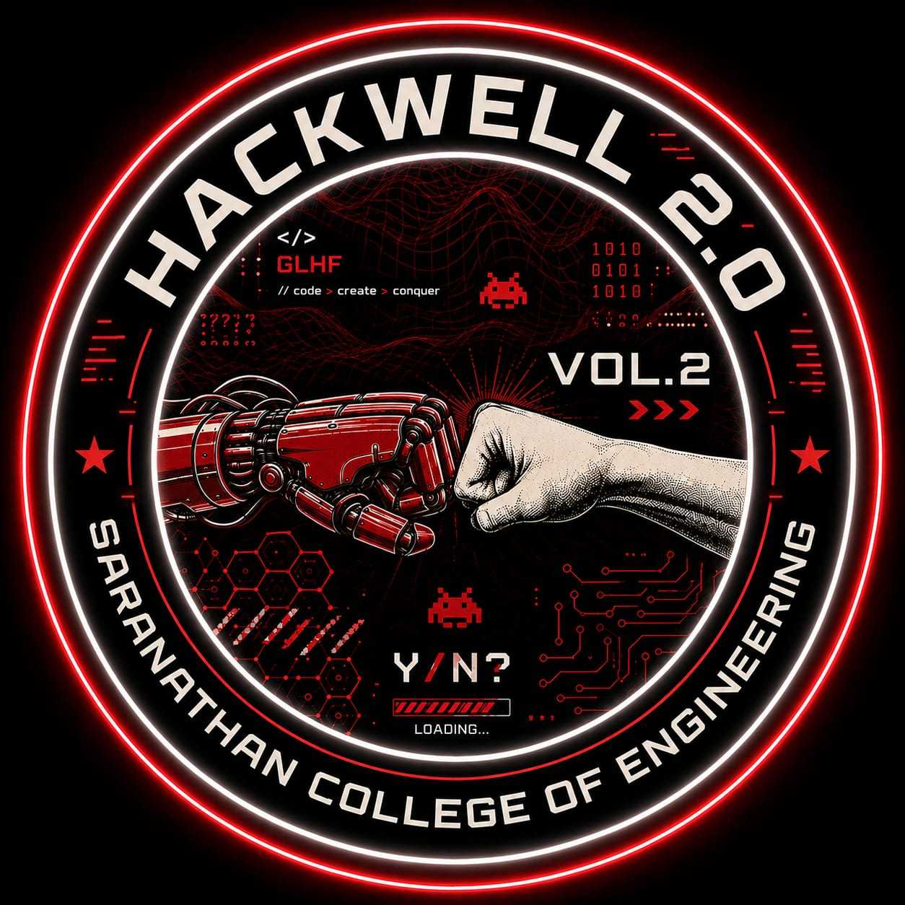
THANK YOU
Team: The Knowledge Knights | Theme: Cybersecurity & Digital Trust
PS ID: CDT-09 - FarmChain AI: Blockchain-Based Transparent Marketplace
Harish Raghavendra V (Lead) • Shanmugasundaram G • Radhika S • Sujith Chavan
HACKWELL 2.0 - SARANATHAN COLLEGE OF ENGINEERING
07 / 07

