Slide 1
AngularJS Bootcamp Course Plan
Day 1: Introduction to Angular JS – Basic Level
: Directives and Data Bindings – Basic Level
Day 2: Programming constructs (ng-if, ng-switch, ng-repeat) –
Basic Level
: MVC with Angular JS – Intermediate Level
Day 3: AJS Modules – Intermediate Level
: AJS Form Handling – Intermediate Level
Day 4: Factory and Services – Advanced Level
: Routes – Advanced Level
Day 5: Formatted Data, communication with backend servers –
Advanced Level
: JSON, AJAX and RESTful Web Services
Advanced Level

Slide 2
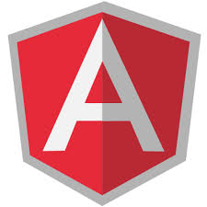
Day 1 Introduction to Angular JS

Slide 3
Day 1 - Agenda
Introduction to Angular JS
Features (RIA, MVC, SPA)
Prerequisites to learn Angular JS
Quick overview of HTML, JavaScript
How to install Angular JS – Writing First Angular Program
Angular Directives

Slide 4
What is AngularJS?
It is fresh, quiet new, latest technology
Commonly known as Angular
Initial version released in 2009
It is a JavaScript framework
Developed by Google and community
Good fit for Single page Applications (SPA)
Provides MVC on the client side
You can add this to any HTML page with <script> tag

Slide 5
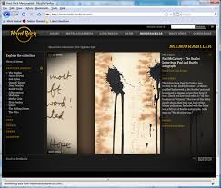
Features
RIA – Rich Internet Applications
What is this?

Slide 6
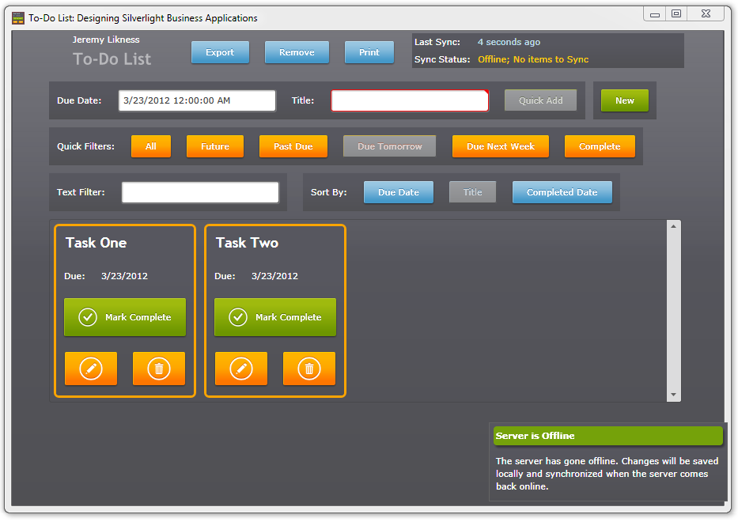
Features
RIA – Rich Internet Applications

Slide 7
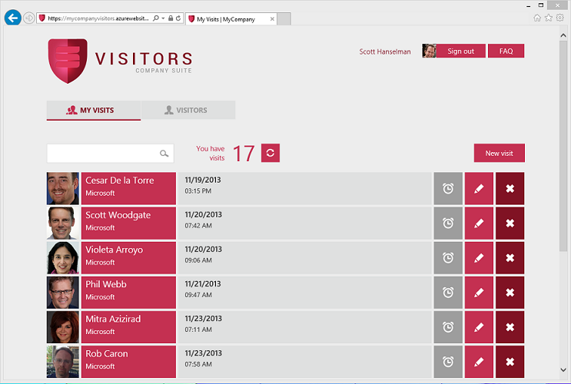
Features
SPA (Single Page Applications)
What is this?

Slide 8
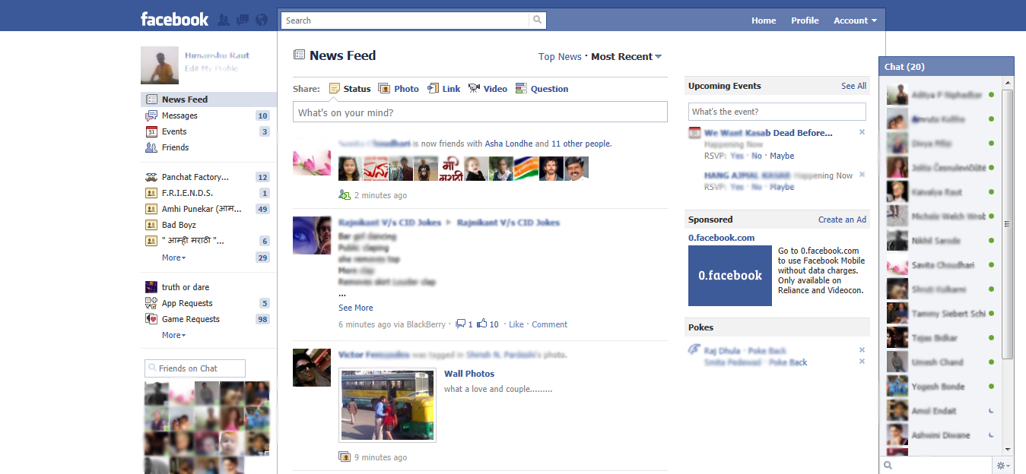
Features
SPA (Single Page Applications)
What is this?

Slide 9
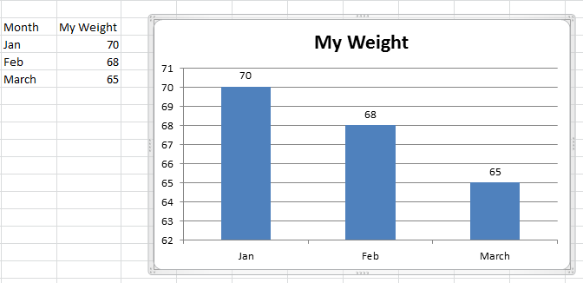
Features
MVC (Model View Controller)
What is this?

Slide 10
MVC
Model is the data / Business Logic
View is the Presentation Logic
Controller is the Input Handling Logic

Slide 11
What you should already know?
HTML
CSS
JavaScript

Slide 12
Quick Overview of HTML
Hyper Text Markup Language
Used to display pages on browser
The pages contain texts, images, audio, video and other links
Style can be applied using CSS
Static in nature
JavaScript can be inserted to make the HTML dynamic

Slide 13
Quick Overview of HTML
Some of the HTML tags:
<html>
<head>
<title>
<body>
<a href>
<table>
<form>
<script>

Slide 14
Quick Overview of JavaScript
JavaScript can be inserted into HTML pages to make them dynamic
JavaScript can be inserted using <script> tag
Example:
<html>
<head><title> My JavaScript page </title> /head>
<body>
<script>
alert(‘Welcome to JavaScript’);
</script>
<body>
</html>

Slide 15
Quick Overview of JavaScript
JavaScript code can be embedded in a Web page using SCRIPT tags
the output of JavaScript code is displayed as if directly entered in HTML

Slide 16
A glimpse of JavaScript
Writing into HTML page
Include between <script> </script> tag
document.write(“Hello This is JavaScript”);
document.write(“<h1>This is header </h1>”);

Slide 17
A glimpse of JavaScript
Writing event handling code:
<button onclick="alert(‘Hello!')">Click Here!</button>
(or)
<input type="submit" onclick="alert('Hi');">

Slide 18
A glimpse of JavaScript
Changing HTML contents:
var x=document.getElementById(“test”);
x.innerHTML=“Changed text”;

Slide 19
A glimpse of JavaScript
Changing HTML Styles
x=document.getElementById(“test")
x.style.color=“red";

Slide 20
How to write JavaScripts?
In HTML, JavaScritps should be inserted between <script> and </script> tags.
JavaScripts can appear in <body> as well as in <head> section of HTML page.
JavaScript is the default scripting language for all browsers.
Earlier, we used to code like:
<script language=“JavaScript”> or
<script type="text/javascript">

Slide 21
JavaScript in <body>
<html> <body> <script> document.write("<h1>UST Global</h1>"); document.write("<p>This is an excellent company to work with</p>"); </script> </body> </html>

Slide 22
JavaScript data types
JavaScript has the following data types
String,
Number,
Boolean,
Array,
Object,
Null,
Undefined.

Slide 23
JavaScript variables
Variable names must begin with a letter
Variable names can also begin with $ and _ (rarely used)
Variable names are case sensitive (y and Y are different variables)
No need to declare variables, will be created the first time used
variables are loosely typed, can assign different types of values

Slide 24
JavaScript variables
var x; // Now x is undefined
var x = 5; // Now x is a Number
var x = "John"; // Now x is a String
var projectName=“eCommerce";
var projectName; // undefined

Slide 25
JavaScript Variables
Booleans
var x=true;
var y=false;
The keyword var is optional. The following are still valid in JavaScript
name=“UST Global”; // no var keyword
city=‘Cochin’; // single quote

Slide 26
JavaScript Arrays
Arrays
var project=new Array();
project[0]=“Java";
project[1]=“c++";
project[2]=“MainFrame";

Slide 27
JavaScript operators
Arithmetic Operators:
+, -, *, /, %, ++, --, …
Relational Operators:
==, !=, <, >, <=, >=
Logical Operators:
&&, ||, !
conditional operators:
variablename=(condition)?value1:value2
y=(x>10)?20:30

Slide 28
JavaScript Strings
a String encapsulates a sequence of characters, enclosed in quotes
Some important properties and methods:
length – stores the number of characters in the string
charAt(index) – returns the chr at the given index
substr(start, end) – returns the part of the string between the start (inclusive) and end (exclusive) indices
toUpperCase() – returns the string in UPPER CASE
toLowerCase() – returns the string in lower case

Slide 29
JavaScript constructs
Sequence
Statements executed one after another
No Jump-over
Selection
Decision Making statements
if, if-else
Iteration
Looping
Repetitive statements
while, do, …

Slide 30
Decision making statement (if)
var x=11;
if (x<=10) {
alert("Less than equal to 10");
}
else {
alert("Greater than 10");
}

Slide 31
Switch statement
Use the switch statement to select one of many blocks of code to be executed.
switch(n)
{
case 1:
execute code block 1
break;
case 2:
execute code block 2
break;
default:
code to be executed if n is different from case 1 and 2
}
Note: In JavaScript, String data type is allowed in switch

Slide 32
Switch statement - Examples
var day=7;
switch(day)
{
case 1: alert("Sunday");
break;
case 2: alert("Monday");
break;
case 3: alert("Tuesday");
break;
default: alert("Invalid day");
}
var name=“Guru"; switch(name) { case "Guru": document.write("Guru<br>"); break; default: document.write("Other than Guru<br>"); break; }

Slide 33
Iteration / Looping Using for loop
for (var i=1;i<10;i++)
{
document.write(i + "<br>");
}

Slide 34
Array Access
var city=[‘Cochin’,’Bangalore’,’Hyderabad’];
/* Method 1 */
for (var i=0;i<city.length;i++)
document.write(city[i]+"<br>");
/* Method 2 - Using for/in loop*/
for (x in city)
document.write(x+"<br>");

Slide 35
For/in loop
var person={fname:“Bill",lname:“Gates",age:55};
for (x in person)
{
document.write(person[x]);
}

Slide 36
Looping with while
var x=1;
while (x<=10)
{
document.write(x+"<br>");
i++;
}

Slide 37
Looping with do…while
var x=1;
do
{
document.write(x+"<br>");
x++;
}
while (x<=10);

Slide 38
How to install AngularJS?
Since it is a library with .js file, you should embed in the <script src=> tag
There are two ways:
If you are connected to Internet – online – then you can include the google CDN (Content Delivery Network) URL like this:
<script src="http://ajax.googleapis.com/ajax/libs/angularjs/1.2.26/angular.min.js"></script>
If you want to work offline, then you can download and save the lib file in local disk and use like this:
<script src=“c:\\guru\\angular.min.js”> just 98 KB

Slide 39
Different library versions
There are two versions of angular js library file:
angular.js (789 KB)
This is a human readable JavaScript library.
Expanded version, useful for developers to check the APIs and debug purpose – bigger size – really helpful for development.
angular.min.js
This is the minified version (just 98 KB)
This is obfuscated, encoded version
Not human readable – smaller in size – really helpful in the production environment

Slide 40
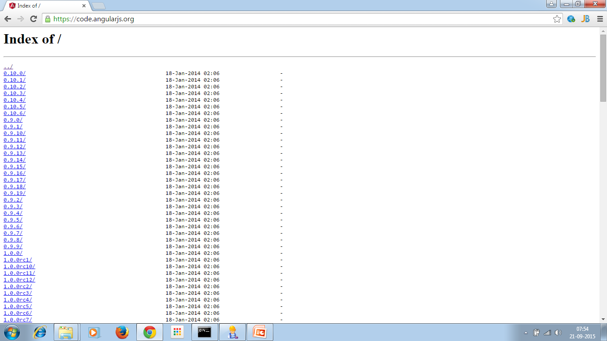
Download from….
https://code.angularjs.org/

Slide 41
The first program (Using V1.2.2)
<!DOCTYPE html> <html lang="en"> <head> <title> Angular JS - One </title> <script src="angular.min.js"> </script> </head> <body ng-app=""> <p>Name? <input type="text" ng-model="myname">
<h1 style="color:red" ng-bind="myname"> </body> </html>

Slide 42
Understanding the program
The library “angular.min.js” is embedded between <script> </script> tags
The file “angular.min.js” should be downloaded and kept in the same directory where your AJS programs reside.
We saw ng-app, ng-bind and ng-model
These are called as angular directives

Slide 43
Another way (CDN – Content Delivery Network)
<head> <title> Angular JS - One </title> <script src=" http://ajax.googleapis.com/ajax/libs/angularjs/1.2.2/angular.min.js"> </script> </head> <body ng-app=""> <p>Name? <input type="text" ng-model="myname">
<h1 style="color:red" ng-bind="myname"> </body> </html>

Slide 44
Day 1 Angular Directives and Data Bindings

Slide 45
Introduction to Angular Directives
Anything starts with ng is Angular Directives
Examples:
ng-app
ng-model
ng-bind
ng-init
Each directive has a purpose
Let’s see in detail

Slide 46
The Angular directives
As soon as the web page has been loaded, AngularJS starts automatically.
ng-app directive tells that who is the owner of AngularJS application, generally empty.
ng-model directive binds the input field to an application variable name “myname”
ng-bind directive retrieves the value from the variable “myname” and sets to the view

Slide 47
How to initialize the variable?
Use ng-init directive to initialize any variable
Example:
<div ng-app="" ng-init="myName=‘Guru’">
<p>My name is: <h1 ng-bind=“myName”></h1> </p>
</div>

Slide 48
AngularJS Expressions
They are given in double braces.
Syntax: {{ expression }}
Example:
<body ng-app="">
Sum of 10 and 10 is {{10+10}}
</body>

Slide 49
AngularJS String
<body ng-app="">
Name? <input type="text" ng-model="nm">
<h1>Your name is {{"Mr. "+nm}}</h1>
</body>

Slide 50
AngularJS Numbers
They are same as JavaScript Numbers
Example:
<body ng-app="" ng-init= " no1=10;no2=15 ">
<h1> The addition is {{no1+no2}}</h1>
</body>

Slide 51
Angular JS Expression using bind
<!DOCTYPE html> <html lang="en"> <head> <title>Angular JS Expresion in bind</title> <script src="angular.min.js"> </script> </head> <body ng-app="" ng-init="no1=10; no2=10"> <h1>The sum is: <span ng-bind = "no1+no2"> </span></h1> </body> </html>

Slide 52
Objects in AngularJS
Similar to JavaScript objects
Recall:
var employee={name:‘Guru’,city:‘Bangalore’}
In AngularJS:
<body ng-app="" ng-init="employee={name:‘Guru’,city:‘Bangalore’}">
<h1> Your name is {{employee.name}}</h1>
<h1> You live in {{employee.city}}</h1>

Slide 53
Objects in AngularJS – using bind
Similar to JavaScript objects
Recall:
var employee={name:‘Guru’,city:‘Bangalore’}
In AngularJS:
<body ng-app=""
ng-init="person={name:'Guru',city:'Bangalore'}"> <h1> You live in
<span ng-bind="person.city"></span></h1>

Slide 54
Arrays in AngularJS
Similar to JavaScript arrays
Example:
<body ng-app="" ng-init="cities=['Mumbai','Kochi','Bangalore']"> <h1> The 2nd city is {{cities[1]}}</h1>
Using bind:
<p>The 2nd city is <span ng-bind="cities[1] "> </span></p>

Slide 55
Data Binding - Exercise
Accept two numbers from the field type “number”
Add the numbers and display the sum.

Slide 56
Solution
<body ng-app="" ng-init="no1=1;no2=1"> Input number 1 <input type="number" ng-model="no1"> Input number 2 <input type="number" ng-model="no2"><br> Output is {{no1+no2}} </body>

Slide 57
Data Binding using ng-bind - Exercise
Do the same exercise found in the previous slide
For this case, set the addition in the paragraph tag
Hint:
<p ng-bind="no1+no2">

Slide 58
End of Day1

Slide 59
T
H
A
N
K
Y
O
U

