Slide 1

Day 2 – Topic 1 Programming Constructs

Slide 2
Day 2 - Agenda
The programming constructs
Iterating with ng-repeat directive
Simple conditions with ng-if directive
Multiple conditions with ng-switch
Setting the data to table and applying CSS styles
AJS API reference for directives
Exercises

Slide 3
The Programming Constructs
Every programming language has the constructs
The way in which the instructions/code have been organized
There are three types of programming constructs
Sequence – One after another in a sequential manner
Selection – Decision making statements
Iteration – Repetitive statements / Looping
Angular JS also has the directives to support these programming constructs

Slide 4
Iterating with ng-repeat directive
ng-repeat is used to iterate the elements from arrays
Example:
<body ng-app=""
ng-init= names="['Vinu', ‘Sreedevi', ‘Martin', ‘Vishnu', 'Aswin', ‘Balaji', ‘Rajeev']"> <div ng-repeat="x in names"> <h1>{{“Hello…”+x}}</h1> </div> Using bind:
<h1 ng-bind="x"></h1>

Slide 5
ng-repeat with Array of objects
<body ng-app="" ng-init=“names=[
{name:'Guru',city:'Bangalore'},
{name:‘Sachin',city:‘Kochi'},
{name:‘Arun',city:‘TVM‘}
]”>
<div ng-repeat="x in names">
<h1> {{x.name+" lives in " +x.city}}</h1>
</div>
Next: Rewrite this exercise using ng-bind

Slide 6
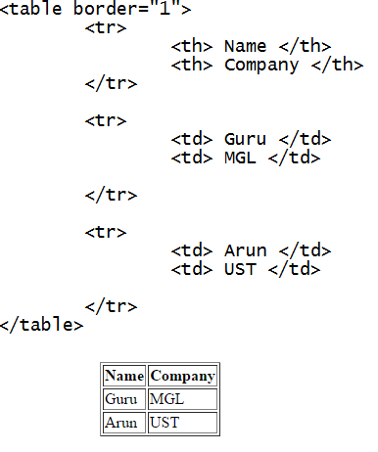
Setting the data (model) in table (view)
You can set the data in table
All you need to do is
associating the
ng directive with the
tr tag
Hope you all know how
to create table in HTML

Slide 7
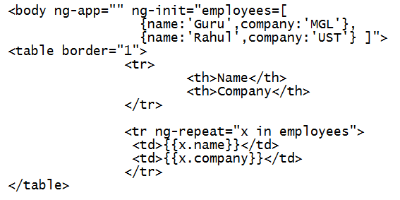
Setting the data (model) in table (view)

Slide 8

Applying CSS style
In the exercise in the previous slide, apply the following CSS style:
Apply background-image for table
Hint: <table border="1" style="background-image:url(‘image.jpg');">
For header, the background color should be yellow and text in white
For data, the font color should be white
Sample output:

Slide 9
Decision Making with ng-if directive
ng-if is used to compare two values
Example:
<body ng-app> Enter the company's name: <input type="text" ng-model="company"> <h1 ng-if="company=='UST'"> My Company </h1> <h1 ng-if="company!='UST'"> Not My Company </h1> </body>

Slide 10
Multiple conditions with ng-switch
ng-switch is used to check multiple conditions.
Example:
<body ng-app="" ng-init="no=51"> <h1 ng-switch="no"> <span ng-switch-when=5>Number is 5 </span> <span ng-switch-default>Number is not 5 </span> </h1> </body>

Slide 11
AngularJS API Reference for Directives
You can check out the following document from angular js website for more details on API
https://docs.angularjs.org/api

Slide 12
Break

