Slide 1

Day 3 – Topic 2 Form Handling in AngularJS

Slide 2
Day 3 - Agenda
What is a Form in general?
Introduction to AngularJS Form
AngularJS Form with CSS classes
Example using ng-show
Two-way data binding in Angular forms
ng-click and ng-disabled events
Custom model update triggers with ngModelOptions (blur, debounced)
Custom Validations

Slide 3
What is a Form in general?
A Form is a collection of controls for receiving the input from the user.
Controls such as input, select, textarea are ways for a user to enter data.
Form and controls provide validation services, so that the user can be notified of invalid input before submitting a form.
This provides a better user experience than server-side validation alone because the user gets instant feedback on how to correct the error.

Slide 4
HTML Form
<form action=“Calculate”>
Enter 1st number: <input type=“number” name=“n1” required><br>
Enter 2nd number: <input type=“number” name=“n2 required”<br>
<input type=“submit”>
</form>
required is used to perform browser specific form validations.
If you want to disable, you can use novalidate.

Slide 5
Introduction to AngularJS Form
Very similar to HTML forms
But, you will be using
Angular specific event handling like ng-click
Angular modules (if required)
Angular controllers (if required)
Angular functions (if required)
Angular specific functions like angular.copy, ng-show etc.

Slide 6
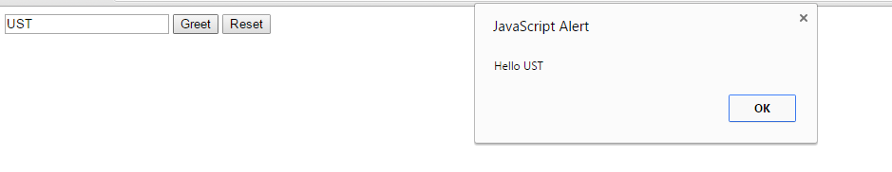
Simple AngularJS Form
Let’s create a very simple but interactive form now
Show a text field for the user to enter a String
Create two buttons; one for displaying an alert with the String “Hello <<name>>; another for clearing the text field content

Slide 7
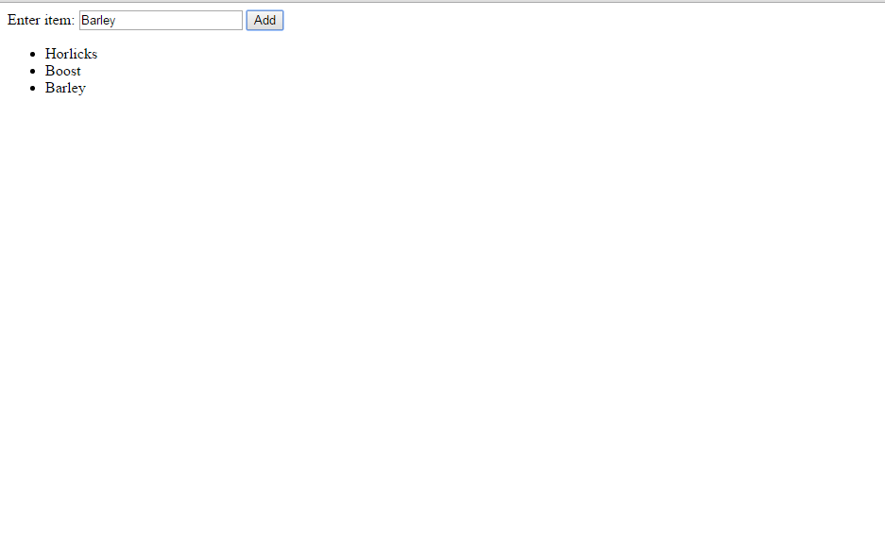
Shopping Cart Form
Click Here
Items get added here

Slide 8
Angular forms with CSS Classes
To allow styling of form as well as controls, ngModel adds the following CSS classes:
ng-dirty: the control has been interacted with
ng-pristine: the control hasn't been interacted with yet
ng-invalid: the model is invalid
ng-valid: the model is valid
ng-touched: the control has been blurred
ng-untouched: the control hasn't been blurred
ng-pending: Waiting for any other action to be completed

Slide 9
Simple example using ng-show
<head> <title>demo of ng-show</title> <script src="angular.min.js"></script> </head> <body ng-app=""> <h1 ng-show="true"> Hello I am visible </h1> <h2 ng-show="false"> Hello I am invisible </h2> </body>

Slide 10
Two-way data binding in Angular Forms
Synchronizing the model to the view
Synchronizing the view to the model
This is done by the directive ngModel.
This is written using the format ng-model and attached to any DOM
Example: <h1 ng-model=“myName”>
Let’s see an example for now.

Slide 11
Binding “email” input type to <h1>
Guess the output of the following code snippet:
<body ng-app=""> Enter your email id: <input type="email" ng-model="userEmail"> <br> <h1 ng-bind="userEmail"></h1> <body>

Slide 12
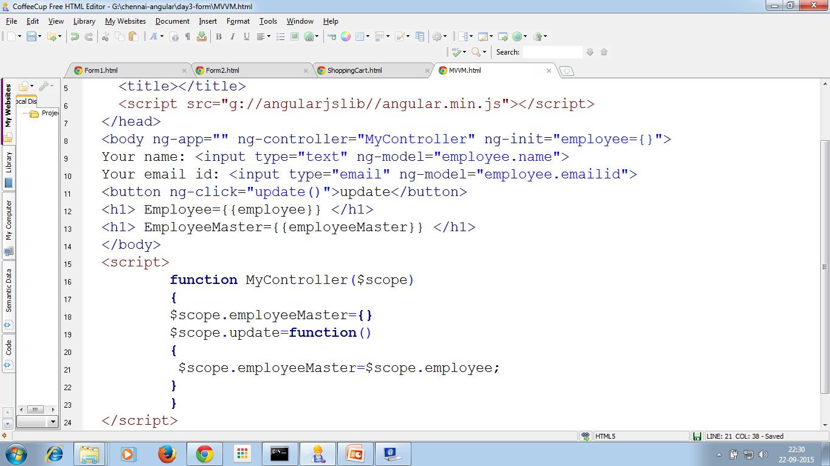
Two way data binding demo
Note: The value of ngModel won't be set unless it passes validation for the input field. For example: inputs of type email must have a value in the form of user@domain.

Slide 13
AngularJS Form and Input Controls
A form is an instance of FormController
An input control that has the ngModel directive holds the instance of NgModelController
Such a control instance can be published as a property of the form instance using the name attribute on the input control.

Slide 14
The Form elements
Enter Employee id: <input name="empid" type="number" ng-model="empId" required> <span style="color:red" ng-show="(employeeForm.empid.$dirty && employeeForm.empid.$invalid)"> Employee id is required.
</span> <br>

Slide 15
$dirty and $invalid properties
The following properties are applicable to form fields
$dirty – True if the user has already interacted with the form (with some values)
$invalid – True if the containing form element is invalid (non-matching data type)

Slide 16
Email validation
For invalid email id:
<span ng-show = "employeeForm.email.$error.email">Invalid email id</span>
For empty email id:
<span ng-show = "employeeForm.email.$error.required">email id is required</span>

Slide 17
ng-click & ng-disabled event
<button ng-click="erase()">Erase</button>
<button ng-disabled="employeeForm.empid.$dirty && employeeForm.empid.$invalid || employeeForm.email.$dirty && employeeForm.email.$invalid" ng-click="submit()">Submit</button>

Slide 18
Custom model update triggers
By default, any change in the model will trigger the view update.
You can override this behavior using the ngModelOptions directive to bind only to specified list of events.
Ex: ng-model-options="{ updateOn: 'blur' }" will update and validate only after the control loses focus (pressing tab).
You can set several events using a space delimited list. i.e.ng-model-options="{ updateOn: 'mousedown blur' }"

Slide 19
Non-immediate (debounced) model updates
Sometimes, you don’t want immediate updates
You want to a delay before updation happens
You can do this by using debounce key
Example:
<input type="text" ng-model="user.name" ng-model-options="{ debounce: 250 }" />

Slide 20
Custom validations (For extra reading…)
You can write custom validations also.
Go through the Angular JS documentation
Also given a sample program in the exercises.

Slide 21
What angular directives we learnt so far?
ng-app
ng-model
ng-bind
ng-controller
ng-click
ng-show
ng-disabled

Slide 22
End of Day 3

Slide 23
T
H
A
N
K
Y
O
U

