Slide 1
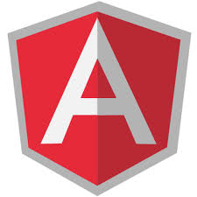
Day 3 Angular Modules

Slide 2
Day 3 - Agenda
What is module?
Why modules are important?
How to create an angular module?
Creating controller in module.
Controller – best practices
JavaScript Minification / Tools
Exercises

Slide 3
What is a Module?
It is a container for the different parts of the application – controllers, services, filters, directives etc.
In AngularJS, we can organize application logic into modules and make them work together using DI (Dependency Injection)

Slide 4
Why Modules are important?
As application developers, we deal with dozens of layers/logic and various patterns.
Presentation Logic, Persistence Logic, Controller Logic, Helper classes, DAO, VO, DB Layer etc.
We can write everything together in a single file (monolithic application), things will still work. But… disadvantages?

Slide 5
Why Modules are important?
We need to have layered architecture
Loose coupling is highly appreciated
It would be flexible, easy to track, easy to find issues, easy to solve it, not much dependency
Touching one part of application should not affect other parts
So, for large enterprise applications, loosely coupled architecture would be preferred.
So that things will not be messy.

Slide 6
How to create an angular module?
Very simple
var app=angular.module(“MyApp”,[“dependency1, dependency2,…]);
Module name is MyApp
app is the reference variable for MyApp
[“dependency1, dependency2,…] – list of dependent modules if any
the 2nd argument could be empty if the module does not depend on other modules.

Slide 7

Is this a valid module?
var x = angular.module(‘USTModule’,[]);

Slide 8
Ok, now….is this a valid module?
var x = angular.module(‘USTModule’);
* Note that there is no 2nd argument

Slide 9
* What is the meaning of missing 2nd argument? *
var x = angular.module(‘USTModule’);
If the 2nd argument is missing, then we are getting the reference of a predefined angular module.
If you include the 2nd argument, which is an array, then it means you are always defining the new module

Slide 10
Creating controller in module
After creating the module, we can create controller inside the module.
The general syntax is:
module.controller(‘ControllerName’,[‘dependency1’ , ‘dependency2’,function(dependency1, dependency2) {
//logic
}]);

Slide 11
Creating controller in module [contd…]
Example:
var myApp=angular.module('myApp',['ngRoute']);
myApp.controller('USTController',['$scope','$http',function($scope,$http){
//logic
}]);
Here, $scope and $http are built-in AngularJS services that are provided as dependencies.

Slide 12
Creating controller in module [contd…]
We can also create the controller as follows:
var myApp=angular.module('myApp',['ngRoute']);
myApp.controller('USTController',function($scope,$http){
//logic
}]);
What difference you observe?

Slide 13
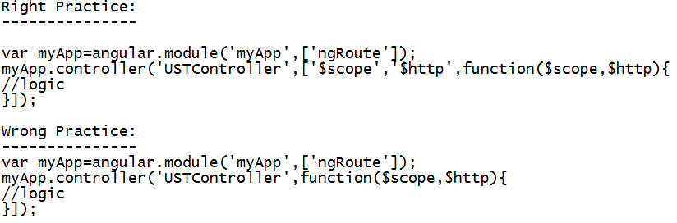
Best practice is array based dependencies
Always prefer array based dependencies.
Note: Function arguments are minified, String literals remain the same.

Slide 14
JavaScript minification tools
Code minification is the standard practice to reduce the code size
It removes unwanted characters from the source code, reduces the variable names
It reduces the download time; faster downloads.
Some excellent JavaScript tools are:
YUI Compressor by Yahoo
Google closure Compiler
JSMin
Packer
Dojo ShrinkSafe

Slide 15
BREAK

Slide 16
T
H
A
N
K
Y
O
U

