Slide 1

Day 4 Factories and Services

Slide 2
Day 4 - Agenda
What is a service?
About $http service (built-in service)
Server side communication with $http (AJAX calls)
Other built-in services like $document, $window, $timeout
Creating user defined services using service and factory
Dependency Injection mechanism
Exercises

Slide 3
What is a service?
A function that encapsulates some logic
Similar to controller
But both are used for different purposes
We can’t write all logic inside controller or inside service
We should have separation of concerns concept
Loose coupling

Slide 4
Usage of $http service
$http is a in-built service provided by angular
You can use either get() or post() method to invoke a server program.
Example:
To invoke a servlet using GET method
$http.get("http://localhost:8081/HelloWorldServlet/Hello");
To invoke a servlet using POST method
$http.post("http://localhost:8081/HelloWorldServlet/Hello");

Slide 5
Retrieving data from a servlet and passing into angular directive – Server communication
We are going to see a simple angular program
The program will contact the servlet which is running on tomcat server on port number 8081
If the servlet sends the data successfully, then the data is captured in angular variable and then passed to angular directive
If the server communication fails, then we are going to display some error message.

Slide 6
Step 1 – Write the server side program (servlet)
Develop a simple servlet program
Define both GET and POST methods
Using PrintWriter object, display the message “Hello World Servlet in GET method” in doGet() method
Using PrintWriter object, display the message “Hello World Servlet in POST method” in doPost() method
Unit test the servlet and make sure both the methods are working.

Slide 7
Step 2 – Write Angular program and define module and controller
Define a module “myApp”
Define a controller “ServerController” inside the module myApp and attach to <body>
Define the controller with two built-in services namely $scope and $http
Code Snippet:
var app = angular.module('myApp', []);
app.controller(‘ServerController', function($scope,$http)

Slide 8
Step 3 – Write logic inside controller
Let’s fill the logic inside ServerController
var response = $http.get("http://localhost:8081/HelloWorldServlet/Hello"); // get is the function of $http service
response.success(function(data,status,headers,config) {
$scope.serverData=data;
// The data is passed to the model serverData
}

Slide 9
Step 3 – Write logic inside controller (Contd…)
response.error(function(data, status, headers, config) {
alert(‘Some error while retrieving the data from server’);
}

Slide 10
Step 4 – Accept the data in directive
Let’s retrieve the data and bind it to DOM <h1>
<h1 ng-bind=“serverData”/>
That’s it.
So Simple ☺
But, you would need Eclipse with Tomcat setup and create dynamic web project to run this program.

Slide 11
What’s the big deal over here?
Once you get the data from the server, you can:
Bind the data (model) in any tag / DOM / view
Format the data in HTML
Filter the data on client side
Apply CSS styles to the data
The data is in client side, you can do whatever you want without any further server side communication, meaning it is going to be very light weight programming.

Slide 12
More on $http service
The $http service is a core Angular service that facilitates communication with the remote HTTP servers via the browser's XMLHttpRequest object
The $http API is based on the deferred/promise APIs (success and error).
If the readyState is 4 and the status is 200, then we are sure that the data transfer from the server is over and completely available to the client.

Slide 13
Other $http service methods – for further reading
$http.get – to perform GET request
$http.head – to perform HEAD request
$http.post - to perform POST request
$http.put – to perform PUT request
$http.delete – to perform DELETE request
$http.jsonp – to perform JSON patch request
$http.patch – to perform patch request

Slide 14
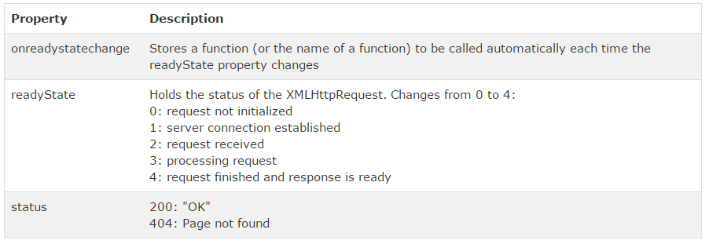
XMLHttpObject – AJAX states

Slide 15
About $document service
This is equivalent to browser’s window.document object
If you want to display the HTML document’s title, you could display as following:
$document[0].title;

Slide 16
$window service
A reference to browser’s window object.
How to use this in controller?
function WindowController($scope,$window) { $scope.display=function(myName) { $window.alert(myName); } }

Slide 17
$timeout service – How to use?
<script> function TimeOutController($scope, $timeout) { $timeout(callMe,3000); } function callMe() { alert('Hi Folks'); } </script>

Slide 18
Other built-in services (for extra reading)
$locale - service provides localization rules for various Angular components.
$q - A service that helps you run functions asynchronously, and use their return values (or exceptions) when they are done processing.
$animate - exposes a series of DOM utility methods that provide support for animation hooks.
$location – synchronizes URL with application
$resource – Used to RESTful web services

Slide 19
User defined services
Service is nothing but a function that encapsulates some logic.
Separation of concern is at the heart while designing an AngularJS application.
Our controller must be responsible for binding model data to views using $scope. It does not contain logic to fetch the data or manipulating it.
For this we must create services.

Slide 20
User defined services (Contd…)
User defined services can be created in 2 ways.
Using module.service()
Using module.factory()
Example:
module.service(‘serviceName’,function);
module.factory(‘serviceName’,function);

Slide 21
Service using module.factory
Services created using factory are singleton objects
These objects are application wide.
A service created using factory, can be used within any other services or controllers
Example:
module.factory(‘MyService’,function(){
var x={};
factory.m1=function(){ // }
factory.m2=function(){ // }
return x;
});

Slide 22
Service using module.service method
In this method, you will get an instance of the function
This object instance becomes the service object that AngularJS registers and injects later to other services / controllers if required.

Slide 23
Service using module.service (contd…)
Example:
module.service(‘YourService', function() {
this.m1 = function() { //}
this.m2 = function() { // }
});

Slide 24
Example now?
Let’s create two buttons Welcome and Goodbye.
If you click on ‘Welcome’ button, it should display Welcome
If you click on ‘Good Bye’ button, it should display Good bye.
Seems very simple??
But, we will implement service and controller.

Slide 25
Step 1 – Define module and controller
Define a module ‘app’
Inside this module, define ‘SaluteController’
Inject the dependent services WelcomeService and GoodByeService along with $scope.
Inside the controller, define two functions:
welcome() – will call wel() function of the service WelcomeService and the return data will be assigned to the variable returnText.
goodbye() – will call good() function of the service GoodByeservice and the return data will be assigned to the variable returnText.

Slide 26
Step 2 – Define services
Define a service with the name WelcomeService and define a method wel() that returns the String ‘Welcome’
Similarly, define another service with the name GoodByeService and define a method good() that returns the String “Good Bye”

Slide 27
Step 3 – Create buttons in main html / template
Now, create a html file “Test.html”.
Attach the module “app” to <body> and also the controller “SaluteController”
Define a button ‘Welcome’ and on click of this, invoke the function welcome().
Similarly, define another button ‘Goodbye’ and on click of this, invoke the function goodbye().

Slide 28
DI (Dependency Injections)
Another object is injected into the current object as dependent.
Example: Address object is inserted into Employee object
Similarly,
Services can be injected into controllers
Built-in services like $http, $scope
User defined services like WelcomeService.
User defined services won’t have $ symbol.

Slide 29
BREAK

Slide 30
T
H
A
N
K
Y
O
U

