Slide 1

Day 5 Dealing with different data formats

Slide 2
Day 5 - Agenda
Client server programs
Data Transfer
Angular communicating with Servlet
RESTful web service
Angular communicating with RESTful web service
Case study: JavaScript – AJAX – Servlet – JDBC - JSON

Slide 3
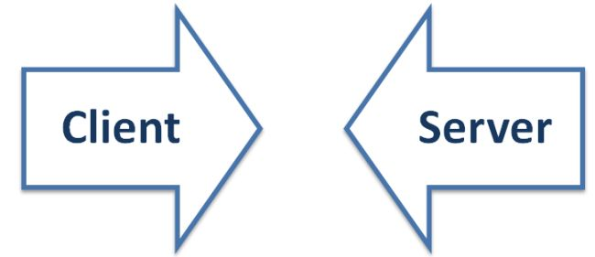
Web Development
Web development is all about communication and data exchange
This communication takes place between two parties: The client and the server

Slide 4
Server and client
The Server is responsible for serving the web pages depending on the client/end user requirement.
It can be either static or dynamic.
A client is a party that requests pages from the server and displays them to the end user.
In general a client program is a web browser.

Slide 5
Server side programs
Can be developed using languages such as:
Java (Servlet)
.NET (C#)
Visual Basic
C++
Python
PHP
Simple UNIX shell scripts
MS Windows BATCH files

Slide 6
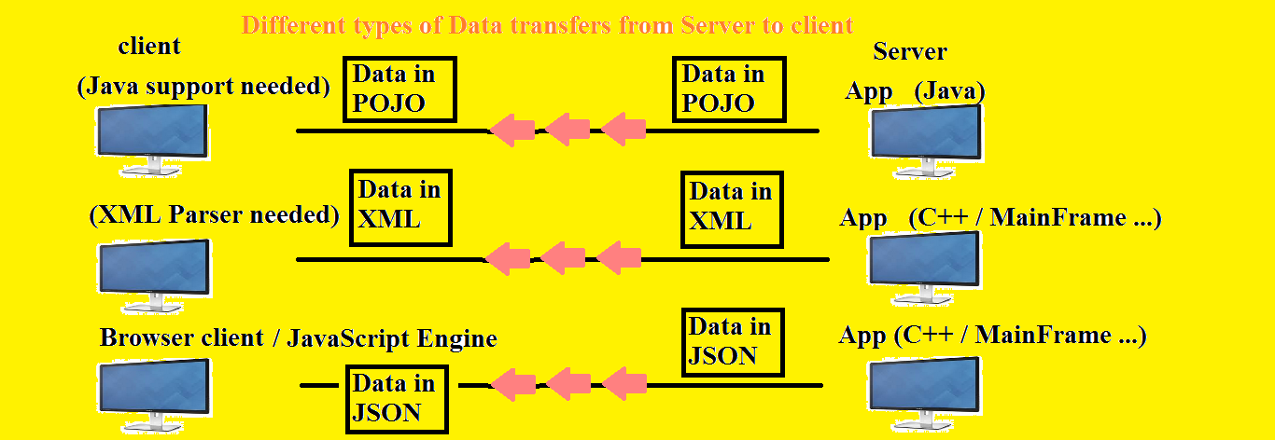
Data transfer

Slide 7
Angular communicates with Servlet
We already saw a demo on how to communicate with Servlet (server program) from AngularJS program
Calling doGet() and doPost() methods

Slide 8
RESTful web service
Now, let’s discuss about RESTful web service
Let’s write a web service that returns the data in different formats
Let’s demo

Slide 9
Angular – RESTful web service communication
We already know how to write RESTful web service
Let’s see how they communicate
Let’s demo

Slide 10
Case study (JavaScript – AJAX – Servlet – JDBC – JSON) on communication
Let’s create a simple HTML file
Let’s define two input controls: Button and the drop-down combo box.
When you access the web page, the drop-down should be filled with data (usernames) that is stored in Oracle database on the back-end
If you click the Button (update), if there is a change in the database table, that should be updated.

Slide 11
End of Day 5

Slide 12
T
H
A
N
K
Y
O
U

