Slide 1

Mastering Workplace Communication
Impactful Data · Compelling Stories · Confident Q&A
COMMUNICATION EXCELLENCE

Slide 2

Effective Communication at Work
Foundations for Success
Clarity
Say more with fewer words
Confidence
Own the room, own the message
Connection
Make every conversation count
Consistency
Build trust through reliability

Slide 3

Active Listening & Clear Messaging
Building Strong Connections
Listen First
Maintain eye contact and open body language
Pause before responding — reflect, don't react
Ask clarifying questions to confirm understanding
Speak with Purpose
Lead with your key message
Use simple, direct language
Confirm your message was received clearly

Slide 4
Presenting Data with Impact
Beyond Just Numbers
Know Your Audience
Choose the Right Visual
Tailor complexity to who is in the room
Match chart type to the story you're telling
Lead with Insight
Drive Action
Don't show data — show what it means
Every slide should answer: "So what?"

Slide 5
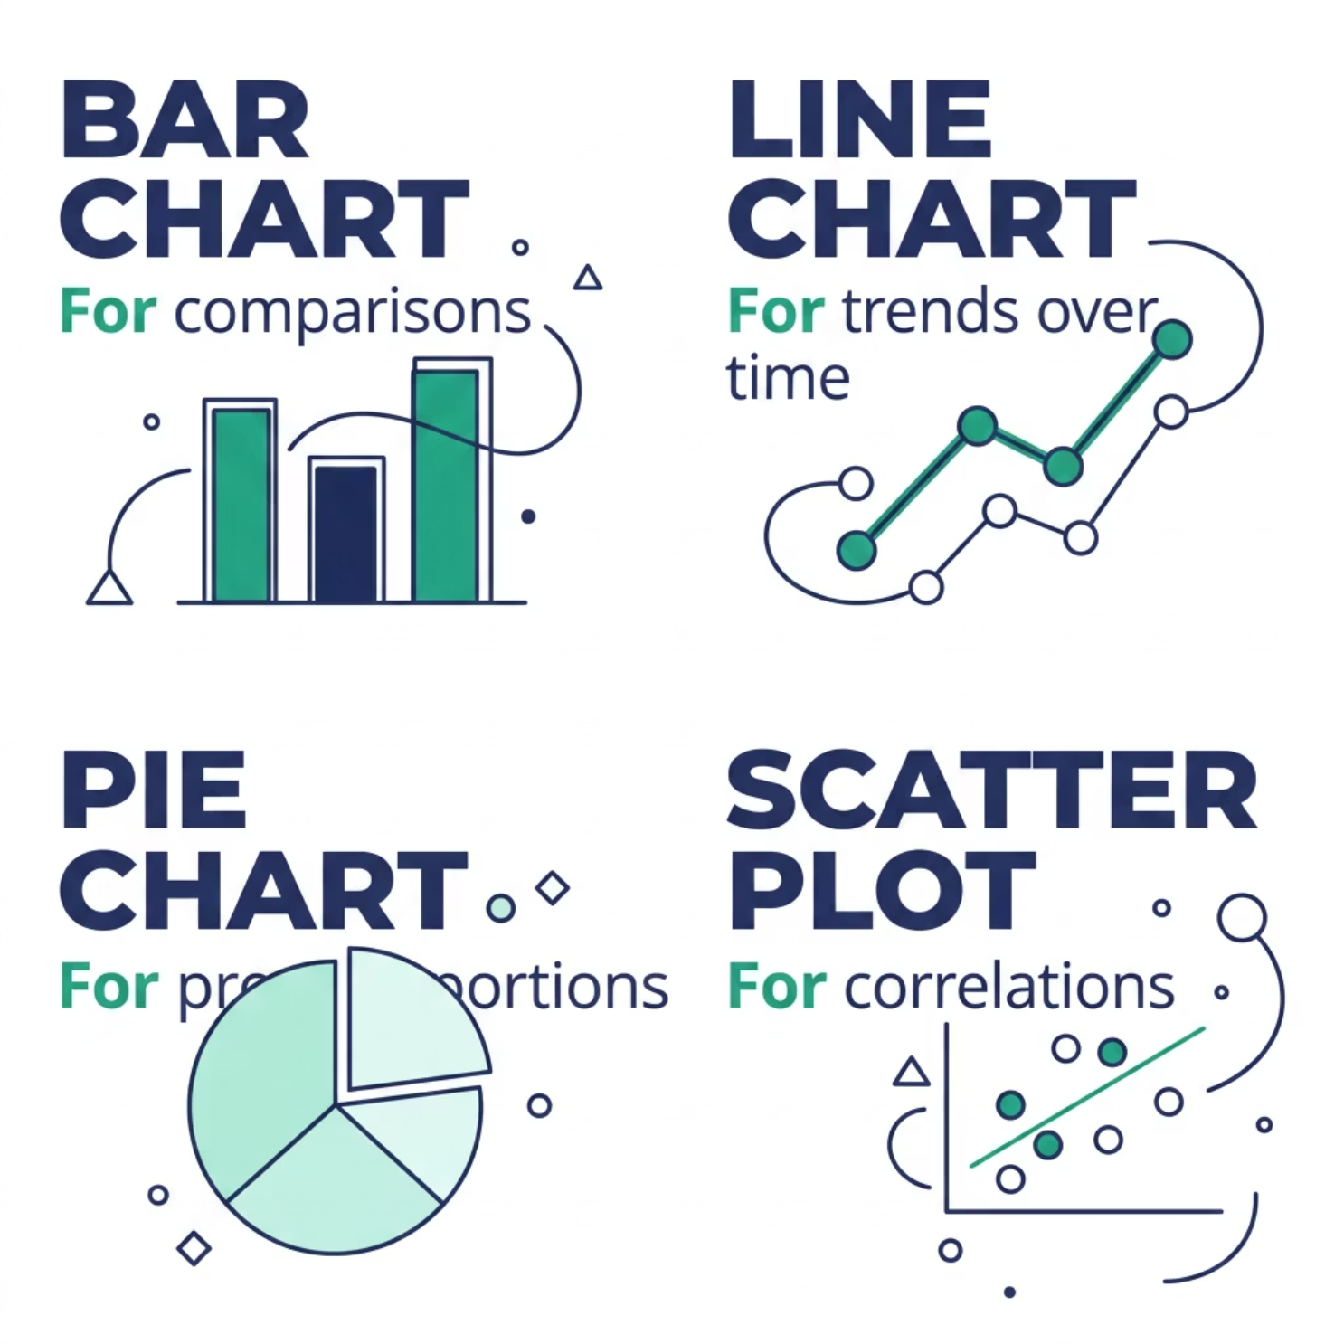


Visualising Data Effectively
Making Complex Simple
Golden Rules of Data Viz
Remove all chart junk — less is more
Use colour to guide attention, not decorate
Label directly — avoid legends where possible
One chart, one message
A confused audience remembers nothing. Simplify ruthlessly.

Slide 6


Crafting a Data Narrative
From Insights to Action
Find Insight
Frame Story
Drive Decision
Data without a narrative is noise. Structure your findings as a story — context, conflict, and resolution — so your audience moves from understanding to action.

Slide 7

Storytelling in Business
Engaging Your Audience
Set the Scene
Establish context — who, what, and why it matters
Introduce the Tension
A challenge or gap that demands attention
Resolve with Impact
Your solution — backed by evidence and emotion

Slide 8
The Power of Narrative
Connecting Emotion with Information
"Facts tell. Stories sell. The best business communicators do both."
People remember stories 22x more than facts alone. Pair your data with a human moment — a customer, a challenge, a turning point.
Emotion
Evidence
Makes it memorable
Makes it credible
Direction
Makes it actionable

Slide 9

Handling Tough Q&A Sessions
Confidence Under Pressure
Pause & Breathe
1
Buy time. Think before you speak.
Acknowledge
2
Validate the question — never dismiss it.
Respond with Structure
3
Short answer first, then context.
Stay in Control
4
Bridge back to your key message.

Slide 10


Strategies for Difficult Questions
Remain Poised and Professional
When You Don't Know
"That's a great point — let me follow up with specifics."
When You're Challenged
Agree on the goal, disagree on the approach — calmly.
When It Gets Hostile
Lower your voice. Slow your pace. Defuse, don't escalate.
Poise under pressure is the hallmark of a master communicator.

