Slide 1






Introduction to Robotic Process Automation
CINECONNECT: STREAMLINED MOVIE REGISTRATION AND REVENUE TRACKER
Project Title: Subscription Tracking Bot
Prepared by: Shanmuga Priya Raanjani S H
Guided by: N Durai murugan
Department of Computer Science and Engineering
Rajalakshmi Engineering College

Slide 2
Abstract
The Subscription Tracking Bot, developed using UiPath Studio, automates subscription management and data processing. It checks renewal dates from an Excel sheet, sends email reminders for approaching due dates, and performs web scraping to extract daily product insights. By automating tasks like report generation and error handling, this bot enhances operational efficiency, reduces errors, and provides valuable data analytics. It offers scalability, adaptability, and serves as a robust solution for businesses to streamline subscription processes and improve decision-making. This project highlights the transformative potential of robotic process automation in optimizing business workflows.
4o
Department of Computer Science and Engineering
Rajalakshmi Engineering College
2

Slide 3
Need for the Proposed System
Automates subscription tracking and reminders.
Reduces manual errors in data handling.
Saves time by automating repetitive tasks.
Enhances customer engagement with timely updates.
Extracts and organizes data efficiently.
Scalable for different business needs.
Provides actionable insights for better decisions.
Department of Computer Science and Engineering
Rajalakshmi Engineering College
3

Slide 4
Main Objective
Automate subscription tracking and renewal notifications.
Extract product-related data through web scraping.
Generate automated reports for analysis and insights.
Minimize manual errors in subscription management.
Save time by streamlining repetitive tasks.
Provide a scalable solution adaptable to various business needs.
Enhance customer satisfaction through timely communication.
Integrate seamlessly with existing business systems and workflows.
Department of Computer Science and Engineering
Rajalakshmi Engineering College
4

Slide 5
Advantages of the Proposed System
Automates subscription tracking and reminders.
Reduces human errors in data management.
Saves time and effort in repetitive tasks.
Enhances customer satisfaction with timely updates.
Generates automated daily reports.
Provides valuable business insights.
Scalable for various business sizes.
Department of Computer Science and Engineering
Rajalakshmi Engineering College
5

Slide 6
Literature Survey
Automation in Subscription Management: UiPath improves efficiency by automating renewals and reminders, reducing manual errors.
Web Scraping: Extracts and analyzes product data for insights on trends and reviews.
RPA in Business: Streamlines repetitive tasks, enhances accuracy, and reduces costs.
Email Notifications: Automates timely reminders, improving subscription renewals.
Data-Driven Decisions: Automated reports aid in better business strategies.
Error Reduction: Minimizes manual errors in data handling and reporting.
Scalability: RPA systems adapt to varying business sizes and handle increasing data volumes.
Department of Computer Science and Engineering
Rajalakshmi Engineering College
6

Slide 7
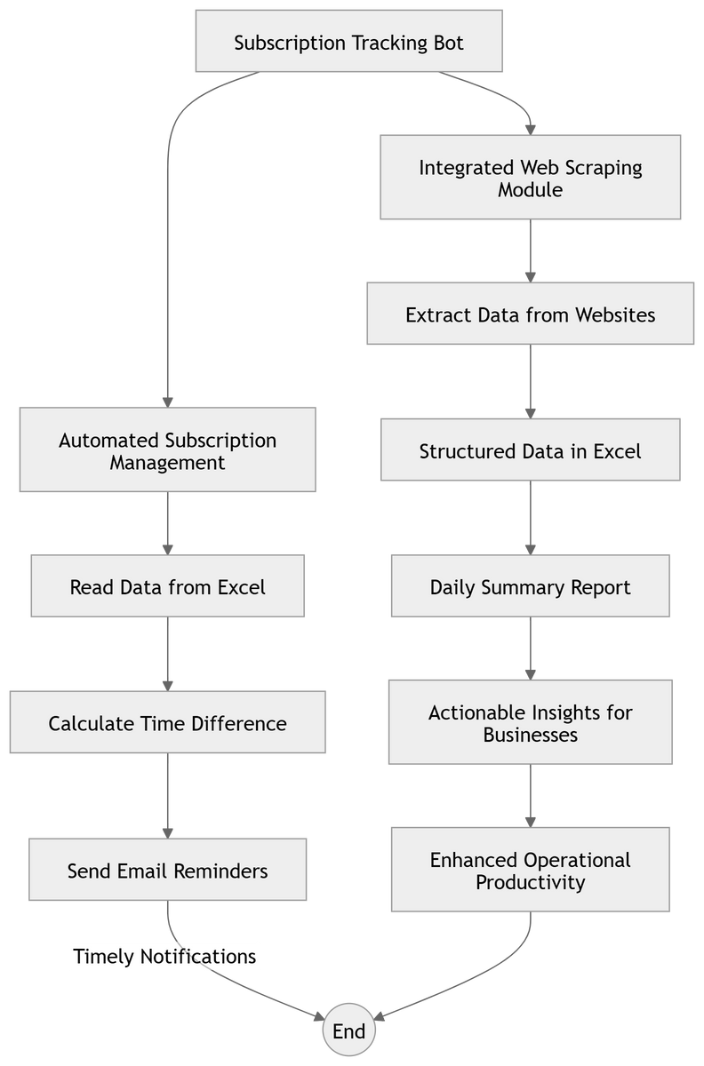
Architecture
Department of Computer Science and Engineering
Rajalakshmi Engineering College
7

Slide 8
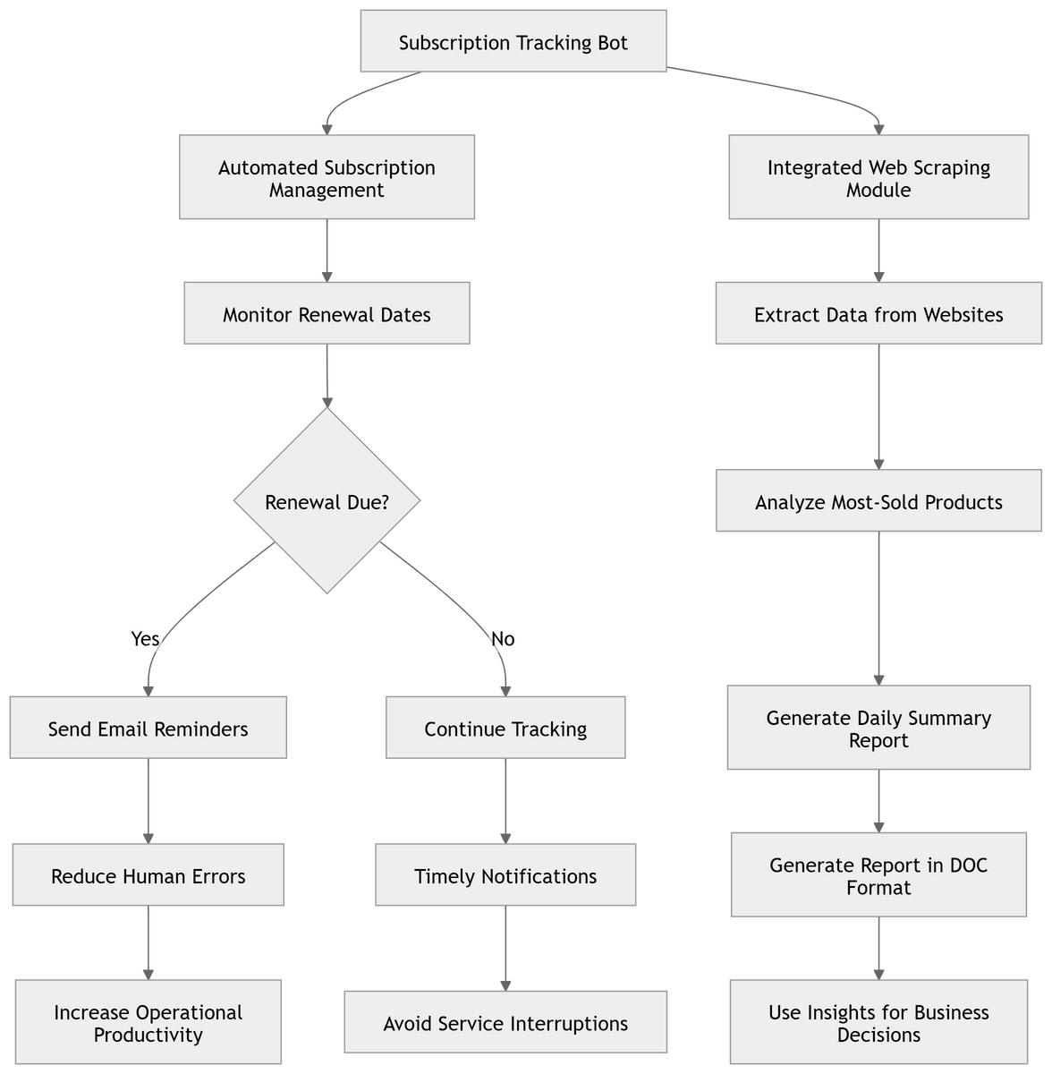
Activity Diagram
Department of Computer Science and Engineering
Rajalakshmi Engineering College
8

Slide 9
Functional Description
Subscription Tracking:
The system should read subscription data from an Excel sheet and identify subscriptions nearing renewal.
Automated Notifications:
Automatically send email reminders to subscribers when the renewal date is within three days.
Web Scraping:
Extract data from websites about product trends, frequently purchased items, and daily reviews.
Data Storage:
Save scraped data into an Excel file for further analysis.
Report Generation:
Generate daily reports in a document format summarizing the scraped data.
Department of Computer Science and Engineering
Rajalakshmi Engineering College
9

Slide 10
Functional Description
User Interface:
Provide a simple interface to upload the Excel sheet and configure email settings.
Error Handling:
Log errors encountered during the automation process for debugging and improvement.
Scalability:
Handle increasing amounts of subscription data and web-scraping sources efficiently.
Integration:
Support seamless integration with email servers and business workflows.
Department of Computer Science and Engineering
Rajalakshmi Engineering College
10

Slide 11
Results
Automated Subscription Tracking:
Subscriptions will be automatically monitored, and reminders will be sent to subscribers on time.
Data Collection:
The bot will gather product data from websites and store it in an organized Excel sheet.
Daily Reports:
The system will generate daily reports summarizing scraped data and subscription reminders.
Department of Computer Science and Engineering
Rajalakshmi Engineering College
11

Slide 12
Results
Email Notifications:
Automated reminders are sent to subscribers nearing renewal, with details like subscription name and renewal date.
Scraped Data Output:
Data from websites is saved in an Excel file, including product trends, top sellers, and reviews.
Daily Report:
A Word document is generated with a summary of scraped data, subscription reminders, and any errors.
Department of Computer Science and Engineering
Rajalakshmi Engineering College
12

Slide 13
Conclusion
The Subscription Tracking Bot developed using UiPath effectively automates subscription management, web scraping, and report generation. By reducing manual effort, it ensures timely subscription renewals and provides valuable insights through automated data extraction and reporting. This system enhances operational efficiency, minimizes errors, and improves customer engagement. Additionally, its scalability and adaptability make it suitable for businesses of various sizes, offering a reliable solution for subscription-based services. The project demonstrates the potential of Robotic Process Automation (RPA) in streamlining business processes, making them more efficient and cost-effective.
Department of Computer Science and Engineering
Rajalakshmi Engineering College
13

Slide 14
Thank You
Department of Computer Science and Engineering
Rajalakshmi Engineering College
14

