Slide 1
Multi-Model Article Classification System

Slide 2
INTRODUCTION
In the era of information overload, efficiently organizing and categorizing textual content has become a vital task across multiple domains. News agencies, content aggregators, and digital media platforms often face the challenge of sorting vast amounts of unstructured text data into meaningful categories for better user experience and content management. This project addresses this challenge by building a Multi-Model Article Classification System that leverages modern Natural Language Processing (NLP) techniques, including traditional Machine Learning, Deep Learning, and Transformer-based models from Hugging Face.
The goal of the project is to design and deploy a fully functional, scalable, and secure article classification platform. It classifies user-submitted news articles into one of several predefined categories—World, Business, Sports, science and Technology—using multiple models, allowing users to choose the best-performing model based on accuracy and confidence scores.

Slide 3
Steps to achieve streamlit app with model
Get the data from kaggle
Preprocessing
Vectorization
Tokenizer with sequence padding
Pretrained tokenizer
Model training
AWS RDS
Streamlit App Development and AWS deployment

Slide 4
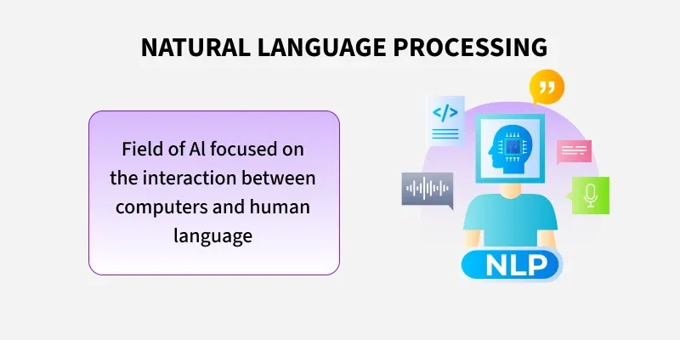
Natural Language Processing
Natural Language Processing (NLP) is a field that combines computer science, artificial intelligence and language studies. It helps computers understand, process and create human language in a way that makes sense and is useful. With the growing amount of text data from social media, websites and other sources, NLP is becoming a key tool to gain insights and automate tasks like analyzing text or translating languages.

Slide 5
Manual preprocessing
In TB datasets, normal cases often outnumber TB-positive cases, leading to biased model predictions.
To prepare the dataset for downstream NLP tasks, a comprehensive manual preprocessing pipeline was implemented. Initially, all HTML tags and embedded URLs were stripped to eliminate markup noise and external references. Emojis and punctuation were removed to ensure uniformity and reduce non-textual artifacts. Excess whitespace was normalized to maintain consistent token boundaries. The entire corpus was then converted to lowercase to standardize word forms and reduce vocabulary sparsity. Tokenization was performed to split the text into individual word units, followed by the removal of stopwords to retain only the most informative terms.

Slide 6
Vectorization
Traditional ML: Text data was transformed using TF-IDF, which assigns weights based on term frequency and inverse document frequency, helping highlight informative words while reducing noise from common terms.
Deep Learning: Employed a Tokenizer to convert text into integer sequences, followed by sequence padding to ensure consistent input length across samples for efficient neural network training.
Transformers: Used a pretrained tokenizer from Hugging Face to generate input IDs and attention masks, enabling the model to capture rich contextual relationships between words.

Slide 7
Logistic Regression
Logistic Regression was selected as a baseline classification model due to its simplicity, interpretability, and effectiveness on linearly separable data. The preprocessed text was vectorized using TF-IDF, transforming it into numerical features suitable for model training. The model was trained to predict binary or multi-class labels based on these features, optimizing the log-loss function using gradient descent. Performance was evaluated using metrics such as accuracy, precision, recall, and F1-score, providing insights into classification quality

Slide 8
GRU Model (Gated Recurrent Unit)
The GRU model was implemented to capture sequential dependencies in the text data, offering a lightweight alternative to LSTM with comparable performance. After tokenizing and padding the input sequences, the GRU architecture processed the data to learn contextual patterns over time. Its gating mechanism helped retain relevant information while mitigating vanishing gradient issues, making it suitable for text classification tasks. Model performance was evaluated using metrics such as accuracy and F1-score, demonstrating its ability to handle long-term dependencies efficiently

Slide 9
DistilBERT model
DistilBERT, a distilled version of BERT, was employed for efficient and high-performance text classification. It retains 97% of BERT’s language understanding while being faster and lighter, making it ideal for resource-constrained environments. Preprocessing involved using a pretrained tokenizer from Hugging Face to generate input IDs and attention masks. The model was fine-tuned on the labeled dataset, leveraging its deep contextual embeddings to capture semantic nuances. Evaluation metrics such as accuracy, precision, recall, and F1-score confirmed its superior performance compared to traditional models.

Slide 10
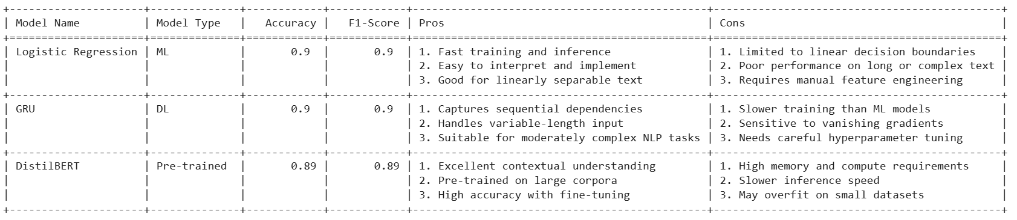
Classification-Models, Test Accuracy
Logistic regressor-0.90
GRU Model -0.90
DistilBERT model -0.89
News Article Classifier Comparison table

Slide 11
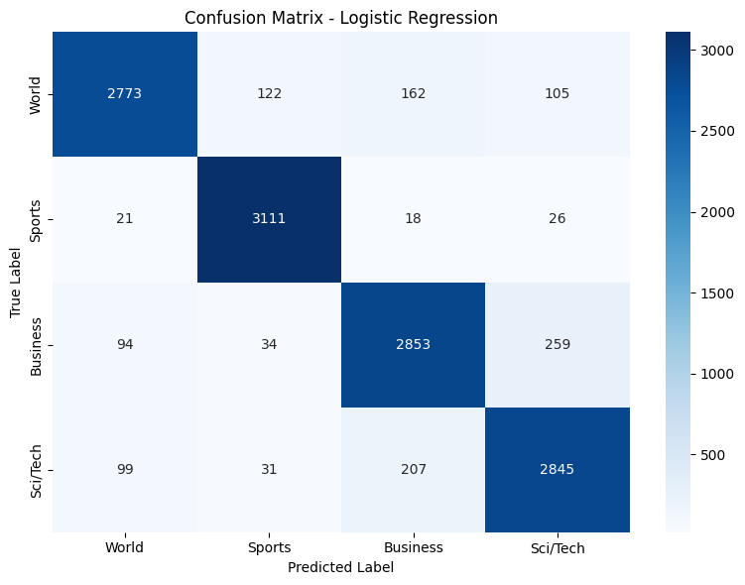
Logistic Regression
Confusion Matrix

Slide 12
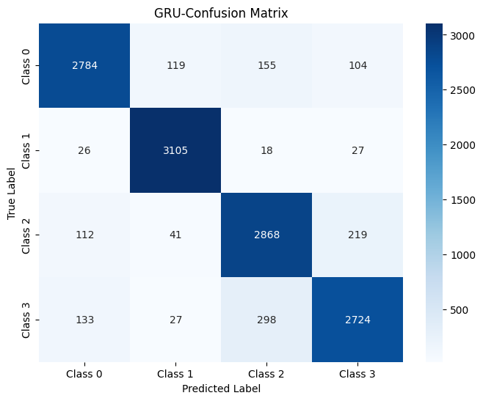
GRU Model Confusion Matrix

Slide 13
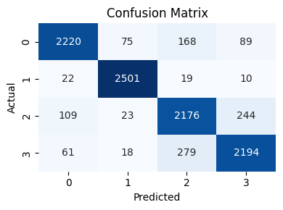
DistilBERT model Confusion Matrix

Slide 14
Streamlit App Development
An interactive ML dashboard was built using Streamlit, enabling users to input data, trigger predictions, and view results instantly. The app integrates model inference, preprocessing logic, and visual outputs in a single Python script, making deployment fast and modular. It was configured for public access via AWS EC2, with ports and firewalls adjusted to ensure secure connectivity. where users can paste or upload text content, and the app classifies it into predefined categories using trained ML,DL and transformer models based on user selection. This functionality showcases real-time NLP capabilities and supports practical use cases like content tagging and news filtering

Slide 15
AWS RDS
An Amazon RDS MySQL instance was provisioned to serve as the backend database for securely storing user login credentials and article-related data. The instance was configured with appropriate security groups, VPC settings, and public accessibility to enable remote connections from the deployed application. A dedicated user table was created to store fields such as username, article content, and timestamps. The application connects to RDS using a secure MySQL connector, allowing real-time authentication and user management. Additionally, article data is stored persistently to support future model updates and retraining, enabling the system to evolve with new content and improve classification accuracy over time
AWS Deployment
The machine learning models were deployed using Streamlit on an AWS EC2 instance, enabling real-time predictions through a web-based interface. The EC2 instance was configured with appropriate security groups to allow inbound traffic on port 8501 (Streamlit’s default) and port 22 for SSH access.

