Slide 1
Tuberculosis Detection Using Deep Learning

Slide 2
INTRODUCTION
This project focuses on building a deep learning-based system to detect tuberculosis (TB) from chest X-ray images. By applying transfer learning with models like ResNet50 and EfficientNetB0, the system classifies images as normal or TB-positive. It includes preprocessing, data augmentation, and performance evaluation. The final model is deployed via Streamlit on AWS, offering a user-friendly interface for real-time TB prediction supporting faster, more accessible diagnostics in healthcare.

Slide 3
Steps to achieve streamlit app with model
Get the data from kaggle
Get balanced dataset using data augmentation
Transfer learning models
Integrate with Mlflow
Streamlit App Development and AWS deployment

Slide 4
Computer vision
Computer Vision is a field of Artificial Intelligence that enables machines to interpret and understand visual data—images, videos, and even live camera feeds. It mimics human vision by extracting meaningful information from visual inputs and making decisions based on that data.
Role of Deep Learning in Computer Vision
Deep Learning has revolutionized Computer Vision by enabling machines to automatically learn hierarchical features from raw visual data—without manual intervention. Traditional methods relied on handcrafted features and rule-based algorithms, which struggled with complex, real-world scenarios. Deep learning, especially through Convolutional Neural Networks (CNNs), has overcome these limitations.

Slide 5
Get balanced dataset using data augmentation
In TB datasets, normal cases often outnumber TB-positive cases, leading to biased model predictions.
In TB datasets, normal cases often outnumber TB-positive cases, leading to biased model predictions.
Models trained on imbalanced data tend to favor the majority class, reducing sensitivity (true positive rate) for TB detection.
Augmenting TB-positive images (rotation, flipping, zooming, contrast adjustment) synthetically increases their count.
This helps the model learn diverse representations of TB features, improving generalization.

Slide 6
Transfer Learning
Transfer learning is a powerful deep learning technique that enables models to leverage knowledge gained from large-scale datasets and apply it to specific tasks with limited data. Instead of training a model from scratch, pre-trained networks like ResNet50, EfficientNetB0, and VGG16 are fine-tuned on the target dataset—in this case, chest X-ray images for tuberculosis detection.
This approach significantly reduces training time, improves model accuracy, and enhances generalization, especially in domains like medical imaging where labeled data is often scarce. By reusing learned features such as edges, textures, and shapes, transfer learning accelerates development and delivers high-performing diagnostic tools.

Slide 7
2023 MDPI study highlighted that transfer learning:
Improves accuracy in medical image classification.
Reduces resource requirements and training time.
Addresses class imbalance and enhances model robustness.
Multistage transfer learning further enhances performance by adapting features across domains with limited data.

Slide 8
Transfer Learning Models
ResNet50
ResNet50 is a deep convolutional neural network with 50 layers that uses residual connections to overcome vanishing gradients and enable training of very deep models. It's widely used for image classification tasks due to its strong performance and robustness.
EfficientNetB0
EfficientNetB0 is the baseline model of the EfficientNet family, designed using neural architecture search to optimize accuracy and efficiency. It balances depth, width, and resolution, achieving high performance with fewer parameters and faster inference.
VGG16
VGG16 is a deep convolutional neural network with 16 layers, known for its simple and uniform architecture using small 3×3 filters. Developed by the Visual Geometry Group at Oxford, it excels in image classification tasks due to its depth and consistent structure.

Slide 9
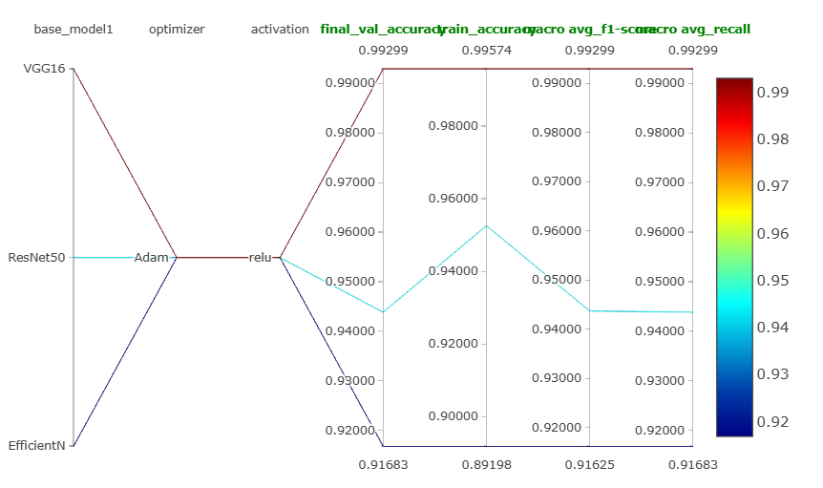
Integrate with Mlflow
Integrating MLflow enables efficient model tracking, version control, and reproducibility in Deep learning workflows.

Slide 10
Classification-Models, Test Accuracy
Resnet50-0.9439
VGG16-0.9930
EfficientNetB0 -0.9168

Slide 11
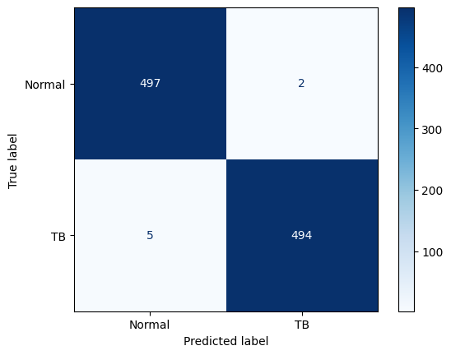
Final Classification model-VGG16
Confusion Matrix-VGG16

Slide 12
Streamlit App Development
Transfer learning
Transfer learning is a technique where a pre-trained model is adapted to a new task, allowing it to leverage existing learned features. It is especially useful when the target dataset is small, improving accuracy and reducing training time.
Final Classification Model Selection-VGG16
VGG16 was selected as the final classification model due to its proven reliability, simplicity, and strong performance in medical imaging tasks.
Fine-tuning VGG16 using transfer learning allowed the model to adapt to the TB dataset efficiently, achieving high accuracy and generalization even with limited data
Early and Accurate prediction
The final TB detection system is deployed as a Streamlit web application, enabling users to upload chest X-ray images and receive instant predictions. Once an image is uploaded, the app preprocesses it and passes it through the fine-tuned VGG16 model, delivering a clear classification either Normal or TB-positive

Slide 13
AWS Deployment
Full control over environment and dependencies.
Scalable compute—choose CPU or GPU instances as needed.
Global access with low latency for real-time predictions.
Secure and cost-effective, with pay-as-you-go pricing

