Slide 1
Human Voice Classification and Clustering

Slide 2
INTRODUCTION
Human voice classification and clustering are powerful techniques in speech analytics and machine learning that aim to
analyze,
categorize and based on their acoustic features.
These methods are widely used in applications like speaker identification, gender recognition, emotion detection.

Slide 3
Steps to achieve streamlit app with model
Exploratory Data Analysis (EDA)
preprocessing
Voice Classification models
Voice Cluster Models
Integrate with Mlflow
Streamlit App Development with voice prediction

Slide 4
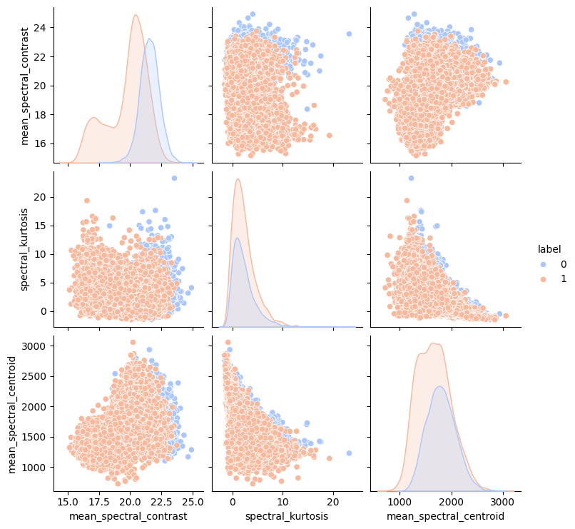
Exploratory Data Analysis (EDA)

Slide 5
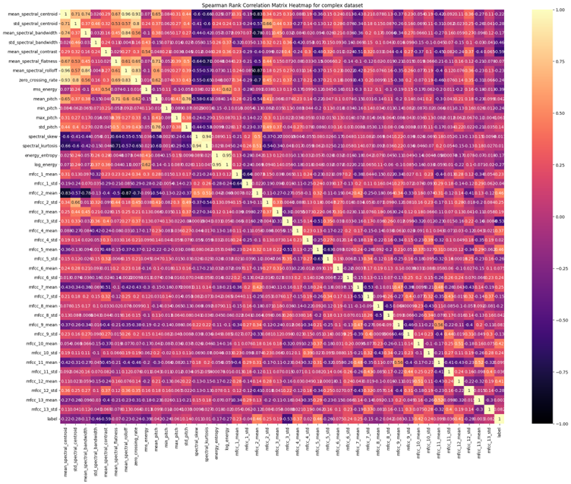
Correlation heatmap
The heatmap indicates that the dataset is complex

Slide 6
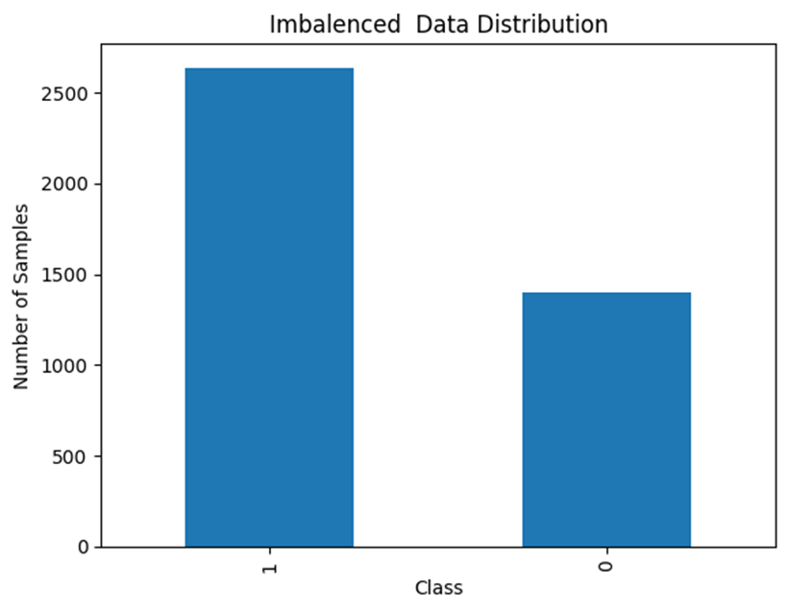
Preprocessing
The Synthetic Minority Over-sampling Technique (SMOTE) was applied to address class imbalance, resulting in a more balanced dataset

Slide 7
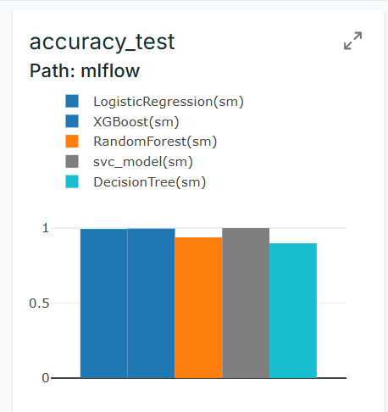
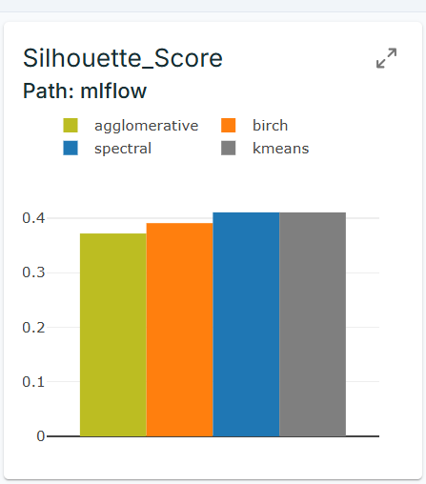
Integrate with Mlflow
Integrating MLflow with DagsHub enables efficient model tracking, version control, and reproducibility in machine learning workflows. By storing experiment results in a DagsHub repository, and select the best-performing model

Slide 8
Classification-Models, Test Accuracy
LogisticRegression-0.99
Decision Tree-0.89
Random Forest-0.99
XGBoost-0.99
SVC-0.99

Slide 9
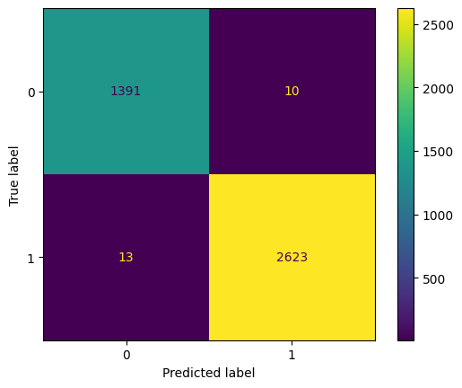
Final Classification model-XGboost
Confusion Matrix-XGBoost
Compared to alternative models, this one demonstrates enhanced computational speed, resulting in faster execution

Slide 10
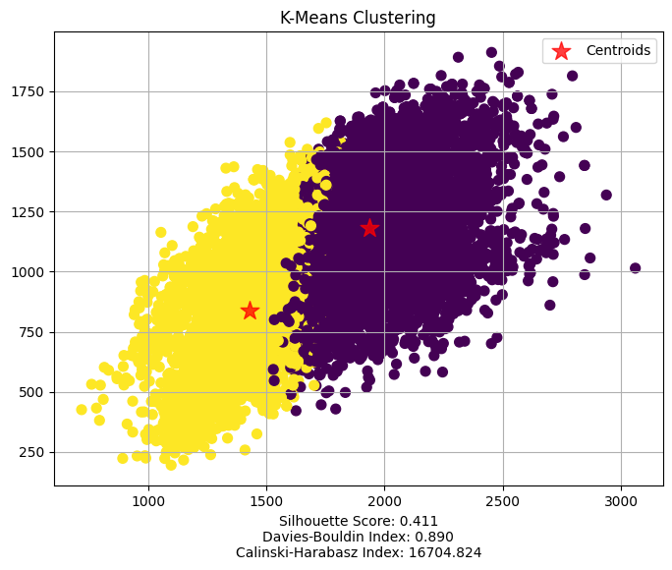
Clustering-Models, silhouette score
K-Means Clustering-0.411
SpectralClustering-0.411
Birch clustering-0.391
Agglomerative Clustering-0.372
K-Means clustering is approximately three times faster than Spectral Clustering and also outperforms other algorithms across key performance metrics

Slide 11
Streamlit App Development
Exploratory Data Analysis part visualized
Exploratory Data Analysis was conducted to understand the dataset's structure and relationships between features.
Final Classification Model Selection –XGBoost classifier
After comparing multiple models, XGBoost classifier was chosen as the best predictive model. The performance metrics accuracy_score, precision_score, recall_score, f1_score visualized
Final Clustering Model Selection –k means cluster
After comparing multiple models, k means cluster was chosen as the best predictive model. The performance metrics silhouette_score, davies_bouldin_score, calinski_harabasz_score visualized
Customer Human Voice prediction done
The trained XGBoost classifier model was integrated into a Streamlit-based web application, allowing to enter the values and receive real-time predictions.

