Slide 2
DDL & DML COMMANDS
By: Shanmuk Kumar Gunnam
February 5, 2024

Slide 3
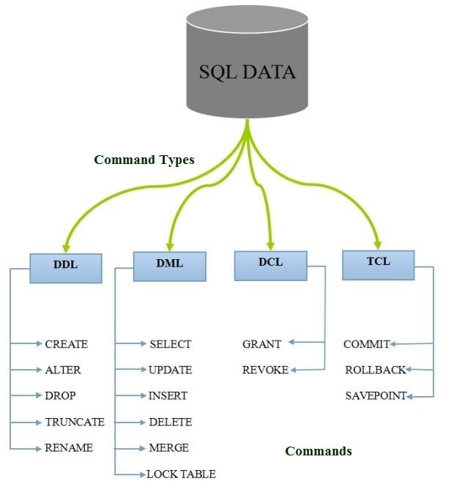
Types of SQL Commands

Slide 4
Data Definition Language (DDL)
DDL changes the structure of the table like creating a table, deleting a table, altering a table, etc.
CREATE: It is used to create a new table in the database.
Syntax:
CREATE TABLE TABLE_NAME (COLUMN_NAME DATATYPES[,....]);
DROP: It is used to delete both the structure and record stored in the table.
Syntax:
DROP TABLE table_name;

Slide 5
ALTER: It is used to alter the structure of the database. This change could be either to modify the characteristics of an existing attribute or probably to add a new attribute.
Syntax:
ALTER TABLE table_name ADD column_name COLUMN-definition;…………..(To Add the new Row).
ALTER TABLE table_name MODIFY(column_definitions....); …………….(To modify the existing Row ).
TRUNCATE: It is used to delete all the rows from the table and free the space containing the table.
Syntax:
TRUNCATE TABLE table_name;

Slide 6
Data Manipulation Language(DML) COMMANDS
DML commands are used to modify the database. It is responsible for all form of changes in the database.
INSERT: The INSERT statement is a SQL query. It is used to insert data into the row of a table.
Syntax:
INSERT INTO TABLE_NAME
(col1, col2, col3,.... col N)
VALUES (value1, value2, value3, .... valueN);
UPDATE: This command is used to update or modify the value of a column in the table.
Syntax:
UPDATE table_name SET [column_name1= value1,...column_nameN = valueN] [WHERE CONDITION]
DELETE: It is used to remove one or more row from a table.
Syntax:
DELETE FROM table_name [WHERE condition];

Slide 7
Data Query Language(DQL) COMMAND
SELECT: This is the same as the projection operation of relational algebra. It is used to select the attribute based on the condition described by WHERE clause.
Syntax:
SELECT expressions
FROM TABLES
WHERE conditions;

