Slide 1
Machine Translation between Tamil and English using Transformer Model’s Positional Encoders.
CSE3013: Artificial intelligence - review 3
Dr. Pradeep k.v
By K Shanmukapriya - 20BCE1803
G nikhil vaidhyanathan - 20BCe1898

Slide 2

Abstract
AI and NLP have led to the development of very advanced machine translation systems which can translate text from one language to another.
Tamil is a language spoken by over 70 million people globally and there is a growing need for accurate and efficient translation systems that can translate Tamil text into English and vice versa.
This project proposes a model for Tamil to English and English to Tamil translation using Transformer model’s positional encoder and AI concepts.
The model is trained using parallel corpus data and we observe the model's results and performance to arrive at a conclusion, there are many limitations and drawbacks to this.
We elucidate the effectiveness of Transformer model for Tamil to English and English to Tamil translation, and the potential of AI for improving the machine.
K Shanmukapriya-20Bce1803 ; g Nikhil vaidhyanathan-20bce1898

Slide 3
Problem statement
“Machine Translation between Tamil and English using Transformer Model’s Positional Encoders.”

Slide 4
Transformer model’s Positional encoding

Slide 5
What is positional encoding?
To encode the position of words in the input sequence, positional encoding is a technique used in Transformer-based models for language translation.
Transformers process every word in parallel, so the model must be able to distinguish between words based on where they are in the input sequence.
In other words, positional encoding tells you where a word is in relation to other words in the input sequence. The encoding is learned during training and added to the input embeddings.
For the Transformer model to be successful in language translation tasks, positional encoding is essential because it enables the model to comprehend the context of the words in the sequence and enhance the accuracy of the translations.

Slide 6
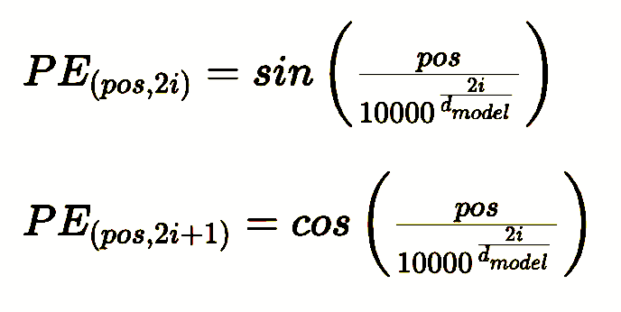
Sine-cosine function

Slide 7



Example
As an example, let's consider the sentence "I love cats". In this case, the first token "I" will have a positional encoding of (2):
(2)
And the second token "love" will have a positional encoding of (3):
(3)
Similarly, the third token "cats" will have a positional encoding of (4):
(4)

Slide 8
Results

Slide 9
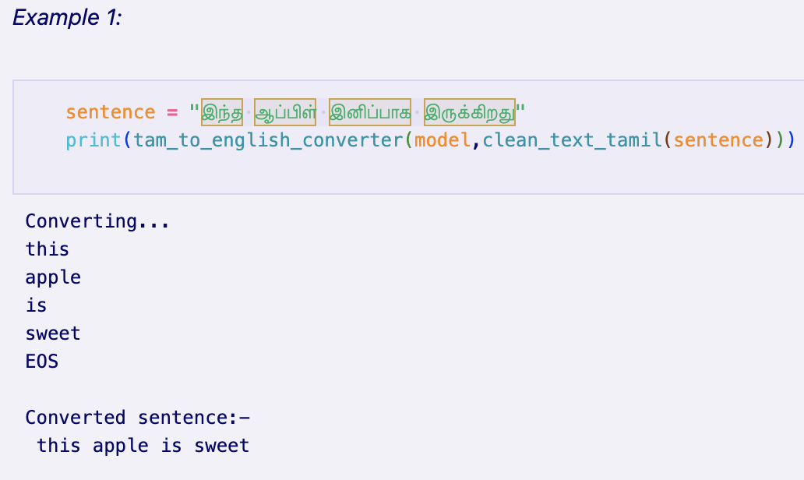
Tamil to English translation

Slide 10
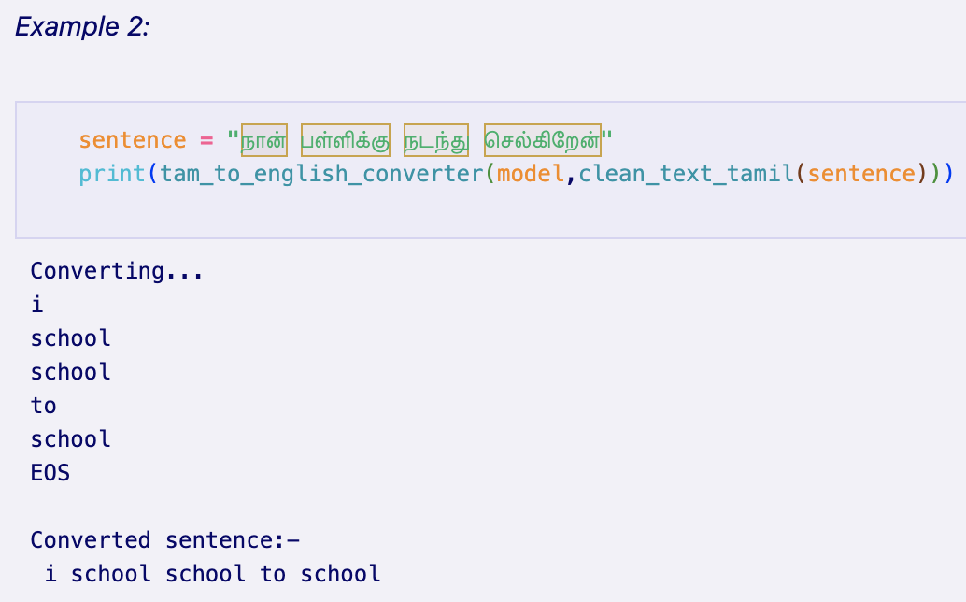
Tamil to English translation

Slide 11
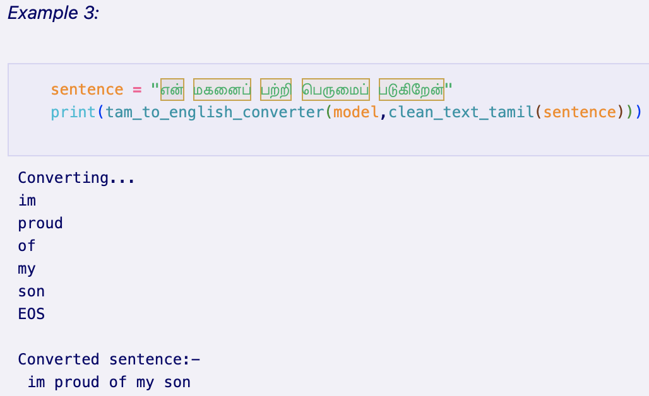
Tamil to English translation

Slide 12
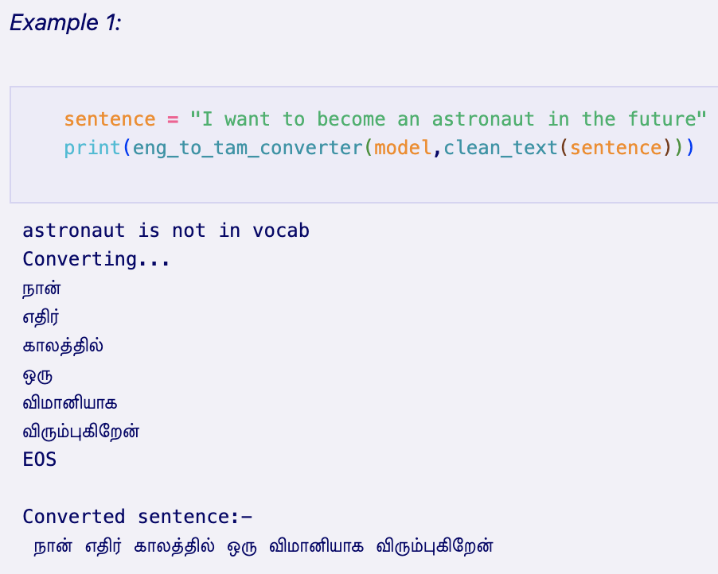
English to Tamil translation

Slide 13
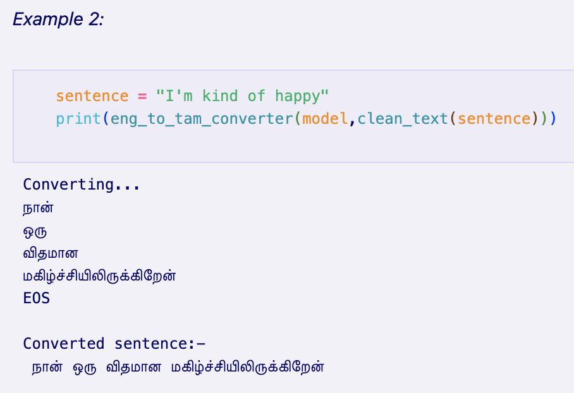
English to Tamil translation

Slide 14
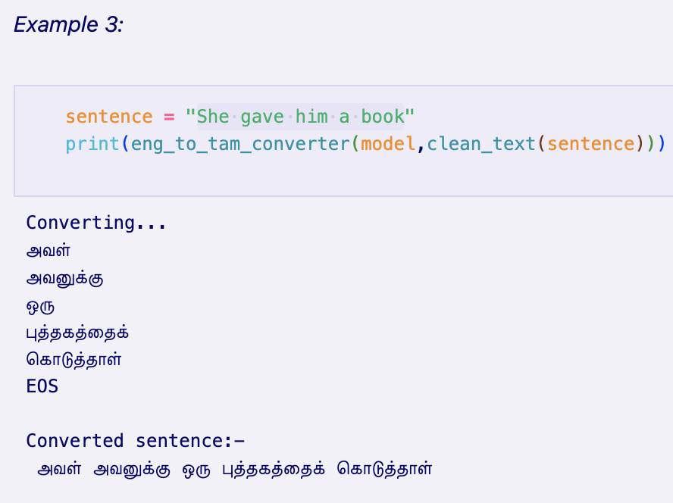
English to Tamil translation

Slide 15
Drawback example

Slide 16
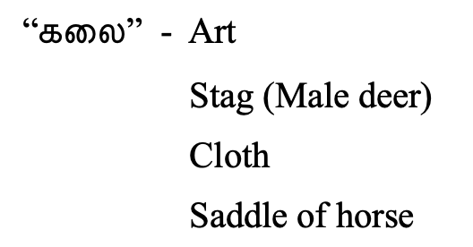

Slide 17
Thank you

