Slide 1

MediMetrics
Hospital Operations & Patient Flow Analytics
From raw data to decisions: Python · MySQL · SQL · Power BI
75,000
2022–2024
14
appointments
three full years
specialties
Notes:
Welcome. MediMetrics is an end-to-end analytics project on 75,000 hospital appointments from 2022 to 2024. In ten slides: the business problem, the data pipeline, the SQL findings, the Power BI dashboard, and what the hospital should do next.

Slide 2



The business problem
Where are appointments lost, and where can patient flow improve?
How many appointments are completed, cancelled or missed?
75,000
32,705
appointments
unique patients
Which specialties and doctors carry the load and the revenue?
320
36
doctors
hospitals in 15 cities
How do waiting time and satisfaction differ by department?
14
3 years
medical specialties
Jan 2022 – Dec 2024
Notes:
The hospital group wants to know where it loses appointments and where care delivery can improve. The dataset is large enough to be reliable: 75,000 appointments, 32,705 patients, 320 doctors across 36 hospitals.

Slide 3





From raw data to dashboard
A five-step, reproducible pipeline
1. Raw CSV
2. Python
3. MySQL
4. SQL
5. Power BI
Appointments (75,000 × 52) and doctors (320 × 15)
Audit, clean and engineer features in pandas notebooks
Cleaned tables loaded into the medimetrics database
10 business queries answer the key questions
3-page dashboard with 11 DAX measures
Project folders: data/processed · notebooks · sql · dashboard
Notes:
Raw CSVs are audited and cleaned in Python, loaded into MySQL, analysed with ten SQL queries, and finally presented in Power BI. Every step lives in the repository, so the work can be reproduced.

Slide 4
Data audit and cleaning
Every blank was explained before it was filled or left alone
Check | Finding | Action
Duplicates | None in appointment_id or doctor_id | No action needed
Insurance provider | 68.7% blank, exactly the uninsured patients | Filled “Not Insured”
Chronic condition, membership | 37.4% and 77.6% blank | Filled “Unknown”
Wait time, satisfaction | Blank for all 19,725 non-completed visits | Kept empty by design
Status vs no-show flag | 100% consistent (11,584 no-shows) | Verified
0
duplicate records
52 → 57
columns after 5 engineered features
26.3%
metrics blank by design
Notes:
The audit found no duplicates and explained every missing value. Insurance provider is blank exactly when the patient has no insurance. Waiting time and satisfaction exist only for completed visits, so they are deliberately left empty for the rest. Five features were added, such as is_weekend and lead_time_category.

Slide 5
Three in four visits are completed
SQL Q1, Q3 and Q4: overall performance and appointment status
73.7%
completed (55,275 visits)
15.45%
no-shows, twice the 7.72% cancelled
17.33%
of resolved visits missed (11,584 of 66,859)
Notes:
Of 75,000 appointments, 73.7% were completed. No-shows are the main leak: 15.45% of all appointments, twice the cancellation rate. Counting only resolved visits, the completed plus no-show ones, 17.33% are missed, about one in six. The 3.13% scheduled are all in December 2024.

Slide 6
No-shows cluster in a few places
SQL Q5 and Q9: no-show rate (% of resolved visits)
26.6%
Psychiatry, the highest specialty
22.7% vs 15.4%
Walk-In vs Apollo App bookings
18.5%
for bookings made 8–30 days ahead
Notes:
Psychiatry, Dermatology and ENT lose the most visits; Neurology loses the fewest at 11.67%. By channel, walk-in bookings are missed most at 22.7% while the Apollo App is lowest at 15.4%. Bookings made 8 to 30 days ahead are missed 18.5% of the time, versus 13.4% for 1 to 2 days.

Slide 7
Volume is not the same as value
SQL Q7, Q8 and Q10: revenue per completed visit by specialty
9.48M
General Physician: top total revenue, 14,981 visits
633 vs 2,640
per visit: General Physician vs Psychiatry
11–12 min
wait; satisfaction 4.02–4.10 in every specialty
Notes:
General Physician earns the most in total, 9.48 million, but only through volume: 633 per visit. Psychiatry earns 2,640 per visit and Neurology 2,076. Total revenue across specialties is 73.89 million. Waiting time, 11.2 to 12.0 minutes, and satisfaction, 4.02 to 4.10, are almost identical everywhere, so they are not the main improvement lever.

Slide 8
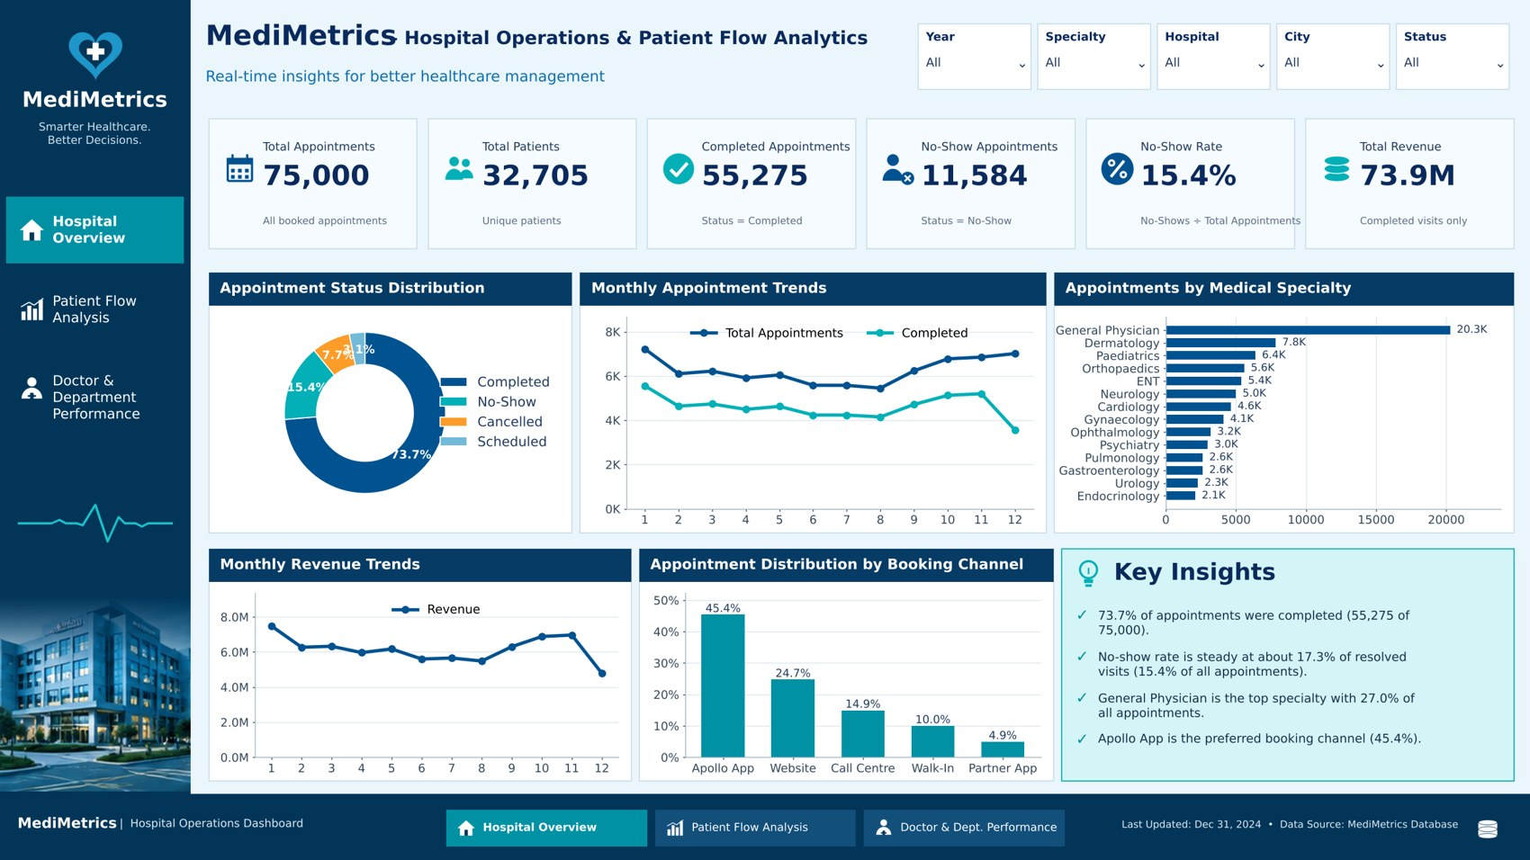
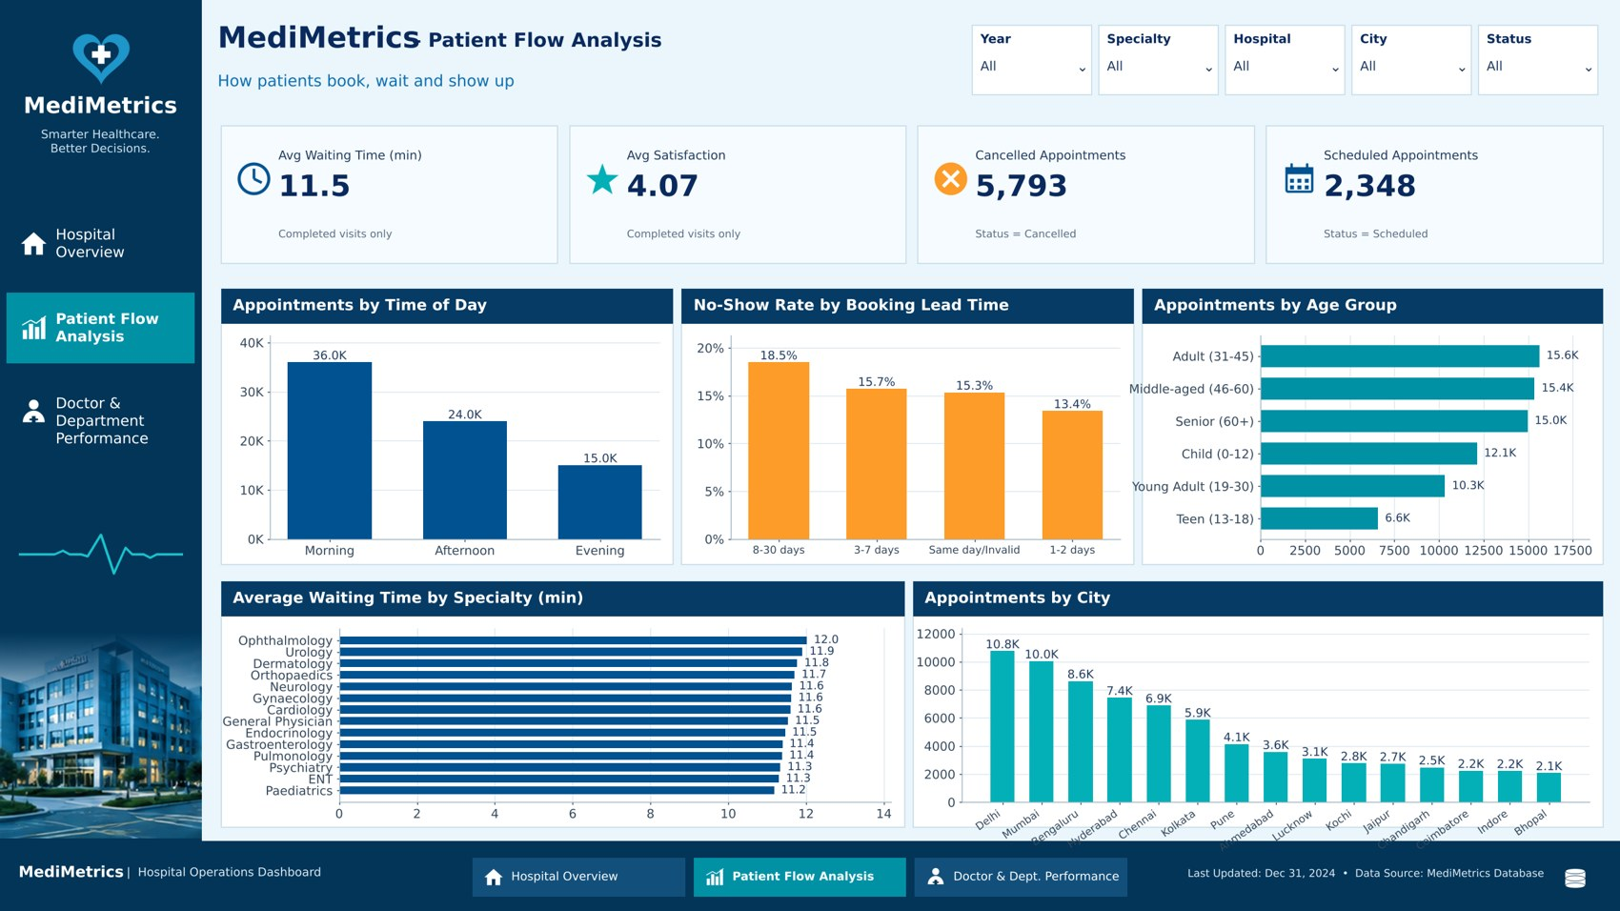
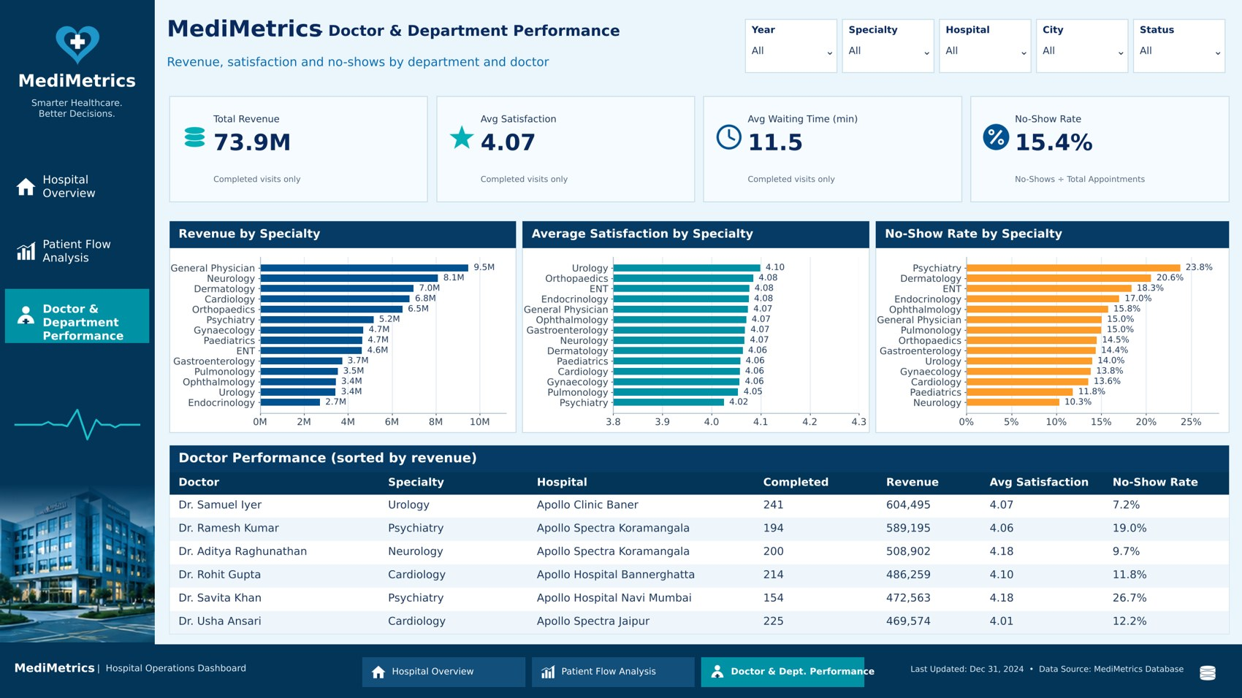
The Power BI dashboard
3 pages · 11 DAX measures · 5 synced filters (Year, Specialty, Hospital, City, Status)
Patient Flow Analysis
Hospital Overview: KPIs, status mix, trends, specialties, channels
Doctor & Department Performance
Notes:
The dashboard has three navigable pages: Hospital Overview, Patient Flow Analysis, and Doctor and Department Performance. Five slicers stay in sync across pages. The model links appointments to doctors many-to-one. The previews on this slide are rendered from the project data; the live .pbix has working filters and navigation.

Slide 9




What the hospital should do
Four actions, ordered by expected impact
Remind and confirm
Overbook with care
Reminders or confirmation calls for Psychiatry, Dermatology, ENT and bookings made 8–30 days ahead
Controlled overbooking in the high no-show specialties, with a waiting list for freed slots
Move walk-ins to the app
Review General Physician mix
Apollo App no-shows are 15.4% against 22.7% for walk-ins, and it already carries 45% of bookings
27% of volume but the lowest revenue per visit (633 vs 2,076–2,640 in Neurology and Psychiatry)
Notes:
The strongest lever is reducing no-shows. Target reminders where the rate is highest, use controlled overbooking, steer walk-ins to the app, and review how General Physician visits are priced and mixed.

Slide 10
Conclusion and data notes
A complete pipeline from raw CSV to a three-page dashboard
SQL counts reconcile with the dashboard KPIs
No-shows are the biggest and most fixable leak
Read results with these notes
December 2024 is incomplete: all 2,348 appointments are still Scheduled
No-show rate is 17.3% of resolved visits (SQL) or 15.4% of all appointments (Power BI)
The calendar table is not yet related, so monthly charts use month numbers
Revenue has no currency symbol in the data
Next step: reload final December 2024 data and relate the calendar table.
Notes:
To close: the pipeline works end to end and the numbers reconcile between SQL and Power BI. Two things to keep in mind when reading results: December 2024 is incomplete, and the two no-show definitions differ. Next steps are to load final December data and connect the calendar table so monthly charts show month names.

