Slide 1
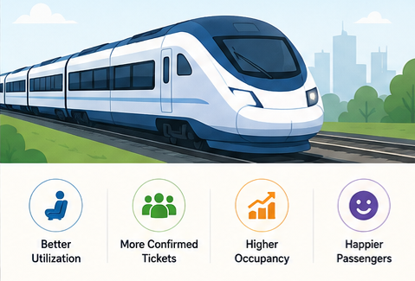
Smart Train Seat Allocation System
- Improving train seat utilization through segment-based seat allocation.
Presented By:
Agithe Yeshwanth - MT25059

Slide 2

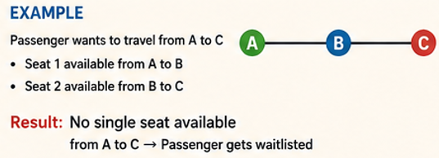
Current Challenges in Train Reservations
Seats are allocated only if available for the entire journey.
Many seats remain partially unused between stations.
Passengers may remain on the waiting list despite available seat segments.
Railway resources are not utilized efficiently.

Slide 3
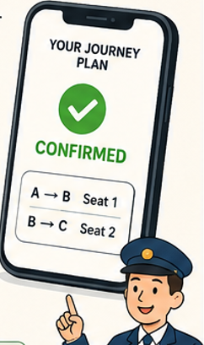
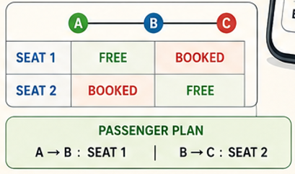
Smart Segment-Based Seat Allocation
Divide the train route into station segments.
Check seat availability for each segment.
Allocate a single seat if available.
Otherwise, suggest seat changes at intermediate stations.
Generate a complete travel plan for the passenger.

Slide 4
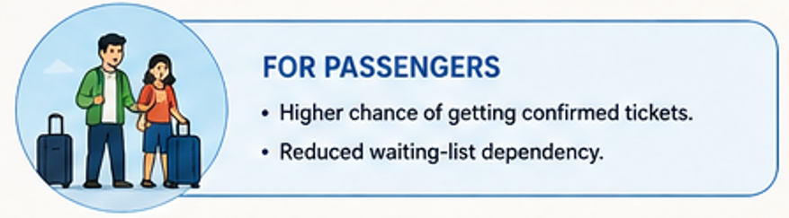
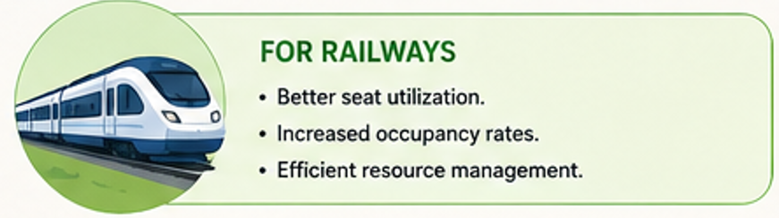
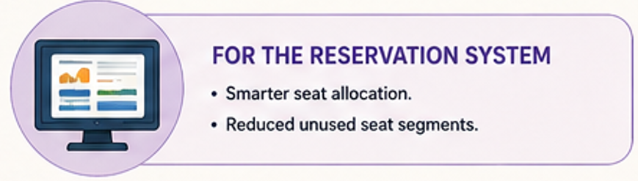
Advantages of the System

Slide 5
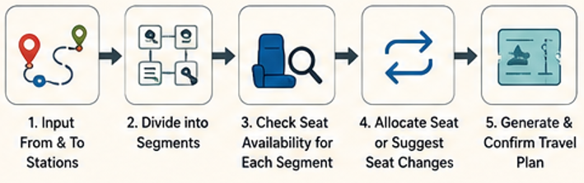
Why Is It Not Commonly Used?
Passengers may need to change seats during the journey.
Reservation calculations become more complex.
Group bookings are harder to manage.
Real-time updates are required after cancellations.

Slide 6
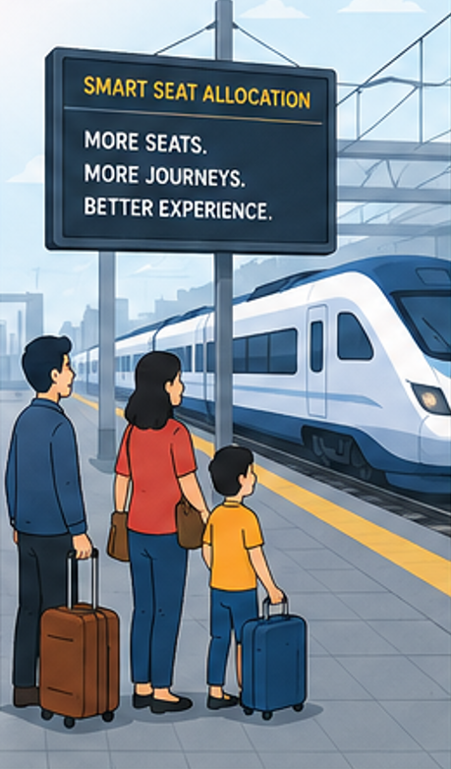
Who Will Benefit?
Primary Users
  Train passengers.
  Waiting-list passengers.
  Frequent travelers.
Expected Impact
  More confirmed tickets.
  Better passenger satisfaction.
  Improved railway efficiency.

Slide 7
Conclusion
Current reservation systems may leave seats partially unused.
Smart Segment-Based Seat Allocation utilizes these unused segments.
Passengers receive more confirmed tickets.
Railways achieve better seat utilization and operational efficiency.

