Slide 1

IMPROVING INTELLIGIBILITY OF DYSARTHRIC SPEECH
IDEATION
Team TRANSFORMERS
"Freedom is the right of all sentient beings."

Slide 2
INTRODUCTION
Dysarthria:
Dysarthria refers to a group of speech disorders resulting from disturbances in muscular control of speech mechanism due to a damage in the central or peripheral nervous system.
Intelligibility:
Intelligibility is a measure of how comprehensible speech is in given conditions.

Slide 3
PROBLEM STATEMENT
To improve intelligibility and comprehensibility of dysarthric speech.
Using Machine Learning approach to transfer characteristics of normal speech to dysarthric speech.

Slide 4
APPROACH
Dataset
Data Pre-processing
DL Model Training
Deployment

Slide 5
DATASET
There are many publicly available datasets of dysarthric speech.
TORGO Database, UASpeech Database
Dataset mainly contains following
Audio samples of person with Dysarthric voice (Dysarthric speaker)
Audio samples of person with Normal voice (Normal speaker)
All digits, letters, common words and Uncommon words are recorded

Slide 6
DATA PRE-PROCESSING
Audio signal is converted into wideband spectrogram using Short-Time Fourier Transform (STFT) with windows of 512 frames and 33% overlap.
Converted to wideband spectrograms ranging from 100-200Hz, which allows for high quality output in the time resolution.
Spectrogram is then converted to dB amplitude scale, and padded with white noise to generate 128x128 pixels images.

Slide 7
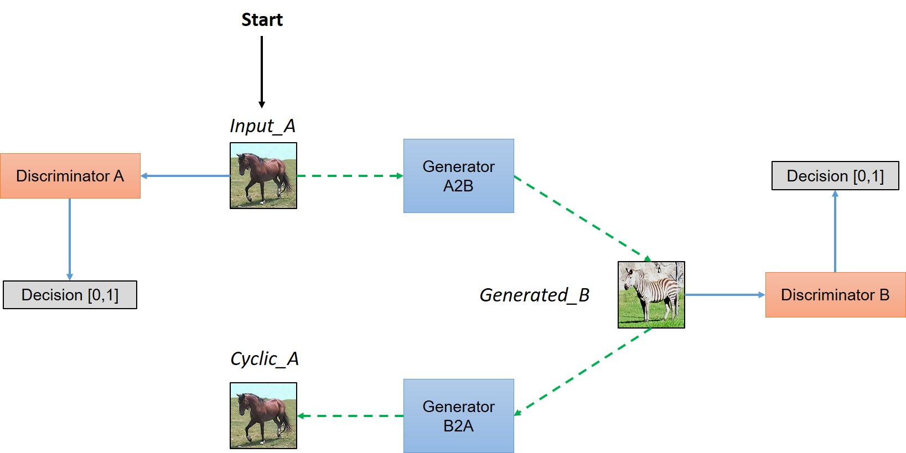
DEEP LEARNING MODEL
CycleGAN is used to transfer characteristics of Normal speech to Dysarthric speech
Ref: Understanding and Implementing CycleGAN in TensorFlow

Slide 8
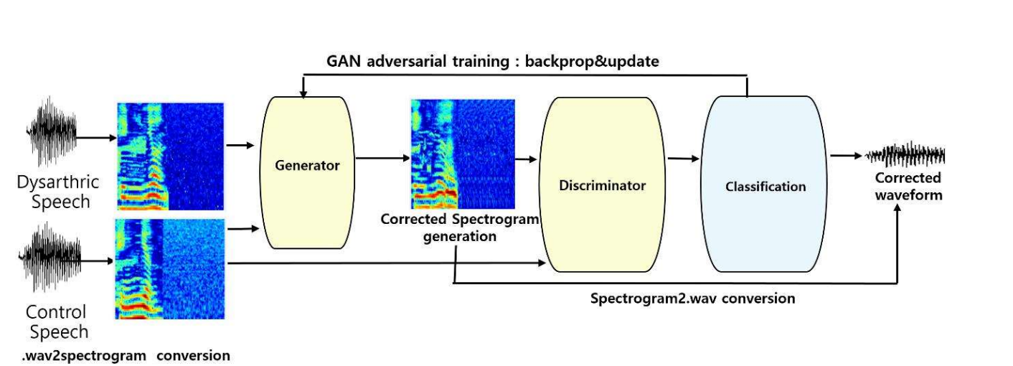
TRAINING FLOW
Ref: Improving Dysarthric Speech Intelligibility Using Cycle-consistent Adversarial Training

Slide 9
MODEL TRAINING
All the wave signals are converted to spectrogram images as mentioned in preprocessing step.
Samples are then divided into Training and Validation data.
Training data is used to train GAN network.
Validation data is used to improve the model’s performance further.
Evaluation metric: Phoneme Error Rate (PER)
During inference, the generated spectrogram is then decoded into WAV format

Slide 10
DEPLOYMENT
The trained model can then be deployed into a web app.
Dysarthric audio can be uploaded which is converted to Normal audio which can be downloaded from the site.
Metrics and spectrograms can also be seen on the other page of web app

