Slide 1
Summary and conclusion

Slide 2
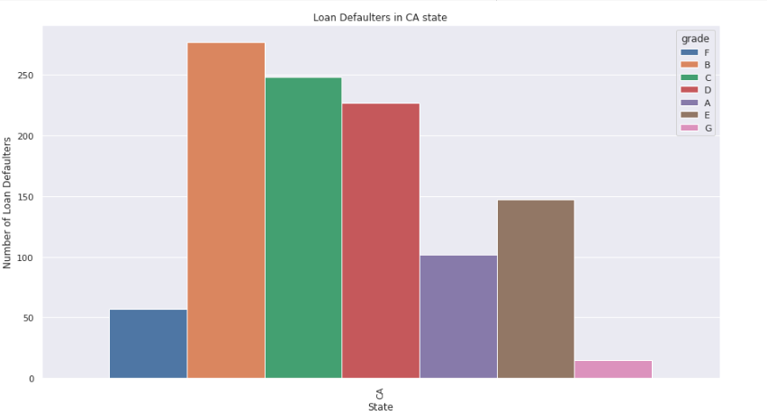
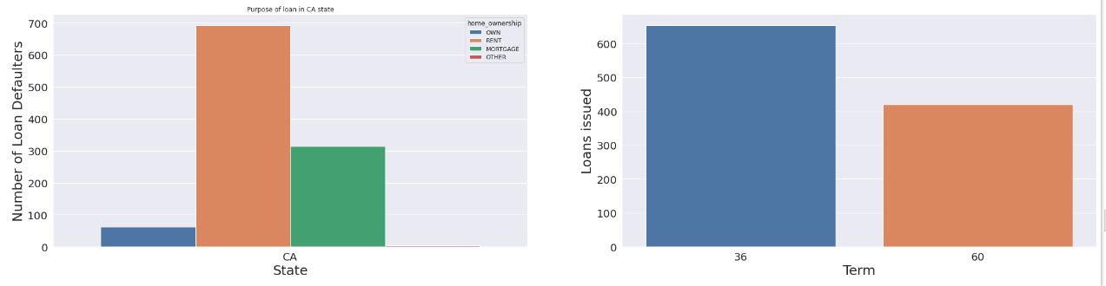
Based on State
We were able to infer from the information that there are more loan applicants with Grades B and C, California has the highest number of applications, and the majority of applicants have applied for loans for rent and mortgages having a 36-month duration.

Slide 3
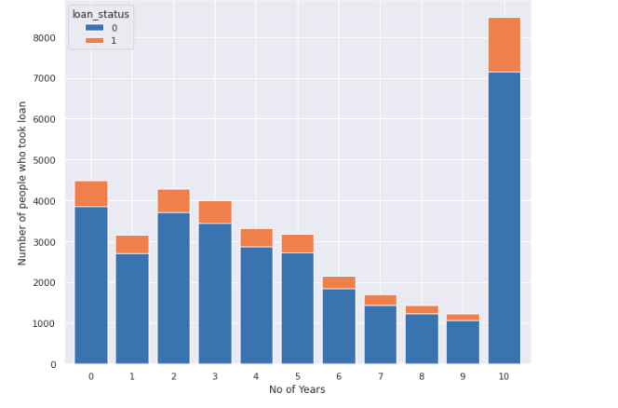
Based on Employee length
When we look at the group of members with 1 to 9 years of work experience, the tendency of defaulters is decreasing, but it abruptly increases when we look at members with 10 and more years of work experience.

Slide 4
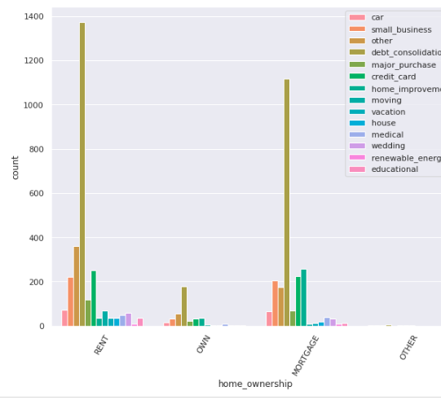
Based on Home ownership
when debtors don't own their own homes, one should be caution when approving debt consolidation, credit cards, home improvements and small business loans.

Slide 5
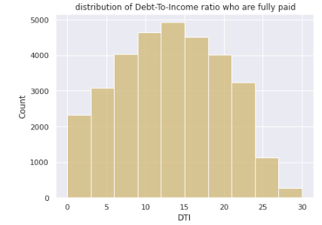
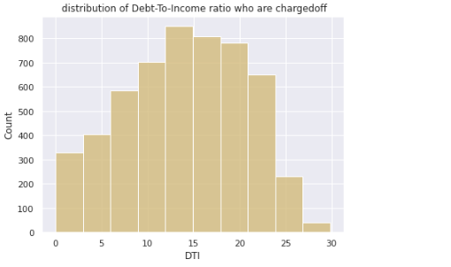
Based on DTI
Around 13-15% debt-to-income ratio is maintained while taking loans who are fully paid and charged-off

Slide 6
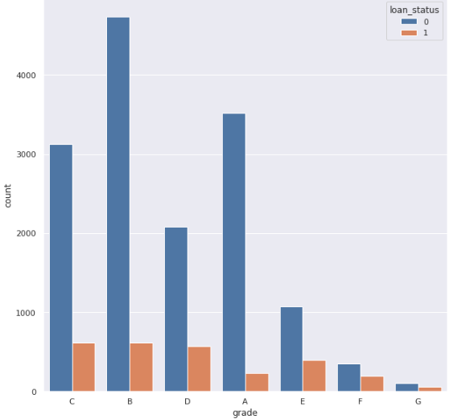
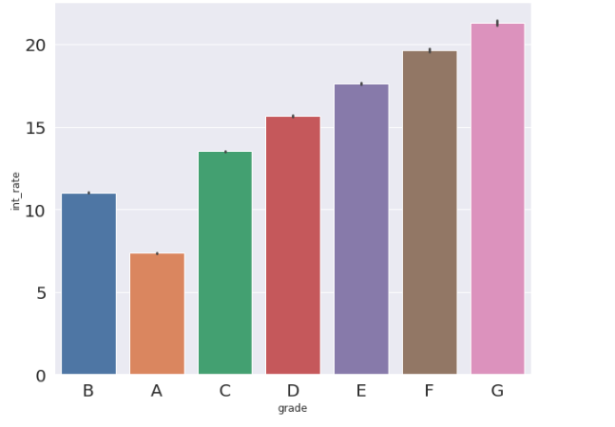
Based on Grade
Based on Grade, Interest rate is being decided i.e; lower the grade higher the interest rate. Due to this reason people belonging to lower grade are not showing interest to take loans.

Slide 7
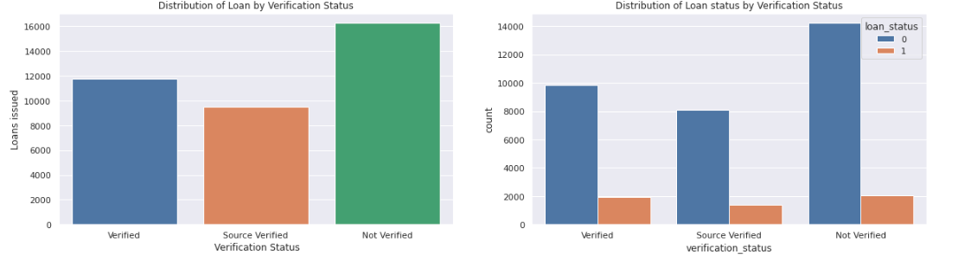
Based on Verification status
We can infer that loans are issued more to the people whose income status is not verified and defaulters are also more.

Slide 8
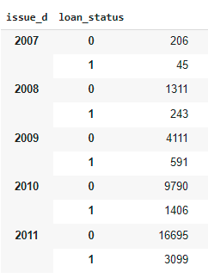
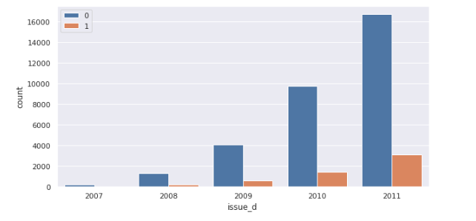
Based on Year.
Number of loans issued increased steadily by every year.

