Slide 1

Road Detection using Satellite images
By Group 15
Shanmukha Datta Koganti
Prasad Reddy Nandi
Izzaz ALI

Slide 2
Topics:
Problem Statement
Data Used
Pre-Processing
Methodology
Results

Slide 3
PROBLEM STATEMENT:
Main aim of our project is to develop an image segmentation algorithm that accurately delineates roads from satellite imagery using hybridized edge detection and adaptive thresholding techniques.
Data Used:
The Data we used is provided by our professor aerial agricultural images exhibiting patterns for segmentation; roads and fields are visible for algorithmic processing and feature extraction.

Slide 4
Pre-Processing:
Grayscale Conversion: Transforms to single-channel grayscale.
Intensity Normalization: Scales pixel values for uniformity.
Adaptive Histogram Equalization: Balances contrast across image.
CLAHE Application: Applies localized contrast enhancement.
Gaussian Blurring: Smoothens image, reduces detail and noise.

Slide 5
Methodology
Below are the different image segmentation methods we have done for road detection:
Sobel edge detection
Canny edge detection
Laplacian edge detection
Hybrid Sobel-Canny edge detection method
Hybrid Sobel-Laplacian edge detection method
Hybrid Laplacian-Canny edge detection method
Adaptive Thresholding with Canny

Slide 6
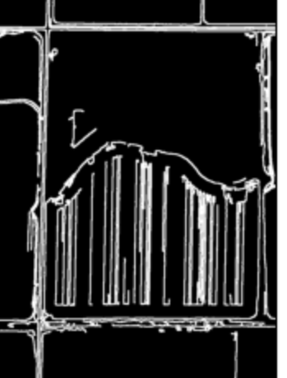

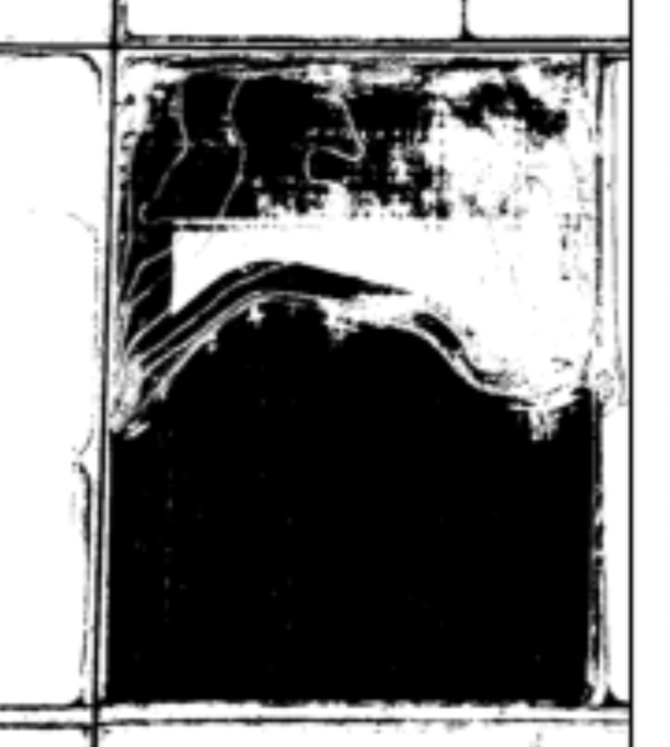
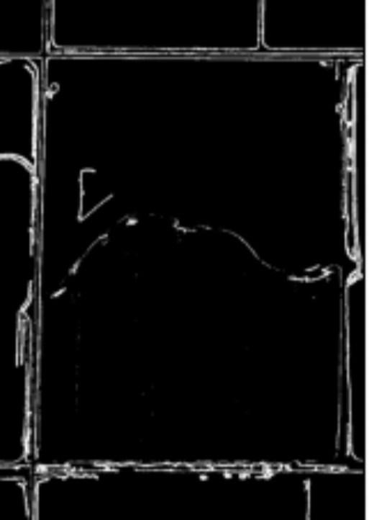
Hybrid canny-sobel Method:
Original Image
Canny edge detection:
Thresholding
(mask1)
Binary
Operations
Mask3 =
(Mask1 & Mask2)
Sobel edge detection:
Thresholding
mask2
Inverse of the Image(~)
Binary Operations (Mask4 & CH2)
Channel 2 of the Image
CH2 = image[:,:,1]
Thresholding

Slide 7
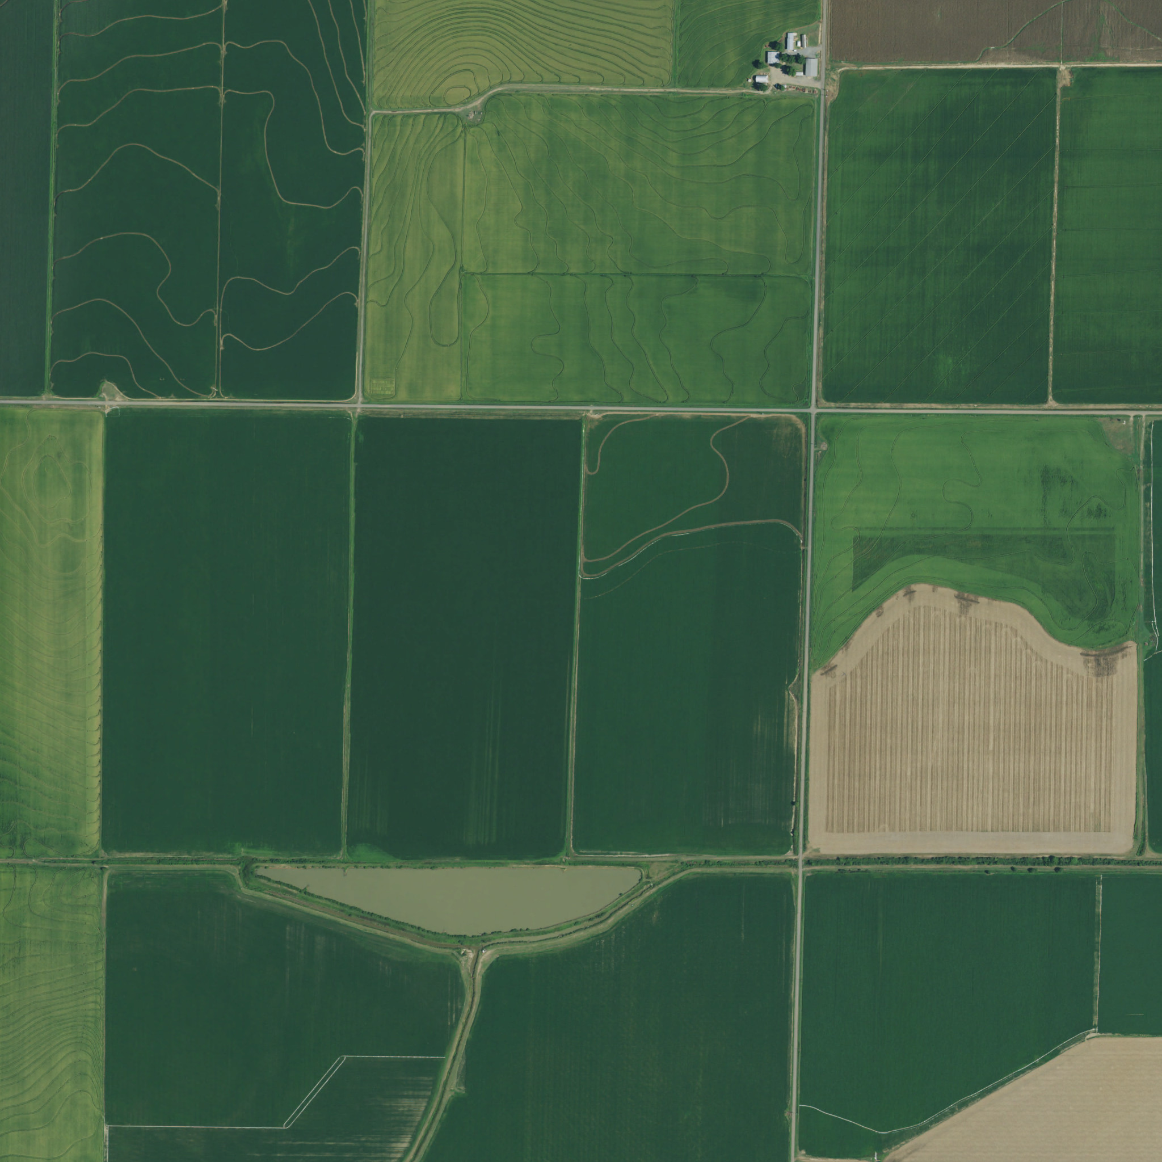
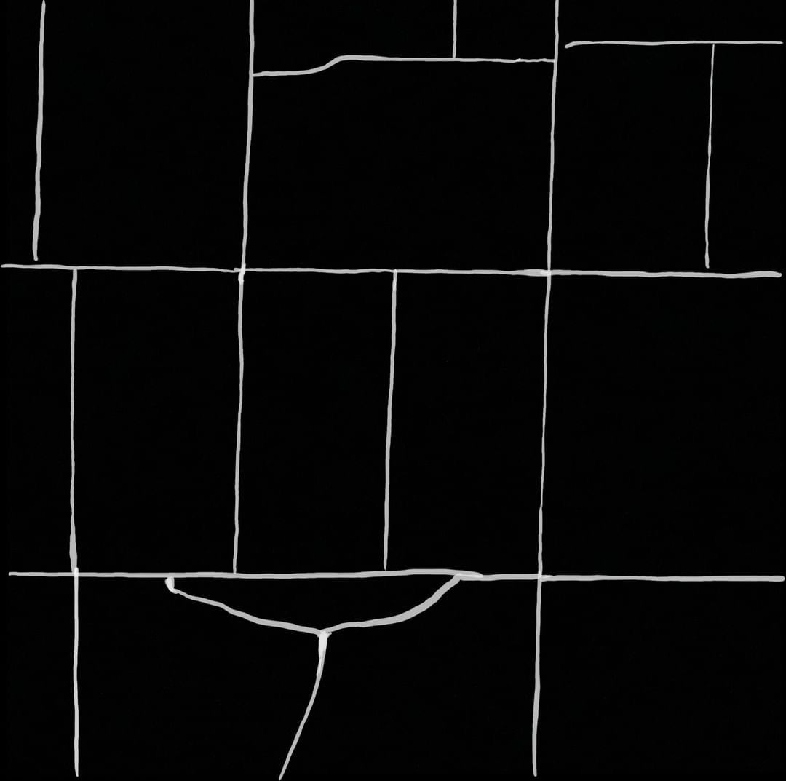
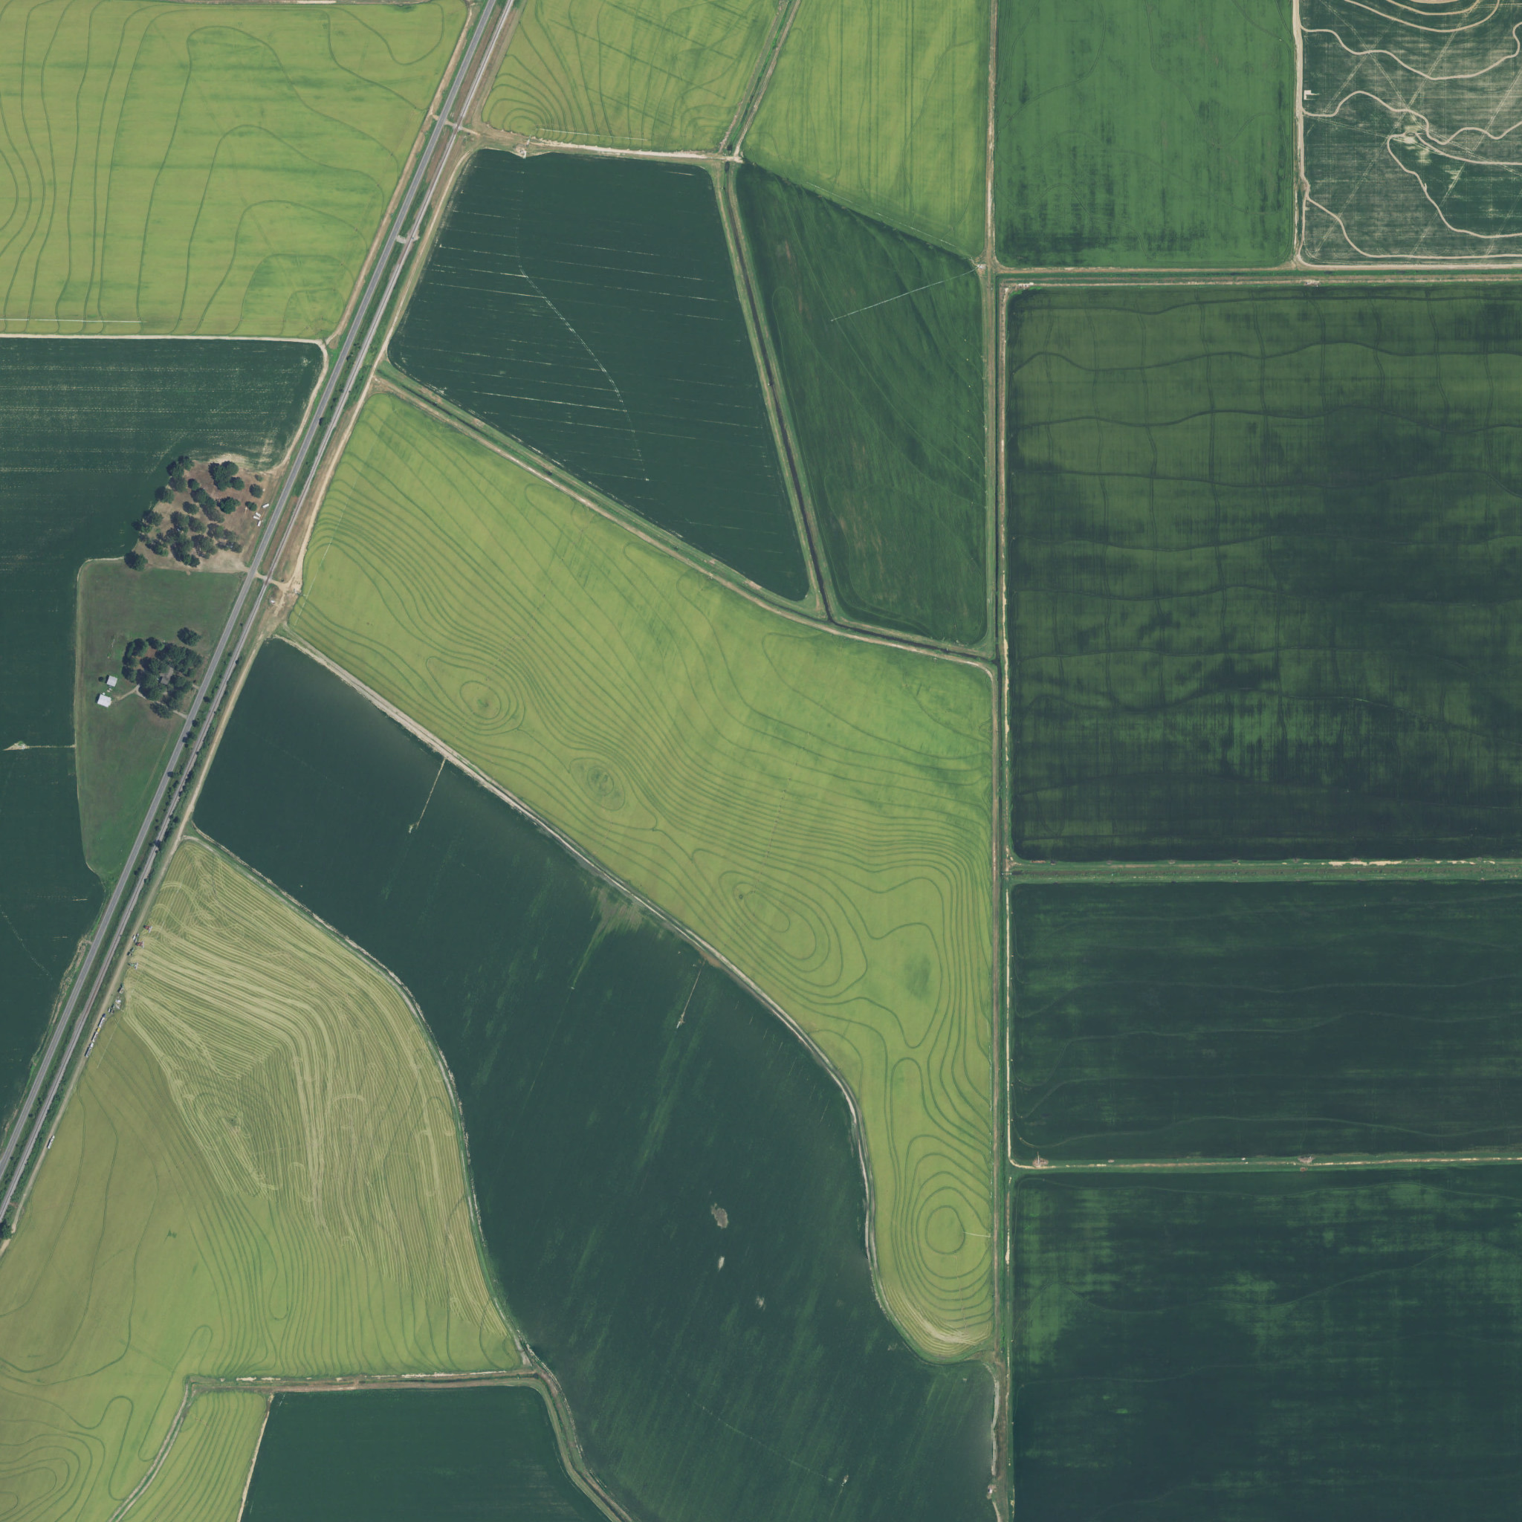
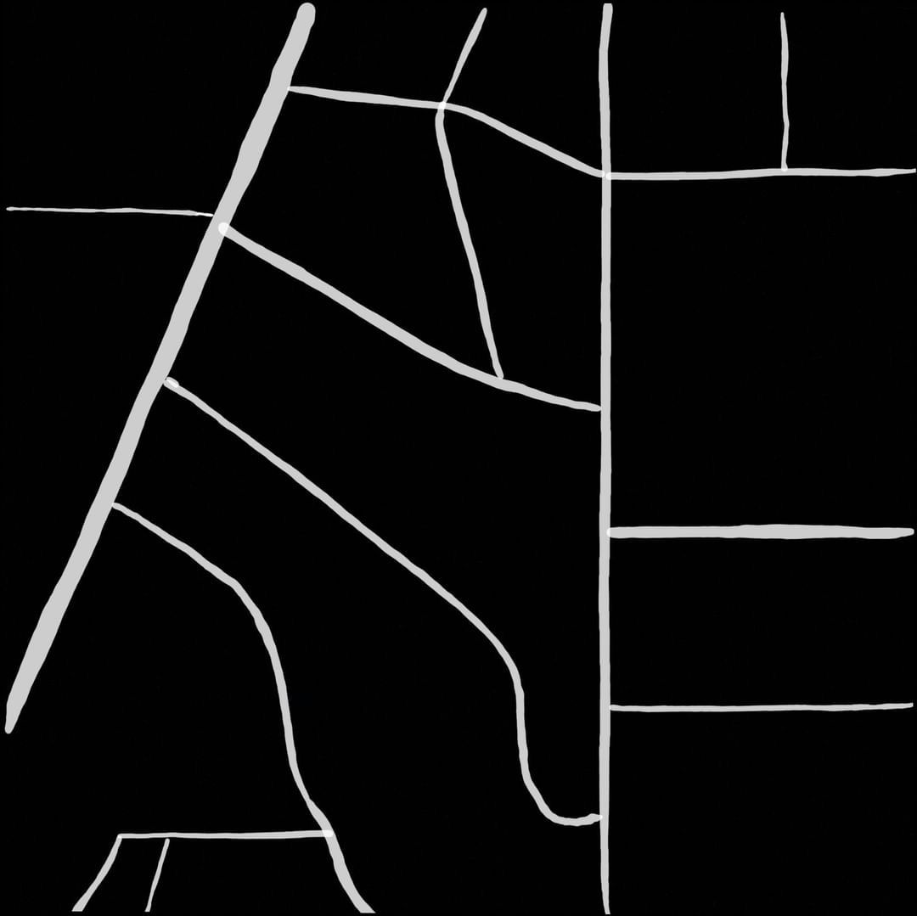
Original Images and their Ground truths:

Slide 8
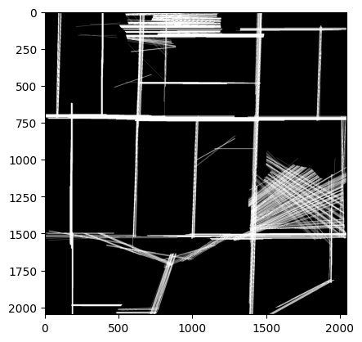
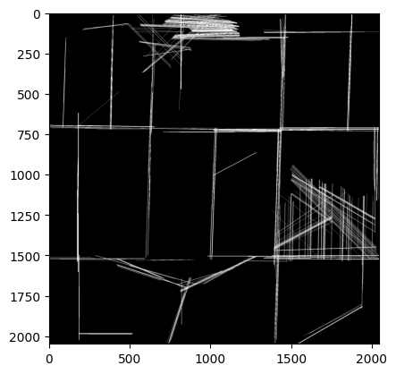
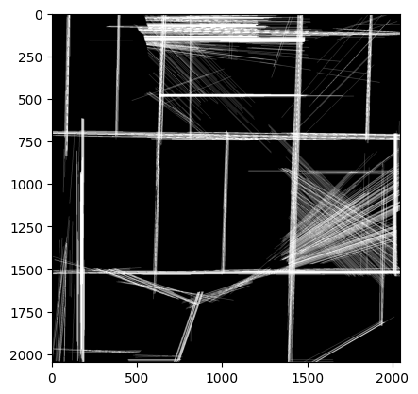
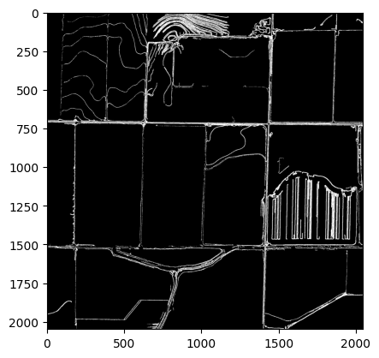
Sobel edge detection with hough transform: Canny edge detection with hough transform:
Laplacian edge detection with hough transform: Adaptive thresholding with canny edge filter:

Slide 9
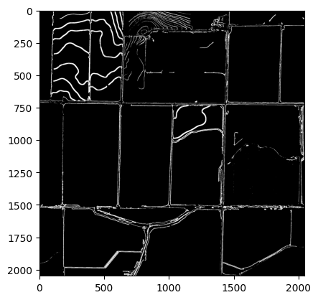
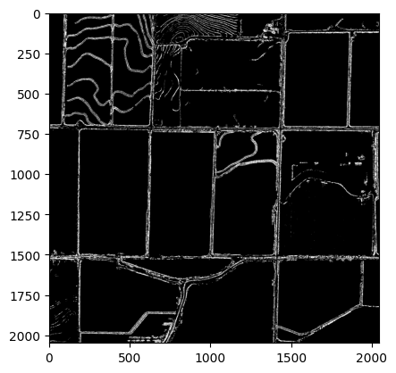
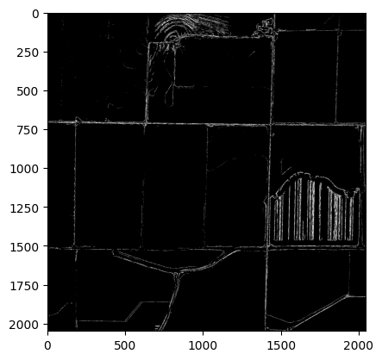
Hybrid Sobel-canny Method: Hybrid Laplacian-sobel Method:
Hybrid Laplacian-Canny Method:

Slide 10
Results:
Image | Method | SSIM Score
L97c | Sobel with hough tranform | 0.682
L97c | canny with hough tranform | 0.666
L97c | Laplacian with hough tranform | 0.688
L97c | Hybrid Sobel_Canny method | 0.665
L97c | Hybrid Laplacian_Sobel method | 0.666
L97c | Hybrid Laplacian_Canny method | 0.660
L97c | Adaptive thresholding with canny method | 0.668
W107d | Sobel with hough tranform | 0.779
W107d | canny with hough tranform | 0.777
W107d | Laplacian with hough tranform | 0.792
W107d | Hybrid Sobel_Canny method | 0.774
W107d | Hybrid Laplacian_Sobel method | 0.774
W107d | Hybrid Laplacian_Canny method | 0.773
W107d | Adaptive thresholding with canny method | 0.781

Slide 11
Results:
L97d | Sobel with hough tranform | 0.828
L97d | canny with hough tranform | 0.831
L97d | Laplacian with hough tranform | 0.826
L97d | Hybrid Sobel_Canny method | 0.831
L97d | Hybrid Laplacian_Sobel method | 0.833
L97d | Hybrid Laplacian_Canny method | 0.835
L97d | Adaptive thresholding with canny method | 0.833
L96b | Sobel with hough tranform | 0.879
L96b | canny with hough tranform | 0.777
L96b | Laplacian with hough tranform | 0.792
L96b | Hybrid Sobel_Canny method | 0.874
L96b | Hybrid Laplacian_Sobel method | 0.774
L96b | Hybrid Laplacian_Canny method | 0.873
L96b | Adaptive thresholding with canny method | 0.681

Slide 12
Time Line:
Updates | Dates | Status
Initial Team Meeting and Role Assignment | 07-Sept-2023
Development of Methodology Framework | 14-Sept-2023 | Completed
Implementation of Sobel-edge Detection | 23-Sept-2023 | Completed
Implementation of Canny-edge Detection | 30-Sept-2023 | Completed
First Integration of Hybrid Methods | 05-Oct-2023 | Completed
Revision and Optimization of Algorithms | 20-Oct-2023 | Completed
Validation of Edge Detection Accuracy | 02-Nov-2023 | Completed
Performance Analysis and Updates | 15-Nov-2023 | Completed
Final Review and Project Completion | 02-Dec-2023 | Completed
Compilation of Final Report and Slides | 04-Dec-2023 | Completed

Slide 13

THANK YOU

