Slide 1
Data Analysis with SQL

Slide 2
Agenda
Basic SQL concepts
Interactive
learning
Hands on by concept based assignments
Evaluation

Slide 3
Contents
Introduction
What is SQL
Why SQL
Database concept
What is database
Types of database
RDMS Database systems

Slide 4
Introduction

Slide 5

SQL
Structured Query Language
SQL is a database programming language created for managing and retrieving data from relational databases.
Standard language for Relation Database System.
To create and alter database tables and views
Update, insert, and delete records
Unique tool used by data experts to manage structured data.

Slide 6
Why SQL ???
To input, edit, and delete date from relational databases.
The organized data is helpful.
Aids in the development of relational database functions, stored procedures, and views.
To define and edit the data that is kept in a relational database.
To control access to table fields, views, and stored procedures.

Slide 7
Database Concepts

Slide 8
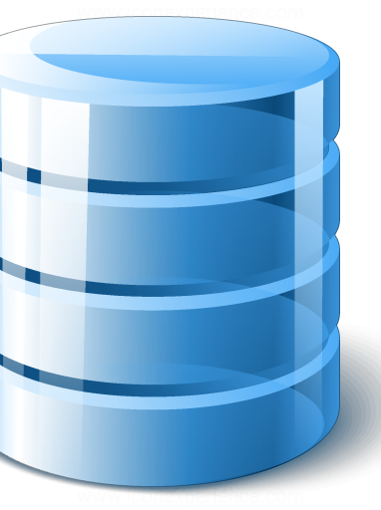
What is database?
Data is a collection of a distinct small unit of information.
A database is a set of data that has been arranged for easy access and management.
Data is accessible to all users through a single set of software programs.
By storing, retrieving, and managing data, you can manage a lot of information.
The representation of a database is shown in a cylindrical form.
The database management system (DBMS) is used to handle modern databases.

Slide 9
Software that stores and retrieves databases is known as a database management system.
DBMS
The gateway to carry out various activities, such as database creation, deletion, change, etc.
To build their databases according to their needs.
Consists of a group of programs that carry out user instructions
It gives the database security.
RDBMS
It is DBMS displayed as a table with rows and columns.
It is a DBMS that is based on E. F. Codd's relational model.
Upholds the data's security, integrity, accuracy, and consistency.

Slide 10




DBMS Advantages
It controls data redundancy by storing all the data in a single database file.
When a system fails, this recovery system automatically creates data and, if necessary, restores data.
Controls redundancy
Backup
The data can be distributed among numerous users by an authorized user.
It offers various user interface types, including GUI and application interfaces.
Date sharing
Multiple users

Slide 11



DBMS Disadvantages
For optimal operation, it requires a lot of RAM and storage space.
Running DBMS software is expensive since it needs a fast data processor and more memory.
Size
Cost
Complexity
DBMS adds more requirements and complexity.

Slide 12
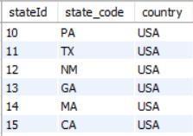
RDBMS Components
Table
Field
Record
Table, which has a large number of columns and rows, is essentially a collection of connected data entries.
A field is a column in a database that is intended to store specific data about each entry in the table.
Every individual entry that is included in a table is referred to as a record, often known as a row of data.

Slide 13
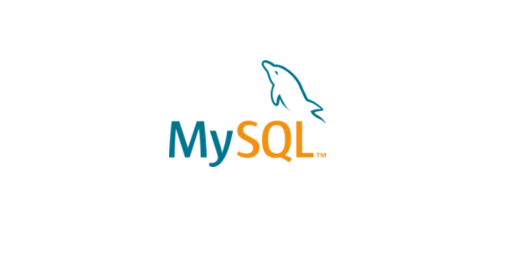
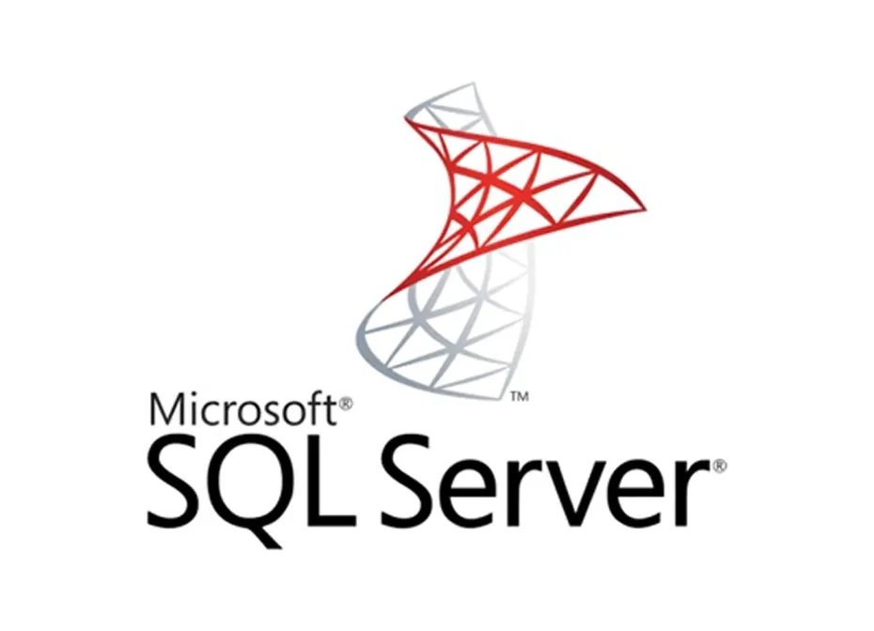
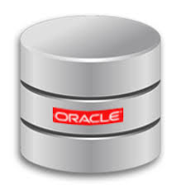
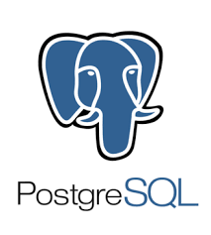
RDBMS Database Systems
MySQL
Microsoft SQL Server
Developed by a Swedish firm, MySQL AB, is an open source SQL database.
MS SQL Server is a Relational Database Management System developed by Microsoft Inc.
01
03
02
04
Oracle database
PostgreSQL
The "Oracle Corporation" produced this incredibly sizable multi-user database management system.
A free and open-source system that emphasizes extensibility and SQL compliance is PostgreSQL, also referred to as Postgres.

Slide 14
Quiz Time !!!
01

Slide 15


Which of the following is not a RDMS database system
MySQL
Oracle
Docker
MS SQL server
Ans: C) Docker

Slide 16
Thank You !

