Slide 1
Walk through sample Database

Slide 2
Contents
Sample Database
Description

Slide 3
Sample database

Slide 4
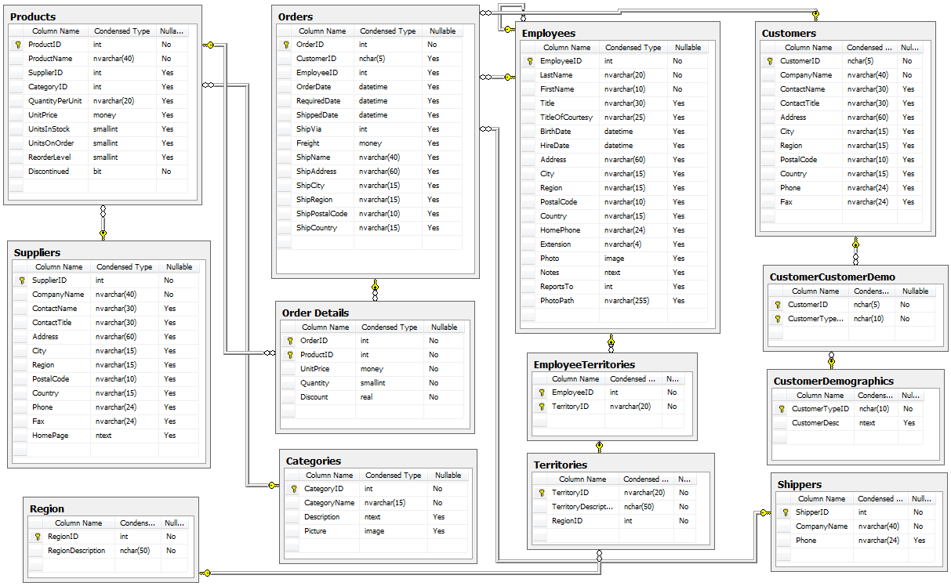

Slide 5

Description
The data considered is regarding a small business handling the orders, customers, employees and the supplies.
This database has 13 tables
Orders (830)
Order details (2155)
Products (77)
Suppliers (29)
Categories (8)
Employees (9)
Employee Territories (49)
Territories (53)
Region (4)
Customers (91)
Customer demo
Customer demographics
Shippers(6)

Slide 6
Thank You !

Slide 7
































































































Icon
You can resize these icons keeping the quality.
You can change the stroke and fill color; just select the icon and click on the paint bucket/pen.

Slide 8































































































Icon
You can resize these icons keeping the quality.
You can change the stroke and fill color; just select the icon and click on the paint bucket/pen.

