Slide 1
Data Types in
MySQL

Slide 2
Contents
Datatypes
What are datatypes
Types of datatypes
Common datatypes

Slide 3
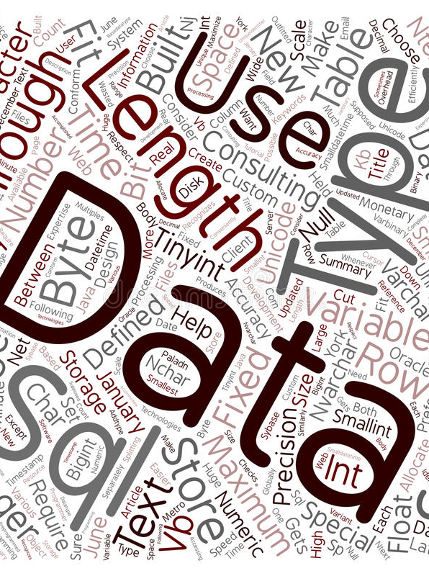
Data Types
The nature of the data that can be recorded in a database table is represented by data types.
For every database, data types are primarily divided into three categories.
Numeric
String
Date and Time

Slide 4
Numeric data type
INT(size)
FLOAT(size, d)
BOOL
Used for integer values
Range: -2147483648 to 2147483647
Unsigned range: 0 to 4294967295
Display width: 255
Used for floating point
Size: no.of digits
d : number of decimal places
Used for Boolean values
True(non-zero) and False(Zero)

Slide 5
String data type
CHAR (size)
VARCHAR(size)
LONGTEXT
Used for fixed length string
Size range: 0 to 255
Default:1
Used for variable length string
Size range: 0 to 65535
Size range up to 4,294,967,295 characters

Slide 6
Date and Time data type
DATE
DATETIME
YEAR
Specify date in yyyy-mm-dd format
Specify date and time in yyyy-mm-dd hh:mm:ss
Specify a year in four digit format
Range:1901 to 2155

Slide 7
Quiz Time !!!
01

Slide 8


Which of the following is not a RDMS database system
MySQL
Oracle
Docker
MS SQL server
Ans: C) Docker

Slide 9
Thank You !

