Slide 1
Joins in SQL

Slide 2
Contents
Joins
INNER JOIN
LEFT OUTER JOIN
RIGHT OUTER JOIN
FULL OUTER JOIN
CROSS JOIN
SELF JOIN

Slide 3

JOINS
Based on a shared column between two or more tables, a JOIN clause is used to merge rows from those tables.
Different types of JOINS in SQL are as follows
INNER JOIN
LEFT OUTER JOIN
RIGHT OUTER JOIN
CROSS JOIN
SELF JOIN

Slide 4
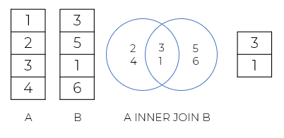
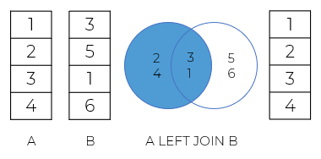
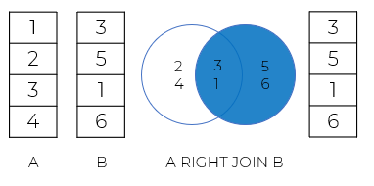
INNER JOIN
LEFT OUTER JOIN
Returns entries with values that are same across both tables.
It return that includes both the matched entries from the right table and all of the records from the left table.
01
03
02
RIGHT OUTER JOIN
Brings up the matching records from the left table and all of the records from the right table.

Slide 5
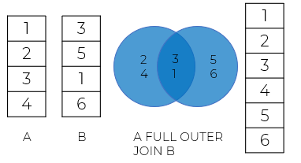
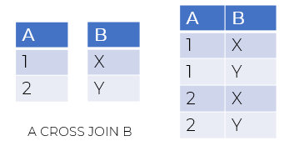
FULL OUTER JOIN
CROSS JOIN
When there is a match in either the left or right table, it returns all records.
An operation known as a cross join creates the Cartesian sum of two or more tables.
A result set in which every row in the first table (A) is paired with every row in the second table.
Assuming that the A table contains n rows and the B table has m rows, the cross-joining of the two tables will produce n x m rows.
04
06
05
SELF JOIN
A table can be joined to itself at times. The self-join is a particular kind of join.
To compare a row's value with other rows in the same table, we link a table to itself.
We employ a left join clause or an inner join clause to carry out the self-join.
We must use table aliases because the same table appears twice in a single query.

Slide 6
Quiz Time !!!
01

Slide 7
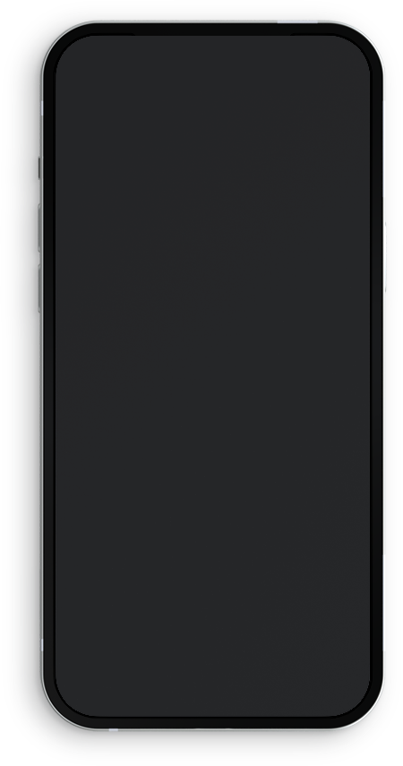

Which of the following is not a RDMS database system
MySQL
Oracle
Docker
MS SQL server
Ans: C) Docker

Slide 8
Thank You !

Slide 9
































































































Icon
You can resize these icons keeping the quality.
You can change the stroke and fill color; just select the icon and click on the paint bucket/pen.

Slide 10































































































Icon
You can resize these icons keeping the quality.
You can change the stroke and fill color; just select the icon and click on the paint bucket/pen.

