Slide 1

Predicting 10-Year Risk of Coronary Heart Disease: A Logistic Regression Approach
Presented By Group 2:
Shanmukha Sree Veda
Anupam Sharma

Slide 2

General Introduction:
World Health Organization has estimated 12 million deaths occur worldwide; every year due to Heart diseases. Half the deaths in the United States and other developed countries are due to cardiovascular diseases. The early prognosis of cardiovascular diseases can aid in making decisions on lifestyle changes in high-risk patients and in turn, reduces the complications. This project intends to pinpoint the most relevant/risk factors of heart disease as well as predict the overall risk using logistic regression

Slide 3
Source & Data Description:
The dataset is publically available on the Kaggle website, and it is from an ongoing cardiovascular study on residents of the town of Framingham, Massachusetts.
The dataset provides the patients’ information. It includes over 3,000 records and 15 attributes. Each attribute is a potential risk factor. There are demographic, behavioral, and medical risk factors.
Data Description
Demographic: • Sex: male or female("M" or "F") • Age: Age of the patient;(Continuous - Although the recorded ages have been truncated to whole numbers, the concept of age is continuous)
• Education: reflects socioeconomic status, which correlates with lifestyle choices and access to healthcare, influencing long-term cardiovascular health.

Slide 4
Behavioral
• is_smoking: whether the patient is a current smoker ("YES" or "NO") • Cigs Per Day: the number of cigarettes that the person smoked on average in one day.(This can be considered continuous as one can have any number of cigarettes, even half a cigarette.)
Medical( history)
• BP Meds: whether the patient was on blood pressure medication • Prevalent Stroke: whether the patient had previously had a stroke • Prevalent Hyp: whether the patient was hypertensive • Diabetes: whether the patient had diabetes

Slide 5
Medical(current)
• TotChol: total cholesterol level • SysBP: systolic blood pressure (measures the maximum force exerted on the arterial walls during each heartbeat. ⩽ 120 millimeters of mercury (mm Hg)) • DiaBP: diastolic blood pressure (measures pressure in the arteries when the heart is resting between beats. ⩽80 mm Hg) • BMI: Body Mass Index • Heart Rate: heart rate (Continuous - In medical research, variables such as heart rate though it is discrete, yet considered continuous because of a large number of possible values.) • Glucose: glucose level
Response variable (desired target)
• 10-year risk of coronary heart disease CHD (binary: “1”, means “Yes”, “0” means “No”)

Slide 6

Model 1:
$log\left(\frac{\hat{θ\left(x\right)}}{1−\hat{θ\left(x\right)}}\right)=$ -8.491941+ 0.063760∗age+ 0.494180∗I(sex=Male) + 0.017436∗cigsPerDay + 0.906743∗I(prevalentStorke=1) + 0.003301∗totChol + 0.016663∗sysBP + 0.009117 ∗ glucose
But when we have plotted the marginal plot, we see that other predictor variables are also significant.
NOTE: We set up the significance level to be 10%

Slide 7
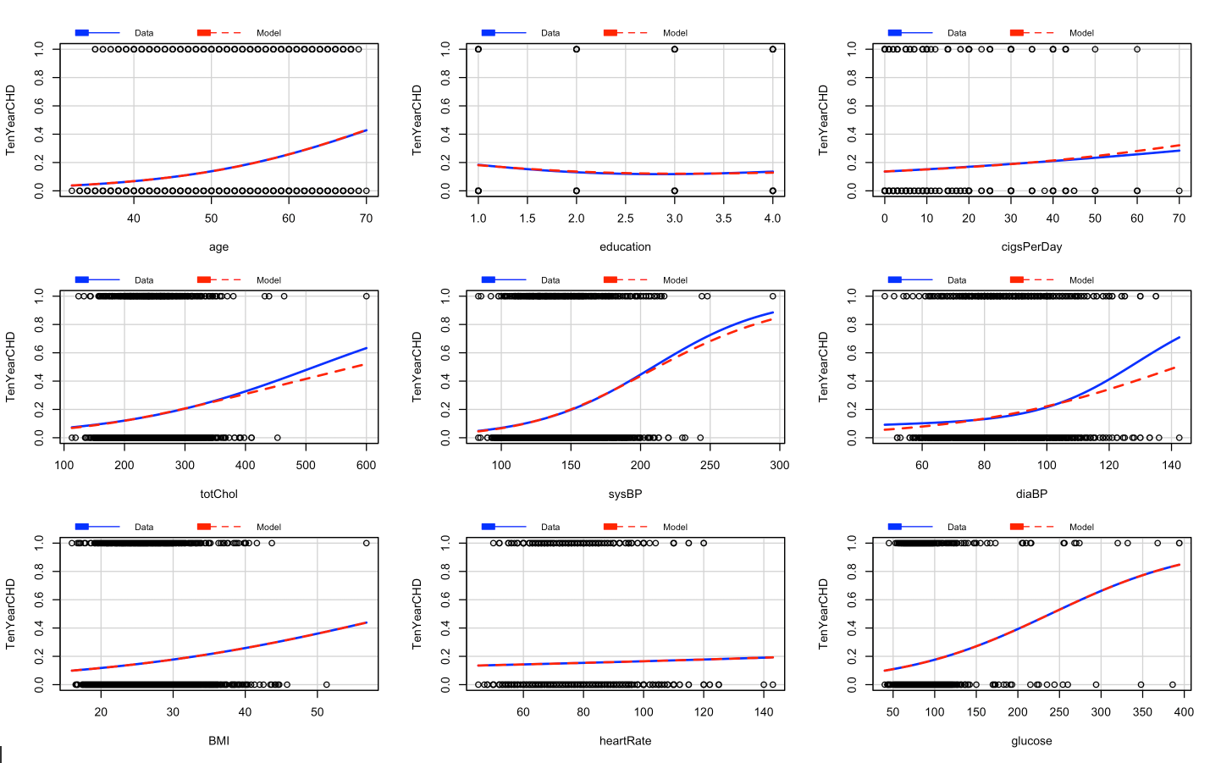
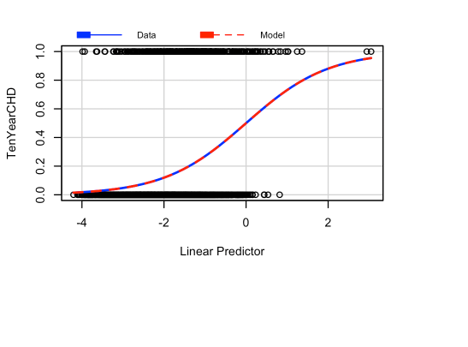
Marginal Plots: even though there are some deviations between the two fits in totChol, sysBP, and diaBP overall these marginal model plots show reasonable agreement across the two sets of fits indicating that model 1 is valid and education, diaBP, BMI, and heartRate provide significant effect.

Slide 8
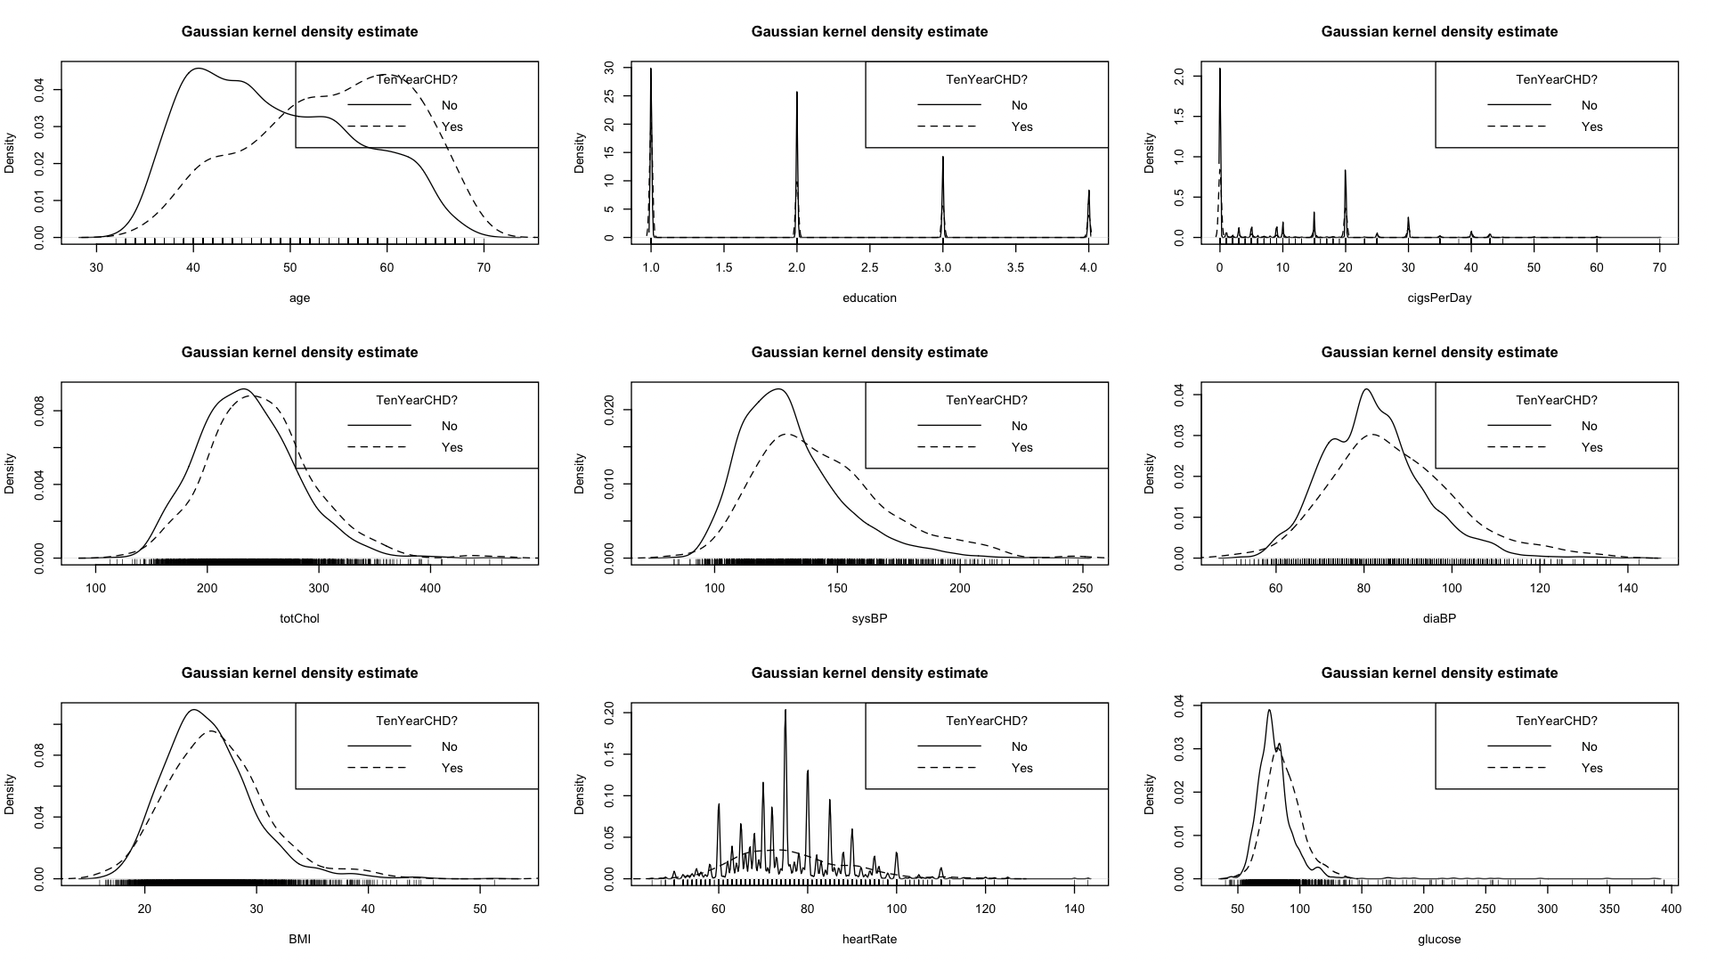
Gaussian kernel density curves
the predictor variable “age” is normally distributed with a different variance for the two values of TenYearCHD, so the log odds are a quadratic function of age. The densities of diaBP are skewed, the log of odds depend on both diaBP and log(diaBP).

Slide 9

Model 2:
$log(\frac{\hat{θ(x)}}{1−\hat{θ(x)}})$ = 20.60+ 0.0006059*$age^{2}$ + 0.5005*I(sex=Male)+ 0.0176*cigsPerDay + 0.9338*I(prevalentStorke=1)+ 0.003769*totchol+ 0.01478*sysBP + 0.08461*diaBP - 7.939*log(diaBP)+ 0.00882*glucose
“diaBP” and “log(diaBP)” shows significant effects a transformation.
However, transforming other predictor variables did not show any significance in the model.

Slide 10

Model 3:
$log(\frac{\hat{θ(x)}}{1−\hat{θ(x)}})$ = 39.53+ 0.006077 * $age^{2}$+ 0.5507* I(sex=Male)+ 0.01702*cigsPerDay + 4.1*I(BPMeds=1) + 5.211*I(diabetes=1) + 0.003785* totChol + 0.01482* sysBP + 0.1704* diaBP - 13.7*log(diaBP) -0.1387 * BMI*BPMeds + 0.0182*glucose*prevalentHYP – 0.03677*sysBP*diabetes + 0.1256*heartrate*prevalentStroke – 0.02891*diaBP*prevalentHYP
Few categorical variables like “BPMeds”, “diabetes”, “prevalentHYP” and “prevalentStroke” show some significance with interaction with other variables.

Slide 11
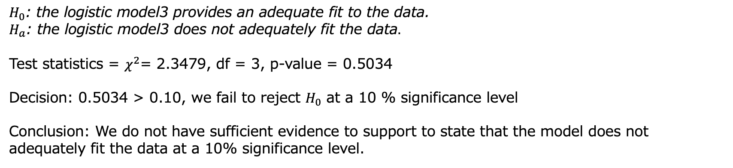
Model Comparison :
AIC (that the smaller the value of AIC the better the model ):
Model1 | Model2 | Model3
2225.014 | 2222.342 | 2201.839
AIC suggest that model3 (model with interaction terms) is better.
Hosmer-Lemeshow Test
$H_{0}$: the logistic model3 provides an adequate fit to the data.
$H_{a}$: the logistic model3 does not adequately fit the data$.$
Test statistics = $χ^{2}$= 2.3479, df = 3, p-value = 0.5034
Decision: 0.5034 > 0.10, we fail to reject $H_{0}$ at a 10 % significance level
Conclusion: We do not have sufficient evidence to support to state that the model does not adequately fit the data at a 10% significance level.

Slide 12
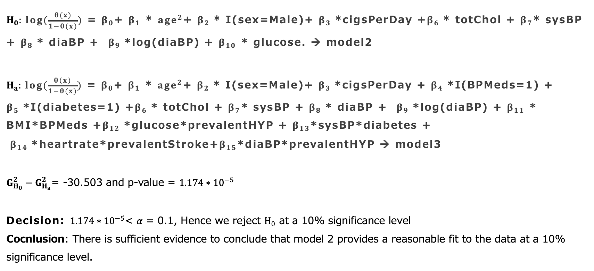
difference in deviance between model:
$H_{0}: log(\frac{θ(x)}{1−θ(x)})$ = $β_{0}$+ $β_{1}$ * $age^{2}$+ $β_{2}$* I(sex=Male)+ $β_{3}$*cigsPerDay +$β_{6}$* totChol + $β_{7}$* sysBP + $β_{8}$* diaBP + $β_{9}$*log(diaBP) + $β_{10}$ * glucose. → model2
$H_{a}: log(\frac{θ(x)}{1−θ(x)})$ = $β_{0}$+ $β_{1}$ * $age^{2}$+ $β_{2}$* I(sex=Male)+ $β_{3}$*cigsPerDay + $β_{4}$*I(BPMeds=1) + $β_{5}$*I(diabetes=1) +$β_{6}$* totChol + $β_{7}$* sysBP + $β_{8}$* diaBP + $β_{9}$*log(diaBP) + $β_{11}$ * BMI*BPMeds +$β_{12}$*glucose*prevalentHYP + $β_{13}$*sysBP*diabetes + $β_{14}$*heartrate*prevalentStroke+$β_{15}$*diaBP*prevalentHYP → model3
$G_{H_{0}}^{2}−G_{H_{a}}^{2}$= -30.503 and p-value = $1.174∗{10}^{−5}$
Decision: $1.174∗{10}^{−5}$< 𝛼 = 0.1, Hence we reject $H_{0}$ at a 10% significance level
Cocnlusion: There is sufficient evidence to conclude that model 2 provides a reasonable fit to the data at a 10% significance level.

