Slide 1
DIGITAL TWIN CHALLENGE 2026
GlucoTwin
An auditable patient model
and care workflow
alpha · vnrvjiet
Shanmukh sai gara · registered team size 1
Public / synthetic research · Actual interface captures · Synthetic narration
Notes:
This explanation uses a disclosed synthetic voice. The interface images are actual captures of the current local research application. GlucoTwin is a patient-specific glucose research platform designed around a simple evidence chain: observe a patient, forecast an upcoming glucose excursion, let a reviewer inspect the evidence, and compare that forecast with the eventual measurement. Our recommendation remains GlucoTwin because its public patient-linked data supports a concrete, understandable chronic-condition demonstration. The product now extends beyond a replay chart into a clinician workspace, patient companion, administration controls, durable intake and immutable forecast receipts. These are implemented local capabilities, not evidence of clinical readiness. We currently have no physical continuous glucose monitor and no authorized clinic data connection. The live source is therefore a partnership dependency, and the application explicitly keeps clinic connections pending. Public recordings and labelled synthetic arrivals let us evaluate the engineering without pretending they are current patient care. The distinguishing idea is visible, auditable adaptation with honest uncertainty and abstention. We show what was known when a forecast was made, which model produced it, how much lead remained, what the reviewer recorded and whether the later observation supports the prediction. Winning the challenge requires that complete story, alongside reproducibility and truthful evidence boundaries.
Evidence: docs/EVIDENCE.md; docs/LIVE_MODEL.md
Synthetic narration. Clinic source and doctor review pending.

Slide 2
GLUCOTWIN / RESEARCH PLATFORM
Fit to the published challenge
01
Historical context plus a dynamic sensor stream
02
Localized adverse-event prediction
03
Doctor-facing interaction and reproducibility
alpha · vnrvjiet | Clinic source and clinical release pending
02
Notes:
The published challenge asks for a focused chronic-condition digital twin combining historical patient information with a dynamic sensor stream, predicting a localized adverse outcome and exposing a usable doctor-facing interaction. GlucoTwin addresses those requirements through Type 2 diabetes, matched demographic context, native continuous glucose monitoring observations and a defined upcoming high-glucose-excursion label. The thirty-minute horizon is our primary target, and sixty minutes is supplementary. These are declared project choices, not numerical judging weights or a guaranteed winning formula. The brief accepts public or synthetic data, so those modes support an honest hackathon demonstration while a future authorized source is pursued separately. We make the twin's updates visible, compare it with stronger baselines, expose uncertainty, and preserve a reviewable record instead of relying on a polished prediction number alone. The submission also includes architecture, a public repository with reproducibility instructions, an open-source license, presentation files and a sufficiently long explanation and demonstration recording. The organizer's page remains the authority for entry details. We should check it again before submission because deadlines and instructions can change. Our materials map existing features to the published requirements without claiming an official weighted score.
Evidence: https://unstop.com/hackathons/crp-digital-twin-challenge-2026-happiest-health-1757873/amp
Synthetic narration. Clinic source and doctor review pending.

Slide 3
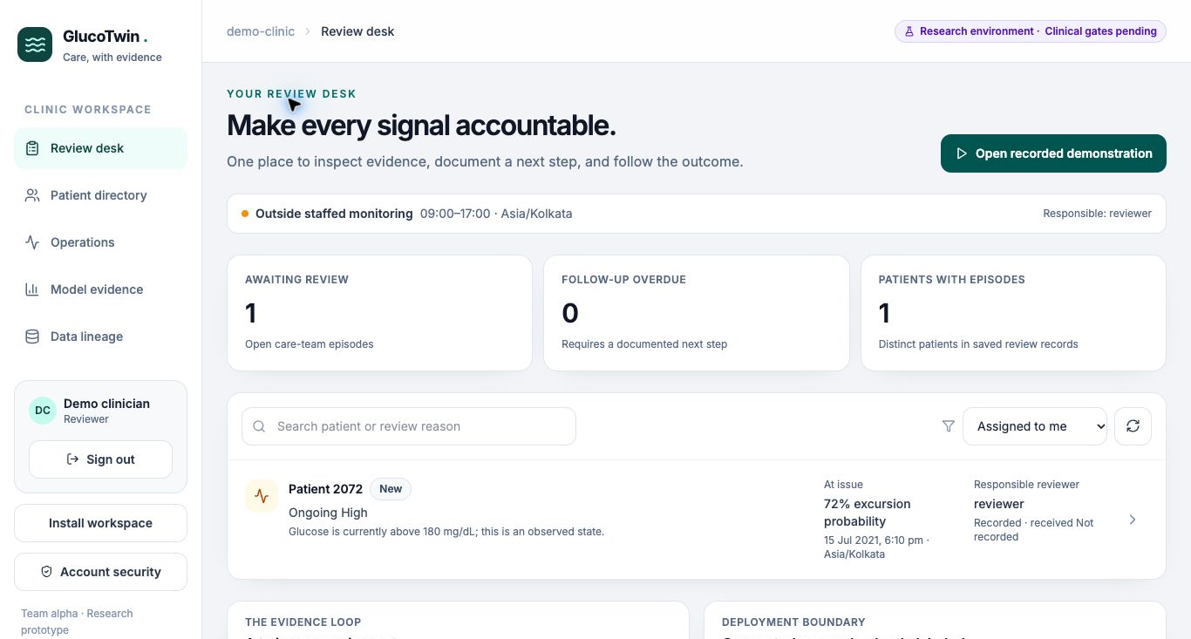
GLUCOTWIN / RESEARCH PLATFORM
The clinic journey we are preparing
Prioritize a review item
Inspect forecast, quality and context
Record follow-up and verify the outcome
Actual local interface · Source and clock labels retained
alpha · vnrvjiet | Clinic source and clinical release pending
03
Notes:
The primary product journey starts with a care-team reviewer opening the queue. A review item distinguishes an observed high reading, a predicted future excursion, a data-quality concern and an ordinary forecast receipt. The reviewer opens the patient record to inspect recent observations, available historical context, the forecast horizon and the source's freshness. The model's output is evidence for review rather than a treatment instruction. The reviewer can acknowledge an item, document a reason and note, plan a follow-up and later close the episode. Each change has an audit record. A consultation summary closes the workflow with a portable PDF. This is the workflow we want a partner doctor to review before any clinical activation. That review has not occurred yet, and the configured staffed hours do not establish that an actual clinic is providing a monitored service. The hackathon core demonstration uses a selected recorded episode so judges can see the prediction and eventual outcome quickly. Separate synthetic wall-clock intake demonstrates the operational system. Keeping those clocks visible matters: a replay from an old public recording is not a current clinical warning, and a synthetic source is not a patient's sensor.
Evidence: docs/DOCTOR_REVIEW.md; docs/API_CONTRACT.md
Synthetic narration. Clinic source and doctor review pending.

Slide 4
GLUCOTWIN / RESEARCH PLATFORM
Data we can actually verify
01
100 Shanghai patients; 109 recordings
02
112,462 native 15-minute observations
03
Synthetic companion excluded from benchmarks
alpha · vnrvjiet | Clinic source and clinical release pending
04
Notes:
The core research data are Shanghai Type 2 diabetes recordings linked to clinical records. Our prepared archive contains one hundred distinct patient identities, one hundred and nine recording files and one hundred and twelve thousand four hundred and sixty-two native fifteen-minute glucose observations. These counts describe the local prepared research assets, not a live patient cohort recruited by this project. All recordings from one person remain together when we evaluate by patient. The public paper and archive provide the scientific context and data provenance. We also considered supplementary datasets during idea selection, including CGMacros, but their sampling and licensing differences prevent treating them as interchangeable streaming measurements. In particular, interpolated one-minute rows must not be counted as newly observed sensor readings. The platform's companion identity and synthetic sources are fully fictional and remain outside the measured benchmark. They are useful for testing permissions, receipts, context entry and workflow behavior. The data plan depends on preserving that separation. A matching chart and an impressive interface cannot compensate for patient mismatch, timestamp ambiguity or unjustified use of future information. These boundaries are documented so the judge can inspect the relationship between the dataset, model and demonstration.
Evidence: https://www.nature.com/articles/s41597-023-01940-7; data/processed/manifest.json
Synthetic narration. Clinic source and doctor review pending.

Slide 5
GLUCOTWIN / RESEARCH PLATFORM
Historical context without future leakage
01
Allowlisted demographics and dated context
02
Observed time differs from receipt time
03
Untimed laboratory results excluded
alpha · vnrvjiet | Clinic source and clinical release pending
05
Notes:
Historical context has to obey a time boundary just as sensor data does. A result measured before a forecast but received afterward was not available to the forecaster at issue time. The source study allows laboratory collection within a window that can extend after monitoring, so untimed laboratory values are excluded from prediction features. The population model uses allowlisted age, sex, body mass index and diabetes duration, with the public dataset's availability assumptions disclosed. New structured historical context is dated and has provenance. The arrival worker uses its trusted receipt time to prevent a backfilled entry from changing an earlier issuance. Patient meal, activity and symptom entries remain explicitly self-reported timeline context; they do not silently become inputs to a validated meal-response or treatment model. Clinician-approved shared notes are similarly distinct from private assessment notes. The current implementation can demonstrate historical-context and dynamic-glucose fusion, but that integration does not prove predictive benefit. The evaluations preserve context ablations and unfavorable findings. For an authorized clinic source, untimed baseline information would be excluded until its availability can be established. This is a practical design constraint and a central methodological safeguard.
Evidence: https://www.nature.com/articles/s41597-023-01940-7; docs/LIVE_MODEL.md
Synthetic narration. Clinic source and doctor review pending.

Slide 6
GLUCOTWIN / RESEARCH PLATFORM
An architecture with an evidence ledger
Source intake
Durable processing
Patient forecast
Synthetic now; clinic pending
Trusted receipt / lease / retry
Available inputs / matured targets
Observed outcome
Clinical review
Permanent evidence
Point and complete-window labels
Revision / disposition / follow-up
Version / cutoff / target
SQLite research / migrated PostgreSQL · Metadata-only SSE · Patient-scoped access
alpha · vnrvjiet | Clinic source and clinical release pending
06
Notes:
The architecture separates collection, forecasting, storage and interaction while keeping the code understandable for a hackathon team. A source event arrives through a scoped connection. Intake validates identity, timestamps, units and duplicate behavior, then commits the accepted measurement and forecast job together. The worker reads only the prefix available at its issue clock, obtains the model output and stores an immutable receipt. Observed outcomes are appended later instead of rewriting the original prediction. The clinician workspace, patient companion and administration views read different projections of that same stored evidence. FastAPI provides the backend, Python libraries implement the research model, and React with TypeScript, Tailwind and Recharts provides the interface. SQLite is the default local store, with a separately tested PostgreSQL path. Operational metadata events allow the interface to refresh without exposing raw health payloads through the event channel. Source quality, model identity and forecast timing travel with each receipt. That makes the architecture diagram meaningful: it represents actual boundaries and persisted records, not a collection of future cloud services. Hardware integration, encrypted clinical hosting and approved prospective evaluation remain outside the demonstrated release.
Evidence: docs/ARCHITECTURE.md; backend/OPERATIONAL.md
Synthetic narration. Clinic source and doctor review pending.

Slide 7
GLUCOTWIN / RESEARCH PLATFORM
Three clocks that must stay visible
01
Measurement time
02
Trusted server receipt and issue time
03
Target time and remaining lead
alpha · vnrvjiet | Clinic source and clinical release pending
07
Notes:
A live-oriented forecast has several timestamps that cannot be collapsed into one. Measurement time says when the source sampled glucose. Trusted server receipt says when the application first knew the reading. Issue time defines the available input prefix used by the forecast. Target time says which future native reading the model predicts. For the existing model, the target is anchored to the latest measurement, not automatically to the current server time. A reading measured at ten o'clock and issued at ten oh one still targets ten thirty for the thirty-minute model, leaving twenty-nine minutes. The application exposes that remaining lead instead of presenting an exact thirty-minute-from-now promise. Recorded research playback has a labelled virtual clock; wall-clock synthetic arrival receipts have a different explicit clock kind. All arrival timestamps require an offset or Z and normalize to UTC. Source-local time affects time-of-day features, but compatibility with the public cohort's unverified local training clock remains unvalidated. That is why timezone and end-to-end latency are required source-verification gates. These timestamps make late delivery, backfill and forecast comparisons understandable and prevent a superficially live interface from concealing stale evidence.
Evidence: docs/LIVE_MODEL.md
Synthetic narration. Clinic source and doctor review pending.

Slide 8
GLUCOTWIN / RESEARCH PLATFORM
Cadence and abstention are product features
01
Five actual native 15-minute readings
02
Gaps and stale readings pause forecasts
03
Unsupported feeds do not get invented samples
alpha · vnrvjiet | Clinic source and clinical release pending
08
Notes:
The saved model expects five actual consecutive native fifteen-minute readings. That contract is deliberately explicit. A five-minute or one-minute source is not accepted by interpolating, averaging or automatically inventing a compatible history. A faster synthetic generator can demonstrate intake arrivals, but its prediction status is unsupported cadence. A missing native slot creates a gap, and readings older than twenty minutes pause the arrival adapter. Those thresholds are engineering policy for this research release, not clinical standards. Endpoint estimates require at least ten minutes of remaining lead. Event probabilities are stricter because their original target list includes intermediate native readings. If any of those targets is at or before the actual issue time, the entire corresponding event probability is suppressed. A probability concerning an original window partly in the past cannot be relabelled as a new future event. For synthetic research review, the earliest target must still have at least ten minutes of lead and the primary thirty-minute signal must meet the declared threshold. Missing-data and unsupported states are visible outcomes. An abstention should never appear as a reassuring low-risk value. This improves both the demonstration's honesty and the future source-validation plan.
Evidence: docs/LIVE_MODEL.md; backend/OPERATIONAL.md
Synthetic narration. Clinic source and doctor review pending.

Slide 9
GLUCOTWIN / RESEARCH PLATFORM
A twin that shows how it changes
01
Visible state updates
02
Bounded patient residual adaptation
03
No treatment or organ-physiology claims
alpha · vnrvjiet | Clinic source and clinical release pending
09
Notes:
The original prototype includes a local-trend state model with Kalman measurement updates. It tracks glucose level and recent change and shows how an incoming observation corrects the estimated state. That is an engineering approximation of the glucose trajectory; it does not model organs, insulin physiology, medication effects or causal treatment responses. The stronger forecasting path combines a population gradient-boosted predictor with a bounded patient-specific residual correction. The correction uses discrepancies between predictions and their later matching native observations, shrinks toward zero and is limited to avoid unbounded drift. Arrival mode tightens that rule further: only actual stored issuances and outcomes already received by the current clock may update adaptation. Historical observations alone do not create imaginary earlier forecasts. Separate accumulators serve the thirty- and sixty-minute horizons, and repeated deliveries or repeated target forecasts are not counted multiple times. The interface can expose level, trend, volatility, adaptation maturity and correction history. The contribution is an observable and auditable evolving patient model. Whether that adaptation improves prediction is answered by experiments, with an experimental label when the evidence does not support promotion to the primary model.
Evidence: backend/MODEL.md; docs/LIVE_MODEL.md
Synthetic narration. Clinic source and doctor review pending.

Slide 10
GLUCOTWIN / RESEARCH PLATFORM
The retrospective comparison is modest
PAIRED MAE DIFFERENCE
−0.206 mg/dL
95% patient-bootstrap CI
[−0.336, −0.110]
Small internal gain
Live performance unestablished
alpha · vnrvjiet | Clinic source and clinical release pending
10
Notes:
The current retrospective comparison uses a frozen patient-separated fivefold evaluation of the public research cohort. Every recording from one person stays in the same partition. At thirty minutes, the population model's mean absolute error is about nine point eight one two milligrams per deciliter, and the hybrid's is about nine point six zero six. The paired mean difference is a modest reduction of approximately zero point two zero six, with a patient-bootstrap interval from minus zero point three three six to minus zero point one one zero. This supports a small internal retrospective adaptation gain for that protocol. It does not establish clinical utility, independent external validity or improved performance under real delivery latency. The original single-split evaluation and the original weaker personalized-filter result remain documented rather than being replaced with the most favorable number. Earlier test results influenced development, so the current evidence is internal and cannot be described as an untouched external holdout. We compare persistence, trend, population and personalized alternatives to distinguish useful changes from complexity. Historical-context ablations likewise prevent the existence of EHR inputs from becoming an unsupported claim that they improve accuracy.
Evidence: data/processed/clinic_benchmark.json; docs/EVIDENCE.md
Synthetic narration. Clinic source and doctor review pending.

Slide 11
GLUCOTWIN / RESEARCH PLATFORM
Predict a defined event, then calibrate it
01
Any native future reading above 180 mg/dL
02
Dedicated event probability
03
Intervals and probabilities need separate checks
alpha · vnrvjiet | Clinic source and clinical release pending
11
Notes:
Our adverse-event label is deliberately narrow: any scheduled native future glucose reading above one hundred and eighty milligrams per deciliter within the declared horizon. This is a research label, not a diagnosis or an emergency definition. A dedicated classifier estimates the probability of that event, while the regression model estimates the future endpoint value. These are different tasks: an excursion can happen at the intermediate reading and resolve before the endpoint, so a single endpoint threshold can miss it. We also distinguish an ongoing observed high reading from an advance warning for a currently below-threshold patient. Event calibration asks whether the displayed probabilities correspond to empirical frequencies. Prediction intervals address uncertainty around future glucose values. The nominal interval target and the warning threshold are selected using calibration information under the frozen evaluation protocol, not optimized after observing each test patient. The declared false-alert budget is provisional engineering policy. Aggregate calibration does not guarantee an individual forecast, and arrival mode explicitly marks transferred probability calibration and interval widths unvalidated. The benchmark view exposes these qualifications so a clear-looking probability or shaded band does not imply more assurance than the data support.
Evidence: docs/EVIDENCE.md; docs/LIVE_MODEL.md
Synthetic narration. Clinic source and doctor review pending.

Slide 12
GLUCOTWIN / RESEARCH PLATFORM
False alerts need their denominator
01
Precision 62.96%; observed-onset recall 76.06%
02
False alerts: 0.919 per 24 eligible hours
03
95% interval extends above the budget
alpha · vnrvjiet | Clinic source and clinical release pending
12
Notes:
The unchanged full retrospective out-of-fold event ledgers provide a separate view of warning quality. At thirty minutes, episode precision is approximately sixty-two point nine six percent and overall observed-onset recall is seventy-six point zero six percent. Patient-cluster bootstrap intervals are about fifty-nine point five one to sixty-six point three eight percent for precision and seventy-three point eight two to seventy-eight point six seven percent for recall. False alerts are approximately zero point nine one nine per twenty-four eligible forecast hours, with an interval from zero point seven eight seven to one point zero five nine. Eligible forecast hours are not all calendar hours and are not staffed clinic hours. That denominator is essential when interpreting burden. The upper interval exceeds the provisional one-alert budget, so we cannot promise that operating burden. One thousand bootstrap draws resample patient-level statistics from fixed predictions; they do not incorporate model-training or selection uncertainty. These statistics belong to the preserved retrospective protocol, not the arrival adapter. A doctor's review must translate warning lead, missed episodes, review time and workload into an acceptable operational policy. The current numbers support a concrete research discussion, not a claim of clinical safety.
Evidence: data/processed/arrival_stress.json; docs/LIVE_MODEL.md
Synthetic narration. Clinic source and doctor review pending.

Slide 13
GLUCOTWIN / RESEARCH PLATFORM
Arrival stress changed our model choice
01
Synthetic delays: 0, 1, 5 and 20 minutes
02
Sparse hybrid MAE was worse
03
Population remains arrival-mode primary
alpha · vnrvjiet | Clinic source and clinical release pending
13
Notes:
We tested the arrival adapter with twenty sampled public patients, three sparse synthetic issuances per patient and four assigned delivery delays: zero, one, five and twenty minutes. The experiment assigns a clock for testing; it does not measure real sensor latency or establish the source timezone. Each scenario passed sixty reordered-prefix checks and sixty unavailable-backfill invariance checks. Forty exact thirty-minute targets were scoreable in each scenario. On that small functional sample, population mean absolute error was about twelve point five five zero, while the actual-issuance hybrid was twelve point six seven six. Adaptation was slightly worse. That negative result matters: the modest retrospective hybrid gain is not transferred into a live-oriented marketing claim. Population forecasting stays primary for arrival mode, with the hybrid visibly experimental. At twenty minutes of delay, an endpoint still had ten minutes remaining, but the first original event target was already past, so both event probabilities were suppressed. No scenario created a clinically eligible queue item. The experiment establishes temporal behavior and exposes a model limitation. A new genuine issue-time forecasting model would need verified device timing, a new frozen future-only label protocol and fresh evaluation before replacing this cautious adapter.
Evidence: data/processed/arrival_stress.json; docs/LIVE_MODEL.md
Synthetic narration. Clinic source and doctor review pending.

Slide 14
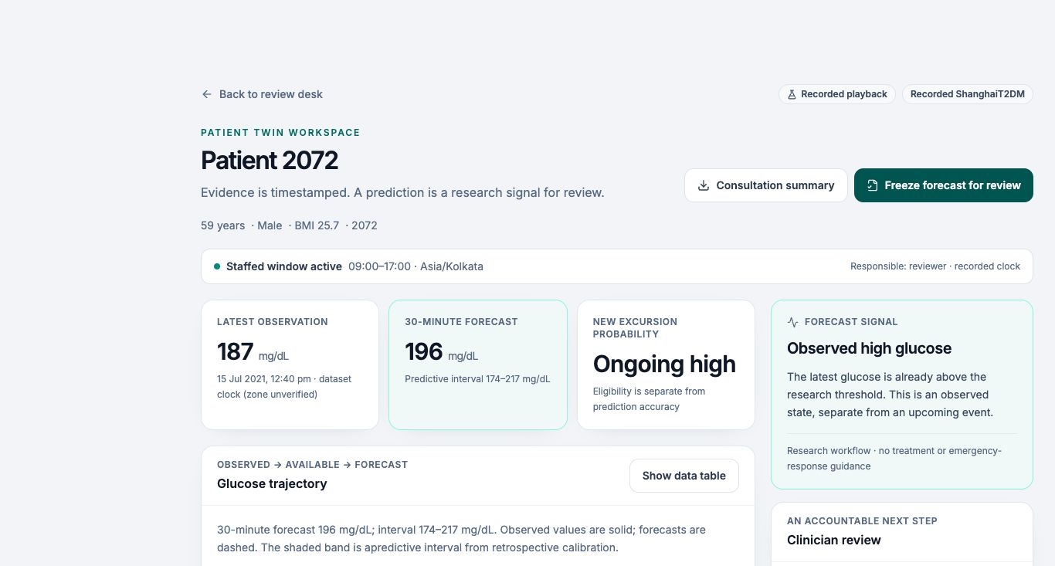
GLUCOTWIN / RESEARCH PLATFORM
The clinician view closes the loop
Observed values and issued predictions
Review state, owner and follow-up
Outcomes and matching consultation PDF
Actual local interface · Source and clock labels retained
alpha · vnrvjiet | Clinic source and clinical release pending
14
Notes:
The clinician interface brings three kinds of evidence together without merging their meanings. Observed glucose is a measurement. A forecast is a stored model estimate issued using an available prefix. A review state is a person's documented response. Reviewing or closing an item does not change the prediction or manufacture a correct outcome. The patient view shows recent history, model comparisons, quality status and relevant context, while the queue retains review ownership, follow-up timing and episode history. Repeated concerns update an existing episode and link the latest receipt rather than endlessly duplicating the same work. A revision number prevents two reviewers from silently overwriting one another's actions. Later point outcomes and complete-window event outcomes are appended separately, which allows an intermediate late reading to complete an event label without rewriting an earlier receipt. The consultation PDF uses the same underlying evidence as the screen. During the recorded core demonstration we can show an advance warning, move to the eventual measured outcome and then export the record. The full explanation also includes a stable episode and a sensor gap so the interface is assessed for abstention and failure behavior, not only a favorable example.
Evidence: docs/API_CONTRACT.md; backend/OPERATIONAL.md
Synthetic narration. Clinic source and doctor review pending.

Slide 15
GLUCOTWIN / RESEARCH PLATFORM
Fifty streams: engineering evidence only
01
400 synthetic observations and durable jobs
02
50 idempotent actual-model receipts
03
No failed jobs; no clinical queue eligibility
alpha · vnrvjiet | Clinic source and clinical release pending
15
Notes:
The operational work includes a short isolated local concurrency check, with evidence recorded rather than an invented scalability claim. Fifty synthetic sources supplied four hundred observations using ten concurrent intake threads. The saved arrival research model processed four hundred accepted jobs into fifty idempotent receipts and fifty review episodes, with no pending or failed jobs at the end. All fifty receipts contained model outputs, and none was clinically eligible. The local measurement reported about zero point three seven three seconds for intake and four point zero eight one seconds to drain forecast jobs. These times describe that short batch on the development computer; they are not a production service-level agreement or a sustained capacity guarantee. A separate deterministic check isolates persistence and patient snapshot correctness from predictive behavior. Scoped source keys, conflict quarantine, job leases, retry limits and immutable receipts are the real operational features behind the result. We also verified actual PostgreSQL intake and worker integration with eight synthetic observations and one idempotent receipt. No physical devices or private patient records were involved. This gives judges concrete evidence that the pipeline works while keeping clinical safety, device access and deployment reliability as separate unanswered questions.
Evidence: docs/operational_validation.json; backend/OPERATIONAL.md
Synthetic narration. Clinic source and doctor review pending.

Slide 16
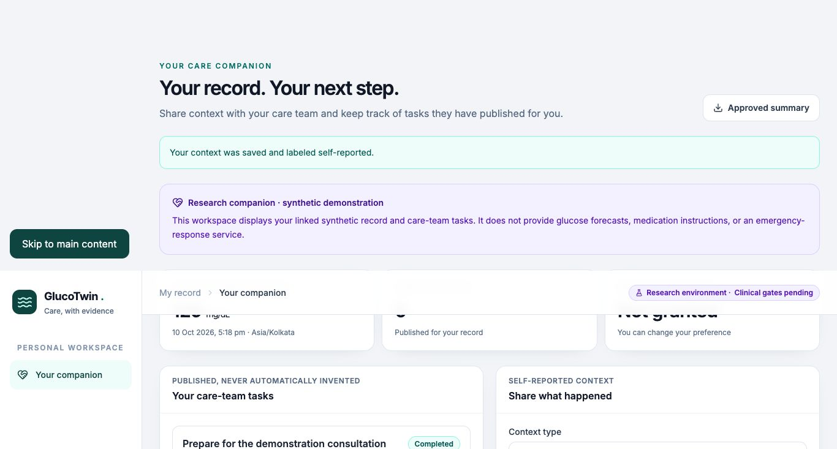
GLUCOTWIN / RESEARCH PLATFORM
A patient companion with a limited view
Own readings and self-reported context
Approved notes and published tasks
No model forecasts or private assessments
Actual local interface · Source and clock labels retained
alpha · vnrvjiet | Clinic source and clinical release pending
16
Notes:
The patient companion is an implemented part of the platform, but its permissions are intentionally different from the clinician workspace. A patient account is bound server-side to its own clinic record. It can inspect its own recorded readings, add a meal, activity or symptom note, see clinician-approved shared notes, complete its own published tasks and export a patient-visible summary. It cannot read the clinic queue, another patient's evidence, staff administration or private assessment notes. Model forecasts are excluded from the companion, and predictions remain disabled. That avoids presenting an experimental research estimate as direct patient advice. The current companion identity is fictional and clearly labelled synthetic. Self-reported entries carry provenance and a receipt time instead of becoming verified sensor facts. A consent history records research collection choices; withdrawal revokes the relevant bound source credential. A consent record does not activate clinical monitoring or replace outstanding approvals. Published follow-up instructions require an authorized care-team role, while draft tasks stay hidden from the patient. These capabilities let us demonstrate a complete platform relationship without claiming that it is operating with real patients. Doctor review, source access and a suitable clinical protocol remain required before that boundary can change.
Evidence: docs/API_CONTRACT.md; backend/tests/test_platform.py
Synthetic narration. Clinic source and doctor review pending.

Slide 17
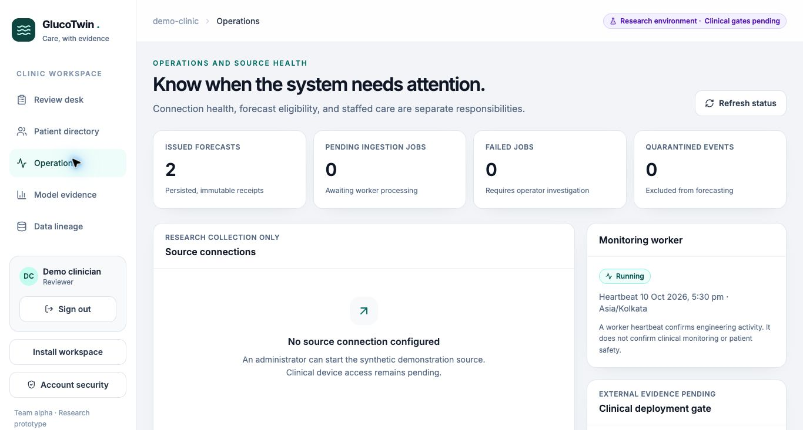
GLUCOTWIN / RESEARCH PLATFORM
Administration and access have real controls
Clinic-scoped roles and invitations
Cookie CSRF checks and optional MFA
Source keys, audit and revocation
Actual local interface · Source and clock labels retained
alpha · vnrvjiet | Clinic source and clinical release pending
17
Notes:
Administration includes synthetic enrollment, individual account invitations, source configuration, intake preview, access revocation and audit review. Invitations use a private manual handover rather than pretending an email service has been integrated. Care-team, coordinator and patient roles have different access. Cookie authentication uses HttpOnly SameSite Strict cookies and mutation CSRF checks. Optional time-based verification codes protect subsequent sign-ins once enrolled, with secrets encrypted in the local store. Enabling verification revokes other existing sessions, and deactivating an account revokes its sessions. Failed sign-ins are throttled by the implemented local policy. Synthetic connections receive a scoped ingestion key once; that key cannot read clinic records or act on another source. A revoked connection cannot be resumed through the ordinary status action. The application also keeps clinic device connections pending without an intake credential. These are tested local safeguards, not a declaration of production security. The legacy bearer route remains a compatibility path with a separate session-policy boundary. HTTPS hosting, broader abuse protection, managed secret rotation, recovery policy, operational roles and retention procedures still need deployment review. Demonstrating actual controls is stronger than claiming that authentication alone makes a medical platform ready for release.
Evidence: docs/OPERATIONS.md; backend/tests/test_platform.py; backend/tests/test_operational.py
Synthetic narration. Clinic source and doctor review pending.

Slide 18
GLUCOTWIN / RESEARCH PLATFORM
Recoverable data and traceable model releases
01
SQLite default; tested PostgreSQL schema 7
02
Encrypted backup and offline restore
03
Checksum selection, archive and restart
alpha · vnrvjiet | Clinic source and clinical release pending
18
Notes:
Local persistence is recoverable rather than an in-memory demonstration shortcut. SQLite remains the default, using foreign keys, WAL and versioned schema upgrades. The actual PostgreSQL path uses SQLAlchemy and Alembic, with both fresh installation and a version-six-to-seven upgrade tested in an isolated PostgreSQL sixteen point fourteen database. Append-only guards protect issued evidence. The PostgreSQL readiness probe confirms connection and schema, not a database integrity audit, and its backup and failover procedures are not yet verified. For SQLite, the encrypted backup script takes a consistent snapshot, includes a checksum manifest and encrypts the archive. Offline restore requires a new destination, the original key and successful integrity verification; it does not overwrite the old runtime database. Backup encryption does not encrypt the application database itself, and off-host recovery remains unverified. Model selection verifies an approved artifact hash, archives the previous model and replaces the selected file atomically. Both API and worker must restart because model objects are cached. A checksum identifies trusted bytes; it does not establish predictive quality or clinical authorization. These operations give the team concrete recovery and rollback steps while leaving deployment readiness honestly pending.
Evidence: docs/OPERATIONS.md; docs/recovery_validation.json
Synthetic narration. Clinic source and doctor review pending.

Slide 19
GLUCOTWIN / RESEARCH PLATFORM
The route to a genuine clinic shadow study
01
Find an authorized source and review workflow
02
Verify device timing and freeze the protocol
03
Measure prospective burden before activation
alpha · vnrvjiet | Clinic source and clinical release pending
19
Notes:
The next real-world step is an authorized clinic partnership, not a synthetic connection renamed as live. We need a source that can lawfully provide patient-bound sensor measurements and establish device identity, sampling cadence, source timezone, receipt latency and missingness. A doctor should review the proposed queue, information hierarchy, uncertainty labels, escalation ownership and follow-up process using public and synthetic examples before private data enters the system. That review is still pending. Privacy arrangements, intended use, consent, retention and applicable approvals must be established before collection. A prospective shadow protocol should then freeze the model, eligibility rules, target window, operating point and outcome definitions. Shadow outputs would be studied under the agreed protocol rather than silently becoming treatment prompts. We must measure actual warning lead, missed episodes, false alerts, review time, data completeness and subgroup behavior, including delayed delivery and outages. The genuine issue-anchored label must only concern native future observations after issue time. Clinical release also requires encrypted deployment, stable hosting, key custody and off-host recovery verification. The current application deliberately rejects nonresearch startup. That gate keeps the platform's development vision clear while making its remaining dependencies visible and actionable.
Evidence: docs/PILOT_GATES.md; docs/DOCTOR_REVIEW.md; docs/LIVE_MODEL.md
Synthetic narration. Clinic source and doctor review pending.

Slide 20
GLUCOTWIN / RESEARCH PLATFORM
Deliver the output of four workstreams
01
Data and evaluation
02
Model/backend plus clinical product
03
Research, integration and submission
alpha · vnrvjiet | Clinic source and clinical release pending
20
Notes:
The build plan treats the available capacity as four coordinated workstreams, regardless of how many people are physically present. Workstream A owns dataset audits, patient matching, frozen evaluation, benchmark tables and failure analysis. Workstream B owns the twin, arrival-time contract, backend, durable jobs and reproducible model artifacts. Workstream C owns the clinical interface, companion, administration views, visualization, accessibility checks and presentation-screen polish. Workstream D owns related-work comparison, claim verification, architecture, submission documentation, the narrated recording and integration rehearsals. They integrate against shared interfaces daily, with temporal correctness and the three-minute journey as common acceptance criteria. The calendar reserves early days for the complete patient-to-forecast-to-dashboard path, then adds uncertainty, arrival operations and evidence polish. The last phase concentrates on packaging and demonstration, not speculative feature expansion. The exact judge journey must succeed three times consecutively from fresh state. We keep a recorded fallback and preserve enough time to inspect exported artifacts. Stop code changes at least two hours before the submission deadline. Output capacity is expressed through concrete deliverables and verified integration, so the plan does not classify the builder by headcount or use team size as an excuse to reduce ambition.
Evidence: docs/TEAM.md; docs/VALIDATION.md
Synthetic narration. Clinic source and doctor review pending.

Slide 21
GLUCOTWIN / RESEARCH PLATFORM
A submission judges can inspect
01
Three-minute core journey; full recorded explanation
02
Repository, license, architecture and deck
03
Measured strengths, failures and pending gates
alpha · vnrvjiet | Clinic source and clinical release pending
21
Notes:
The submission should make verification easy. The three-minute core journey introduces one recorded patient, shows an advance forecast, reveals the eventual observation, compares population and patient adaptation, and demonstrates a sensor gap. The longer recording expands that story with data provenance, architecture, model evaluation, arrival semantics, patient and administration permissions, operational tests, recovery and the clinic activation plan. The published minimum is twenty minutes; narration and the actual browser demonstration should clearly exceed it, with disclosed synthetic speech if used. The public repository needs clear setup instructions, the open-source license, reproducibility commands and an accurate inventory of implemented features. Architecture and presentation files should remain legible, editable where appropriate and accompanied by PDF outputs. Private runtime records, generated credentials, keys and unsuitable licensed assets must stay out of the public package. Published dates currently list registration on eighteenth October and prototype submission on twentieth October at seven PM Indian Standard Time, but the organizer's page must be rechecked before delivery. We cannot guarantee a win. We can deliver a distinctive, operationally concrete research platform whose claims are supported, whose negative results are visible and whose path to a real clinic is specific rather than implied.
Evidence: https://unstop.com/hackathons/crp-digital-twin-challenge-2026-happiest-health-1757873/amp; docs/SUBMISSION.md
Synthetic narration. Clinic source and doctor review pending.

