Slide 1
DIGITAL TWIN CHALLENGE 2026
GlucoTwin
A patient model.
An accountable next step.
alpha · vnrvjiet
Shanmukh sai gara · registered team size 1
Public / simulated data · Synthetic narration · Doctor review pending
Notes:
GlucoTwin is a research prototype for a diabetes clinic and its care team. Its purpose is to connect an evolving patient model to a review process that can be inspected. A forecast by itself is only a number. The clinician needs to know which observations were available, how recent they are, how uncertain the prediction is, and what happened after the prediction was issued. The product brings these pieces together. This walkthrough explains the use case, shows the implemented application, describes the model and evaluation, and makes the remaining clinical gates explicit. The data are public and anonymized, or clearly synthetic in integration scenarios. Recorded patient playback is identified as recorded playback. This presentation uses synthetic narration and an automated recording of the local prototype. Doctor feedback and prospective clinical validation are pending. The intended outcome of this build is a reproducible and reviewable foundation for a supervised pilot.
Synthetic narration disclosed. Doctor workflow review pending.

Slide 2
GLUCOTWIN / MODEL AND EVIDENCE
Clinic review workflow
01
Identify a patient needing review
02
Inspect context, prediction and reliability
03
Document follow-up and compare the outcome
One review episode connects prediction to documented follow-up.
alpha · vnrvjiet | Internal retrospective research prototype
02
Notes:
The core journey starts with the clinic review queue. A care-team member chooses a patient who has an unresolved forecast review item or a data-quality concern. The patient view shows glucose history together with historical context and the issued forecast. The reviewer can inspect probability, intervals, data freshness and adaptation maturity before recording a decision. The action record contains the reviewer, time, reason, note and next review date when appropriate. As playback advances, an observed outcome becomes available and can be compared with the earlier forecast. That comparison belongs to the evidence, whether the prediction succeeded or failed. The workflow is deliberately narrow. It supports accountable review of a defined glucose excursion rather than claiming to manage every aspect of diabetes. Meals, activity and symptoms can be recorded as context. They do not become validated predictive signals just because a form exists. This keeps the product's useful workflow separate from claims that still need evidence.
Synthetic narration disclosed. Doctor workflow review pending.

Slide 3
GLUCOTWIN / MODEL AND EVIDENCE
Challenge alignment
01
Historical context plus incoming CGM
02
An evolving state and future-excursion model
03
A doctor-facing review dashboard
Published requirements guide the build; numerical judging weights are not published.
alpha · vnrvjiet | Internal retrospective research prototype
03
Notes:
The challenge asks for a focused chronic-condition prototype that combines historical patient context with a dynamic sensor stream, predicts a localized adverse outcome, and shows how a doctor interacts with it. GlucoTwin addresses those requirements with Type 2 diabetes, matched historical context, native continuous-glucose-monitoring observations and a future high-glucose-excursion label. Public or synthetic data are accepted by the brief, so an approved live-device connection is not a dependency for the demonstration. The thirty-minute target is our primary evaluation horizon, with sixty minutes reported separately. The brief's longer glucose example is illustrative. Our demonstration makes the evidence chain visible: inputs, patient state, forecast, review and later outcome. This is also the basis of our practical differentiation. The published page does not provide numerical judging weights, and we do not invent them. The submission materials describe actual implementation and measured outcomes rather than estimating a probability of winning.
Source: https://unstop.com/hackathons/crp-digital-twin-challenge-2026-happiest-health-1757873/amp
Synthetic narration disclosed. Doctor workflow review pending.

Slide 4
GLUCOTWIN / MODEL AND EVIDENCE
Measured CGM at native resolution
01
100 patients · 109 recordings
02
112,462 usable measured observations
03
15-minute sampling; gaps preserved
Native 15-minute observations preserve the timing evidence.
alpha · vnrvjiet | Internal retrospective research prototype
04
Notes:
The primary source is the Shanghai Type 2 diabetes dataset. Our inspected and prepared archive contains one hundred patient base identifiers and one hundred and nine recordings. There are one hundred and twelve thousand, four hundred and sixty-two usable measured glucose observations. The native interval is fifteen minutes. Thirteen rows with missing required values were excluded, and eleven native gaps were retained. We do not create additional measurements by interpolating between sensor observations. All recordings belonging to a patient remain in the same evaluation partition. The interface uses one primary recording for the recorded demonstration, while evaluation can include every eligible recording. The dataset has matched clinical summaries, and its original attribution remains separate from the software license. These counts establish what was loaded and audited. They do not establish clinical accuracy, Indian generalization or the suitability of a future outpatient deployment. The data manifest and preparation script make the audit reproducible.
Source: https://www.nature.com/articles/s41597-023-01940-7
Synthetic narration disclosed. Doctor workflow review pending.

Slide 5
GLUCOTWIN / MODEL AND EVIDENCE
Historical context and availability
01
Use information available at the prediction time
02
Record source, observed time and available time
03
Exclude untimed labs and medications
Late information cannot rewrite an earlier forecast.
alpha · vnrvjiet | Internal retrospective research prototype
05
Notes:
Historical information needs a time boundary as carefully as sensor information. A laboratory result measured earlier but received later was not necessarily available to the model when a forecast was issued. New intake therefore distinguishes observation time from arrival or availability time. Patient identity and provenance are also retained. The original Shanghai summary provides age, sex, body mass index and diabetes duration with documented availability assumptions. Untimed laboratory values and medication information are excluded from prediction features. This matters because the source study permits some laboratory collection after the glucose monitoring period. A synthetic EHR scenario can demonstrate dated diagnoses, observations and care plans without claiming that an unrelated record belongs to a measured participant. The two types of evidence stay separate. Patient-entered meal, activity and symptom entries are labelled self-reported context. They appear in the timeline but do not silently become inputs to a validated treatment or meal-response model.
Synthetic narration disclosed. Doctor workflow review pending.

Slide 6
GLUCOTWIN / MODEL AND EVIDENCE
System architecture
Data intake
Point-in-time checks
Patient model
Native CGM · CSV · FHIR
Identity · units · availability
Population + residual + classifier
Observed outcome
Care-team review
Issued evidence
Available target · summary PDF
Reason · note · follow-up
Version · cutoff · intervals
SQLite persists observations, context, forecasts, outcomes and review actions.
Human actions and model evidence are stored separately.
alpha · vnrvjiet | Internal retrospective research prototype
06
Notes:
The system keeps a short and readable architecture. React and TypeScript provide the clinic interface. FastAPI handles intake, patient evidence, monitoring configuration and review actions. The forecasting module consumes an observation prefix and the historical context available at that point. SQLite stores observations, context, issued forecasts, review episodes and action records. Schema versions support repeatable migrations. The existing recorded replay remains useful for controlled demonstrations. The upgraded model adds population and adapted forecasts, event probabilities and a maturity record. A forecast record keeps its issue time, input cutoff and model version so later data cannot rewrite what was known earlier. The review workflow consumes that record and stores human actions separately. Consultation summaries use the same evidence records. This separation is important: acknowledging a warning changes its workflow status, not the model's output or its accuracy. Future outcomes are revealed only after their observation time has been reached.
Synthetic narration disclosed. Doctor workflow review pending.

Slide 7
GLUCOTWIN / MODEL AND EVIDENCE
Population forecasting foundation
01
Gradient boosting over causal CGM features
02
Historical context enters the candidate model
03
Persistence, trend and context-free comparisons
Context is an input; its benefit must be measured.
alpha · vnrvjiet | Internal retrospective research prototype
07
Notes:
The population forecaster is the starting point for reliable prediction. It uses a gradient-boosted model over causal features extracted from recent native glucose observations. These include current and lagged readings, changes over time, recent mean and variability, time of day and available historical attributes. At least five consecutive native readings are required to construct the expected history. The model is compared with persistence, a simple trend forecast and a context-free version. These baselines answer different questions. Persistence asks whether simply carrying the current value forward is competitive. The trend model asks whether recent movement is sufficient. The context-free comparison asks whether the historical attributes actually improve performance. In the earlier split, the population model was stronger than the original personalized filter, and removing context improved the score. That finding is retained. The existence of an EHR input does not prove that it improves forecasting. The updated evaluation measures that contribution explicitly.
Synthetic narration disclosed. Doctor workflow review pending.

Slide 8
GLUCOTWIN / MODEL AND EVIDENCE
Online patient adaptation
01
Bounded, shrunk residual correction
02
Update only after an earlier target matures
03
Compare with the identical unadapted model
Residual adaptation is bounded and learns only from available outcomes.
alpha · vnrvjiet | Internal retrospective research prototype
08
Notes:
Patient adaptation is evaluated as an additional contribution, rather than assumed to help. The upgraded candidate applies a bounded and shrunk correction to the population forecast. A correction can update only when a previously issued forecast has reached its target and the corresponding measured outcome is available. It cannot learn from an outcome that remains in the future. Early in a recording there is little patient-specific evidence, so the correction stays close to the population foundation. As outcomes mature, the interface shows adaptation samples and correction history. The engineering state can also describe recent level, trend and variability. These quantities do not establish a mechanistic simulation of metabolism or insulin. The appropriate comparison is the identical population engine with adaptation disabled. We claim superior personalization only if the paired patient-bootstrap uncertainty interval supports it. When that gate fails, the primary forecast remains the population model and the adapted candidate is labelled experimental.
Synthetic narration disclosed. Doctor workflow review pending.

Slide 9
GLUCOTWIN / MODEL AND EVIDENCE
Future-excursion prediction
01
Any reading above 180 mg/dL within the horizon
02
30 minutes primary; 60 minutes separate
03
Ongoing high glucose is displayed separately
Forecast a future event; distinguish ongoing high glucose.
alpha · vnrvjiet | Internal retrospective research prototype
09
Notes:
A glucose value at the end of a horizon is not the same as an excursion anywhere inside the horizon. The earlier alert rule used an endpoint forecast above one hundred and eighty milligrams per deciliter. That can miss a transient excursion that rises and falls before the endpoint. The upgraded pipeline therefore trains a dedicated classifier whose label is any measured glucose above the research threshold within the next thirty minutes. Sixty-minute classification is evaluated separately. Windows with unobservable targets or unsupported history are handled by the frozen protocol rather than treated as confirmed negatives. An ongoing high reading is identified separately from a prediction of a new excursion. The displayed probability is calibrated using patients separate from those used to fit the model. An alert episode is deduplicated across repeated readings. The event label is a research definition, and it does not by itself establish that a particular clinical intervention is appropriate.
Synthetic narration disclosed. Doctor workflow review pending.

Slide 10
GLUCOTWIN / MODEL AND EVIDENCE
Calibration and alert burden
01
Separate probability and interval calibration
02
Validation-selected operating thresholds
03
Report false alarms, misses and abstention
An engineering alert budget awaits clinician review.
alpha · vnrvjiet | Internal retrospective research prototype
10
Notes:
Forecast reliability has several parts. Predictive intervals describe uncertainty around the future glucose value. Event calibration asks whether displayed probabilities correspond to observed frequencies. Both need evaluation on data separate from model fitting. The warning threshold is selected on calibration or validation data using a provisional false-alert budget. The initial engineering target is one false-alert episode per twenty-four eligible monitored hours. This is a prototype operating point, not a clinical standard. The benchmark reports false alarms, missed episodes, warning lead time and the precision-recall tradeoff. The denominator is identified so that below-threshold eligible time is not confused with all calendar time. Data-quality abstention is also reported. A forecast paused during a gap should not look like a low-risk prediction. Fixed residual-based intervals are empirical estimates, and their aggregate coverage does not guarantee coverage for every patient. Clinical acceptance criteria and response expectations remain subject to the partner doctor's review.
Synthetic narration disclosed. Doctor workflow review pending.

Slide 11
GLUCOTWIN / MODEL AND EVIDENCE
Patient-separated internal validation
01
Five outer patient folds
02
Grouped inner selection and separate calibration
03
Out-of-fold results and patient uncertainty
Every patient is evaluated by a model fitted on other patients.
alpha · vnrvjiet | Internal retrospective research prototype
11
Notes:
The upgraded evaluation uses five outer patient folds. Every recording belonging to a patient stays together. Inside each outer training partition, grouped inner validation selects from predeclared model parameters, and separate patients calibrate probability and intervals. The resulting evaluation predictions are out of fold. Each patient is scored by a model that did not fit that patient's outcomes. We report every fold, pooled results and bootstrap uncertainty resampled by patient. This avoids treating overlapping forecast windows as independent patients. The original seventy-fifteen-fifteen split remains as a legacy benchmark. Its evaluation patients and failure cases were already inspected, so we do not rename a new subset untouched validation. The new report is stronger internal retrospective evidence. Independent confirmation still requires a suitable external cohort or a prospective study. Cold-start and adapted periods are shown separately, and failures remain part of the report rather than being removed from the demonstration narrative.
Synthetic narration disclosed. Doctor workflow review pending.

Slide 12
GLUCOTWIN / MODEL AND EVIDENCE
Measured model evidence
PAIRED DIFFERENCE
−0.206 mg/dL
95% patient-bootstrap CI
[−0.336, −0.110]
Precision 62.96%
Overall recall 76.06%
False alerts 0.919 / 24 h*
*All eligible forecast time, not staffed hours. Historical-context benefit inconclusive.
A small internal gain does not establish clinical effectiveness.
alpha · vnrvjiet | Internal retrospective research prototype
12
Notes:
The application's benchmark view presents measured results and their interpretation. The legacy thirty-minute mean absolute errors were twelve point seven six for persistence, ten point five three for the population forecaster, and fourteen point four eight for the original personalized filter. The original filter therefore was not our best predictor. The completed five-fold benchmark reports nine point eight one two for the population model and nine point six zero six for the hybrid. The paired difference is minus zero point two zero six, with a ninety-five percent patient-bootstrap interval from minus zero point three three six to minus zero point one one zero. This supports a small internal improvement. Thirty-minute episode precision is sixty-two point nine six percent and overall observed episode recall is seventy-six point zero six percent. False alerts average zero point nine one nine per twenty-four eligible forecast hours. This denominator includes all eligible time, not just staffed hours. Historical context benefit was inconclusive. The primary model is chosen according to the predeclared evidence gate, with the adapted candidate kept experimental when superiority is not supported. These are retrospective errors in milligrams per deciliter. Event precision, recall, false-alert burden and calibration answer additional questions that mean absolute error alone cannot answer. A low average error can coexist with missed excursions. The benchmark includes unsuccessful predictions and limitations so the reviewer can assess the practical boundary. None of these retrospective scores establishes a benefit from treatment changes or proves clinical effectiveness in Indian clinics.
Synthetic narration disclosed. Doctor workflow review pending.

Slide 13
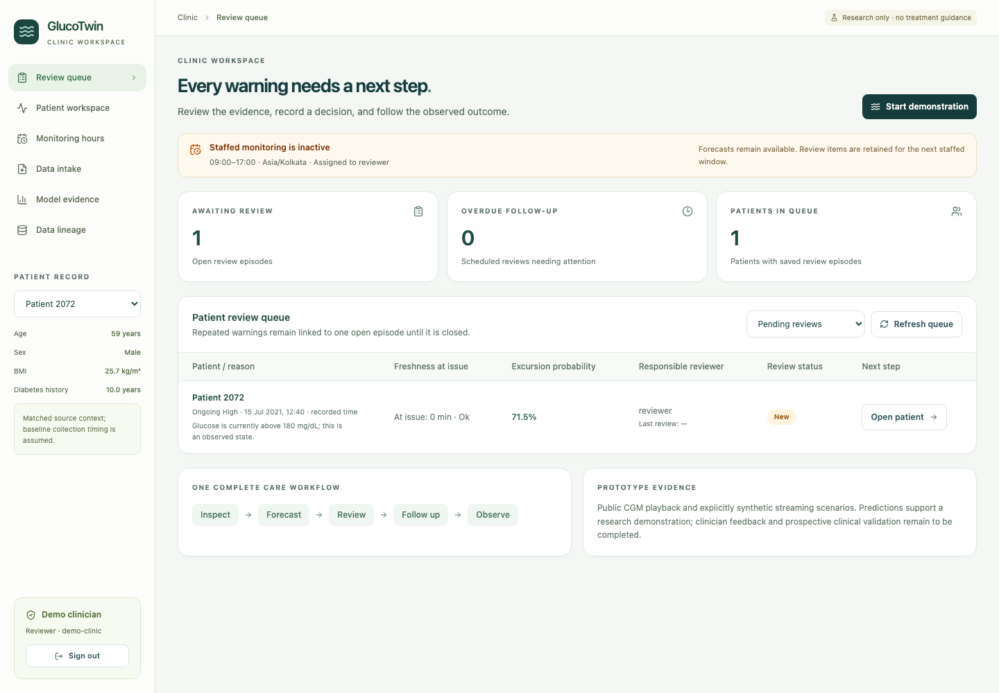
GLUCOTWIN / CARE WORKFLOW AND HANDOFF
Patient review queue
• Risk, freshness, ownership and review status
• Forecast and missing-data concerns distinguished
• Open the patient evidence directly
Actual local application capture
Freshness at issue is distinct from a live sensor connection.
alpha · vnrvjiet | Internal retrospective research prototype
13
Notes:
The review queue is the entry point for the care team. It brings the latest known state, forecast review items, reading freshness and responsibility into one place. A forecast concern is distinguishable from a missing-data concern. This prevents stale data from appearing reassuring. Opening a patient brings the reviewer to the evidence behind the item instead of a generic dashboard. A review item refers to issued evidence, and repeated readings do not create an endless stream of duplicate work. The queue also shows review status and overdue handling where configured. Its role is prioritization for human inspection. It is not a claim that the application can make an independent clinical decision. The chosen demonstration follows one actual recorded episode from this entry point through review and observed outcome. That keeps the three-minute story understandable while the benchmark provides the broader evidence needed to judge the model's performance.
Synthetic narration disclosed. Doctor workflow review pending.

Slide 14
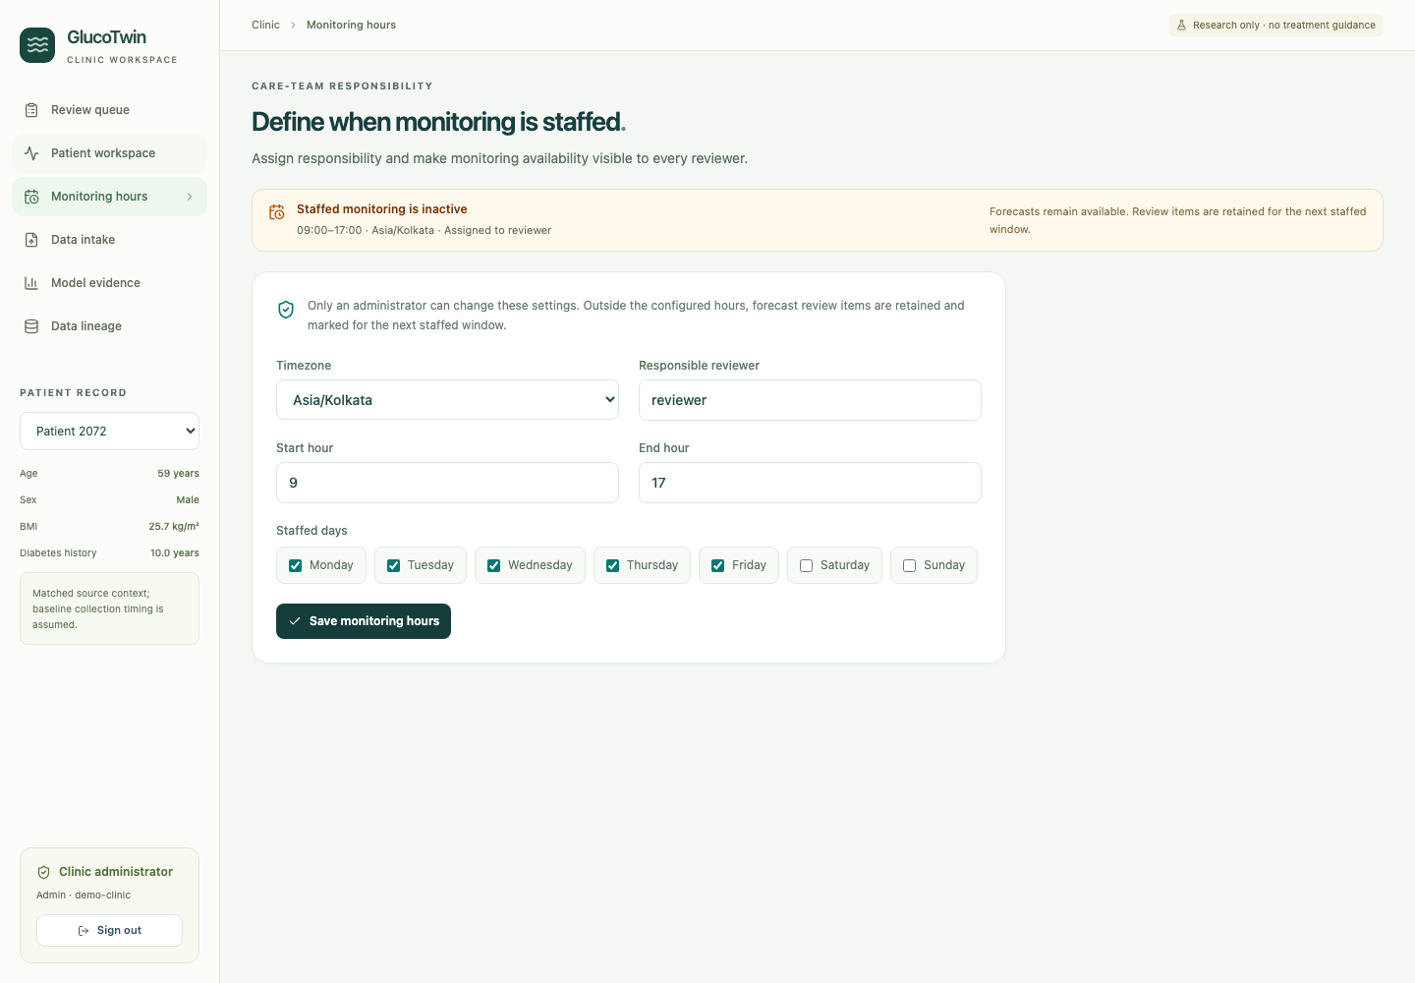
GLUCOTWIN / CARE WORKFLOW AND HANDOFF
Staffed monitoring windows
• Configured hours and assigned reviewer
• Visible active or inactive status
• Overdue review is an operational concern
Actual local application capture
Outside hours, items are retained with monitoring visibly inactive.
alpha · vnrvjiet | Internal retrospective research prototype
14
Notes:
A thirty-minute warning has practical meaning only if the workflow accounts for who can review it. The application therefore includes monitored hours and an assigned reviewer. During a staffed window, a review item can be shown to the responsible care team. An overdue indicator identifies an unresolved operational task. Outside the configured window, the interface states that active monitoring is unavailable and retains evidence for later review. It does not imply that someone is watching twenty-four hours a day. Recorded playback uses its simulation clock, while future live intake needs verified observation and arrival times. The doctor review packet asks for response expectations and escalation ownership. These choices should be settled with the clinical partner before any live-care use. The implementation can demonstrate the configuration and review loop now, but it cannot manufacture staffing or guarantee a response. The monitoring status is part of the evidence a reviewer sees alongside probability and freshness.
Synthetic narration disclosed. Doctor workflow review pending.

Slide 15
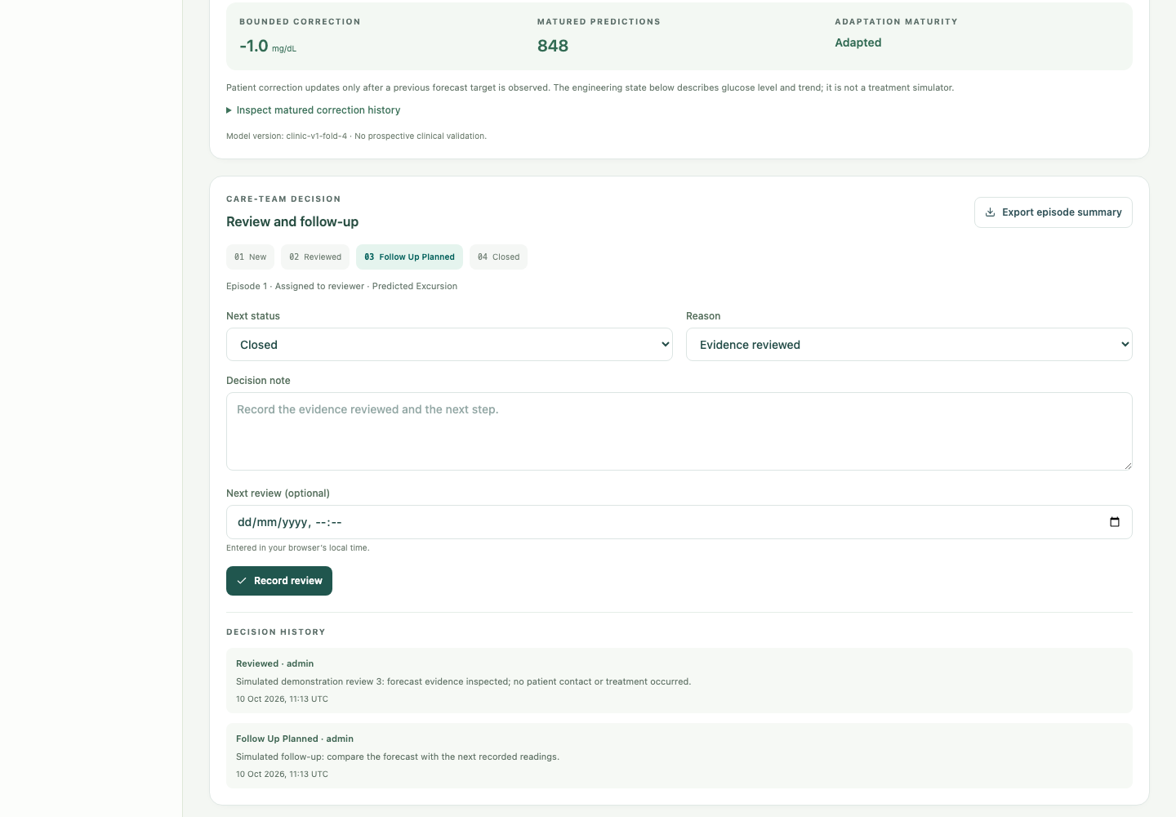
GLUCOTWIN / CARE WORKFLOW AND HANDOFF
Persistent review and follow-up
• New → reviewed → follow-up planned → closed
• Reviewer, time, reason, note and next review
• Action history survives restart
Actual local application capture
Acknowledgement changes workflow status, never forecast accuracy.
alpha · vnrvjiet | Internal retrospective research prototype
15
Notes:
The review process stores more than a dismissed notification. A new item can be reviewed, followed up and closed through documented actions. Each action records who performed it, when it happened and the reason or note. A next review date can be retained when follow-up is planned. These records survive a browser or application restart. The audit history helps explain what the care team did with the information. It remains separate from prediction generation. Acknowledgement does not change the forecast value, interval, event probability or eventual outcome. This distinction is tested because it is easy for a demonstration to accidentally conflate a completed workflow with a successful prediction. A false alarm can be closed with an explanatory note and remain a false alarm in evaluation. A missed event remains a missed event even if later follow-up was appropriate. The product preserves both kinds of evidence for review.
Synthetic narration disclosed. Doctor workflow review pending.

Slide 16
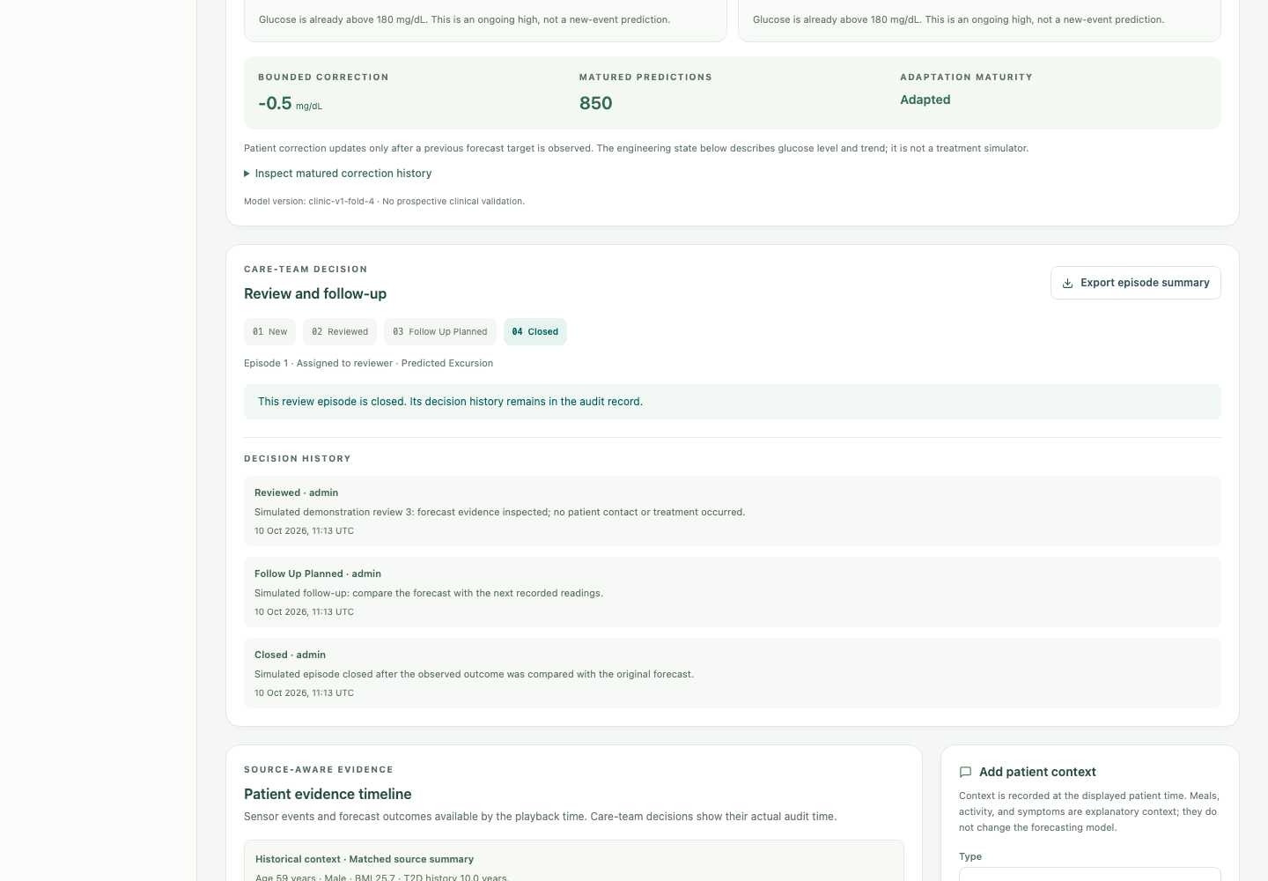
GLUCOTWIN / CARE WORKFLOW AND HANDOFF
Patient evidence timeline
• Glucose, context, predictions and outcomes
• Measured, synthetic and self-reported labels
• Late data retains its true availability time
Actual local application capture
The issue time and input cutoff reconstruct what was known.
alpha · vnrvjiet | Internal retrospective research prototype
16
Notes:
The patient timeline makes the order of information understandable. It combines measured glucose observations, historical context, saved predictions, later outcomes and care-team notes. Each source keeps its provenance. A synthetic diagnosis is marked synthetic. A meal or symptom entered by a person is marked self-reported. If a historical observation arrives late, its availability time is retained instead of making it appear available earlier. Previously issued forecasts preserve their input cutoff. This is essential for an honest reconstruction of a decision. The clinician can see not only what is now known, but what was known when the warning was issued. The timeline also shows data gaps and recent forecast errors. Those details help a reviewer understand why a prediction may be uncertain or unsupported. The system does not infer a causal meal effect from a note, and it does not simulate the effect of changing a medication without separate validated evidence.
Synthetic narration disclosed. Doctor workflow review pending.

Slide 17
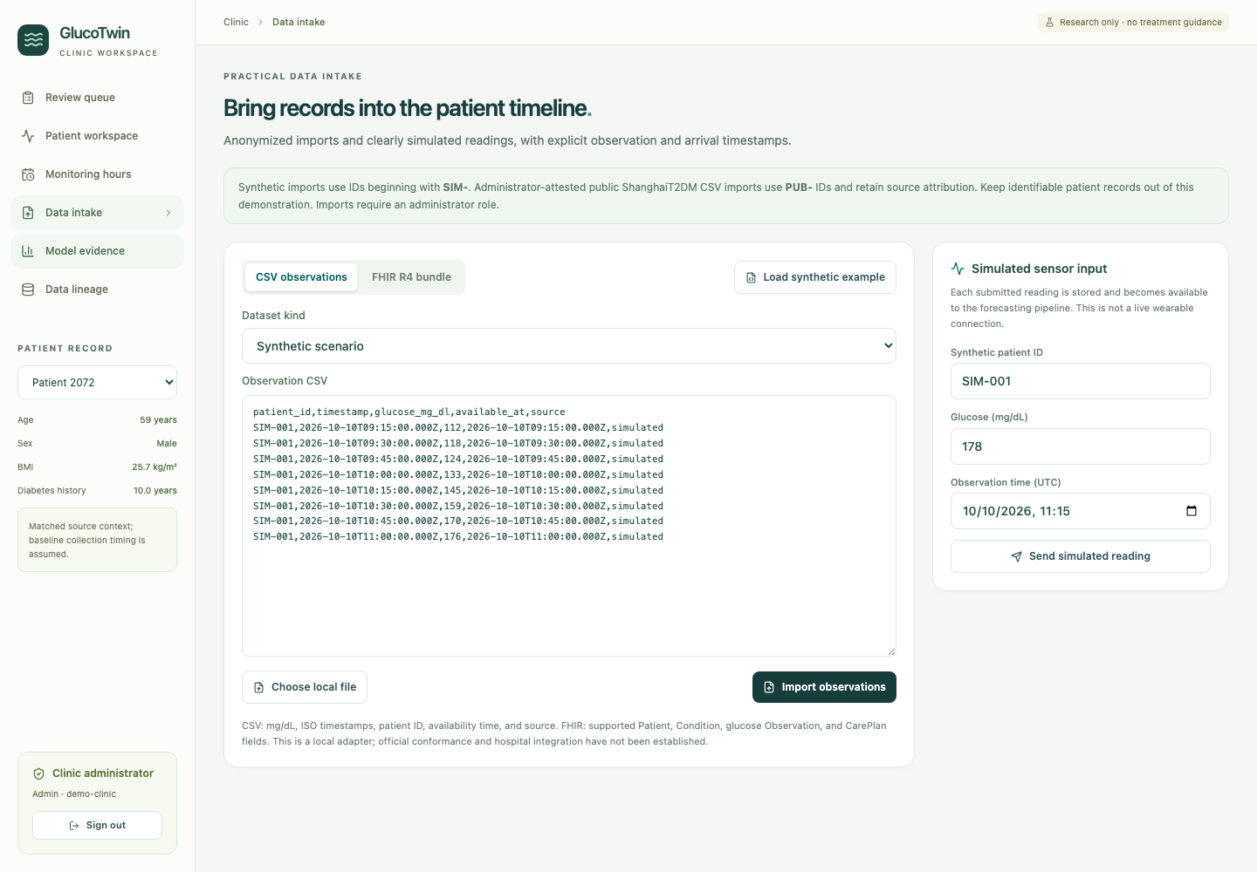
GLUCOTWIN / CARE WORKFLOW AND HANDOFF
Practical data intake
• Anonymized CSV and synthetic stream
• Limited Patient / Condition / Observation / CarePlan FHIR
• Identity, units, times and duplicate checks
Actual local application capture
Local FHIR intake is a prototype; conformance is unestablished.
alpha · vnrvjiet | Internal retrospective research prototype
17
Notes:
The intake screen gives the prototype a practical integration boundary. An anonymized CSV can provide timestamped glucose observations. A synthetic streaming control can send successive native-cadence readings through the same backend path. A limited local FHIR adapter accepts supported patient and clinical resources while checking identity references, required information and units. Observation time and arrival time are explicit. Duplicate inputs are handled idempotently, and invalid references or unsupported timing are rejected. The local adapter is an interoperability demonstration. It is not proof of live ABDM participation or a complete hospital integration. Official vendor CGM access is also a separate milestone. Some integrations can deliver historical or delayed observations, which cannot support a current thirty-minute warning. A future pilot must measure end-to-end latency rather than infer it from a vendor name. In the public demonstration, intake stays within the project's anonymized and clearly synthetic data boundary.
Source: https://www.nrces.in/ndhm/fhir/r4/index.html
Synthetic narration disclosed. Doctor workflow review pending.

Slide 18
GLUCOTWIN / CARE WORKFLOW AND HANDOFF
Consultation summary
01
Observed patterns and data coverage
02
Forecasts versus outcomes and unresolved reviews
03
Clinician notes and provenance
Export the same evidence the reviewer inspected.
alpha · vnrvjiet | Internal retrospective research prototype
18
Notes:
The consultation summary is a concrete output a clinician can use to review the record. It contains observed glucose information, the duration and completeness of available data, issued forecasts and their outcomes where known, unresolved review items and documented notes. Gaps and unsuccessful predictions remain visible. The report uses the same evidence as the interface so export does not become a separate source of truth. User-entered notes are handled as text, and protected downloads require the authenticated account. Short or fragmented recordings are identified. A brief recording cannot support the same stable pattern interpretation as a complete longer monitoring period. The summary therefore reports its observation coverage and evidence boundary instead of presenting an unsupported long-term assessment. For the hackathon, exporting this document closes the core journey and gives judges an artifact they can inspect. Future clinical use still requires the agreed validation, data arrangements and operating protocol.
Synthetic narration disclosed. Doctor workflow review pending.

Slide 19
GLUCOTWIN / CARE WORKFLOW AND HANDOFF
Access, audit and recovery
01
Reviewer/admin roles and clinic access
02
Environment secrets and persistent audit
03
Consistent backup and offline restore
Local controls work; clinical deployment controls remain separate gates.
alpha · vnrvjiet | Internal retrospective research prototype
19
Notes:
Deployment controls make the workflow reviewable and recoverable. The application authenticates users and distinguishes reviewer and administrator responsibilities. Patient routes are protected, and clinic identity limits access to records. Initial local credentials are generated into an ignored runtime location rather than committed to the public source. Secrets come from the environment or protected local runtime files. The database persists review and forecast records, and action history is retained. The backup tool uses SQLite's consistent backup mechanism, which includes committed changes even when write-ahead logging is enabled. Restore is an offline operation and does not silently overwrite an existing database. The local check verifies integrity and that stored review records survive recovery. These controls are engineering evidence. A future deployment must also address encrypted transport and storage, consent and retention, incident response and applicable privacy obligations. Successful authentication is not a certificate of compliance or clinical readiness.
Synthetic narration disclosed. Doctor workflow review pending.

Slide 20
GLUCOTWIN / CARE WORKFLOW AND HANDOFF
Clinical pilot gates
01
Doctor workflow review remains pending
02
Verify authorized source latency and Indian applicability
03
Shadow evaluation before alerts influence care
Shadow evaluation precedes any influence on care.
alpha · vnrvjiet | Internal retrospective research prototype
20
Notes:
The clinical roadmap starts with intended use, responsibility and evidence. The partner doctor should review the five prepared cases, agree staffed hours and response ownership, and identify misleading displays or inappropriate implied actions. That provides usability feedback, not clinical effectiveness. Authorized device timing and identity matching must be verified before live short-horizon warnings. Privacy, regulatory and ethics requirements need assessment for the intended use and pilot design. Prospective shadow evaluation should record frozen-model forecasts without influencing patient care, allowing performance and workload to be measured in the intended setting. Only after the agreed gates pass should a supervised clinical-use stage begin. The Shanghai benchmark does not establish Indian clinic performance. We retain this boundary because the product's credibility depends on describing what exists. The pilot roadmap is actionable, but a timetable alone cannot establish that its evidence or approval requirements have been met.
Source: https://www.imdrf.org/documents/software-medical-device-samd-clinical-evaluation
Synthetic narration disclosed. Doctor workflow review pending.

Slide 21
GLUCOTWIN / CARE WORKFLOW AND HANDOFF
Reproducibility and handoff
01
Source, setup, frozen protocol and benchmark
02
Architecture, presentation and demo assets
03
Team alpha · vnrvjiet · Shanmukh sai gara
Registration size 1; four coordinated delivery workstreams.
alpha · vnrvjiet | Internal retrospective research prototype
21
Notes:
The handoff package includes the source, dependency setup, data preparation, model evaluation, operating documentation and demonstration assets. A fresh environment can prepare the public dataset, launch the local application and repeat the reviewed journey. The frozen evaluation protocol, legacy benchmark and clinic benchmark remain available for inspection. Model versions and checksums identify the artifacts used in predictions. The architecture and presentation explain the evidence chain, and the doctor packet records the remaining workflow review. The actual automated product recording is included in the walkthrough so the presentation shows the implemented interface. This synthetic narration is disclosed. The registered team is alpha, with one member, Shanmukh sai gara, from vnrvjiet. Four workstreams describe delivery responsibilities rather than additional members. Public repository publication and platform submission must use the appropriate account and destination. No completed submission is implied by the presence of local files. The immediate contribution is a working and inspectable clinic prototype with reproducible evidence and a defined path to supervised clinical evaluation.
Synthetic narration disclosed. Doctor workflow review pending.

