Slide 2
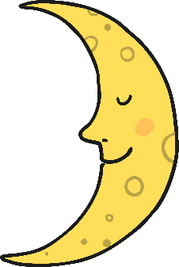
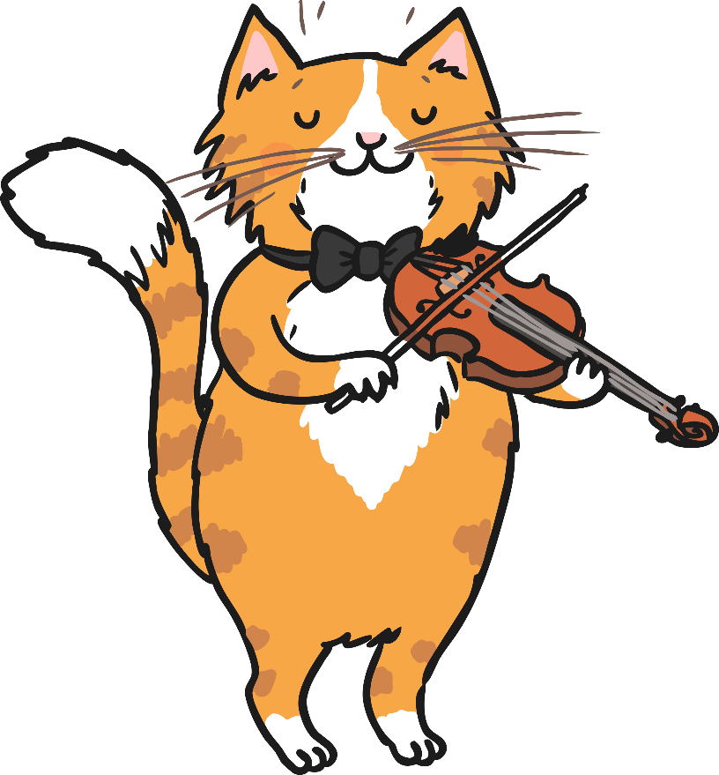
Hey diddle diddle, the cat and the fiddle,

Slide 3
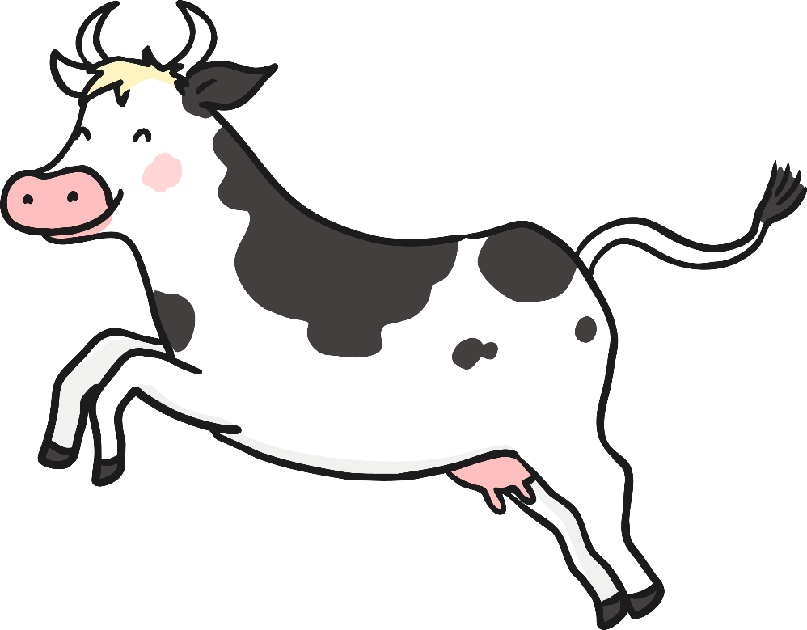

The cow jumped over the moon.

Slide 4
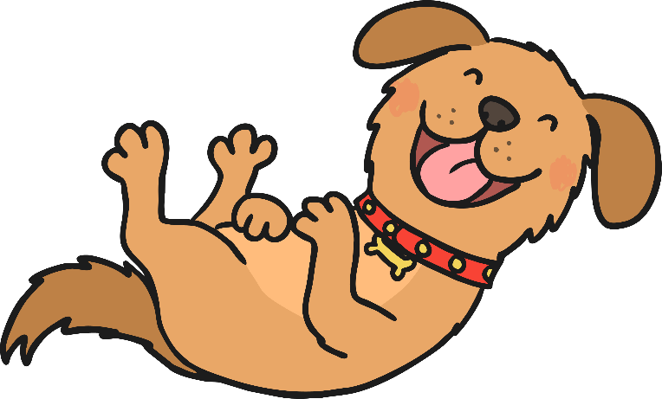
The little dog laughed to see such fun,

Slide 5
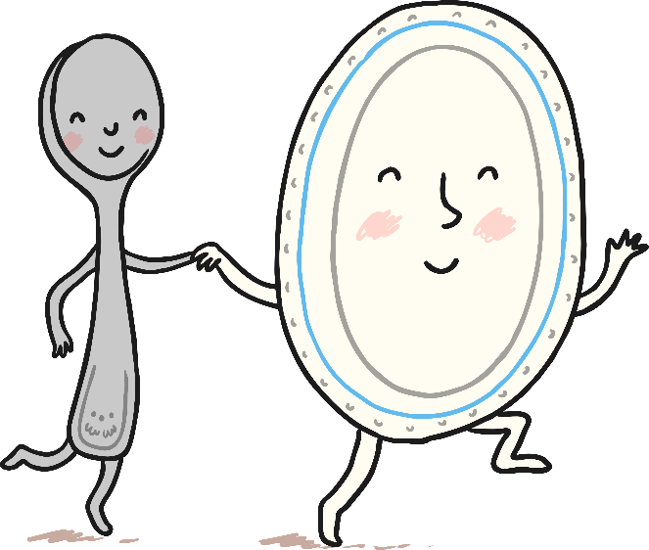
And the dish ran away with the spoon!

