Slide 1




Slide 2



Slide 3

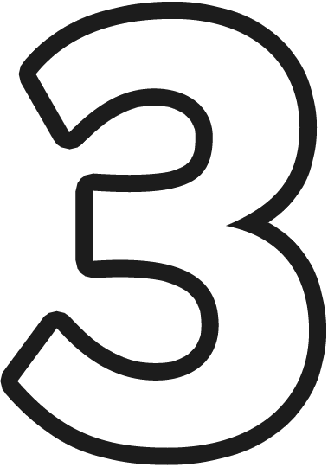


Slide 4




Slide 5




Slide 6




Slide 7


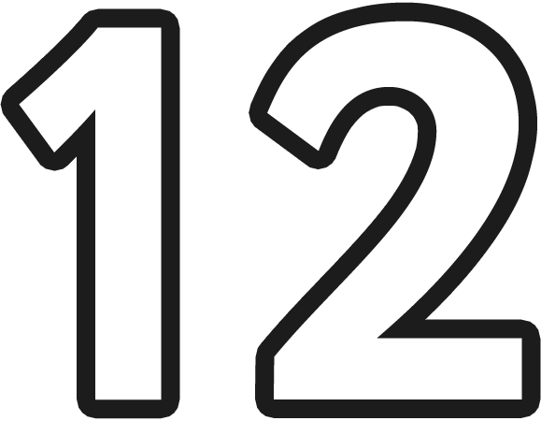

Slide 8




Slide 9




Slide 10




Slide 11




Slide 12

THE END

