Slide 1
Overview
Big Data Challenges
Distributed system and challenges
Hadoop Introduction
History
Who uses Hadoop
The Hadoop Ecosystem
  Hadoop core components
    HDFS
    Map Reduce
  Other Hadoop ecosystem components
    Hbase
    Hive
    Pig
    Impala
    Sqoop
    Flume
    Hue
    Zookeeper
Demo

Slide 2
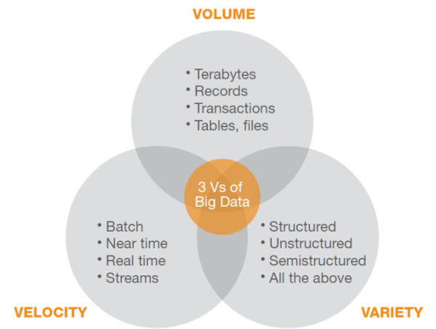
Big Data Challenges
Notes:
Reference for diagram: http://blog.vitria.com/bid/87945/Big-Data-Analytics-Challenges-Facing-All-Communications-Service-Providers

Slide 3
Distributed System Challenges
Programming Complexity
Finite bandwidth
Partial failure
The data bottleneck

Slide 4
New Approach to distributed computing
Hadoop:
A scalable fault-tolerant distributed system for data storage and processing
  Distribute data when the data is stored
  Process data where the data is
  Data is replicated

Slide 5
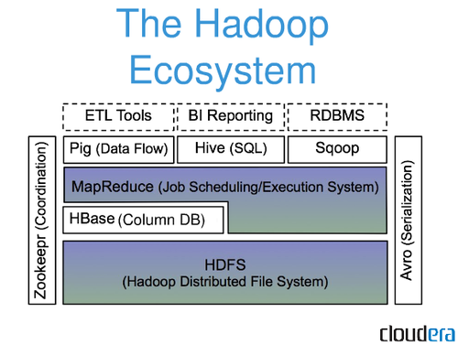

Slide 6
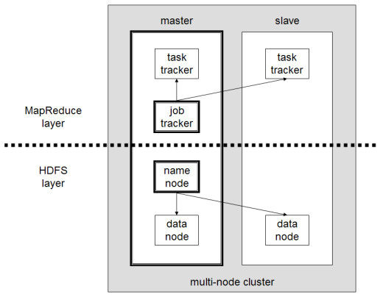
A multi-node Hadoop cluster
Notes:
Reference: http://en.wikipedia.org/wiki/Apache_Hadoop

Slide 7
HDFS
Hadoop Distributed File System (HDFS) is designed to reliably store very large files across machines in a large cluster. It is inspired by the GoogleFileSystem.
Distribute large data file into blocks
Blocks are managed by different nodes in the cluster
Each block is replicated on multiple nodes
Name node stored metadata information about files and blocks
Notes:
Definition by http://wiki.apache.org/hadoop/HDFS

Slide 8
Nodes
NameNode:
  Master of the system
  Maintains and manages the blocks which are present on the DataNodes
DataNodes:
  Slaves which are deployed on each machine and provide the actual storage
  Responsible for serving read and write requests for the clients
Jobtracker:
  takes care of all the job scheduling and assign tasks to Task Trackers.
TaskTracker:
  a node in the cluster that accepts tasks - Map, Reduce and Shuffle operations - from a jobtracker

Slide 9
HDFS
Hadoop Distributed File System (HDFS) is designed to reliably store very large files across machines in a large cluster. It is inspired by the GoogleFileSystem.
Distribute large data file into blocks
Blocks are managed by different nodes in the cluster
Each block is replicated on multiple nodes
Name node stored metadata information about files and blocks
Notes:
Definition by http://wiki.apache.org/hadoop/HDFS

Slide 10
What makes Hadoop unique
Moving computation to data, instead of moving data to computation.
Simplified programming model: allows user to quickly write and test
Automatic distribution of data and work across machines

Slide 11
Other Hadoop components in Ecosystem
HBase | Hadoop database for random read/write access
Hive | SQL-like queries and tables on large datasets
Pig | Data flow language and compiler
Oozie | Workflow for interdependent Hadoop jobs
Sqoop | Integration of databases and data warehouses with Hadoop
Flume | Configurable streaming data collection
ZooKeeper | Coordination service for distributed applications
Notes:
(Refer “Sources and References point 10” in article http://practicalanalytics.wordpress.com/2011/11/06/explaining-hadoop-to-management-whats-the-big-data-deal/ )

Slide 12
Hbase
HBase is an open source, non-relational, distributed database modeled after Google's BigTable.
It runs on top of Hadoop and HDFS, providing BigTable-like capabilities for Hadoop.

Slide 13
Difference between Hbase and HDFS
HDFS | Hbase
Good for storing large file | Built on top of HDFS. Good for hosting very large tables like billions of rows X millions of column
Write once. Append to files in some of recent versions but not commonly used | Read/write many
No random read/write | Random read/write
No individual record lookup rather read all data | Fast records lookup(update)

Slide 14
Hive
An sql like interface to Hadoop.
Data warehouse infrastructure built on top of Hadoop
Provide data summarization, query and analysis
Query execution via MapReduce
Hive interpreter convert the query to Map reduce format.
Open source project.
Developed by Facebook
Also used by Netflix, Cnet, Digg, eHarmony etc.

Slide 15
Pig
A scripting platform for processing and analyzing large data sets
Apache Pig allows to write complex MapReduce programs using a simple scripting language.
High level language: Pig Latin
Pig Latin is data flow language.
Pig translate Pig Latin script into MapReduce to execute within Hadoop.
Open source project
Developed by Yahoo

Slide 16
Pig
Pig Latin example:
A = LOAD 'student' USING PigStorage() AS (name:chararray, age:int, gpa:float);
X = FOREACH A GENERATE name,$2;
DUMP X;

Slide 17
Pig and Hive
Both requires compiler to generate Map reduce jobs
Hence high latency queries when used for real time responses to ad-hoc queries
Both are good for batch processing and ETL jobs
Fault tolerant

