Slide 1
QR CODE GENERATOR
SHANMUGAPRIYA D -CSE

Slide 2
OBJECTIVE
Create a QR Code Generator web application.
Allow users to input text or URL and generate corresponding QR Code instantly.
Provide a user-friendly interface for generating QR Codes for text or URL.

Slide 3
SOLUTION DESCRIPTION
Tool Used:
HTML,CSS and JavaScript.

Slide 4
PROJECT TIMELINE
Duration to complete:
I have taken to complete QR code Generator project within 4 days.
Reference:
I have referred from YouTube tutorials and Google Searches(W3Schools, Stack Overflow).
QR Code Reference: https://api.qrserver.com

Slide 5
FUTURE WORK
I have planned to complete QR Code Generator to Scanner in future for different industries.
Like Healthcare, Hospitality and Tourism.

Slide 6
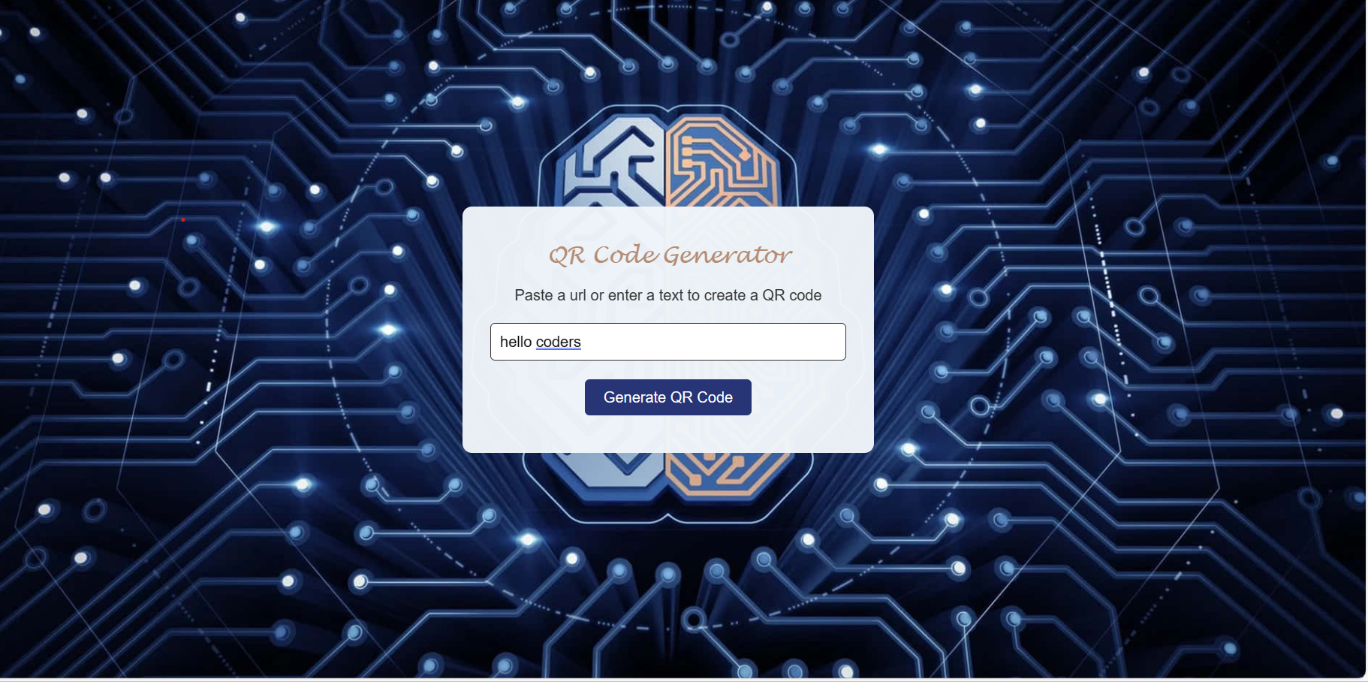
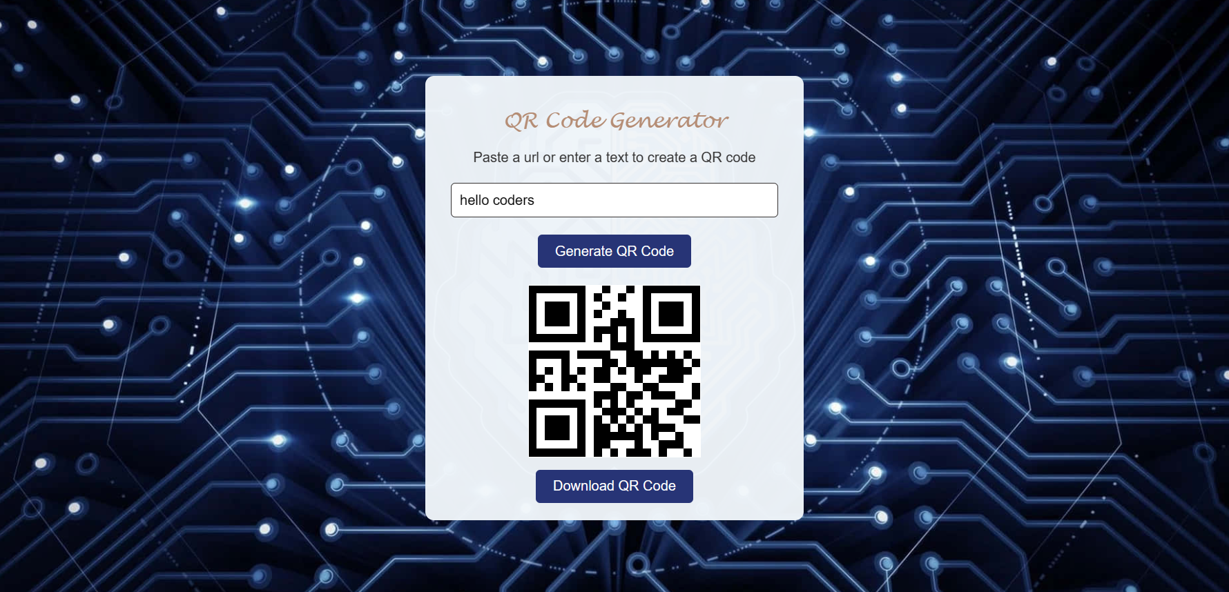
RESULTS AND OUTCOMES

