Slide 1

Mojo Story Composer
Summer 2026 Intern Project
Notes:
Hello everyone, thanks This is Story Composer, the project that we’ve been working on over the last couple of months

Slide 2




The Interns
Shannon Crandley
Van Davey
Hilson Jesus
Computer Engineer
Computer Engineer
Computer Scientist
MOJOTECH 2026

Slide 3



Overview
Story Composer Improves Issues at the Source
Story Composer is a tool that creates and refines Jira tickets using agentic AI.
MOJOTECH 2026
Notes:
A quick overview of Story Composer: Story Composer is an AI-assisted planning tool that guides teams through writing and technically refining software issues. It combines project documentation and codebase context through a guided conversation to produce a structured draft that people can review, edit, and promote to Jira.

Slide 4

Why This Matters?
Creating Jira tickets can be tedious and difficult to do alone, so the process is streamlined with Story Composer. Users can talk through the planning process and refine the issues as the agent reads through the codebase.
Benefits of Story Composer:
Updating and refining tickets using AI is in one application
Codebase is connected to the Jira ticket-planning process
Helps the PM refine the ticket without needing to manually search the codebase
Reduces ambiguity within tickets
The Business Value: Helps PMs and engineers generate detailed tickets using agentic AI without needing to manually search the codebase. Reduces time to turn a rough request into a reviewable, technically informed issue.
MOJOTECH 2026
Notes:
A little bit on why this matters:
The creation of a strong Jira issue can take longer than it first appears
PM may understand the business goal clearly, but not know where to start in the codebase, or which edge cases engineers will need to consider.
On the other hand, engineers also may need to understand the user need better, even if they understand the codebase well
Rather than requiring a PM or engineer to manually search through GitHub or waiting for a technical review before writing anything down, the app brings project-context to the issue-authoring process.
This does not replace PM or engineer in the planning process
We made Story Composer to accelerate preparation and surface questions that may have otherwise been missed
The business value is that PMs, tech leads, and engineers can spend less time trying to assemble context from separate tools, and more time making informed decisions. The outcome we are aiming for is clearer Issues, smoother handoffs, and development work that begins with fewer unknowns.

Slide 5

The Tech Stack
Framework & Language
SvelteKit
TypeScript
Vite
Auth
Better Auth
Atlassian OAuth
GitHub OAuth
AI / LLM Integration
Vercel AI SDK
OpenRouter
Tooling & Quality
ESLint + Prettier (with Tailwind/Svelte plugins)
svelte-check
Vitest
Nix
docker
Bun
Sveltekit app
Part 2
Part 3
Part 4
External Integrations
jira.js
Octokit
Database & Data Layer
PostgreSQL
Drizzle ORM
User Interface
Tailwind CSS 4
Lucide
Storybook
Marked and DOMpurify
Part 5
Part 6
Part 7
MOJOTECH 2026
Notes:
Our application is built with SvelteKit and TypeScript, with Vite supporting the front-end build process. For authentication, we use Better Auth. Users sign in through Atlassian OAuth, and GitHub OAuth lets them link their GitHub identity. We then use a GitHub App with Octokit to securely access the project’s codebase for technical refinement. For AI, we use the Vercel AI SDK with OpenRouter. This gives us a flexible way to use and switch between language models while keeping the agent workflow consistent. Jira.js handles our Jira integration, allowing reviewed Issues to be promoted to Jira. Our data is stored in PostgreSQL, with Drizzle ORM managing database queries and schema changes. On the UI side, we use Tailwind CSS for styling, Lucide for icons, and Storybook to build and test components independently. Marked converts the agents’ Markdown responses into displayable HTML, while DOMPurify sanitizes the resulting HTML before it reaches the interface. We also created a Docker container using our Nix-based environment, which helps make deployment and staging more consistent across machines. Finally, Bun, Nix, and direnv standardize our development environment, while ESLint, Prettier, svelte-check, and Vitest help us maintain code quality and catch problems early.

Slide 6
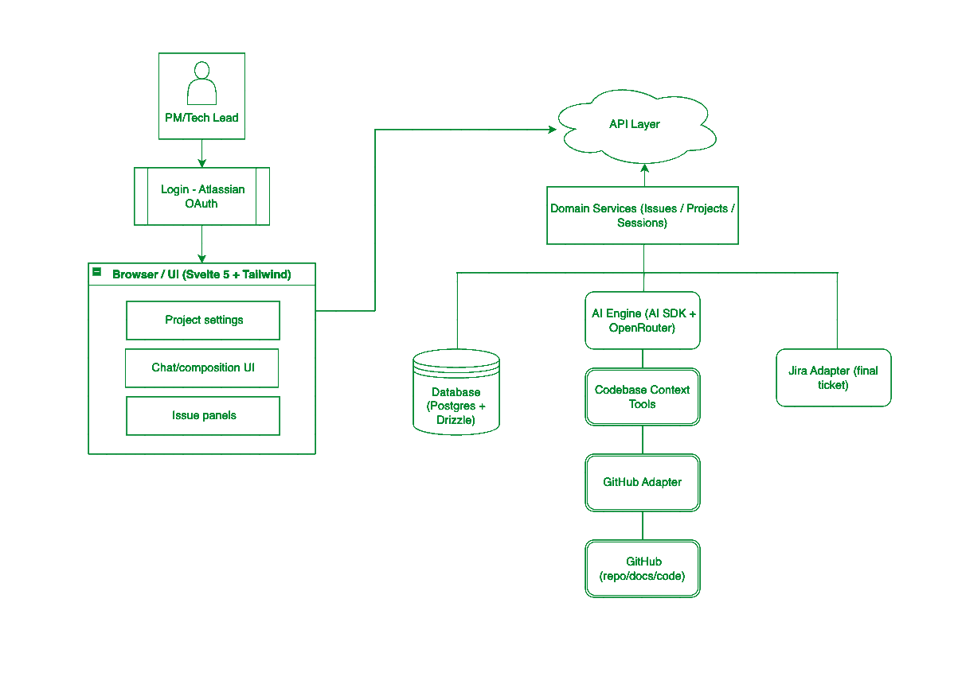
Architecture
AI Guided Chat - Turns a rough idea into a draft issue, grounded through the projects docs.
Codebase Aware - The agent also has access to the connected Github Repository.
Human In the Loop - Human review is still required. No Auto-Publishing or Auto-Authoring.
Two-step process before anything ships:
  Authoring Mode - grounded in project docs
  Technical Refinement Mode - grounded in the real code
Jira Promotion - When the issue is ready then the user can promote it to Jira.
MOJOTECH 2026
Notes:
At a high level, this is a ports-and-adapters architecture. It starts with users logging in through Atlassian OAuth, which serves as our identity provider — a natural starting point since Jira is the eventual destination for every issue. From there, everything flows through one API into our core domain logic, covering issues, projects, and sessions. That core is kept deliberately isolated — it never talks to a vendor directly. Instead, two things plug into it as adapters: an AI engine, and external services like GitHub and Jira. The AI engine is model-agnostic, so it's not locked to any one provider. GitHub, meanwhile, connects through Octokit to give the AI, codebase context — and to keep that context fresh, a webhook listens for pushes to the default branch and automatically refreshes it, so nothing goes stale. On the other side, Jira is where finished issues get promoted, but only once a human approves. And underneath all of it, that state — issues, sessions, connections — is persisted in Postgres.

Slide 7

The Demo
MOJOTECH 2026

Slide 8

MOJO STORY COMPOSER
The Agents
MOJOTECH 2026

Slide 9

Authoring
Refinement
Model-tiered field updates
Doc-grounded prompting
4 Phases:
  Preliminary - Fill fields based on first message
  Phase 1 - Work through all missing fields
  Phase 2 - Review Issue and recommend changes
  Phase 3 - Work through strengthening those weak fields
Defines how to build the work
Searches codebase using read-only tools
3 Phases:
  Phase 1 - understand the issue
  Phase 2 - Investigates the codebase
  Phase 3 - Produce and save the plan
Codebase Search Tools:
readRepositoryTree
readFile
searchCode
getRecentCommits
Same conversational model - both run on defaultModel via streamText
MOJOTECH 2026
Notes:
Story Composer uses two specialized AI agents to guide Issue authoring and refinement. The Authoring Agent helps a product manager turn an idea into clear business requirements, while the Technical Refinement Agent uses read-only codebase context to turn those requirements into a realistic implementation plan. The agents provide structured, grounded suggestions, but a human remains in control: nothing is sent to Jira until it has been reviewed and approved.
What it does
The Authoring agent doesn't just chat and hope the issue gets filled in, it actually calls a separate structured-output agent behind the scenes to update the issue fields. So there's this two-agent connection happening: the conversational agent handles the back-and-forth with the user, and whenever it decides a field is ready to be written, it hands that off to the structured update agent, which is model-tiered, meaning we can use a lighter or heavier model depending on how complex that particular field update is. That's the "model-tiered field updates" piece.
Doc grounding
On top of that, everything it suggests is doc-grounded, anchored in the project's actual documentation, not just general knowledge.
The four phases
It works through this in four phases. First, a preliminary step takes the user's very first message and does a first pass at filling in whatever fields it can. Phase 1 works through all the fields that are still missing. Phase 2 is a review step, it looks at the issue as a whole and recommends changes. And Phase 3 goes back through the weaker fields specifically, the ones that got filled in but could use more depth, and strengthens those.
The refinement agent mirrors the authoring agent and works in a similar format: receive context, use the codebase search tools, stream a response, and save the structured results. Additionally, both agents use the same model for simplicity. The main difference is the input of the first prompt and the context delivered to the refinement agent, as the codebase search tools are called when the user asks to generate a refinement plan, as opposed to authoring agent, which requires the user to explicitly ask the agent to use the codebase search tools.

Slide 10




Model Choice
Reasoning model (defaultModel candidates):
Extraction model (fastModel):
Model | Verdict | $ In/out
Sonnet 5 | Not fast and occasionally hallucinated tool calls that don't exist | $2 / $10
Sonnet 4.6 | Solid speed and reliability, less conversational | $3 / $15
Opus 5 | Great quality, but by far the slowest and most expensive | $5 / $25
GPT-5.6 Sol | Highly conversational, sometimes too verbose, very efficient with token use | $5 / $30
GPT-5.6 Luna | Best speed-to-performance ratio; most inexpensive; less conversational | $0.2/ $1.2
GPT-5.6 Terra | Stronger than Luna, more conversational, slightly pricier | $2 / $12
Model | Verdict | $ In/out
Haiku 4.5 | Handles detailed tickets and clears issues well; pricey | $1 / $5
Gemini 3.5 Flash | Solid speed and reliability, occasionally fails to clear; pricey | $1.5 / $9
Gemini 3.6 Flash | Same output quality as 3.5 | $1.5 / $7.5
GPT-5.4 Mini | Fastest of the group | $0.25 / $2
GPT-5.6 Luna | Cheapest option; still reasonably quick | $0.2/ $1.2
MOJOTECH 2026
Notes:
Capability / reasoning
- Reasoning depth, can it handle multi-step, ambiguous, or open-ended tasks vs. simple pattern-completion
- Instruction-following fidelity, how reliably it sticks to a schema or format
- Context window, how much surrounding conversation/doc/code it can actually take in at once
Cost
- Price per input token / output token, often 10-20x difference between tiers
- Total cost per request, smaller models are cheaper even before volume
Speed
- Latency per request, smaller models return faster, which matters for a UI waiting on a field update
- Throughput, how many requests can run concurrently without rate-limit pressure
Output characteristics
- Determinism / consistency, smaller, narrower tasks tolerate more deterministic, constrained models well
- Structured output reliability, some models are simply better at hitting a JSON/schema shape without drifting
- Creativity vs. precision, conversational tasks benefit from more "creative" reasoning; field-writing benefits from precision
Practical/architecture
- Provider flexibility — using OpenRouter/AI SDK means you can swap tiers without changing your integration code
- Rate limits / availability — cheaper models often have more generous limits, useful for high-frequency background tasks like field updates

Slide 11

Risks and Mitigations
AI output can be incomplete/inaccurate
Every result remains a draft until a person reviews, edits and promotes it.
Available project context may be incomplete
In Progress
Story Composer uses project documentation and code while asking users to clarify missing information.
Not Started
Jira or GitHub may be unavailable temporarily
Not Started
Composition sessions are saved so work is not lost and the action can be retried.
Not Started
MOJOTECH 2026
Notes:
The first risk is that AI output can be incomplete or inaccurate. The mitigation is that a product manager or engineer can review every field, edit anything that needs to change, and decide whether the Issue is ready to be promoted to Jira. The AI accelerates the work, but the person remains accountable for the final result.
The second risk is incomplete project context. Story Composer can use connected project documentation and code, but business decisions or future requirement can update overtime. That is why the authoring experience is conversational. When important information is missing, the agent can ask the user for clarification rather than pretending that it has complete context.
Finally, Story Composer depends on systems like Jira and GitHub. Those services can be temporarily unavailable, or a connection may need to be renewed. Our approach is to preserve the composition session, so the user’s work is not lost. The Issue remains available as a draft, and the user can retry an external action once the connection is working again.

Slide 12

The Future of Story Composer
Ability to Give More Context
Continuous Project Health
Flexible AI Model Selection
Upload product briefs, design files, and meeting notes
Attach PDFs, screenshots, or specifications to a chat
Use added files as temporary Issue context without changing the repository
Detection of stale or duplicate issues
Flag test gaps, vulnerabilities and outdated dependencies
Recommend backlog priorities
Choose from available models in Project Settings
Balance response quality, speed, and cost
Change models without changing the project setup or workflow
MOJOTECH 2026
Notes:
The first direction is giving the agent more context beyond the connected repository. A codebase is important, but a project’s most useful information does not always live in GitHub. It may be in a product brief, a design specification, or meeting notes. In the future, a user could attach those materials directly to a chat so the agent can consider them while working on a specific Issue.
The second direction is continuous project health. Instead of only helping at the moment an Issue is written, Story Composer could help teams notice when their backlog and their codebase drift apart. It could flag stale or duplicate Issues, identify test gaps or maintenance risks, and suggest a priority order for the backlog. These would remain recommendations for the team to review, not automatic changes.
Finally, we want the user to be able to have a selection of AI models to choose from in the project settings. Users will be able to choose the model that best fits their needs, whether they prioritize response quality, speed, cost, or a specific type of task. For example, someone working on a quick, straightforward Issue might prefer a faster and less expensive model, while a more complex task could benefit from a more capable model.

Slide 13
Impact on the Interns
Hands-on experience for the software engineering development cycle
All three of learned Typescript
Improved our ability to code review and debug
Understanding how to create an application end to end
  APIs
  Front-end development
  Back-end development
  Agentic AI use
We are in a strange time as we enter our engineering careers, where AI is both a tool and a hindrance. Does it help our progress rather than hurt our learning?
MOJOTECH 2026
Notes:
This engineering internship provided us an insight into what software dev is like in industry. We have had the chance to talk to many people within the company who fill many roles, such as engineers, AI experts, and people in leadership roles. We were able to ask questions freely, and never felt lost or confused, as our mentors were always there to fill the gap. We are extraordinarily lucky to have this opportunity, and we have learned so much from so many different people in the company. The project taught us about end-end development, and we were also able to learn a new coding language. We became more proficient in code review and debugging, and we expanded on our knowledge of front-end, back-end, APIs, and agentic AI use. The one question that we still feel unanswered is something that we will have to figure out ourselves over time, but we will leave you with it: When does AI help our progress rather than hurt our learning?

Slide 14
MOJO STORY COMPOSER
Thank You!
Questions?
MOJOTECH 2026

