Slide 1
What makes a successful movie?
Done by: Pranwanth, Malcolm and Shannen
Team Number: 12
Lab Group: FSP7

Slide 2

What makes a successful movie?
Which factor is the best in predicting the success of a movie?
Revenue ≥ 2 x Budget
Release Month
Production Companies
Genres
Budget

Slide 3



Extracting the data

Slide 4
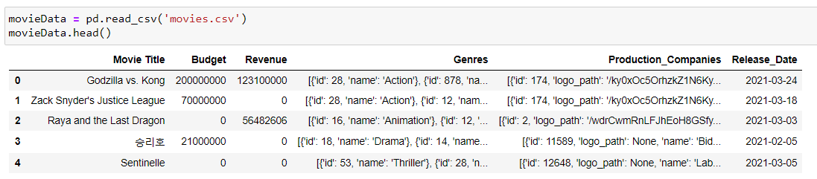
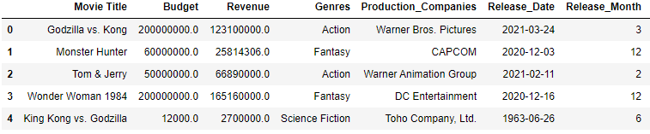
Cleaning the data
Before:
After:

Slide 5

Exploratory Data Analysis

Slide 6
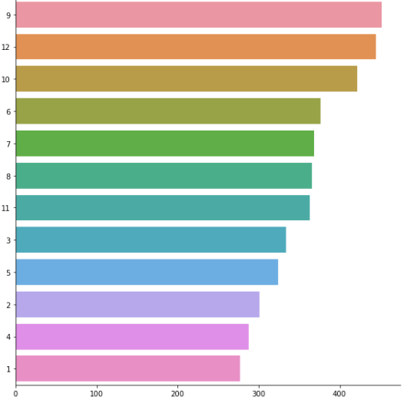
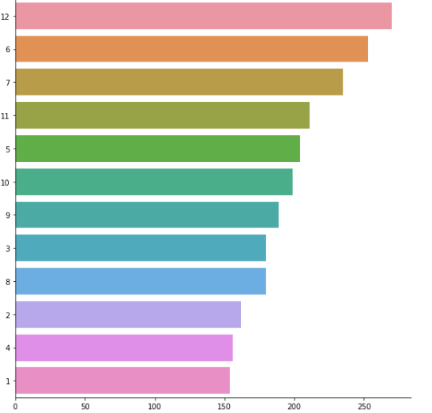
Release Month
Release Month
Release Month
Number of Movies Released
Number of Successful Movies Released

Slide 7
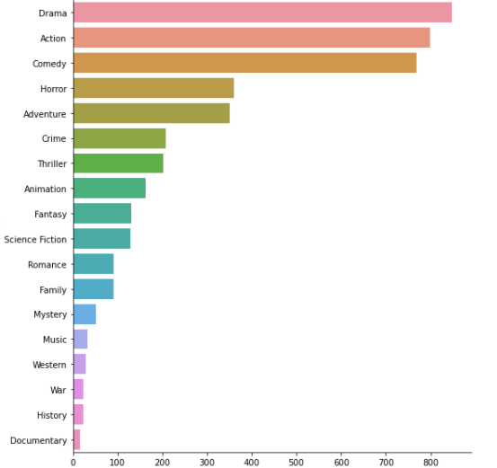
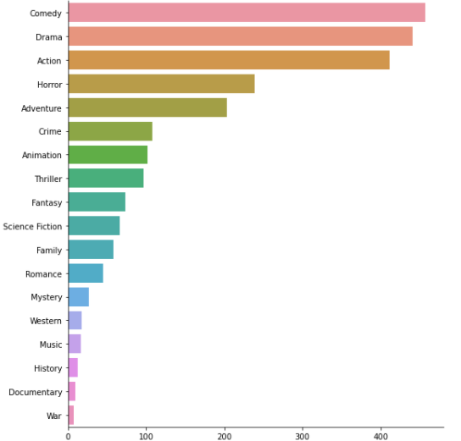
Genres
Genre
Genre
Number of Movies Released
Number of Successful Movies Released

Slide 8
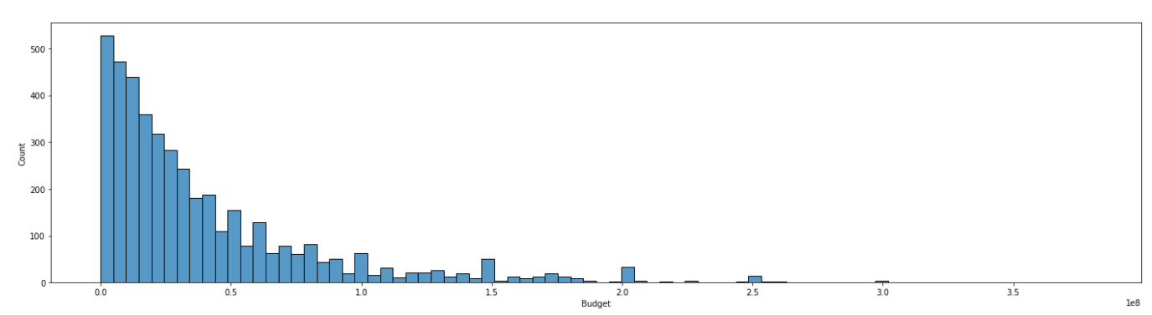
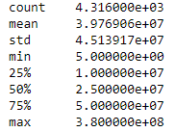
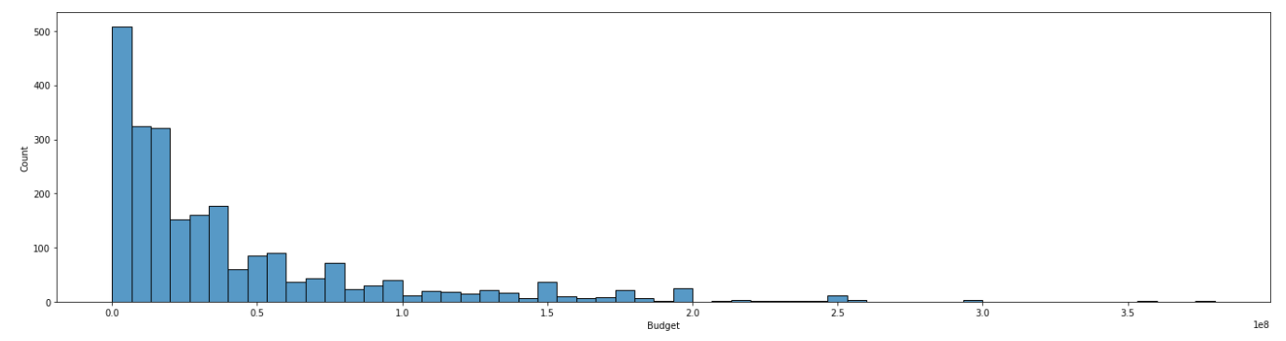
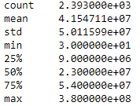
Budget
Number of Movies Released
Budget
1e8
Number of Successful Movies Released
Budget
1e8

Slide 9
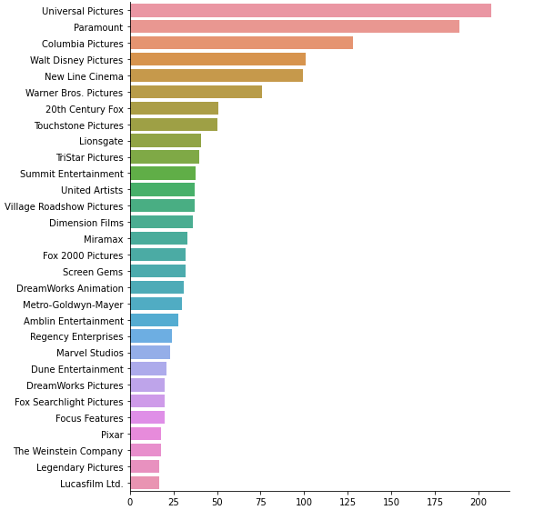
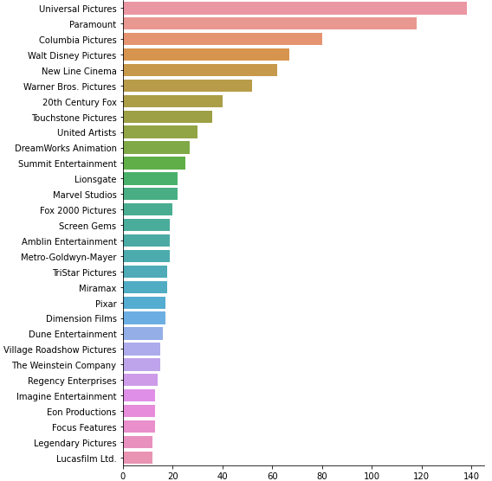
Production Companies
Production Company
Production Company
Number of Movies Released
Number of Successful Movies Released

Slide 10

Machine learning
Classification
Why we used classification and how it solves our problem
How did we apply ML techniques to solve our problem, which models, how and why

Slide 11
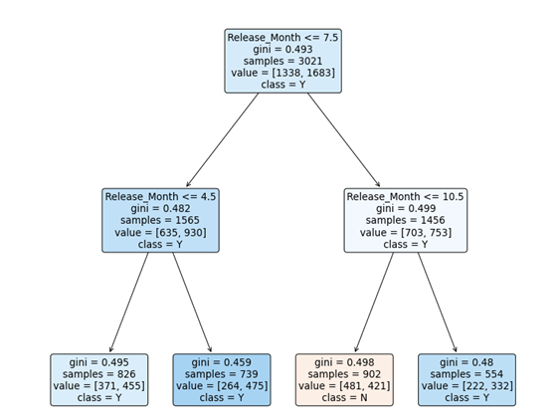
Machine Learning
Models Used:
Classification
Multi-Variate Classification

Slide 12
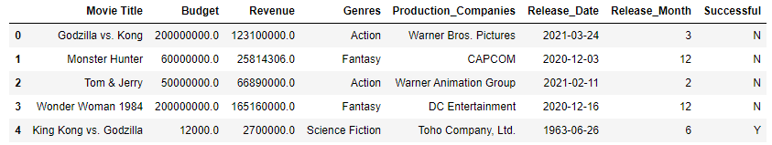
Machine Learning
Revenue ≥ 2 x Budget

Slide 13
Predictor Variables
Response Variable
Release Month
Genres
Successful
Budget
Production Companies

Slide 14
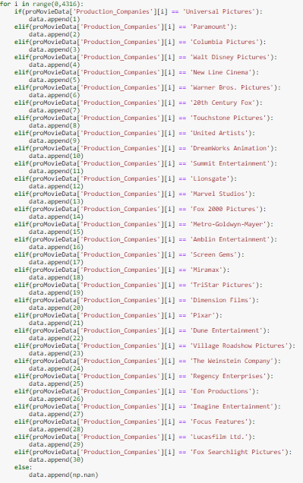
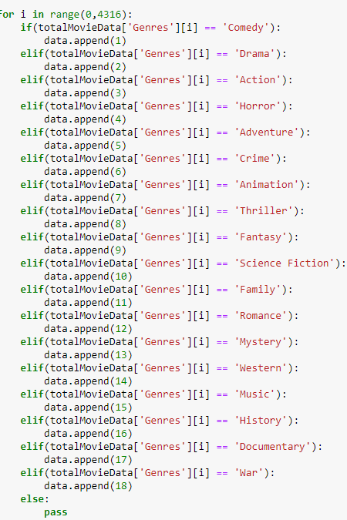


Slide 15
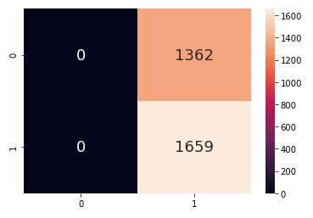
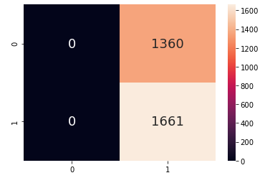
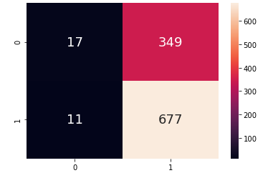
Classification Model
(Initial Approach)
Genre
Budget
Production Companies

Slide 16


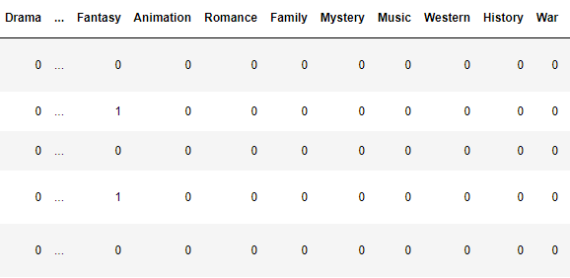
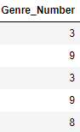
Under-Sampling
One-Hot Encoding

Slide 17
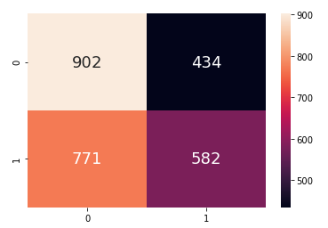


Improving our model

Slide 18
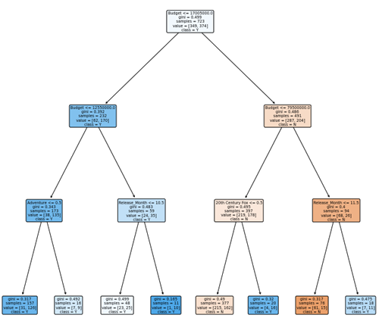

Multi-Variate Classification model
Budget
Production Companies
Genres
Release Month

Slide 19





Outcome

Slide 20



New insights!

Slide 21


New insights!

Slide 22

Thanks!

Slide 23
References
https://slidesgo.com/
https://commons.wikimedia.org/wiki/File:Jupyter_logo.svg
https://www.postman.com/company/press-media/
https://medium.com/swlh/exploratory-data-analysis-in-seconds-60767e2fbe0
https://velocityglobal.com/blog/forget-machine-learning-humans-still-a-lot-to-learn-about-themselves-ii/
https://www.google.com/imgres?imgurl=https%3A%2F%2Fimage.flaticon.com%2Ficons%2Fpng%2F512%2F1556%2F1556198.png&imgrefurl=https%3A%2F%2Fwww.flaticon.com%2Ffree-icon%2Fdecember_1556198&tbnid=MozeSJEgyL20WM&vet=12ahUKEwj69YehxJTwAhVSUysKHQWvC0IQMygHegUIARCXAQ..i&docid=WorP8SBrszUHJM&w=512&h=512&q=december%20calendar%20icon&safe=strict&ved=2ahUKEwj69YehxJTwAhVSUysKHQWvC0IQMygHegUIARCXAQ
https://www.google.com/url?sa=i&url=https%3A%2F%2Fdryicons.com%2Ficon%2Fflat-laughing-with-tears-emoticon-icon-8927&psig=AOvVaw3Cej_-WlgviNwxgB8iHJ2N&ust=1619273175359000&source=images&cd=vfe&ved=0CAIQjRxqFwoTCMjVmejElPACFQAAAAAdAAAAABAF
https://www.google.com/url?sa=i&url=https%3A%2F%2Fwww.dreamstime.com%2Fstock-illustration-stickman-banner-teamwork-stickmen-text-image53704260&psig=AOvVaw1hmqyK9p5M5w3tagyBfTgn&ust=1619273279172000&source=images&cd=vfe&ved=0CAIQjRxqFwoTCNi_1JfFlPACFQAAAAAdAAAAABAD

