Slide 1
QUANTUM MACHINE LEARNING · COMPUTATIONAL FLUID DYNAMICS
Benchmark of Quantum-Assisted
Physics-Informed Neural Networks
1D Navier–Stokes Shock-Tube Simulation Surrogate
Shan Zeng · David Liu
shan.zeng@hotmail.com
dqliu@purdue.edu
Notes:
Title. The core idea: hold everything fixed — parameter budget, interface, physics loss — and vary only whether a quantum circuit replaces part or all of the network.

Slide 2
The Benchmark
Governing Law of the Physics
The simulator solves the 1D viscous compressible Navier–Stokes equations in conservation form:
Mass continuity
∂ρ/∂t + ∂(ρu)/∂x = 0
ρ
gas compresses as it decelerates
Momentum balance
∂u/∂t + u·∂u/∂x = −(1/ρ)∂p/∂x + ν·∂²u/∂x²
u
pressure and viscosity slow the flow
Energy balance
∂T/∂t + u·∂T/∂x = −(γ−1)T·∂u/∂x + (κ/ρ)∂²T/∂x²
T
compression work heats the gas
Notes:
The governing system. Genuinely coupled: pressure ties density and temperature into momentum; the mass flux ρu ties velocity into continuity; compression converts flow work into heat.

Slide 3
Ground Truth
Classical Simulations: 1D Navier–Stokes Shock-Tube Simulation
Inputs:
[x, t, p_ratio, mu, rho_L, rho_R, p_R]
The solver
The classical method uses:
An explicit Lax–Friedrichs update for the inviscid flux.
An implicit backward-Euler update for viscosity and Fourier heat conduction.
Adaptive time steps based on the CFL condition.
A uniform finite-volume grid.
A mass-conservation quality check for every generated scenario.
Parameter | Meaning | Default sweep range
x | Spatial coordinate | 0–1
t | Time coordinate | 0–0.2
p_ratio | Left/right pressure ratio | 2–20
mu | Dynamic viscosity | 0–0.02
rho_L | Initial left density | 0.5–2.0
rho_R | Initial right density | 0.05–0.5
p_R | Initial right pressure | 0.05–0.3
Outputs:
[rho, u, p]: 255 x 41 grid
Notes:
Ground-truth data. The LHS sweep across 5 parameters × 41 snapshots × 256 points yields millions of labelled rows per field; the mass-drift gate keeps the reference trustworthy.

Slide 4
The Question
Does a quantum layer strengthen how a PINN learns?
Why should hybrid or fully quantum Physics-Informed Neural Networks (PINNs) be explored for surrogate physics modeling, and how can their architectures—including quantum data encoding, parameterized ansätze, qubit mapping strategies, embedded quantum layers, and physics-informed loss functions—be designed to improve accuracy, computational efficiency, and adherence to physical conservation laws in sparse-data settings?
Model | Hidden architecture
MLP | Four hidden layers, each 128 neurons with Tanh
Classical PINN | Same 4 × 128 architecture as MLP; physics equations are added through the loss
QAPINN (hybrid) | Four hidden stages; one classical 128 → 128 stage is replaced by a quantum layer
QPINN | No classical hidden neural-network layers; uses repeated quantum encoding and ansatz blocks
Notes:
Motivation and the controlled design. The three cards are the three levers we hold or vary.

Slide 5
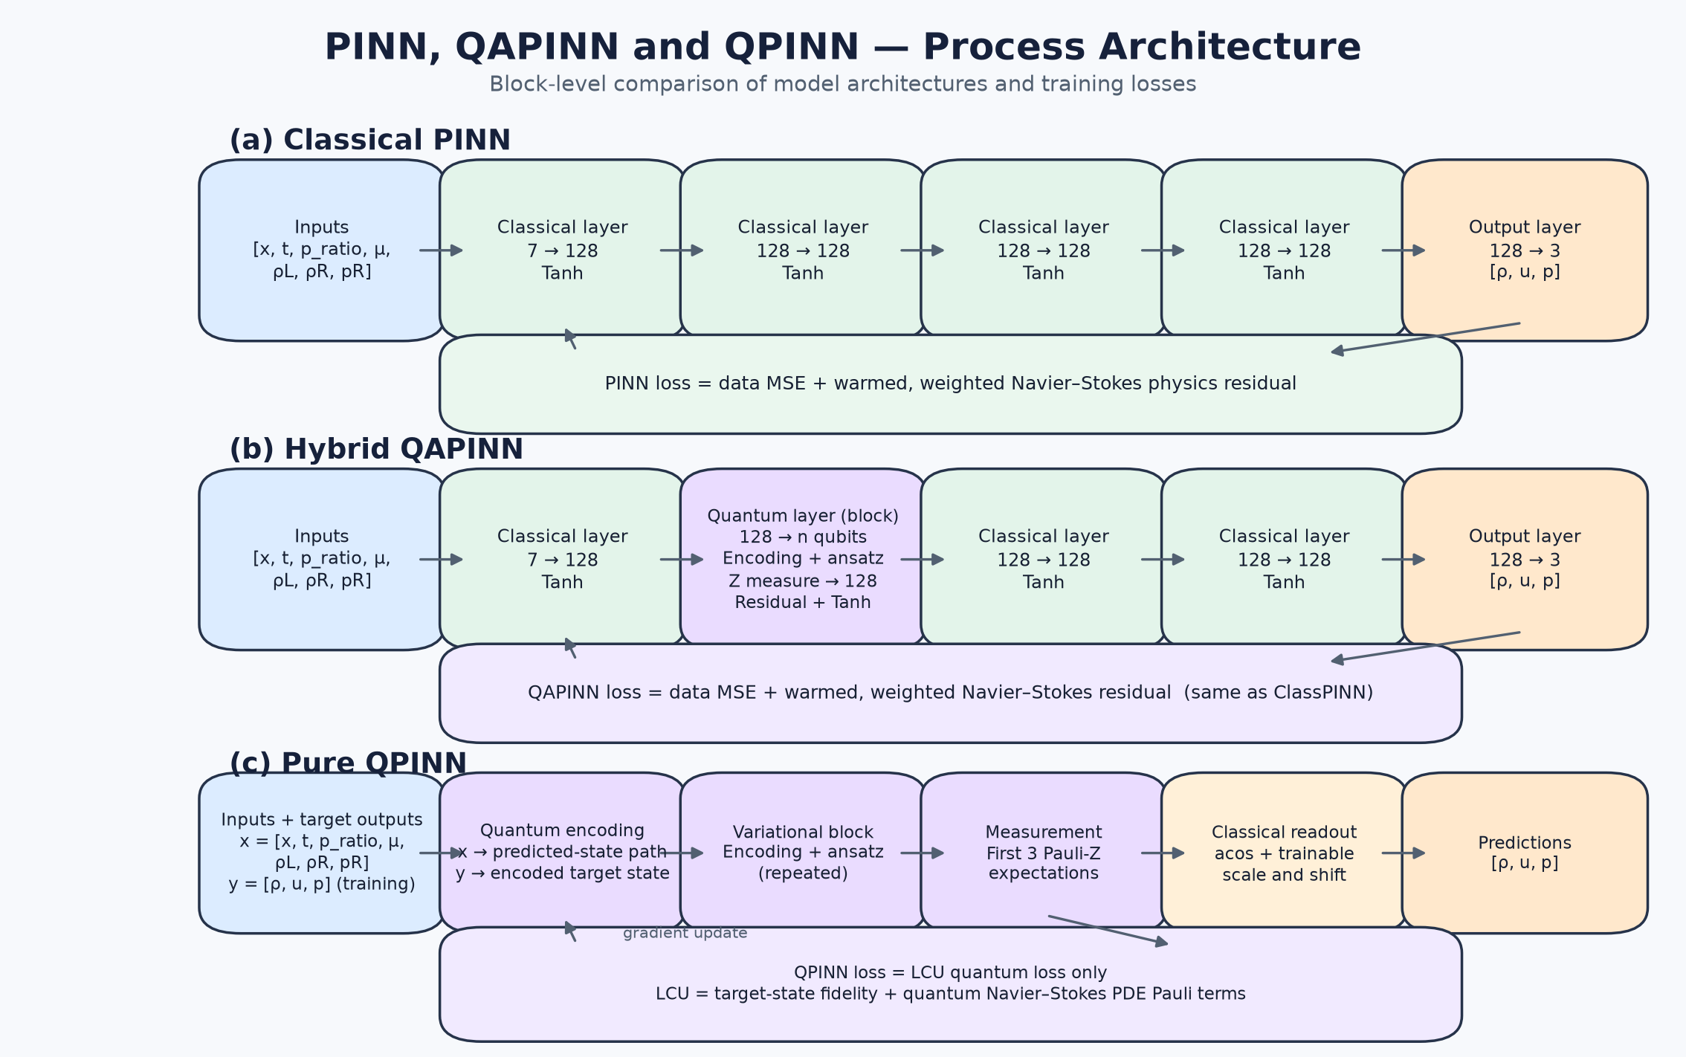
ML Sturctures
Notes:
Motivation and the controlled design. The three cards are the three levers we hold or vary.

Slide 6
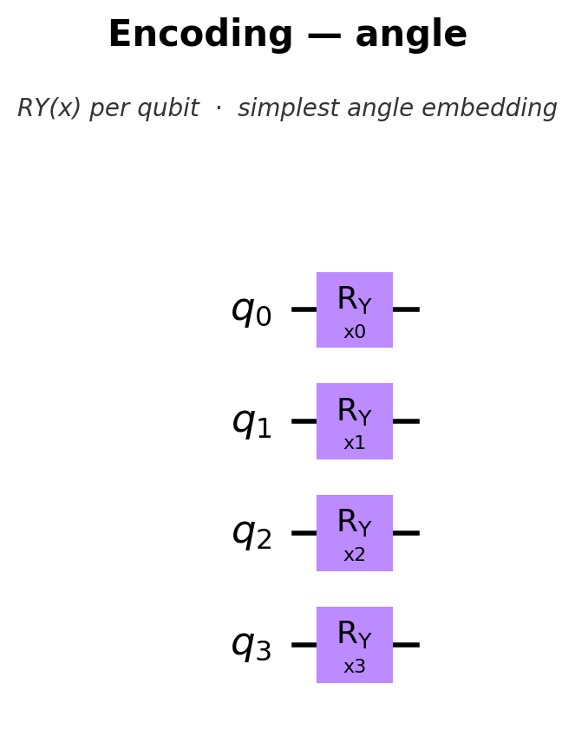
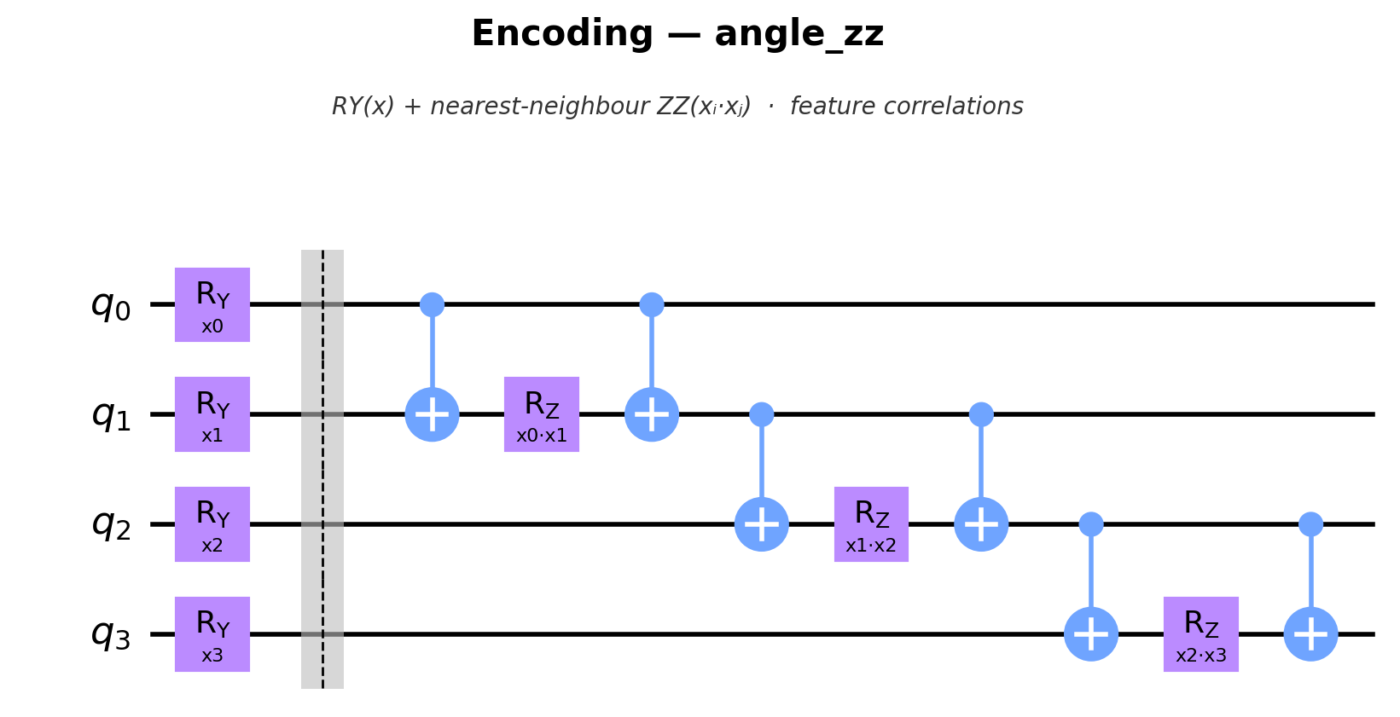
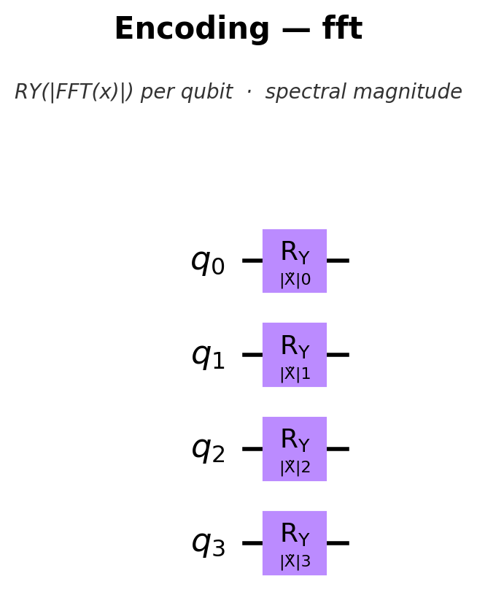
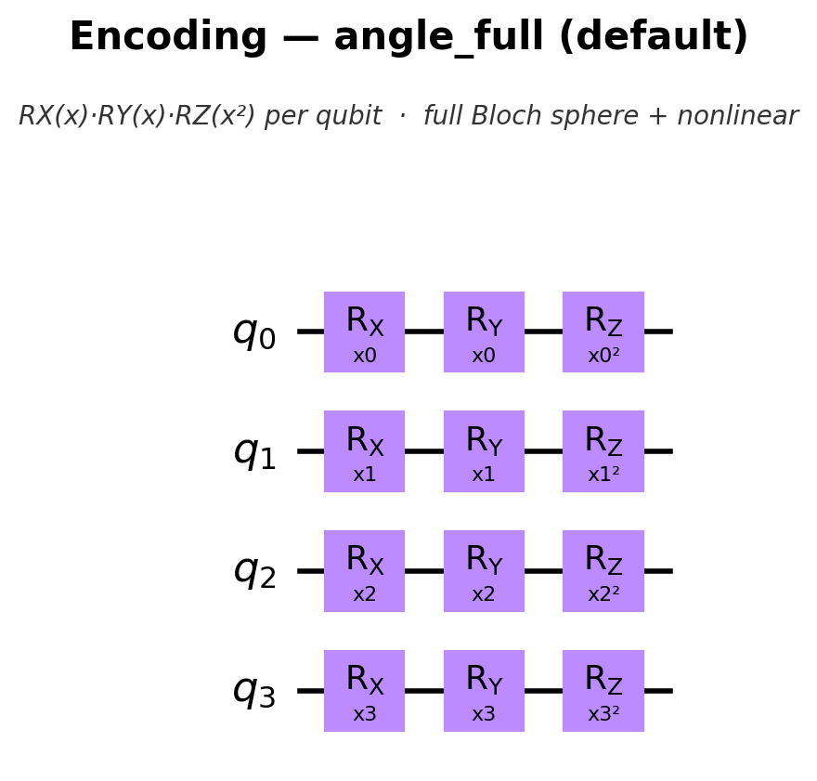
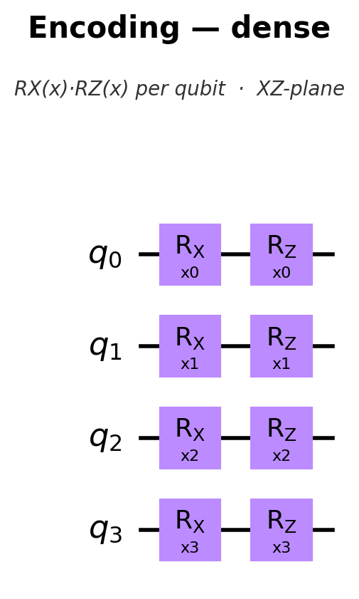
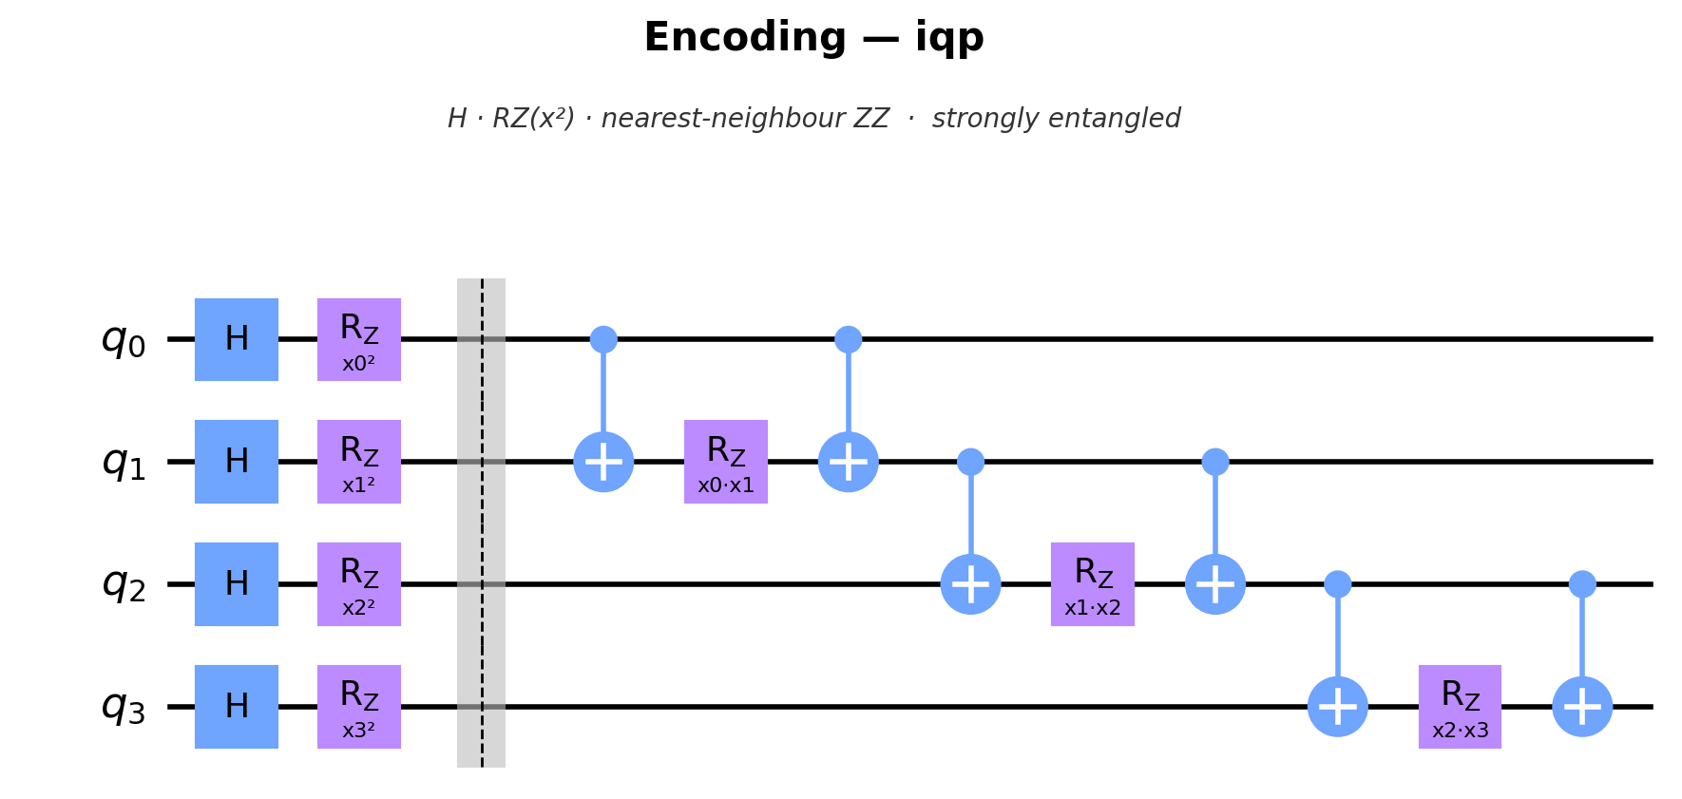
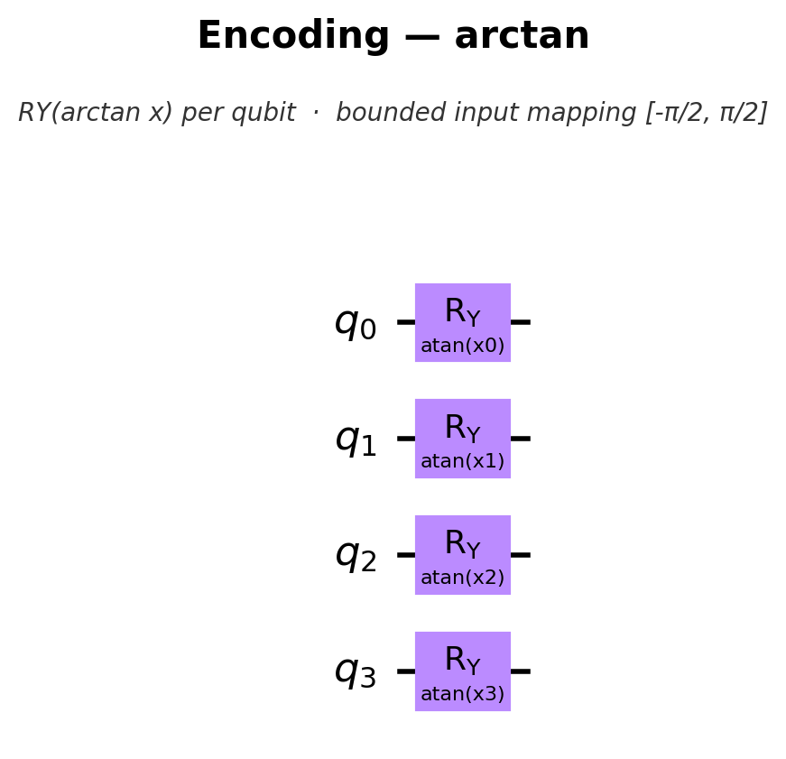
Different Encoding
Quantum encodings
utilities_quantum_torch.py implements:
angle
angle_full
angle_zz
dense
arctan
iqp
amplitude
fft
fft_phase
fft_full
Notes:
The physics loss is redesigned as the full constraint set. L_cons guards against globally mass-violating solutions that still look locally accurate.

Slide 7
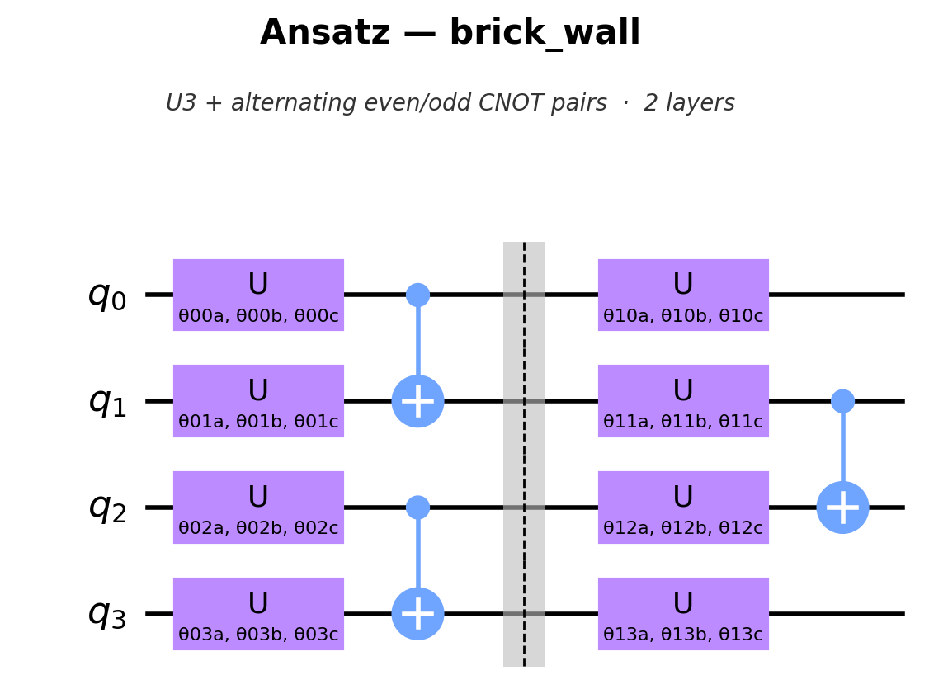
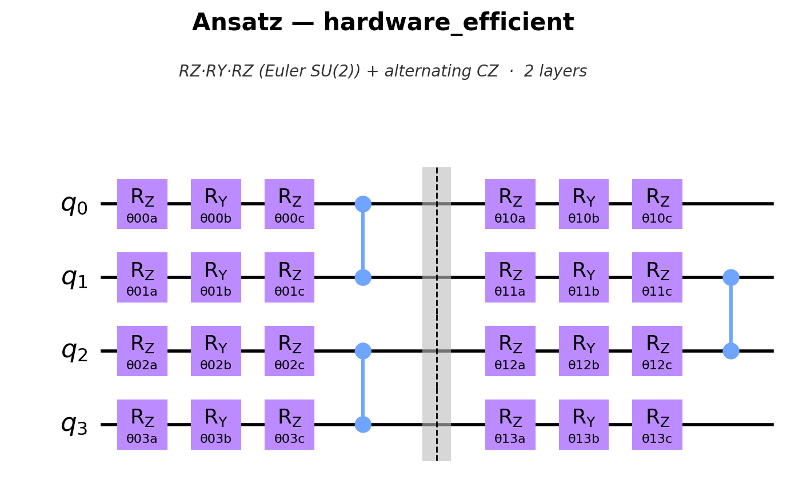
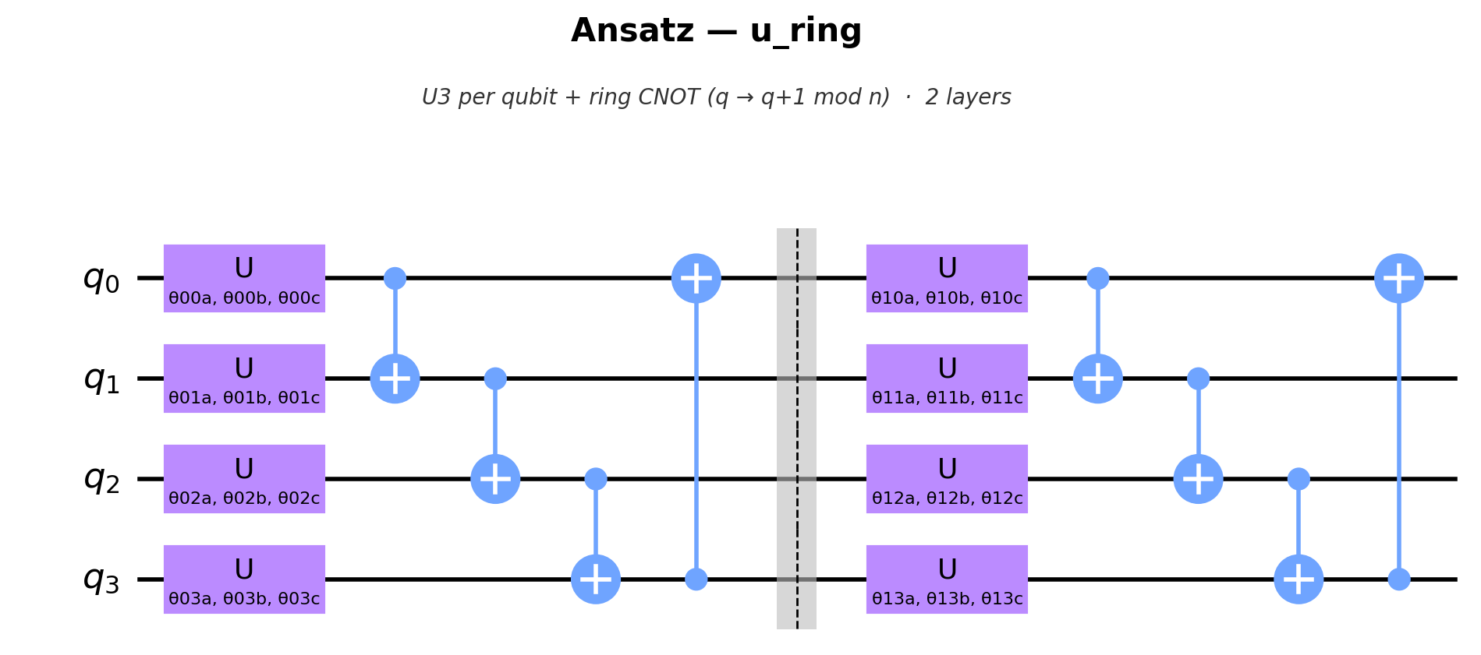
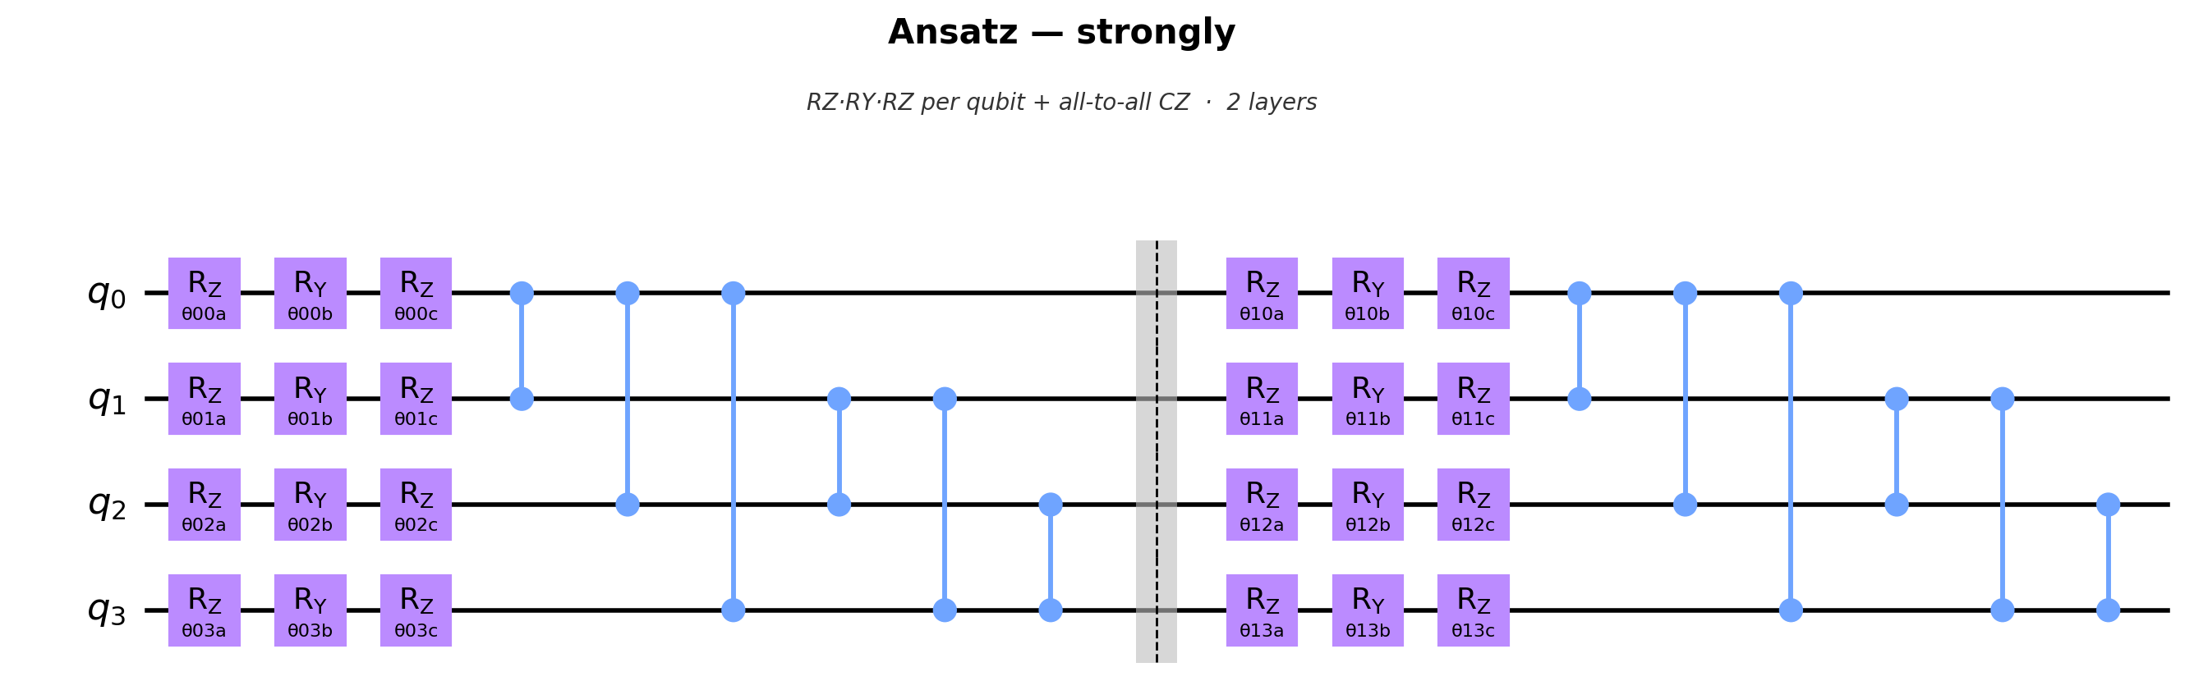
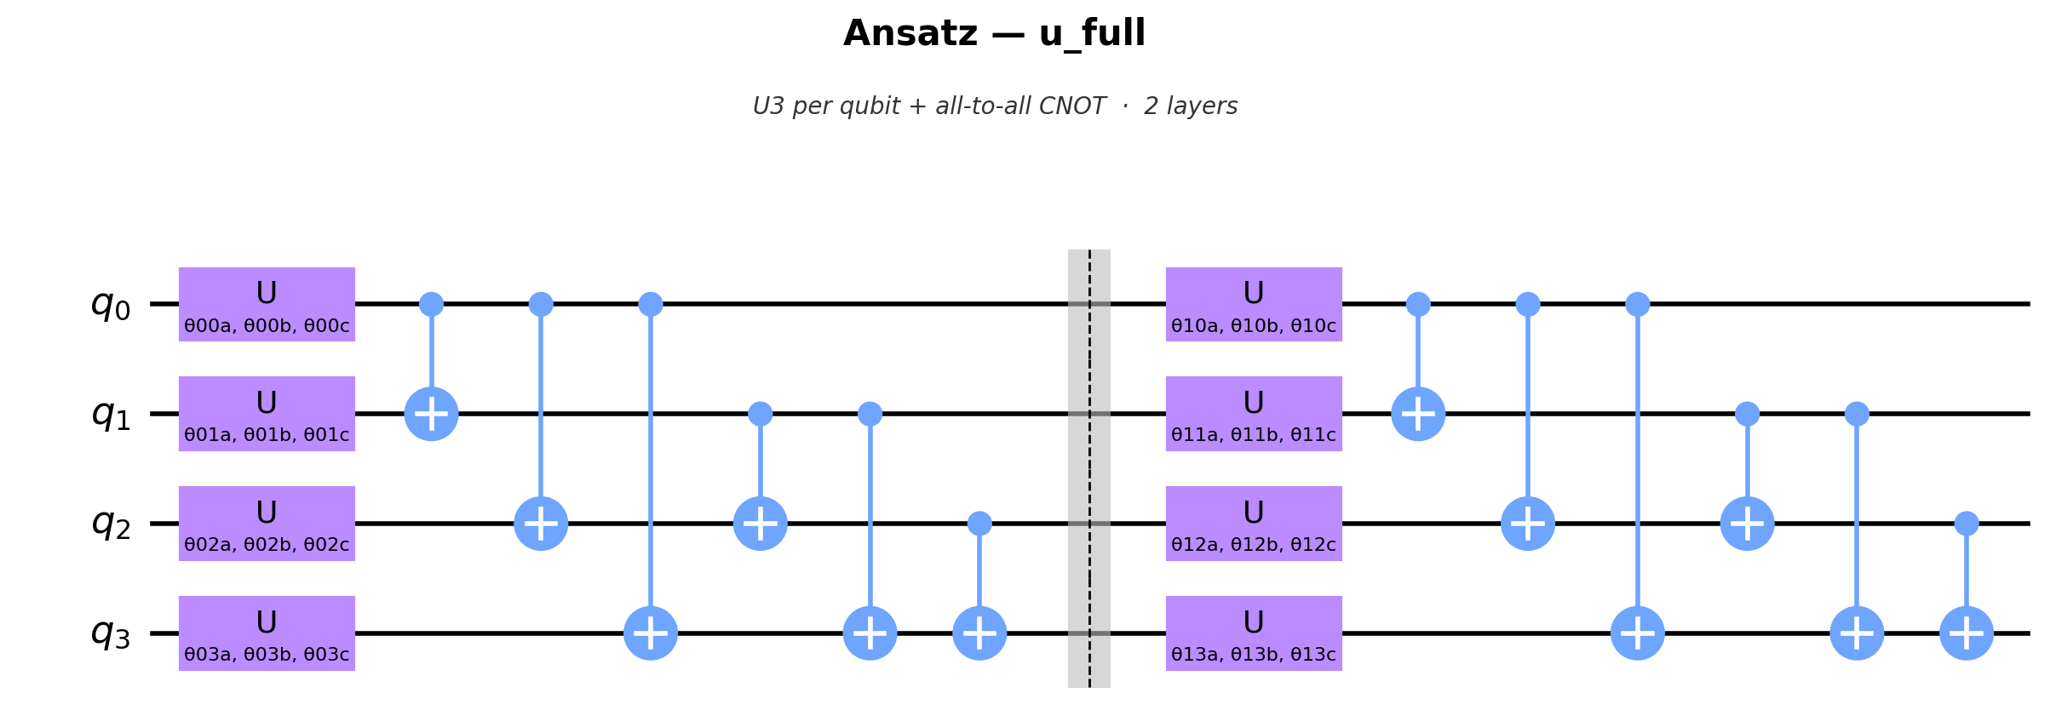
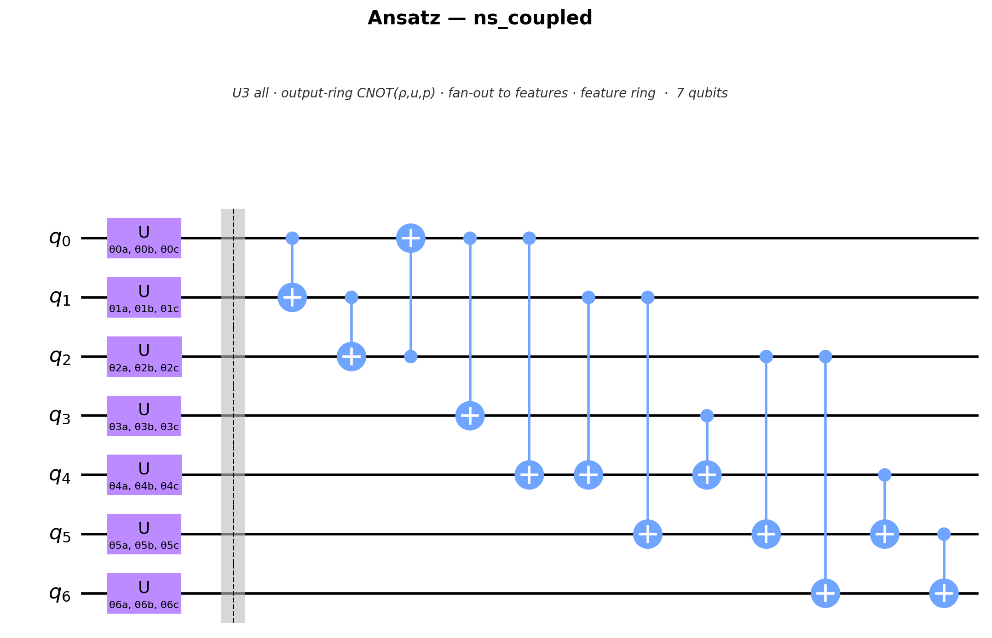
Different Anzats
Quantum ansatzes
The quantum utility module implements:
u_ring
u_full
u_alternate
efficient_su2
real_amplitudes
strongly
ns_coupled
brick_wall
hardware_efficient
Notes:
The physics loss is redesigned as the full constraint set. L_cons guards against globally mass-violating solutions that still look locally accurate.

Slide 8
Key Contribution
Prediction and loss as measurements of one wavefunction
A
Branch A — Prediction
Why it matters
Data-register observable ⟨Z₀⟩ → the field value
Variational
quantum circuit
The differential operator is block-encoded as a linear combination of unitaries (LCU), so the residual is a native measurement — no classical post-processing.
Both branches co-train; on hardware, residual derivatives come from the parameter-shift rule.
one shared wavefunction
B
Branch B — Quantum loss
Ancilla observable reads the block-encoded PDE residual norm
Rather than computing the physics residual classically after measurement, Branch B reads it directly from an ancilla register — connecting prediction and loss in a single quantum model.
Notes:
The two-branch fully quantum model — the most forward-looking element. It removes the classical residual computation that dominates standard quantum-PINN cost.

Slide 9
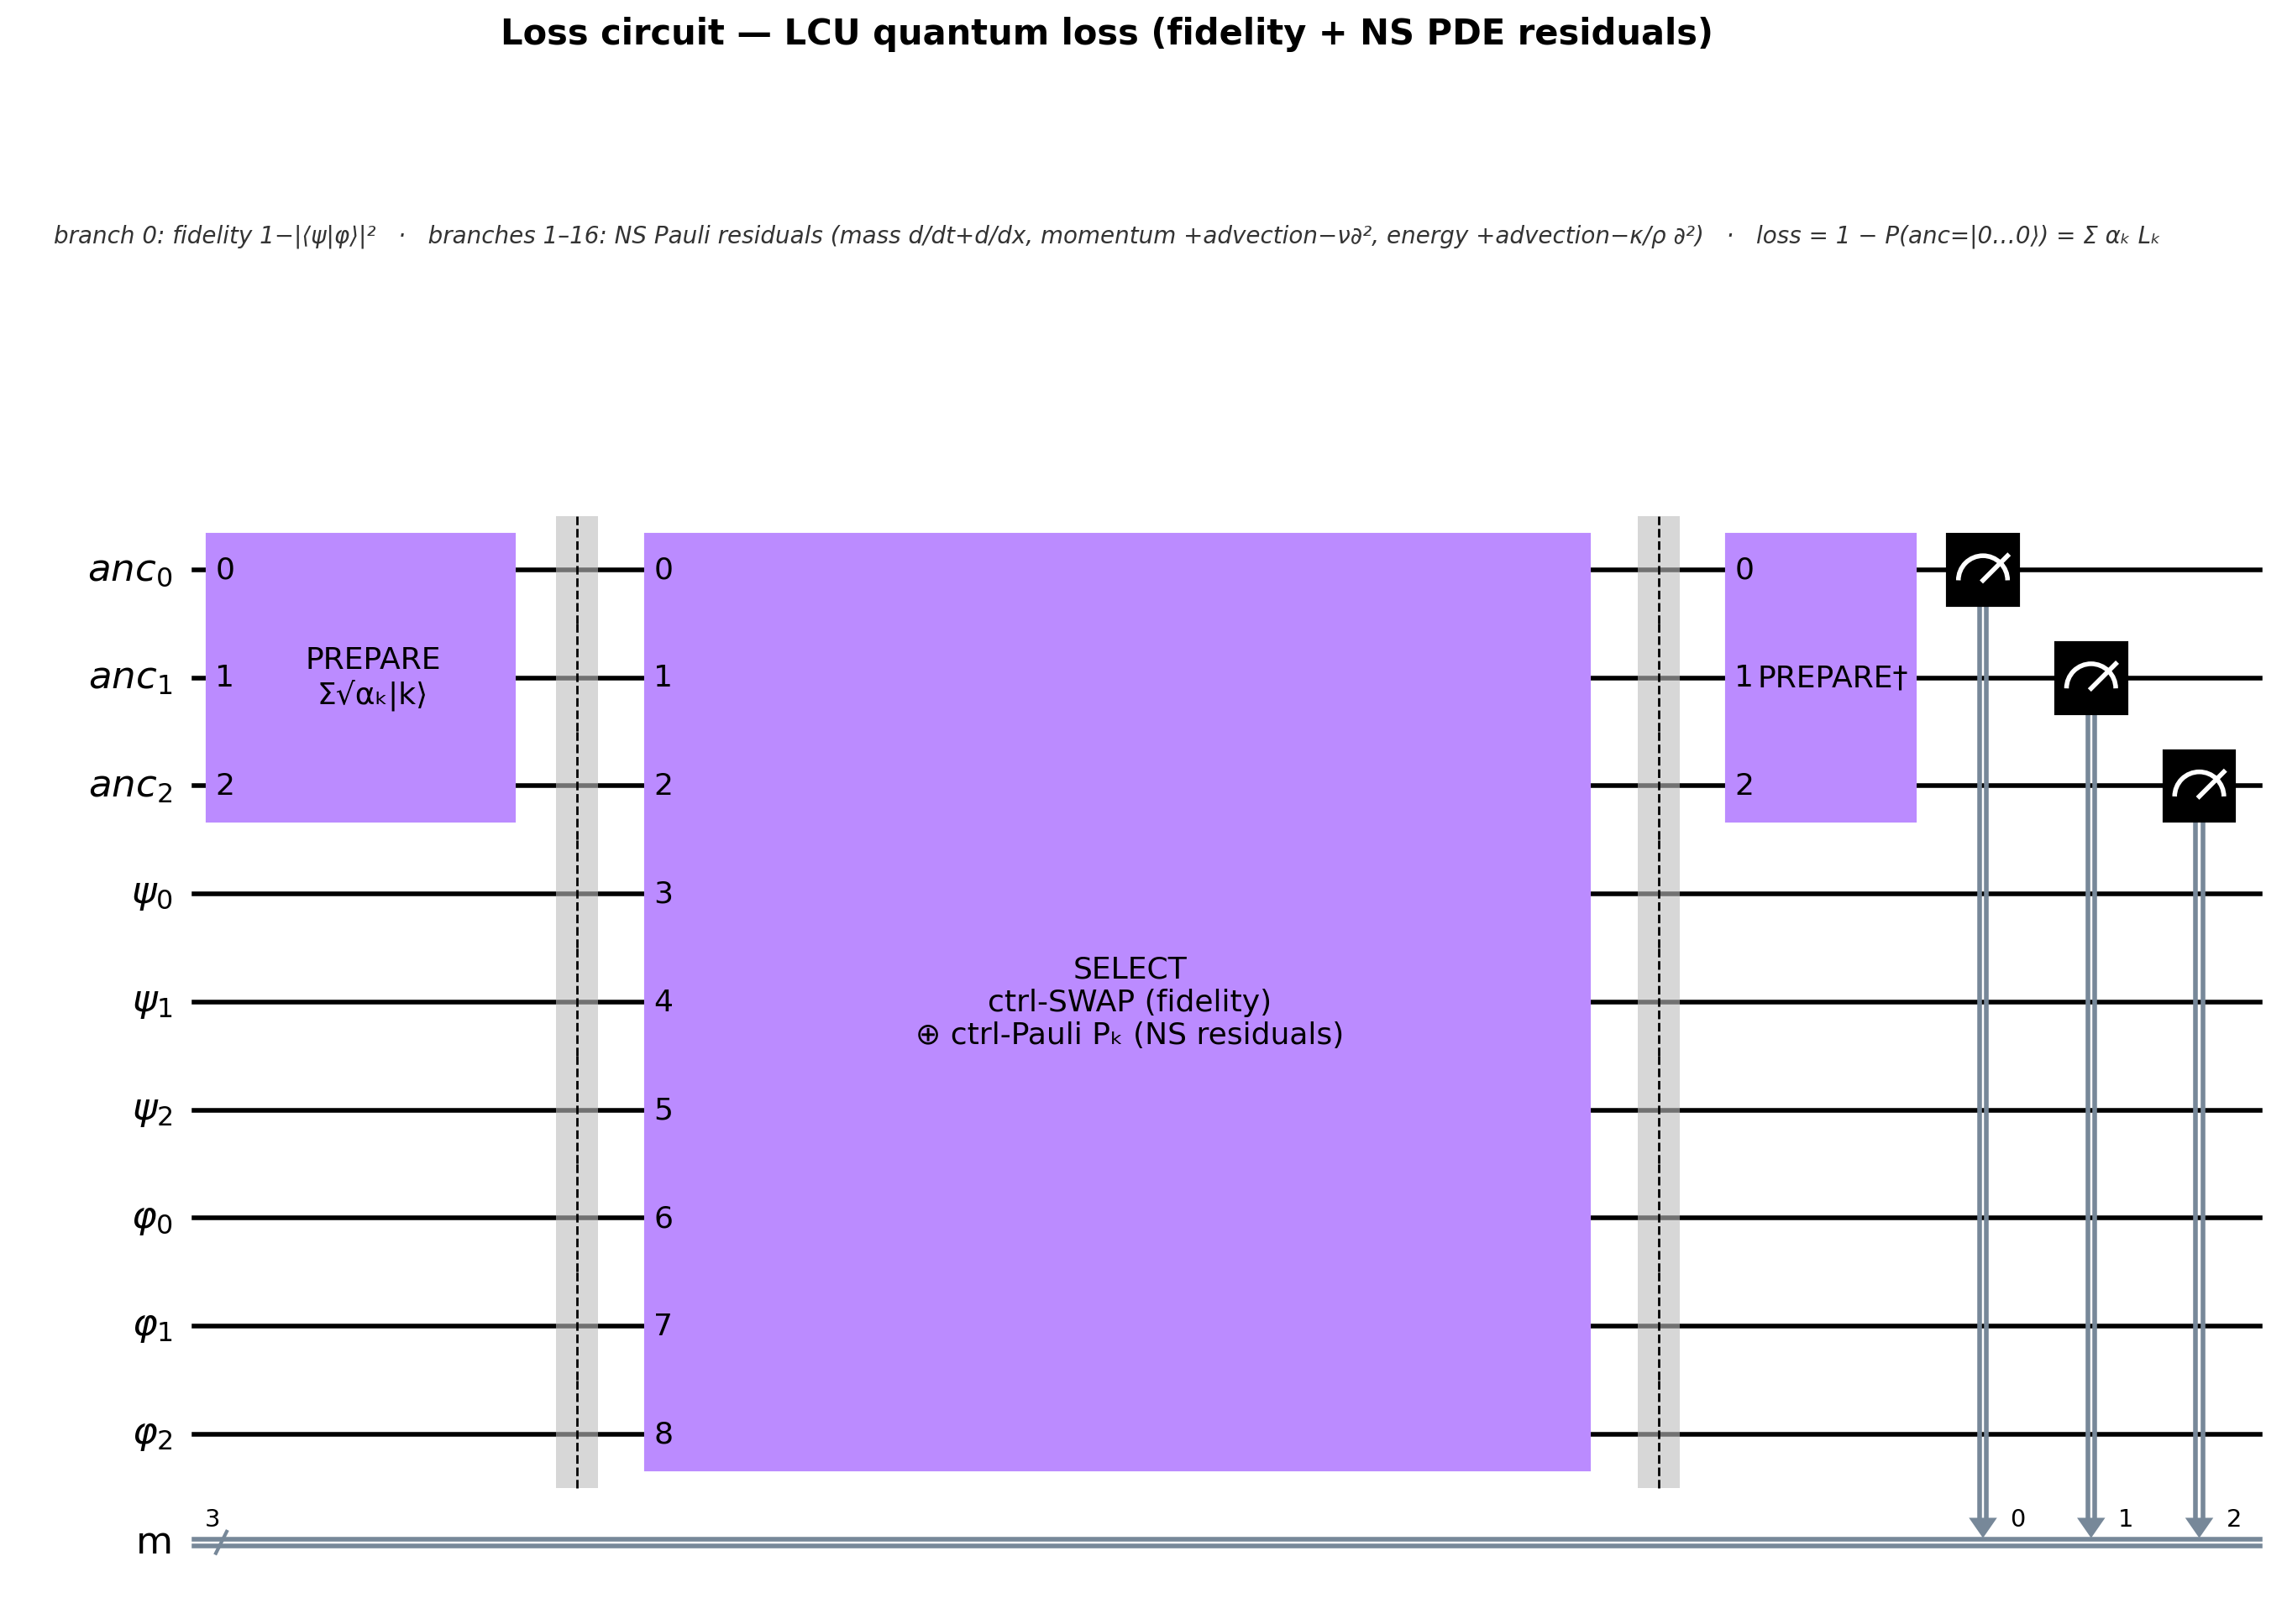
Physics Loss
A complete set of physical constraints — not just the PDE residual
L_physics = w_pde·L_pde + w_ic·L_ic + w_bc·L_bc + w_bound·L_bound + w_cons·L_cons
L_cons
QPINN loss. The fully quantum QPINN builds two states:
• ψ: the predicted quantum state from the encoded inputs plus the ansatz.
• φ: the quantum encoding of the ground-truth outputs.
Its executed loss is:
L_QPINN = λ_data · L_MSE + L_LCU
where the LCU loss contains:
L_LCU = α_fid · L_fidelity(ψ, φ) + Σ_k α_k ( c_k ⟨ψ| P_k |ψ⟩ )²
The Pauli terms represent the quantum Navier–Stokes PDE constraint. The fidelity and PDE weights are normalized into the LCU coefficients α_k.
Global conservation
Integral mass balance: d/dt ∫ρ dx = net mass flux
L_pde
Conservation laws (interior)
Mass, momentum & energy residuals at random collocation points
L_bound
Physical admissibility
Positivity of density and temperature (ρ>0, T>0)
L_ic
Initial condition
The physical starting state — quiescent cooler gas column
Boundary conditions
L_bc
Hot-fast inflow at x=0; soft zero-gradient outflow at x=1
Notes:
The physics loss is redesigned as the full constraint set. L_cons guards against globally mass-violating solutions that still look locally accurate.

Slide 10
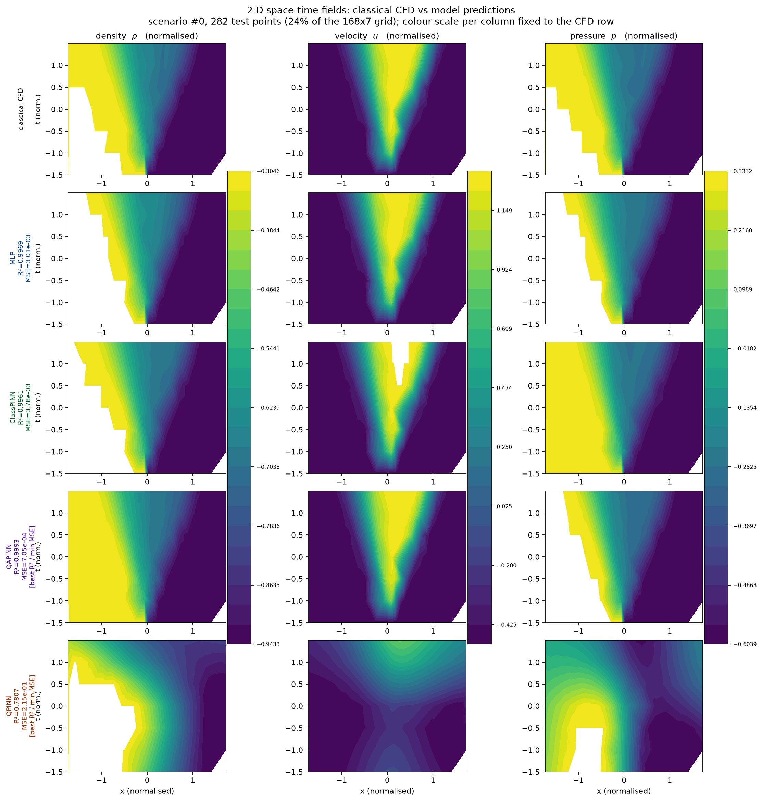
Results & Ablations
Results
Predictions
1
Hybrid (QAPINN) can have better performance compared to classical PINN
Full Quantum neural network accuracy needs to be improved
Notes:
The experiment matrix. Each ablation targets one factor specific to the quantum setting.

Slide 11
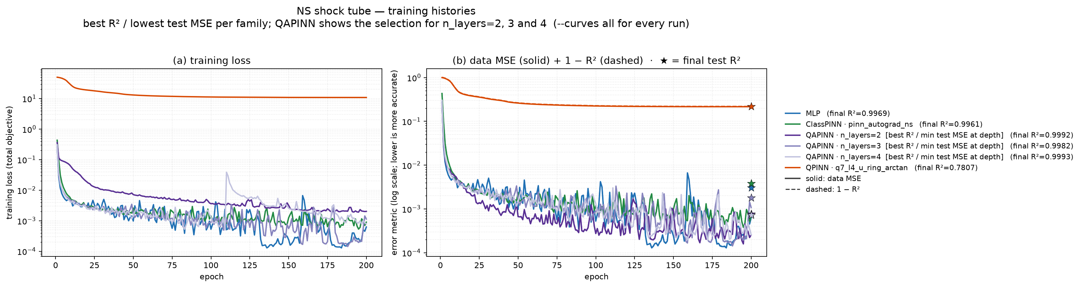
Results & Ablations
Results
1
Four-model comparison
Hybrid (QAPINN) can have better performance compared to classical PINN
Full Quantum neural network accuracy needs to be improved
Notes:
The experiment matrix. Each ablation targets one factor specific to the quantum setting.

Slide 12
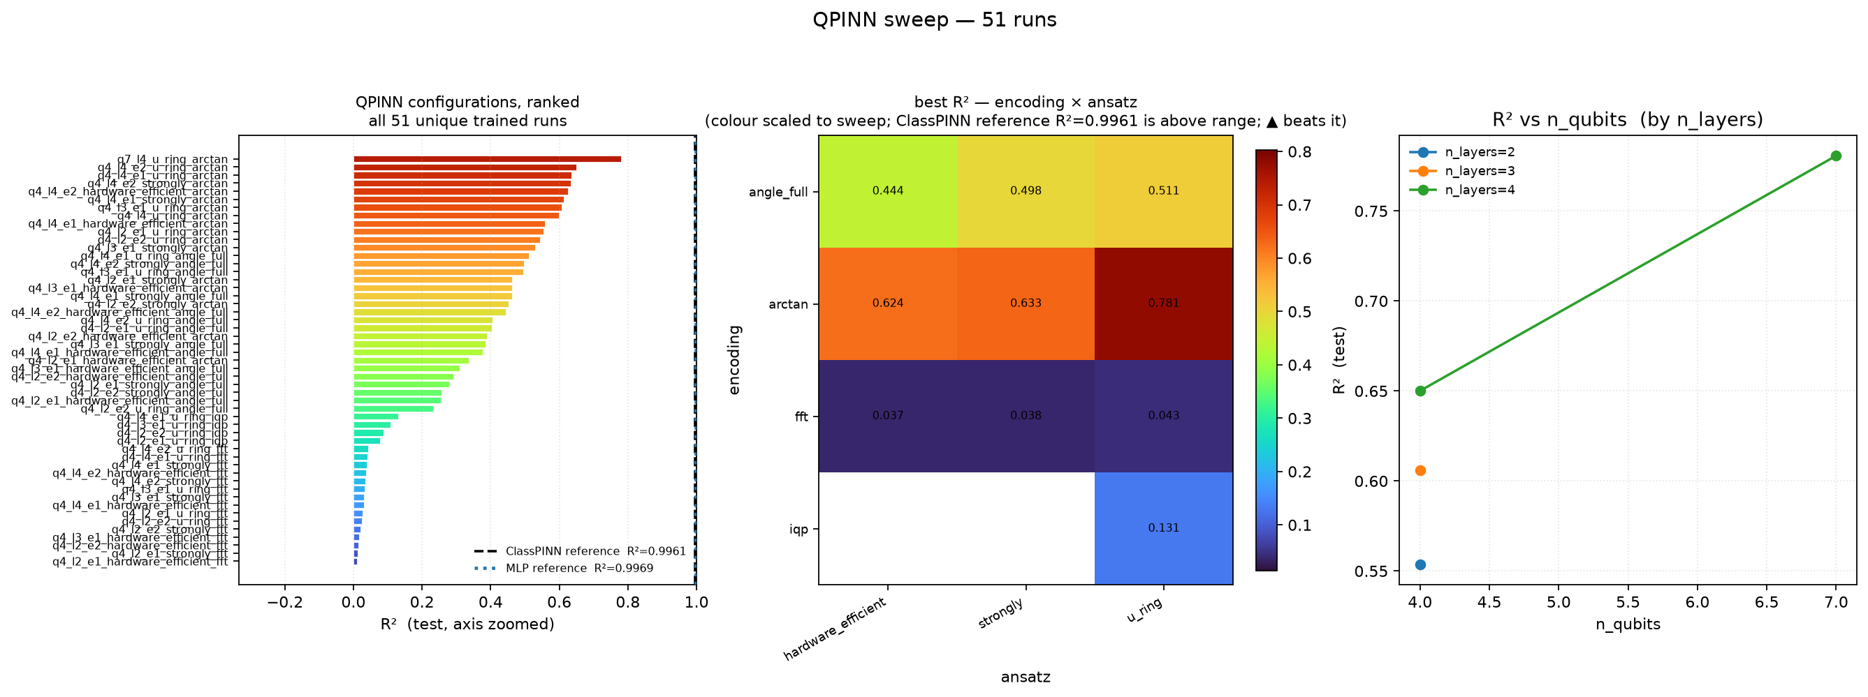
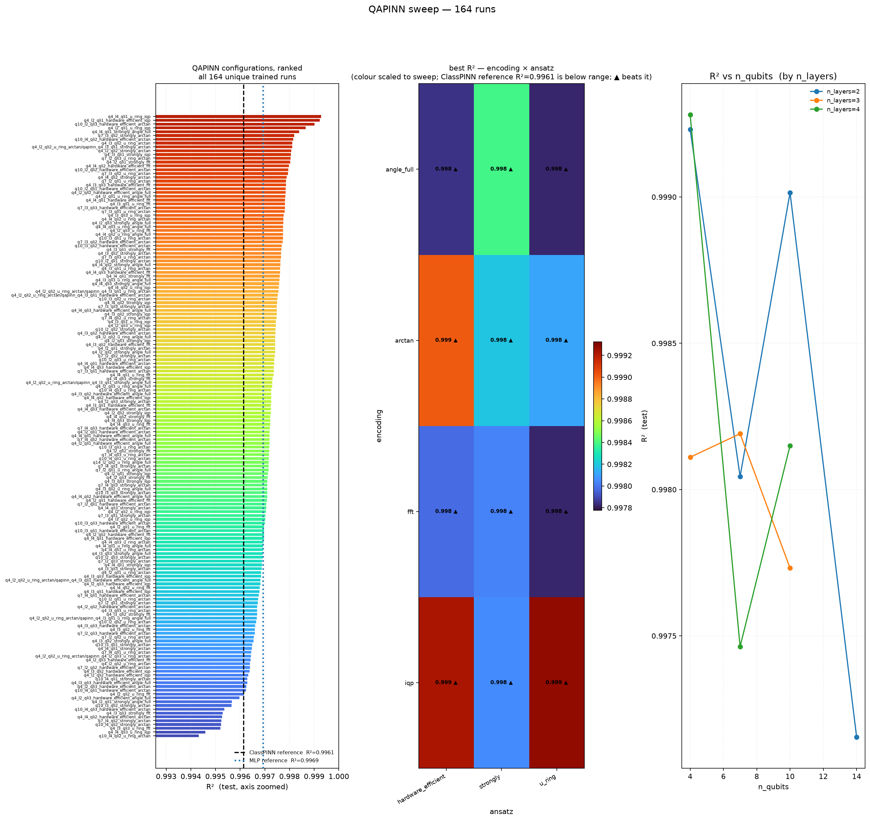
Results & Ablations
Results
2
Circuit depth (QPINN)
3
Encoding strategy
Four-model comparison
Notes:
The experiment matrix. Each ablation targets one factor specific to the quantum setting.

Slide 13
Conclusion
Conclusion and Future Work
1
The fully quantum QPINN, in its best swept configuration, reaches only R² ≈ 0.78 on the test set, against R² ≈ 0.9961 for the classical PINN and R² ≈ 0.999 for the hybrid QAPINN.
2
QAPINN loss decrease faster if quantum layer are for the last layer but accuracy is better
3
Both the selection of encode and the selection of ansatz can impact on the accuracy of QAPINN results
→
More work are needed to improve fully quantum code: mapping to larger qubit number seems the most important thing to improve the accuracy
Notes:
Conclusion and future work. Once populated, the tables establish whether a quantum layer confers a measurable advantage on this coupled, shock-generating flow at matched parameter count.

