Slide 1
Processor Status and Flags Register
Computer Organization and Assembly Language

Slide 2
Agenda
The microprocessor status
The FLAGS register
Signed and unsigned overflow
Instructions affecting FLAGS register

Slide 3
Processor Status
The circuits in the CPU perform simple decision making based on the current state of the processor.
In 8086 processor, the processor state is implemented as nine individual bits called flags.
Each decision made by the 8086 is based on the values of these flags.

Slide 4
Flags Register
The flags are placed in the FLAGS register and are either status flags or control flags.
Status flags reflect the result of a computation.

Slide 5
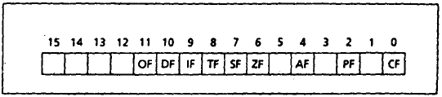
Flags Register
The status flags are bits 0, 2, 4, 6, 7, and 11.
The control flags are located in bits 8, 9, and10.
The other bits have no significance.

Slide 6
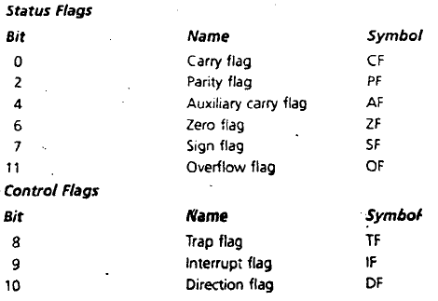
Flags Register
Flag Numbers, Names and Symbols

Slide 7
Status Flags - Carry Flag (CF)
The status flags to reflect the result of an operation.
Example, If SUB AX,AX is executed, the zero flag becomes 1, indicating that a zero result was produced.
CF is 1 if there is a carry out from the most significant bit (msb) on addition, or there Is a borrow into the msb on subtraction; otherwise, its 0.
CF is also affected by shift and rotate Instructions

Slide 8
Status Flags - Parity Flag (PF)
PF = 1 if the low byte of a result has an even number of one bits (even parity).
It is 0 if the low byte has odd parity.
For example, if the result of a word addition is FFFEh, then the low byte contains 7 one bits, so PF = 0.

Slide 9
Status Flags - Auxiliary Carry Flag (AF)
AF = 1 if there is a carry out from bit 3 on addition, or a borrow into bit 3 on subtraction.
AF is used in binary-coded decimal (BCD) operations.

Slide 10
Status Flags - Zero Flag (ZF)
ZF = 1 for a zero result, and ZF = 0 for a nonzero result.

Slide 11
Status Flags - Sign Flag (SF)
SF = 1 if the msb of a result is 1; it shows the result is negative if a signed interpretation is used.
SF = 0 if the msb is 0 .

Slide 12
Status Flags - Overflow Flag (OF)
OF = 1 if signed overflow occurred, othcrwise it is 0.

Slide 13
Overflow
The range of signed 16 bit numbers or word is -32768 to 32767; for 8 bit the range is -128 to 127.
For unsigned numbers, the range for a word is 0 to 65535; for a byte, it is 0 to 255.
If the result of an operation falls outside these ranges, overflow occurs and the truncated result will be incorrect.
For an arithmetic operation such as addition, there are four possible outcomes: (1) no overflow, (Z) signed overflow only, (3) unsigned overflow only, and (4) both signed and unsigned overflows.

Slide 14

Overflow - Unsigned
The example below is an unsigned overflow but not signed overflow, suppose AX contains FFFFh, BX contains 0001h, and ADD AX,BX is executed.
The binary result is-
The result is 10000h=65536, but it is out of range for a word. A 1 is carried out of the msb and wrong answer stored in AX, 0000h, so unsigned overflow occurred.
But the stored answer is correct as a signed number, as FFFFh = -1 0001h = 1, and FFFFh + 0001h = -1 + 1 = 0, so signed overflow did not occur.

Slide 15

Overflow - Signed
Let AX and BX both contain 7FFFh, and instruction ADD AX, BX is executed
The signed and unsigned decimal interpretation of 7FFFh IS 32767.
Thus for both signed and unsigned addition, 7FfFh + 7FFfh = 32767 + 32767 = 65534.
This is out of range for signed numbers; the signed interpretation of the stored answer FFFEh is -2. so signed overflow occurred.
Unsigned interpretation of FFFEh is 65534, which is correct answer, so there is no unsigned overflow.

Slide 16
Overflow and the Flags
The processor sets OF= 1 for signed overflow and CF = 1 for unsigned overflow.
It is then up to the program to take appropriate action,
The result of a subsequent instruction may cause the overflow flag to be turned off.
Processor turns on CF or OF for unsigned overflow or signed overflow, respectively.

Slide 17
Unsigned Overflow and the Flags
On addition, unsigned overflow occurs when there is a carry out of the msb.
Tha is, the correct answer is larger than the biggest unsigned number; that is, FFFFh for a word and FFh for a byte.
On subtraction, unsigned overflow occurs when there is a borrow into the msb.
That is, the correct answer is smaller than 0.

Slide 18
Signed Overflow and the Flags
On addition of numbers with the same sign, signed overflow occurs when the sum has a different sign.
This happens when adding 7FFFh and 7FFFh (two positive numbers), getting FFFEh (a negative result).
Subtraction of numbers with different signs is like adding numbers of the same sign.
Example, A - ( -B) = A + B and -A -(+B) = -A -B.
Signed overflow occurs if the result has a different sign than expected.

Slide 19
Instructions Affecting Flags
Each time the an instruction is executed, the flags are altered to reflect the result.
Here is an example instruction and the flags affected upon its execution.
ADD AX, BX ; AX has FFFFh, BX contains FFFFh.
Now AX contains result FFFEh and the status of flags is:
SF = 1 because the msb is 1.
PF = 0 since there are 7 (odd number) or 1 hits in the low byte of the result.
ZF = 0 because the result is nonzero.
CF = 1 because there is out of the msb on addition.
OF = 0 because the sign of the stored result is the same as that of the number being added.
[See details on page 85 of the book]

