Slide 1
Flow Control Instructions
Computer Organization and Assembly Language

Slide 2
Agenda
Introduction
Conditional Jumps
JMP instruction
Branching Structures
Loops

Slide 3
Flow Control
The jump and loop instructions transfer control to another part of program.
This transfer can be unconditional or conditional depending on a particular combination of status flag settings.

Slide 4
Conditional Jumps
JNZ is a conditional jump instruction. The syntax is
Jxxx destination_label

Slide 5
Conditional Jumps
If the condition for the jump is true, the next instruction to be executed is the one at destination_label, which may precede or follow the jump instruction.
If the condition is false, the instruction Immediately following the jump executed.
For JNZ, the condition Is that the result of the previous operation is not zero

Slide 6
Conditional Jumps
To demonstrate the jump instructions the program below displays the IBM character set.
.model small
.stack 100h
.code
MAIN PROC
MOV AH, 2
MOV CX, 256 ; Loop counter, number of characters to display
MOV DL, 0 ; Contains ASCII code of character to display, starting with 0
DISPLAY_LOOP:
INT 21H ; Output the character in DL
INC DL ; Update to next character
DEC CX ; Decrement loop counter
JNZ DISPLAY_LOOP ; Repeat the statements if CX is not 0
MAIN ENDP
END MAIN

Slide 7
Conditional Jumps
To display the characters, a loop is used (JNZ DISPLAY_LOOP) instruction.
Before entering the loop, AH Is initialized to 2 (single character display) and DL is set to 0, the initial ASCII code.
CX Is the loop counter; it is set to 256 before entering the loop and is decremented after each character is displayed.
The instruction that controls the loop is JNZ (Jump if Not Zero).
If the result of the preceding Instruction (DEC CX) is not zero, the JNZ instruction transfers control to the instruction at label DISPLAY_LOOP.
When CX finally contains 0, the loop ends.

Slide 8
CPU Implementing a Conditional Jump
To implement a conditional jump, the CPU looks at the FLAGS register, which reflects the result of last instruction.
If the condition for the jump (a combination of status FLAGS settings) are true, the CPU adjusts the IP to point to the destination label, so that the instruction at this label will be done next.
If the jump condition is false, then IP is not altered; which skips the jump and executes the next instruction in code.
In last example, CPU executes JNZ DISPLAY_LOOP by checking ZF.
If ZF = 0, control transfers to PRINT_LOOP; if ZF = 1, the program goes on to execute following instruction.

Slide 9
Conditional Jump Categories
There are three categories;
(1) signed jumps are used when a signed interpretation is being given to results,
(2) the unsigned jumps are used for an unsigned interpretation, and
(3) the single-flag jumps, which operate on settings/of individual flags.
The jump instructions themselves do not affect the flags.

Slide 10
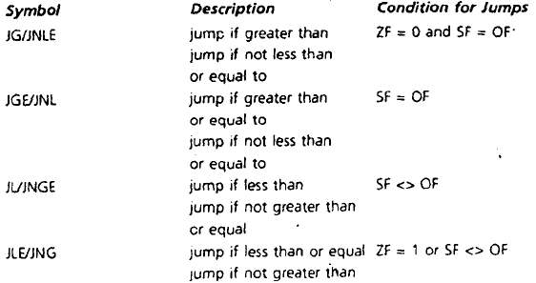
Signed Jumps
Given below are signed jumps

Slide 11
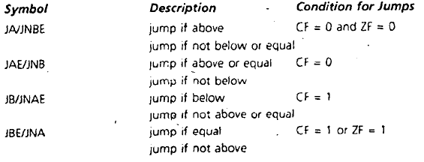
Unsigned Conditional Jumps
Given below are unsigned jumps

Slide 12
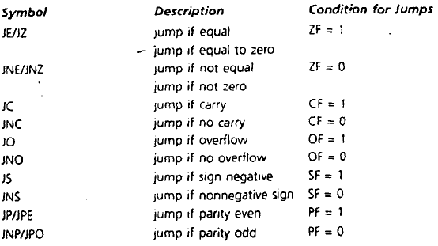
Single-Flag Jumps
Given below are Single-Flag jumps

Slide 13
CMP Instruction
The jump condition is often provided by the CMP (compare) instruction.
It has the form
CMP destination, source
This instruction compares destination and source by computing destination contents minus source contents.
The result is not stored, but the flags are affected.
The operands of CMP may not both be memory locations.
Destination may not be a constant.
CMP is like SUB, except that destination is not changed.

Slide 14
CMP Example
For following instructions:
CMP, AX,BX
JG BELOW
where AX = 7FFFh, and BX = 0001.
The result of CMP AX,BX is 7ffFh - 0001h = 7FFEh.
The jump condition for JG Is satisfied ( see the jump tables), because ZF = SF = OF = 0, so control transfers to label BELOW.

Slide 15
Interpreting Conditional Jumps
In the last example, we determined by looking at the flags after CMP was executed that control transfers to label BELOW.
This is how the CPU Implements a conditional jump.
But a programmer can just use the name of the jump to decide if control transfers to the destination label. In the following,
CMP AX,BX
JG BELOW
if AX Is greater than BX (in a signed sense), then JG (jump if greater than) transfers to BELOW.

Slide 16
Conditional Jump without CMP
The conditional jump can also work with other instructions apart from CMP. For example:
DEC AX
JZ NEXT
If the contents of AX become 0, control transfers to NEXT.

Slide 17
Signed Versus Unsigned Jumps
Each of the signed jumps corresponds to an analogous unsigned jump; for example, the signed jump JG and the unsigned jump JA.
The table above on jumps shows that these jumps operate on different flags: the signed jumps operate on ZF, SF, and OF, while the unsigned jumps operate on ZF and CF.
Using the wrong kind of jump can lead to incorrect results.
Example: suppose we're giving a signed interpretation. If AX = 7FFFh, BX = 8000h, and we execute
CXP AX,BX
JL BELOW
Even though 7FFFh > 8000h in a signed sense, the program does not jump to BELOW, because 7FFFh < 8000h in an unsigned sense, and we are using the unsigned jump JA.

Slide 18
Unconditional Jump - JMP Instruction
The JMP (jump) instruction causes a unconditional transfer of control. The syntax is
JMP destination
where destination is usually a label in the same segment as the JMP itself.
JMP can be used to get around the range restriction of a conditional jump.

Slide 19
Branching Structures
Branching structures enable a program to take different paths, depending on conditions.

Slide 20
Branching Structures - IF-THEN
The IF-THEN structure may be- expressed in pseudocode as follows:
IF condition is true
THEN
execute true-branch statements
END_IF
The condition is an expression that is true or false.
If the condition is true, the true branch statement is executed

Slide 21
Branching Structures
Branching structures enable a program to take different paths, depending on conditions.

Slide 22
Branching Structures
Branching structures enable a program to take different paths, depending on conditions.

Slide 23
Branching Structures
Branching structures enable a program to take different paths, depending on conditions.

Slide 24
Branching Structures
Branching structures enable a program to take different paths, depending on conditions.

Slide 25
Branching Structures
Branching structures enable a program to take different paths, depending on conditions.

Slide 26
Branching Structures
Branching structures enable a program to take different paths, depending on conditions.

