Slide 1
Predicting Stock Returns from Earnings Call Transcripts
Shannon Maccallum | DSCI 410

Slide 2
Introduction
The Problem
Why This Interests Me
Stock prices react immediately to earnings calls — but can we predict that reaction before the market fully prices it in?
Executives choose their words carefully. Their tone, emphasis, and language around guidance, growth, and risk all carry signals — but those signals are buried in unstructured text. I wanted to see if these sentiments can be used to predict a stocks return. This would allow for systematic trading based off of earning call transcripts.
Finance reflects human behavior
Markets move on expectations, confidence, and fear, andnot just numbers. I want to quantify that human layer.
Longer-term vision
Build a live interface that ingests transcripts in real time and generates trading signals as calls happen — eventually turn this into a company.

Slide 3
Dataset
148
25
2022–2024
Earnings call transcripts
S&P 500 companies
Date range
Transcripts — Alpha Vantage API
Returns — Yahoo Finance
Fetched from Alpha Vantage API, cached locally as JSON for each daily rate limits (25/day free) Sectors: Tech, Finance, Healthcare, Consumer, Energy Note: Accidentally saved 75 empty API error responses before adding a validity check and lost several days of collection. Ended up with 148 clean transcripts. Also, I should have started pulling data way earlier.
3-day post-earnings return matched to each transcript: Target variable: % change in closing price from earnings day to 3 trading days later
Wish I had more:
Plan to scrape SEC EDGAR this summer to get thousands of transcripts and retrain.

Slide 4
Model Architecture
Transcript
Text
FinBERT
Tokenizer
FinBERT
Encoder
Linear
768→1
Return
%
Pre-trained on Finance
Sentiment output ->
Return Predictor
Training Setup
FinBERT is BERT fine-tuned on 4.9B tokens of financial text so that it understands earnings language.
MSE
80/20 split
Gradient clipping
GPU on Talapas
Data pulled outside of Talpas
AdamW optimizer — adjusts how much each of the model's 110M parameters updates after every batch, with weight decay to prevent overfitting on our small dataset
FinBERT's original output classifies text as positive, negative, or neutral
Take the 768 dimensional vector it builds for each transcript
feed that into a single linear layer that predicts a continuous return percentage

Slide 5
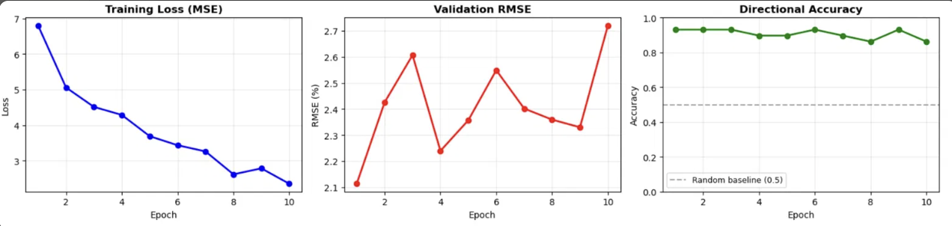
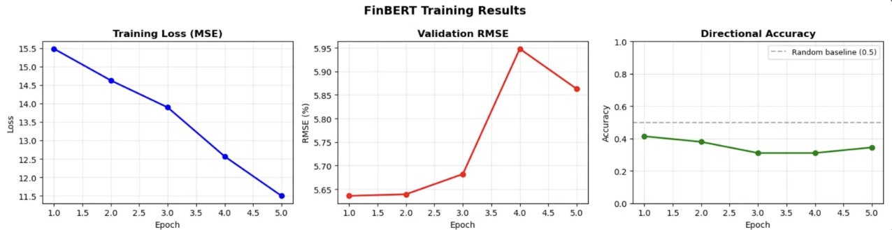
Training Challenges & Breakthrough
10 Epochs
5 Epochs
The Problem
Standard fine-tuning wasn't working because of the small data set:
High epochs (10) + low lr (1e-5): Training loss kept dropping but validation RMSE showed the model was overfitting so much. Low epochs (5) + standard lr (2e-5): RMSE ~5.9%, directional accuracy only 34%, bias of -2.31% , so model predicted near-zero for every stock
Gradual Unfreezing
Gradual unfreezing addresses “catastrophic forgetting” which is the risk that fine tuning on a small dataset overwrites FinBERT's pretrained financial language knowledge. My model was the best at epoch one so this was able to fix that
Phase 1: Freeze FinBERT entirely, train only the new prediction layer at a high learning rate — forces the model to learn how to read FinBERT's existing financial language representations without overwriting them.
Phase 2: Unfreeze everything and fine-tune at a very low learning rate — FinBERT makes small targeted adjustments to its representations for our specific task rather than relearning from scratch.

Slide 6
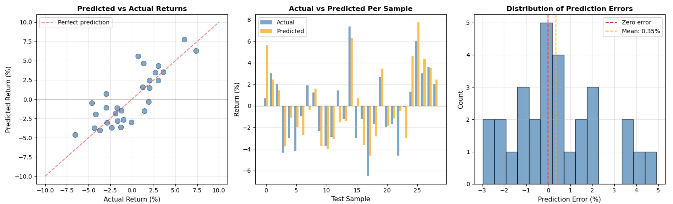
Results — After Gradual Unfreezing
83%
90%
1.57%
Signal Accuracy at ±0.5%
Directional Accuracy
Mean Absolute Error

Slide 7
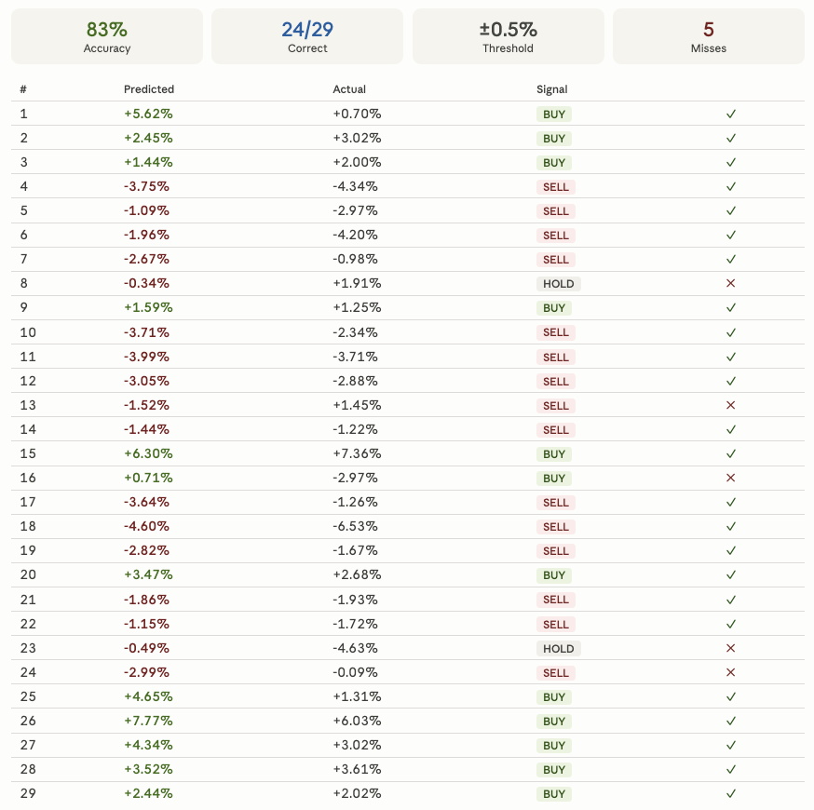
Results — Buy/Sell/Hold Signals
Signal Results (±0.5% threshold)
BUY signals
11 made
9 correct
82%
SELL signals
13 made
11 correct
85%
HOLD signals
5 made
4 correct
80%
TOTAL
29 test
24 correct
83%
At ±0.5% threshold the model beats random (50%) across all signal types

Slide 8
Conclusions
✓
Did it work?
Partially — best run achieved 83% signal accuracy using gradual unfreezing, but results varied significantly (45–83%) across runs due to the small dataset (29 test samples). The random train/test split has a large impact when n is this small. Gradual unfreezing was the key technical contribution — without it the model predicted near-zero for everything.
✗
What I'd do differently — more data
I accidentally saved 74 empty API error responses before adding a validity check, losing several days of collection. I only ended up with 148 transcripts. More data would significantly improve the model — I would need to scrape SEC EDGAR transcripts (thousands of transcripts, free) and retrain. I may do this, this summer because I was disappointed in the lack of data
→
Next steps
Get thousands of transcripts via EDGAR scraping and potentially build a live web interface that generates buy/sell/hold signals as earnings calls happen, if I was able to purchase access to a live API.

