Slide 1
Modelling explosive percolation under local rules: replicating paper results
December 4, 2018
Shannon Moran
Notes:
I’m a PhD Candidate in Chemical Engineering, but more relevant to the topic of this lecture, I spent 3 years at the Boston Consulting Group in Chicago before coming back to school working on projects for chemicals and health care clients. I know in this class you all will be working on consulting projects this semester, and a number of you are likely also thinking about going into consulting after graduation. How many of you are thinking of going into consulting, whether management or technical or something else? Okay, great. In consulting, or any industry really, running an effective meeting is one of the easiest and most critical ways of earning your client’s respect and trust. It is the easiest way of showing that you are in control of the process. I’m going to frame this through both the lens of what meetings look like out in the real world and lessons you can apply to your teams in this class, but also want tie this into experiences you probably have now with your advisors and collaborators. Any questions before we get in?

Slide 2
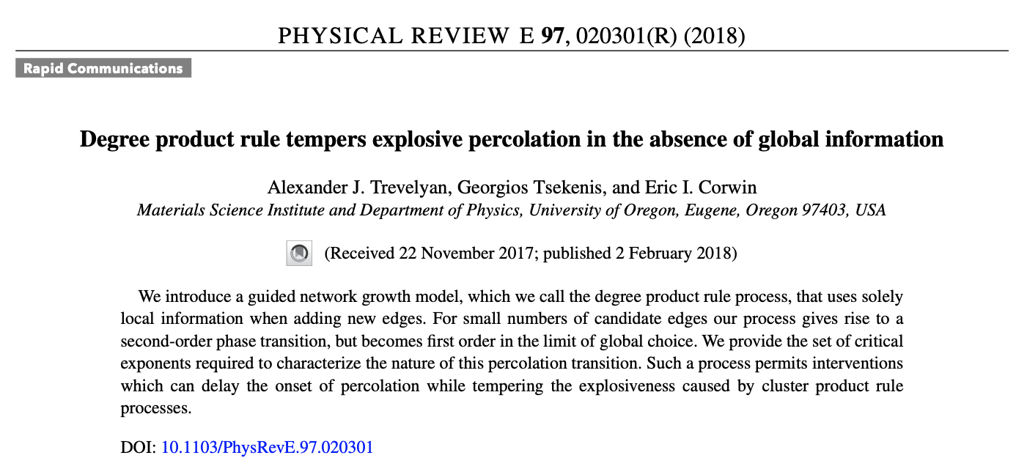
1

Slide 3
What they did
The authors introduce this new method of percolation which exhibits explosive percolation behavior

Slide 4
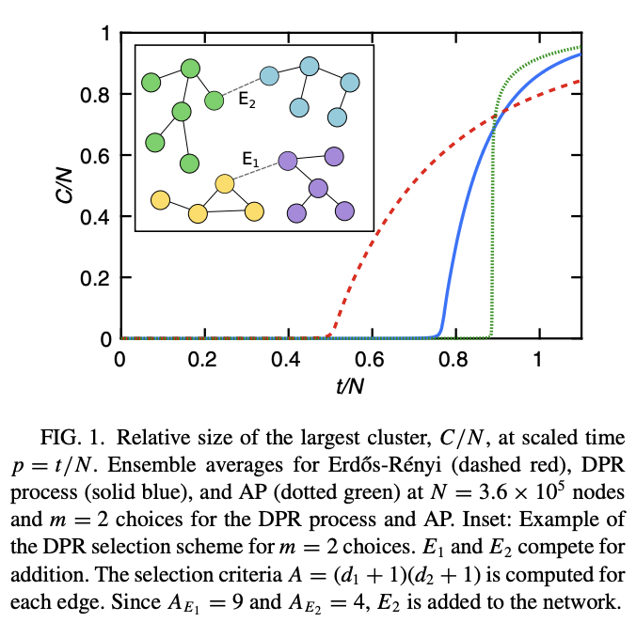
What I did
Plot cluster sizes over time for ER, DPR, and AP at a bunch of nodes

Slide 5
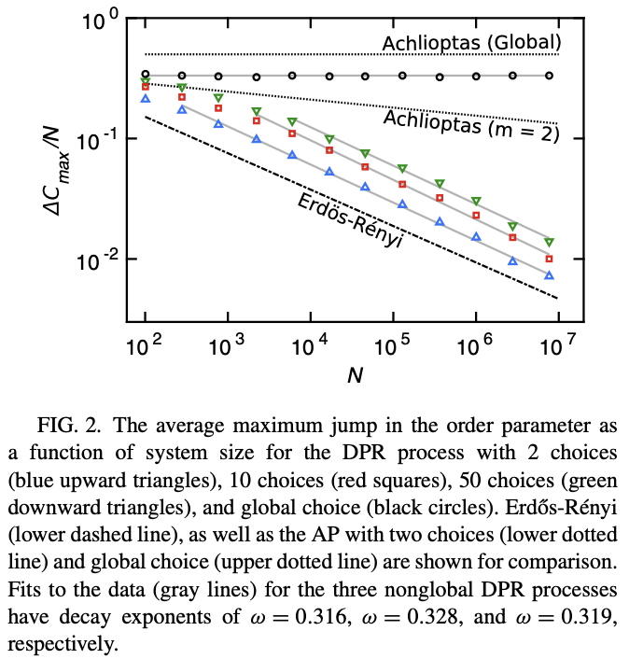
What I did, 2
Maximum jump in the order parameter over a number of system sizes

Slide 6
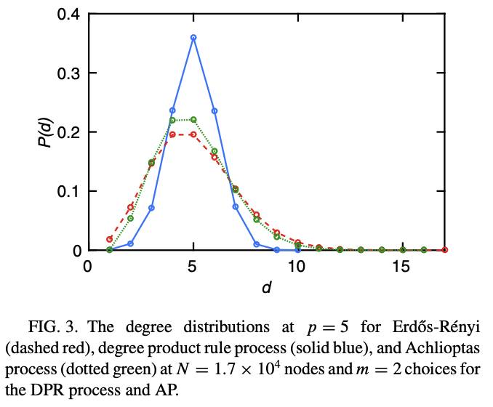
What I did, 3
Calculate the degree distributions?
Percentage of nodes having each degree distribution

Slide 7
Replicating the criticality behavior

