Slide 2

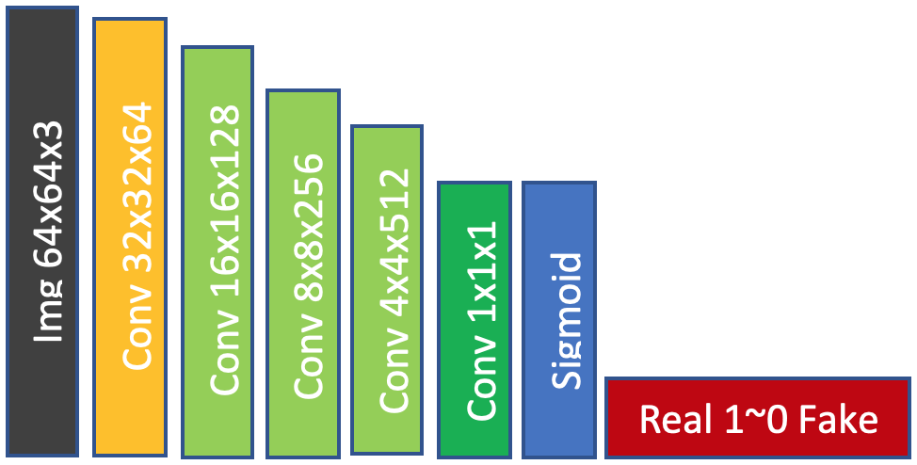
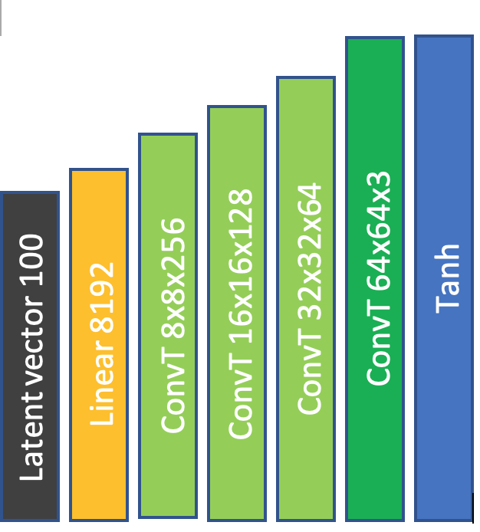
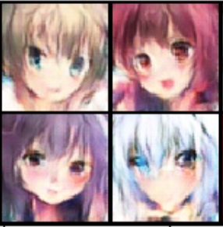
Real image
Discriminator
Dataset
= Conv + LeakyReLU
Generator
= Conv + BatchNorm2d + LeakyReLU
= Conv
= Linear + BatchNorm1d + ReLU
= ConvT + BatchNorm2d + ReLU
= ConvT
Fake image
Random noise

Slide 3
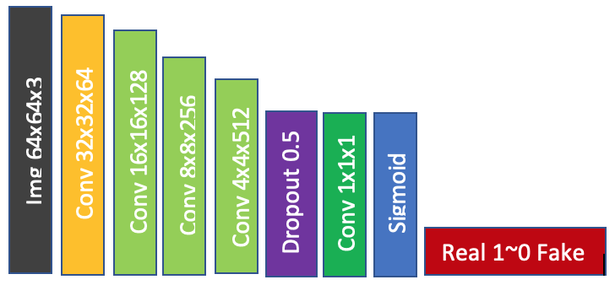
Real image
Discriminator
Dataset
= Conv + LeakyReLU
Generator
= Conv + BatchNorm2d + LeakyReLU
= Conv
= Linear + BatchNorm1d + ReLU
= ConvT + BatchNorm2d + ReLU
= ConvT
Fake image
Random noise

Slide 4
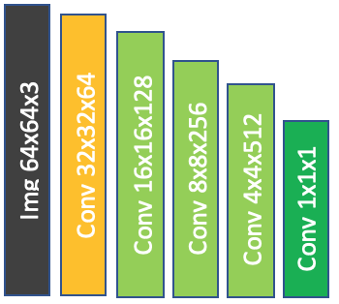
Real image
Discriminator
Dataset
= Conv + LeakyReLU
= Conv + BatchNorm2d + LeakyReLU
Generator
= Conv
= Linear + BatchNorm1d + ReLU
= ConvT + BatchNorm2d + ReLU
= ConvT
Fake image
Random noise

