Slide 1
Genome assembly and investigation of Hypomesus transpacificus (delta smelt) genome for estimates of effective population sizes and identification of sex-specific markers.
Shannon E.K. Joslin
Thesis Committee Meeting 2021
07 May 2021
(https://github.com/shannonekj/presentations/tree/master/2021_05-thesis_commitee_meeting)
Notes:
First off I want to thank you all for meeting today. Me and my thesis work feel really appreciative there was a time that worked for everyone. I want to give everyone an update on my thesis work. I have about twenty slides and am primarily looking for feedback on my last aim. So while of course feel free to interrupt me, also please leave a little time for discussing my last aim. YOu all have been in many more thesis meetings than I have so let me know if that format isn't consistent with their point.
Also, I believe I've let all of you know individually but I applied to a position as Yosemite National Park's Wildlife Data Manager and got the position. woo hoo! I will be starting that position in July and will be working part time towards finishing my degree from then on.
Anyways, onto my research––I think all of you know by now but just in case any interactions that you've had with me has been wiped from your memory I've been working on the genome assembly and investigation of the delta smelt genome for estimates of effective population size and identification of sex-specific markers.

Slide 2
Overview
AIM #1: Produce a reference genome for delta smelt.
AIM #2: Infer contemporary & historical effective population sizes of delta smelt.
AIM #3: Discover sex-specific markers for sex identification of delta smelt.
Notes:
My first aim is to produce a high-quality reference genome for delta smelt
My second aim is to estimate contemporary and historical effective population size using temporal data from roughly 25 generation of delta smelt.
My third and last aim is to identify sex-specific markers that can be used to non-invasively (aka genetically) sex wild and captive delta smelt. This is the topic that I'm hoping to glean some advice for

Slide 3
Aim #1: Setup
Aim 1: Assembly Aim 2: N_{E} Aim 3: Sex Marker
hybrid assembly
one male, one female
original experimental design
implemented experimental design
linked reads + hi-c
long reads + linked reads + hi-c + linkage map ++ karyotype
Why/how??
cheaper
recovered linkage loci
collaboration with Delaney lab
Notes:
For my first aim I carried out two hybrid assemblies one with a female and one with a male delta smelt. originally I was intending to only used 10X Genomics linked-read sequencing and Phase Genomics hi-c but I struck a bit of luck and the price of pacbio sequencing dropped dramatically a few years ago, we recovered the loci sequences from a linkage map study by Lew et al 2015 and I was able to collaborate with the Delaney lab to karyotype delta smelt for a non-sequence based chromosome number. count

Slide 4
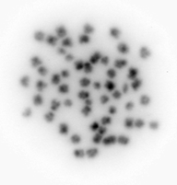
Aim #1: karyotype
Aim 1: Assembly Aim 2: N_{E} Aim 3: Sex Marker
2 experiments
used juvenile fish
found 2n = 56
image is too low res to say anything about sex chromosomes or chromosome composition
<- useful!
Notes:
We ran two separate experiments to karyotype the fish. The first ended up being a bit of a trial run to get the process of selecting and processing individuals. We used juvenile fish that were about 100 days post hatch. Upon dissection we sex the fish and separated the head kidney (which would have cells dividing at a rapid rate) into male and female pools. Unfortunately, we didn't find many cells with usable chromosomes were suspended at the correct step of mitosis and this was the best image we captured. It does tell us 2n=56 but cannot give any further information like chromosome composition or tell if there is the presence of a sex chromosome.

Slide 5
Aim #1: Implementation & Results
Aim 1: Assembly Aim 2: N_{E} Aim 3: Sex Marker
Sequencing
Initial assembly
Purge duplicate haplotigs
Add in sequencing technology
More sequencing
Incorporate linkage map information
Scaffold
Scaffold
Sample +
HMW DNA extraction
long reads
(PacBio)
IPA
linked reads
(10X)
scaff10x
hi-c
(Phase)
SALSA
chromonomer
purge_dups
male assembly stats
female assembly stats
N50 | 12,200,365
L50 | 15
n_contigs | 549
asm_length | 472,157,411
BUSCO | 88.40%
N50 | 14,850,352
L50 | 13
n_contigs | 376
asm_length | 437,273,953
BUSCO | 89.30%
Genome
!
= software
= sequencing technology
Notes:
While the karyotyping study was happening I was also working to assemble the genome of delta smelt. This slide gives a rough idea of the steps I took to complete the assemblies.
First, I sampled the fish and either brought the tissues samples to the DNA Technologies Core for extraction and sequencing, or shipped them to Phase for extraction and hi-c sequencing.
Once I received the long-read sequencing data I ran a primary assembly using just the long reads.
I then purged the assembly of duplicated haplotigs and scaffolded the assembly using the long-range information from the linked-reads.
I then further scaffoled the linked and long read assembly using the ultra long-range information from the hi-c data.
After, I used the linkage map loci to anchor the by now very large scaffolds into chromosome level scaffolds.
The BUSCO statistics of the male and female assemblies were fairly comparable. But female assembly has air parenthesis better N50 and L50 statistics while the male assembly length is slightly longer. This could be due to the presence of a male chromosome but alas, perhaps let's hold off on this until aim 3.

Slide 6
Aim #1: next steps…
Aim 1: Assembly Aim 2: N_{E} Aim 3: Sex Marker
manually curate according to Howe et al. (2021)
submit to NCBI
write up for paper
Notes:
Next I will be manually curating the assembly according to a newly published paper from Howe et al (2021) which has many members of the Vertebrate Genome Project on the author line and has been useful in bettering or finalizing their assemblies.
Once I clean up the assemblies a bit I will upload them to NCBI
Then write everything up.

Slide 7
Aim #2: Setup
Aim 1: Assembly Aim 2: N_{E} Aim 3: Sex Marker
2945 individuals
Cohorts: 1993 – 2020
Historical N_{E} = Pi & Watterson’s
Contemporary N_{E} = linkage disequilibrium & temporal
Notes:
For my second aim of inferring the effective population size of delta smelt, I ran a preliminary analysis while I was carrying out the genome assembly. The dataset for this portion of my project consists of 2945 individuals spanning about 25 birth years. As a reminder delta smelt have an annual life cycle so each years also corresponds to a different generation. My initial analysis estimated historical and contemporary Ne using a de novo RAD-sequencing based "reference assembly".

Slide 8
Aim #2: Trial run
Aim 1: Assembly Aim 2: N_{E} Aim 3: Sex Marker
historical
used RADseq based reference assembly

Slide 9
Aim #2: Preliminary result (w new asm)
Aim 1: Assembly Aim 2: N_{E} Aim 3: Sex Marker
historical
needs further filtering

Slide 10
Aim #2: Trial run (used previous RAD asm)
Aim 1: Assembly Aim 2: N_{E} Aim 3: Sex Marker
contemporary
used RADseq based reference assembly
rerunning using new genome

Slide 11
Aim #2: Next steps
Aim 1: Assembly Aim 2: N_{E} Aim 3: Sex Marker
currently re-running analysis using new reference genome

Slide 12
Aim #3: Depth analysis
Aim 1: Assembly Aim 2: N_{E} Aim 3: Sex Marker
compared M & F RAD alignment depths between sexes
2 experiements
aligned to M reference
aligned to F reference
…found no differences

Slide 13
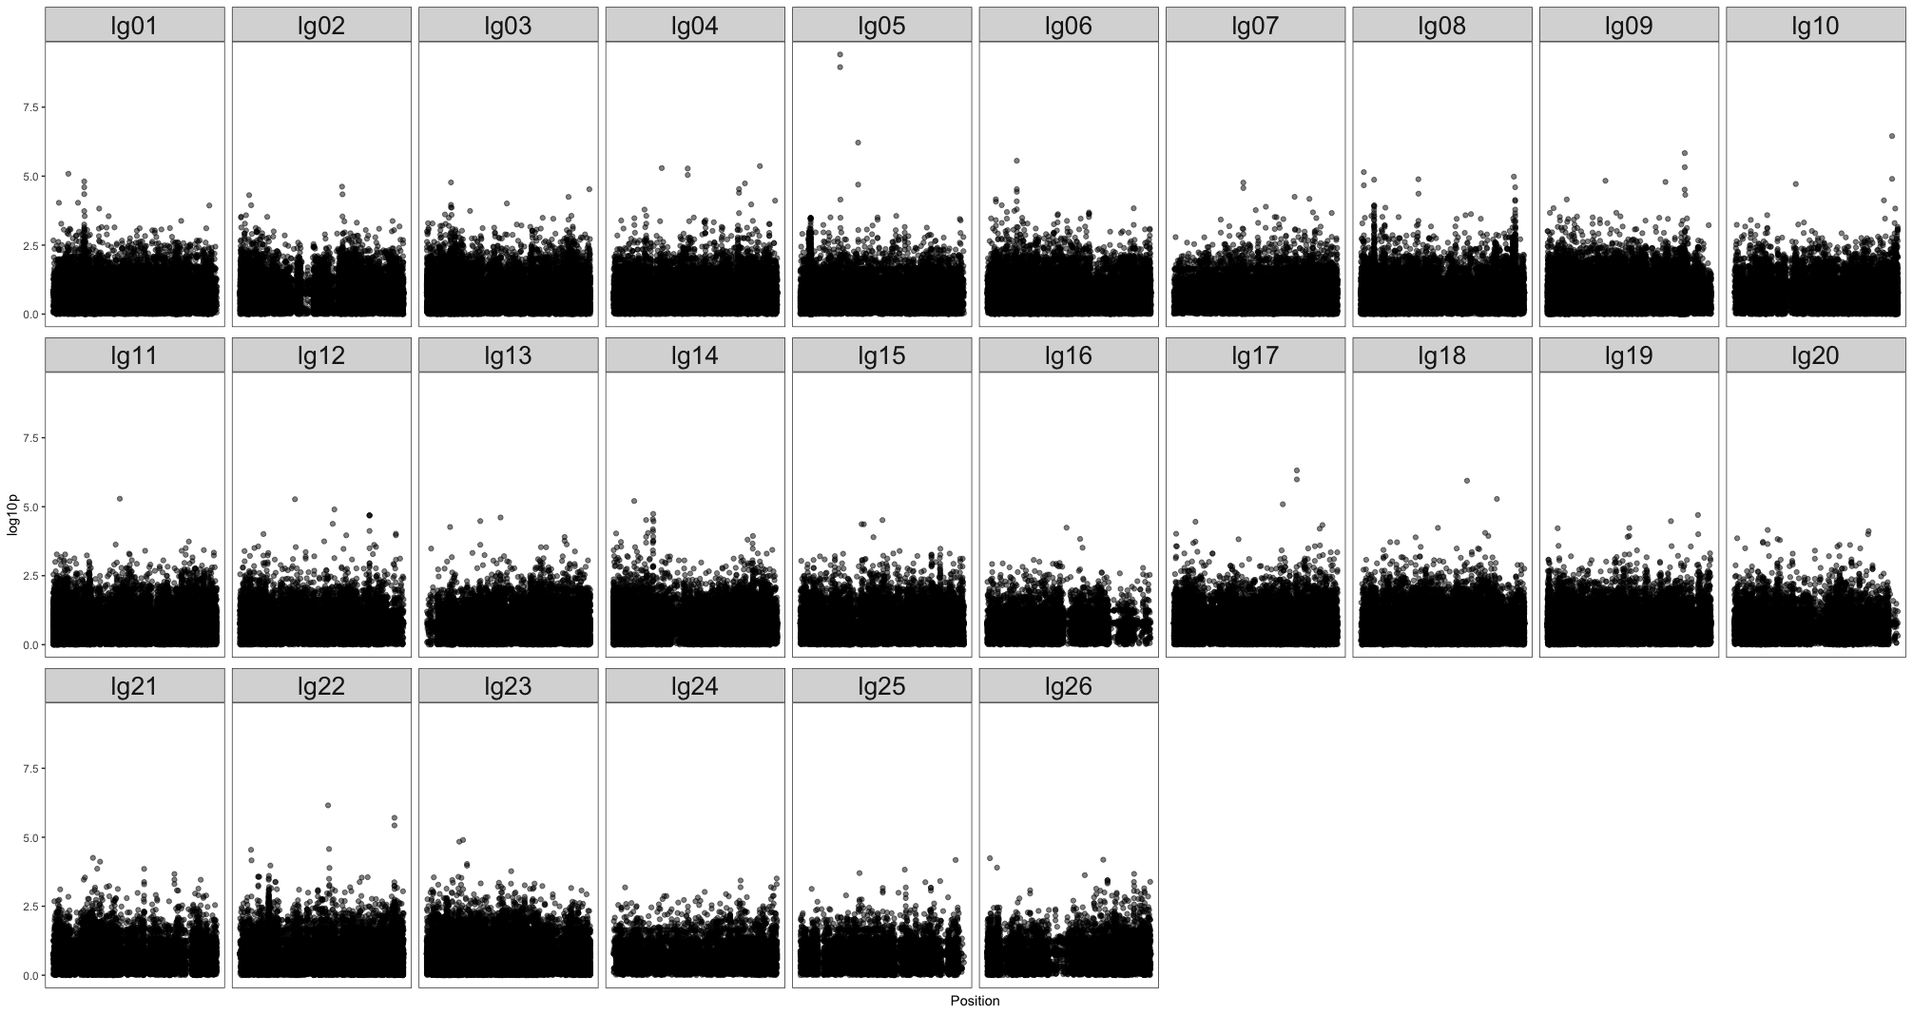
Aim #3: Genome wide association study
Aim 1: Assembly Aim 2: N_{E} Aim 3: Sex Marker
but the genotypes for these two
markers don’t segregate with sex…

Slide 14
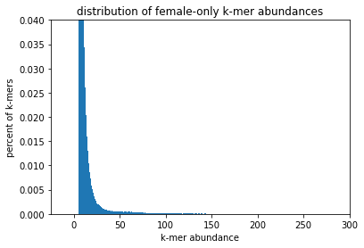
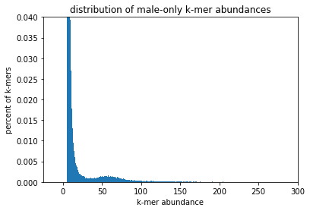
Aim #3: k-mer analysis
Aim 1: Assembly Aim 2: N_{E} Aim 3: Sex Marker
made signature of kmers belonging to each sex
filtered for low abundance kmers (minAb > 5)

Slide 15
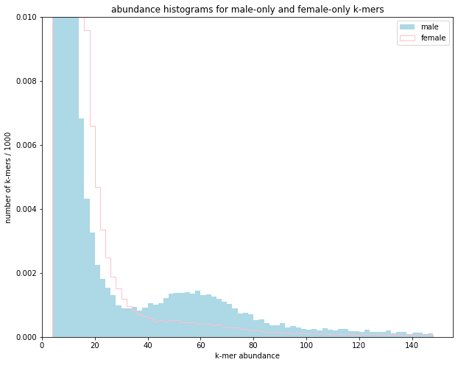
Aim #3: k-mer analysis
Aim 1: Assembly Aim 2: N_{E} Aim 3: Sex Marker
made signature of kmers belonging to each sex
filtered for low abundance kmers (minAb > 5)
compared # of male only, female onle kmers
(found males have more high abund kmers)

Slide 16
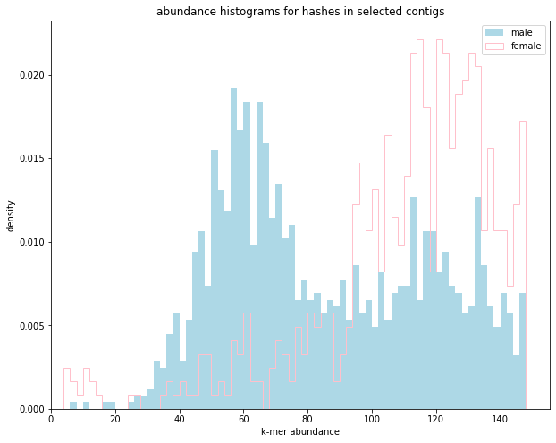
Aim #3: k-mer analysis
Aim 1: Assembly Aim 2: N_{E} Aim 3: Sex Marker
made signature of kmers belonging to each sex
filtered for low abundance kmers (minAb > 5)
compared # of male only, female onle kmers
(found males have more high abund kmers)
extracted contigs with > 5 kmers
looked at kmer abundances in extracted contigs
(male specific peak from abundance of 30-70)

Slide 17
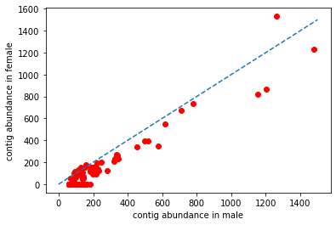
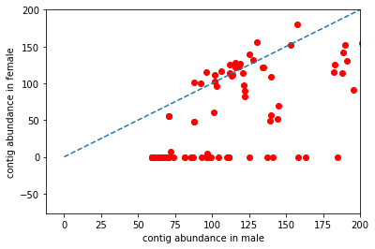
Aim #3: k-mer analysis
Aim 1: Assembly Aim 2: N_{E} Aim 3: Sex Marker
made signature of kmers belonging to each sex
filtered for low abundance kmers (minAb > 5)
compared # of male only, female onle kmers
(found males have more high abund kmers)
extracted contigs with > 5 kmers
looked at kmer abundances in extracted contigs
(male specific peak from abundance of 30-70)
compare contig abundance in M & F

Slide 18
Aim #3: k-mer analysis
Aim 1: Assembly Aim 2: N_{E} Aim 3: Sex Marker
made signature of kmers belonging to each sex
filtered for low abundance kmers (minAb > 5)
compared # of male only, female onle kmers
(found males have more high abund kmers)
extracted contigs with > 5 kmers
looked at kmer abundances in extracted contigs
(male specific peak from abundance of 30-70)
compare contig abundance in M & F
aligned “putative Y” sequences to genome
compared M & F depth at loci
(found no differences)

Slide 19
Aim #3: next steps…
Aim 1: Assembly Aim 2: N_{E} Aim 3: Sex Marker
acquire shotgun WGS data to further investigate CHR 5
suggestions?

