Slide 1
Genome assembly and investigation of Hypomesus transpacificus (delta smelt) genome for estimates of effective population sizes and identification of sex-specific markers.
Shannon E.K. Joslin
Thesis Committee Meeting 2021
07 May 2021

Slide 2
Aims
AIM #1: Produce a reference genome for delta smelt.
AIM #2: Infer contemporary & historical effective population sizes of delta smelt.
AIM #3: Discover sex-specific markers for sex identification of delta smelt.

Slide 3
Aim #1: Setup
Aim 1: Assembly Aim 2: N_{E} Aim 3: Sex Marker
hybrid assembly
one male, one female
original experimental design
implemented experimental design
linked reads + hi-c
long reads + linked reads + hi-c + linkage map ++ karyotype
Why/how??
cheaper
recovered linkage loci
collaboration with Delaney lab

Slide 4
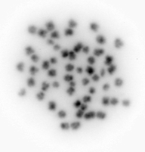
Aim #1: karyotype
Aim 1: Assembly Aim 2: N_{E} Aim 3: Sex Marker
2 experiments
used juvenile fish
found 2n = 56
image is too low res to say anything about sex chromosomes or chromosome composition
<- useful!

Slide 5
Aim #1: Implementation & Results
Aim 1: Assembly Aim 2: N_{E} Aim 3: Sex Marker
Sequencing
Initial assembly
Purge duplicate haplotigs
Add in sequencing technology
More sequencing
Incorporate linkage map information
Scaffold
Scaffold
Sample +
HMW DNA extraction
long reads
(PacBio)
IPA
linked reads
(10X)
scaff10x
hi-c
(Phase)
SALSA
chromonomer
purge_dups
male assembly stats
female assembly stats
N50 | 12,200,365
L50 | 15
n_contigs | 549
asm_length | 472,157,411
BUSCO | 88.40%
N50 | 14,850,352
L50 | 13
n_contigs | 376
asm_length | 437,273,953
BUSCO | 89.30%
Genome
!
= software
= sequencing technology

Slide 6
Aim #1: next steps…
Aim 1: Assembly Aim 2: N_{E} Aim 3: Sex Marker
manually curate according to Howe et al. (2021)
submit to NCBI
write up for paper

Slide 7
Aim #2: Setup
Aim 1: Assembly Aim 2: N_{E} Aim 3: Sex Marker
2945 individuals
Cohorts: 1993 – 2020
Historical N_{E} = Pi & Watterson’s
Contemporary N_{E} = linkage disequilibrium & temporal

Slide 8
Aim #2: Preliminary result (w new asm)
Aim 1: Assembly Aim 2: N_{E} Aim 3: Sex Marker
historical
needs further filtering

Slide 9
Aim #2: Trial run (used previous RAD asm)
Aim 1: Assembly Aim 2: N_{E} Aim 3: Sex Marker
contemporary
rerunning using new genome

Slide 10
Aim #2: Trial runs (while working on genome)
Aim 1: Assembly Aim 2: N_{E} Aim 3: Sex Marker
contemporary

Slide 11
Aim #2: Next steps
Aim 1: Assembly Aim 2: N_{E} Aim 3: Sex Marker
currently re-running analysis using new reference genome

Slide 12
Aim #3: Depth analysis
Aim 1: Assembly Aim 2: N_{E} Aim 3: Sex Marker
compared M & F RAD alignment depths between sexes
2 experiements
aligned to M reference
aligned to F reference
…found no differences

Slide 13
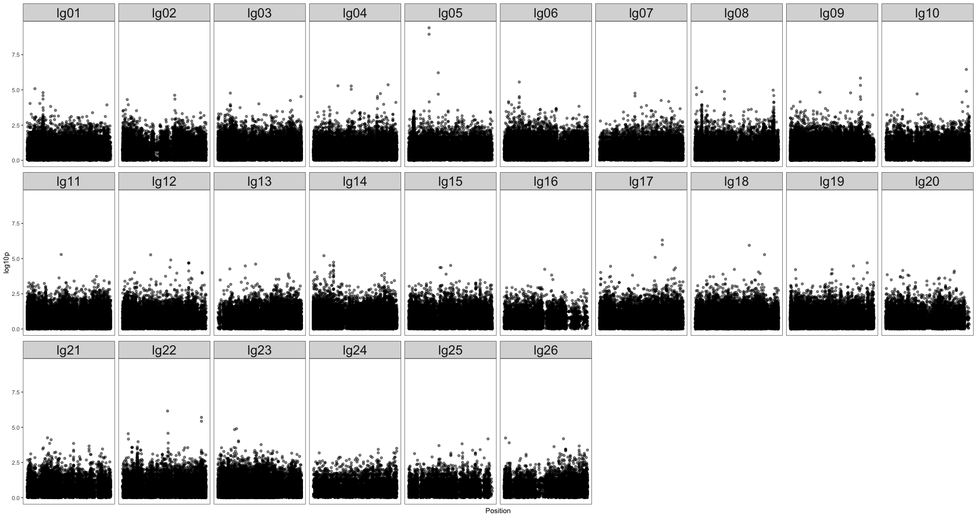
Aim #3: Genome wide association study
Aim 1: Assembly Aim 2: N_{E} Aim 3: Sex Marker
but the genotypes for these two
markers don’t segregate with sex…

Slide 14
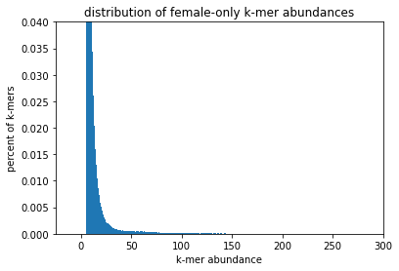
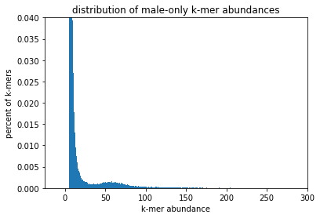
Aim #3: k-mer analysis
Aim 1: Assembly Aim 2: N_{E} Aim 3: Sex Marker
made signature of kmers belonging to each sex
filtered for low abundance kmers (minAb > 5)

Slide 15
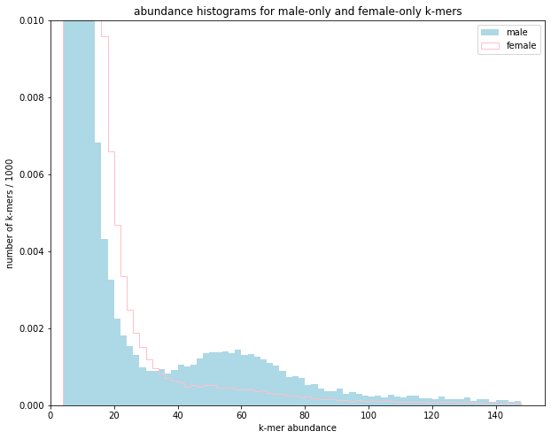
Aim #3: k-mer analysis
Aim 1: Assembly Aim 2: N_{E} Aim 3: Sex Marker
made signature of kmers belonging to each sex
filtered for low abundance kmers (minAb > 5)
compared # of male only, female onle kmers
(found males have more high abund kmers)

Slide 16
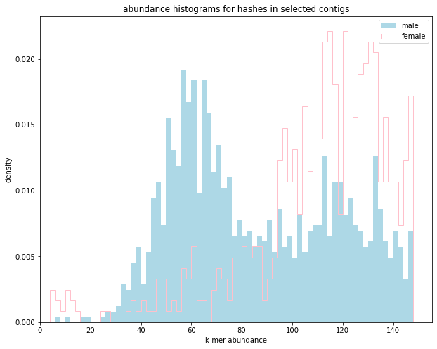
Aim #3: k-mer analysis
Aim 1: Assembly Aim 2: N_{E} Aim 3: Sex Marker
made signature of kmers belonging to each sex
filtered for low abundance kmers (minAb > 5)
compared # of male only, female onle kmers
(found males have more high abund kmers)
extracted contigs with > 5 kmers
looked at kmer abundances in extracted contigs
(male specific peak from abundance of 30-70)

Slide 17
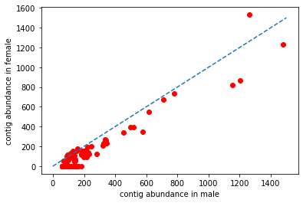
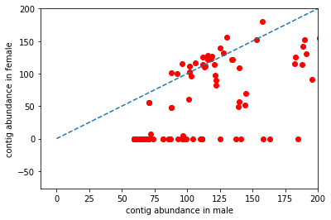
Aim #3: k-mer analysis
Aim 1: Assembly Aim 2: N_{E} Aim 3: Sex Marker
made signature of kmers belonging to each sex
filtered for low abundance kmers (minAb > 5)
compared # of male only, female onle kmers
(found males have more high abund kmers)
extracted contigs with > 5 kmers
looked at kmer abundances in extracted contigs
(male specific peak from abundance of 30-70)
compare contig abundance in M & F

Slide 18
Aim #3: k-mer analysis
Aim 1: Assembly Aim 2: N_{E} Aim 3: Sex Marker
made signature of kmers belonging to each sex
filtered for low abundance kmers (minAb > 5)
compared # of male only, female onle kmers
(found males have more high abund kmers)
extracted contigs with > 5 kmers
looked at kmer abundances in extracted contigs
(male specific peak from abundance of 30-70)
compare contig abundance in M & F
aligned “putative Y” sequences to genome
compared M & F depth at loci
(found no differences)

Slide 19
Aim #3: next steps…
Aim 1: Assembly Aim 2: N_{E} Aim 3: Sex Marker
acquire shotgun WGS data to further investigate CHR 5
suggestions?

