Slide 1
Mental Health Predictors
Luis Arroyo, Shannon Young, Jayla Gary, Henry Lemen

Slide 2
Background
In the US, approximately 1 in 5 adults (about 60 million) live with a Mental Illness.
Our goal is to create a Supervised machine learning model to predict mental illness based off a variety factors.
We used a large dataset (>400,000 rows) from Kaggle with 14 columns of socioeconomic data to create an XGBoost model.

Slide 3
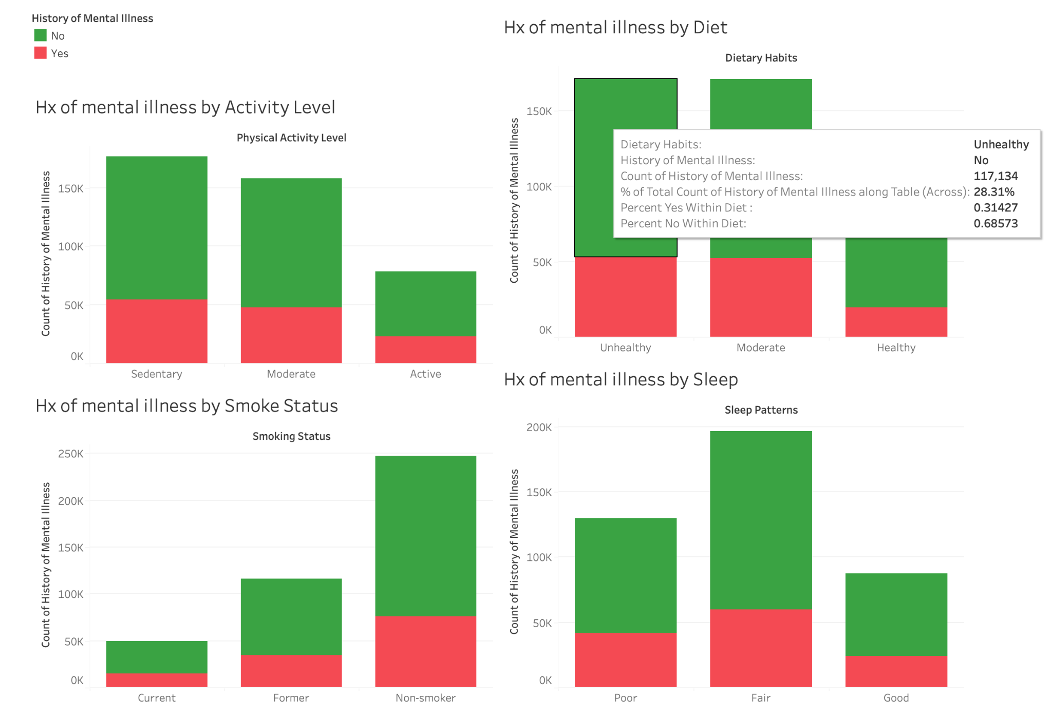
Health Factors

Slide 4
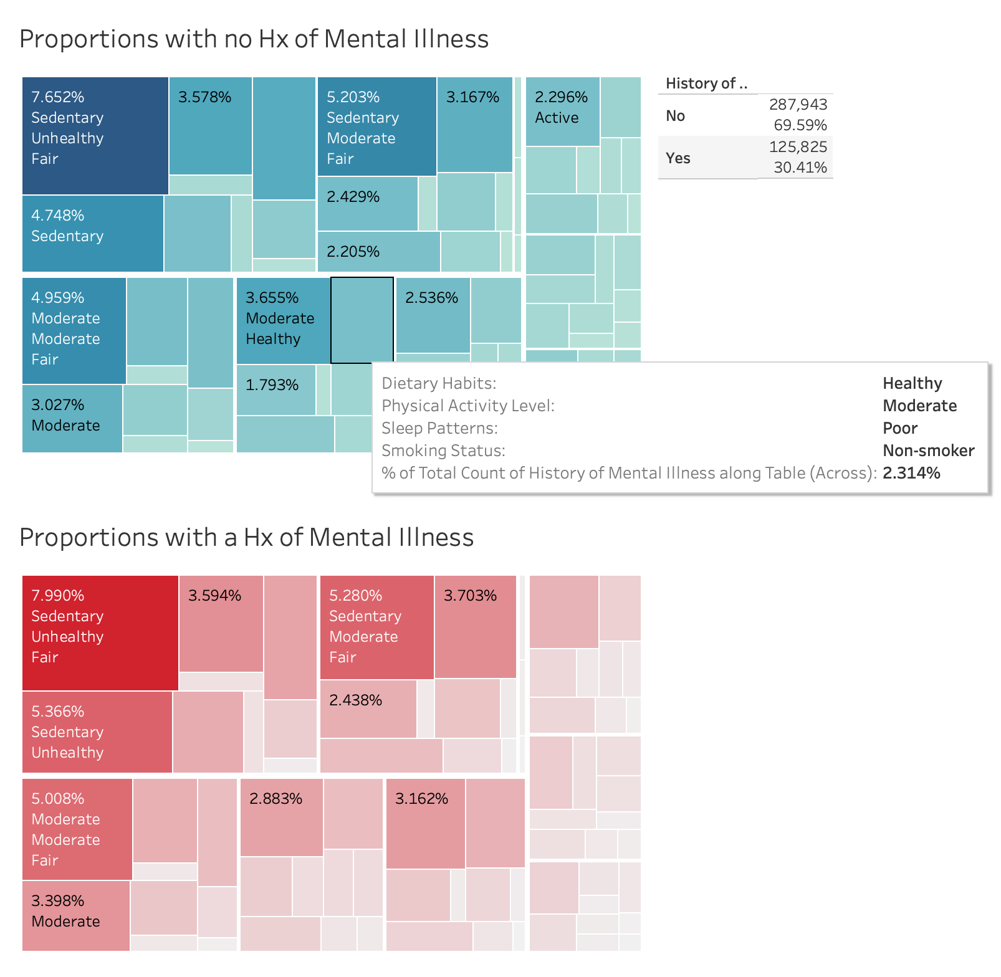

Slide 5
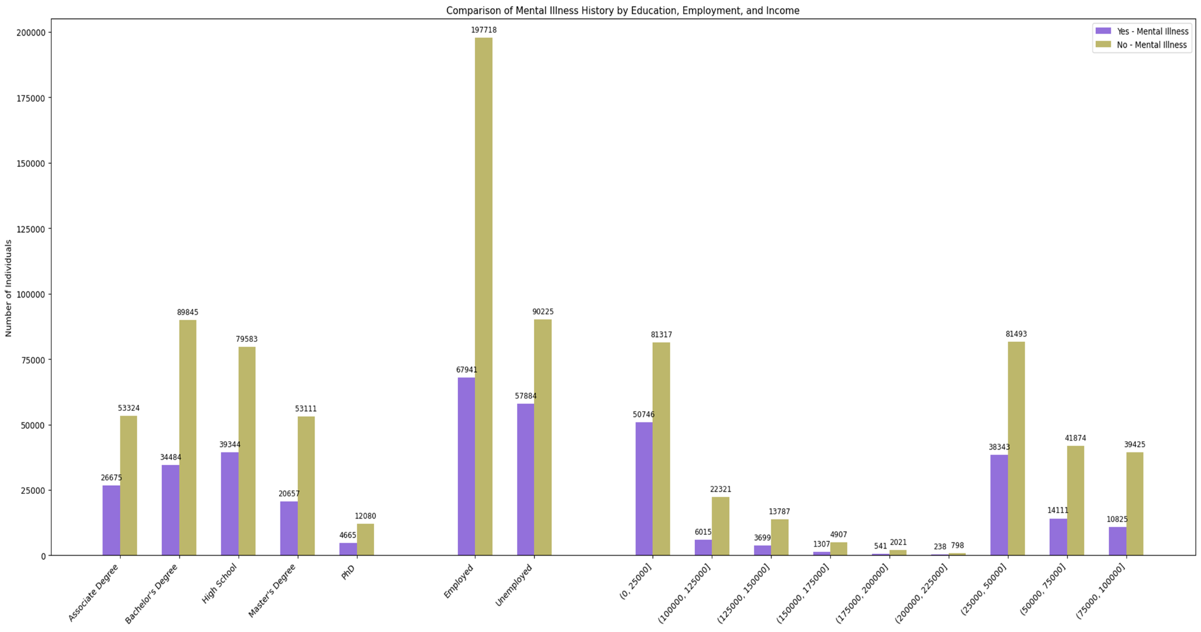
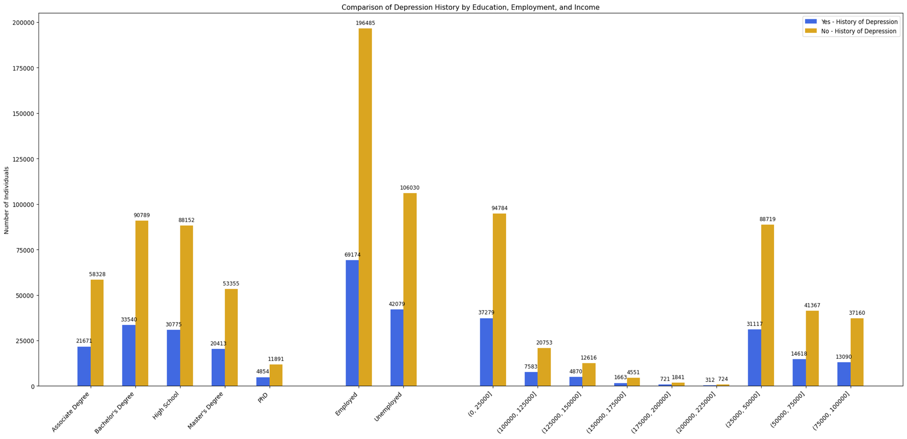
Income/Education/Employment

Slide 6
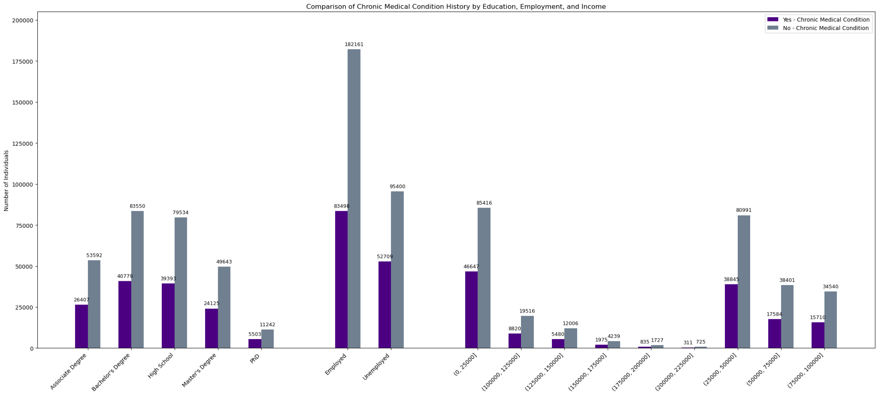
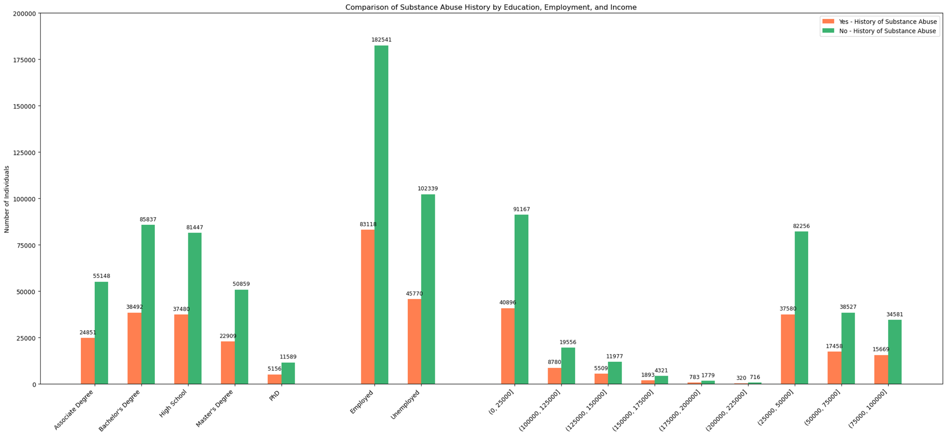

Slide 7
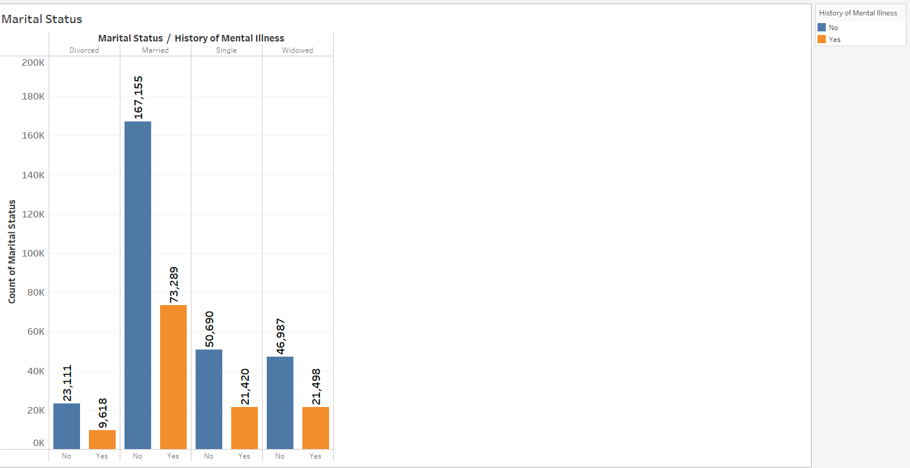
Marital Status
Total Number of Participants:
423,768

Slide 8
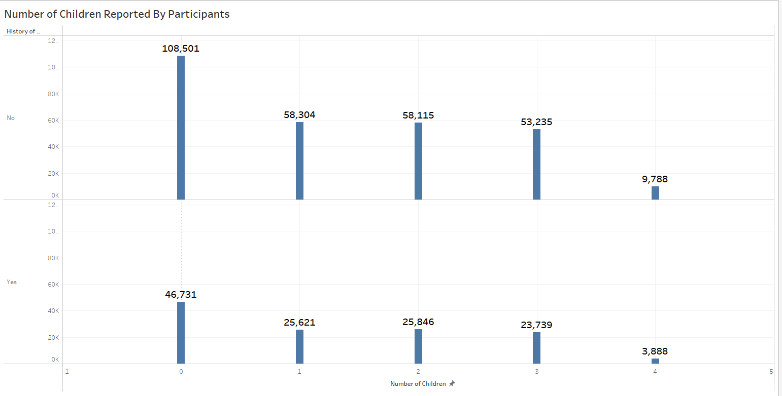
Number of Children

Slide 9
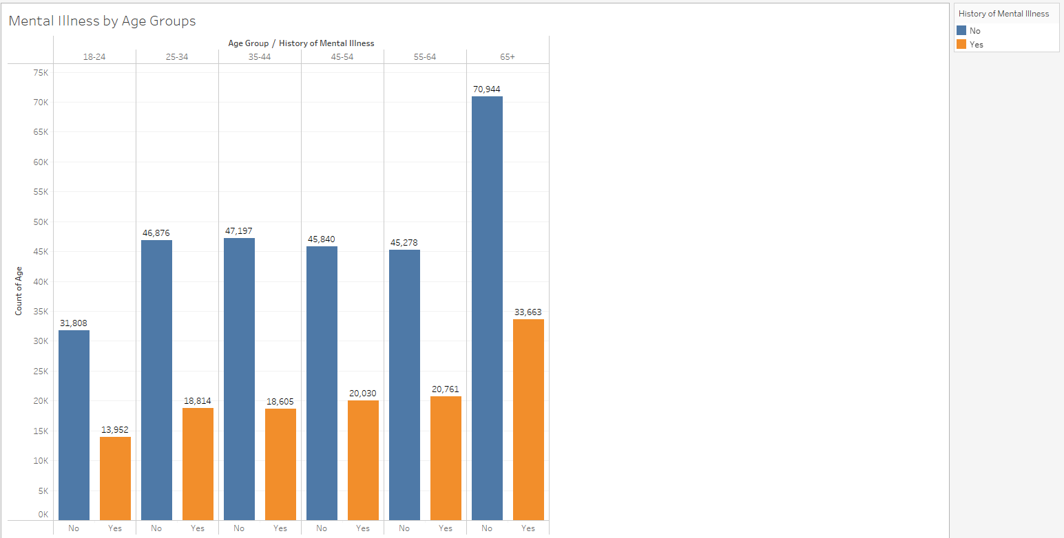
Participants Age

Slide 10
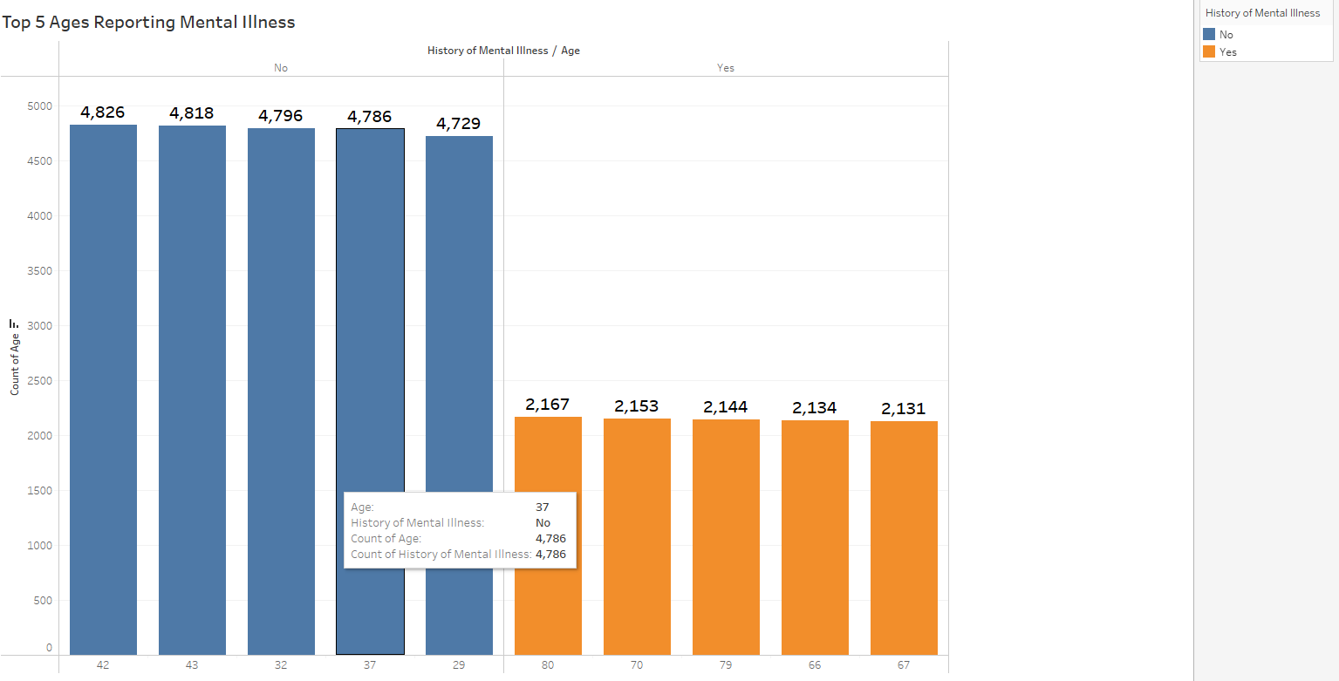
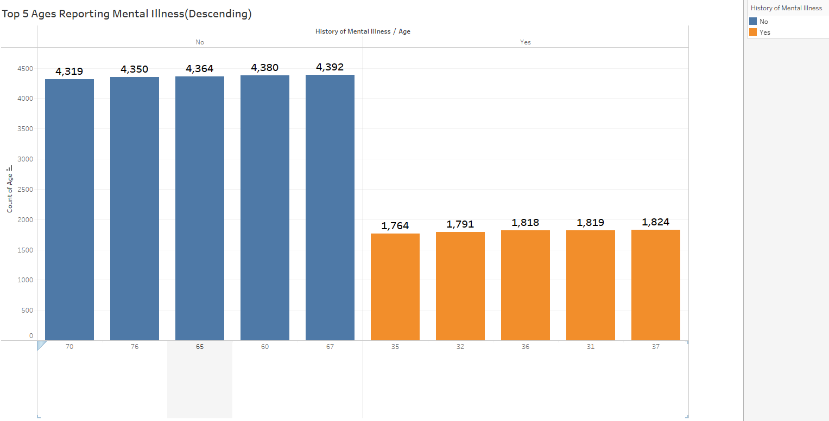
Highest/Lowest by Age

Slide 11
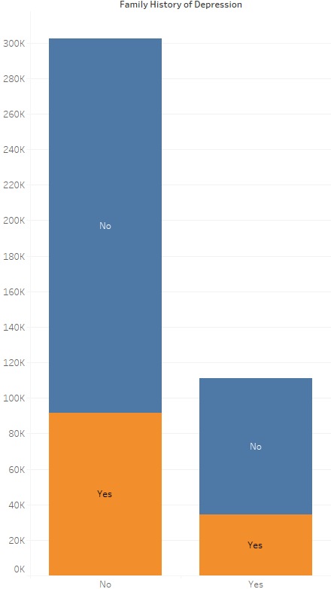
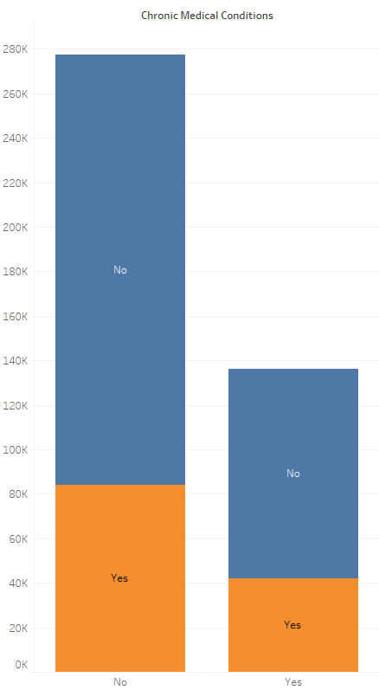
Family History of Depression
Chronic Medical Conditions

Slide 12
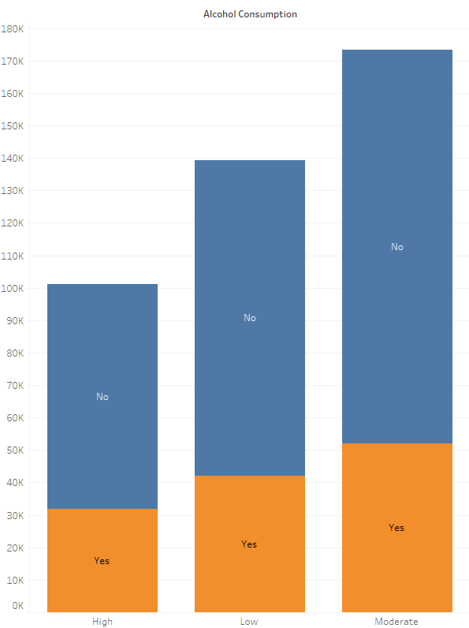
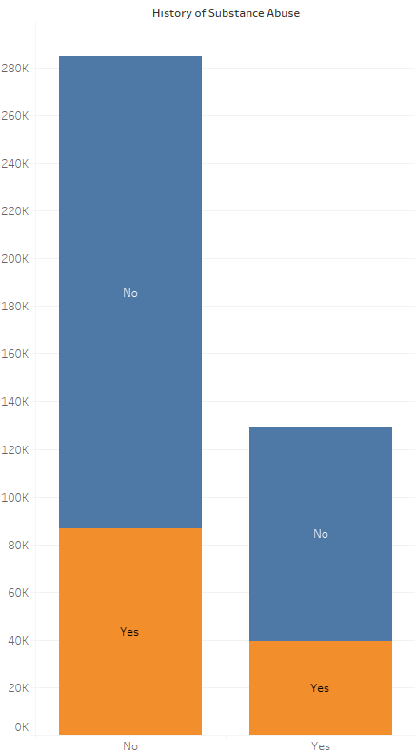
History of Substance Abuse
Levels of Alcohol Consumption

Slide 13
XGBoost
XGBoost builds upon the principles of gradient boosting, combining multiple weak learners (like a decision tree) to create a strong predictive model.
Has built in regularization techniques to prevent overfitting
Designed to handle large datasets

Slide 14
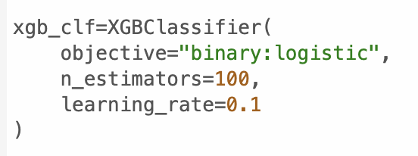
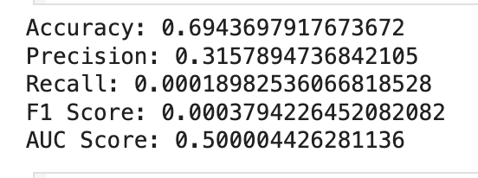
First Model

Slide 15
Synthetic Minority Oversampling Technique (SMOTE)
To balance the date prior to model creation, SMOTE was utilized.
SMOTE synthesizes new data from the existing samples
First selects a minority class instance a at random and finds its k nearest minority class neighbors. The synthetic instance is then created by choosing one of the k nearest neighbors b at random and connecting a and b to form a line segment in the feature space. The synthetic instances are generated as a convex combination of the two chosen instance a and b.

Slide 16
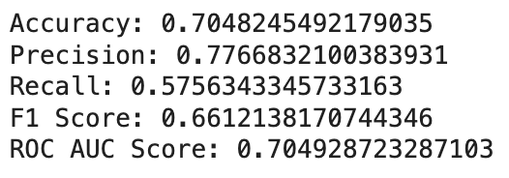
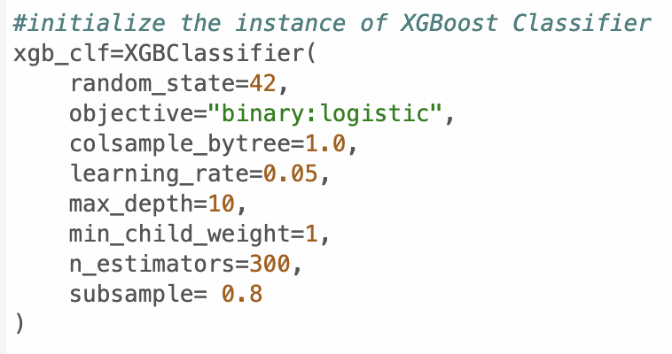
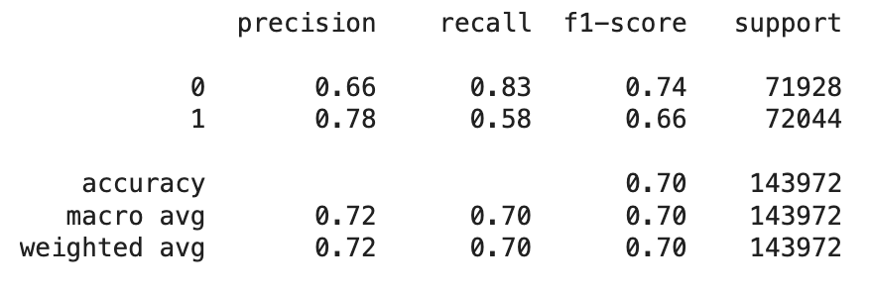
Final Model

Slide 17
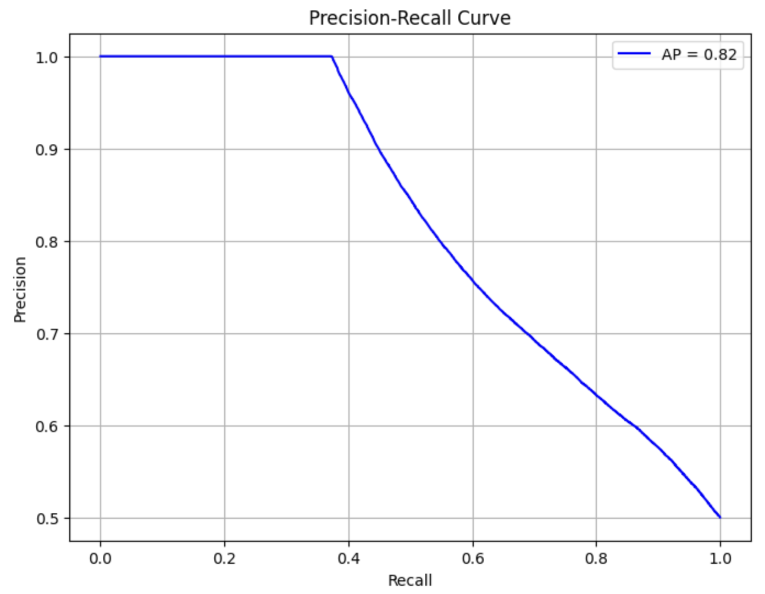

Slide 18
Limitations and Further Optimizations
One possible limitation of the dataset is the potential for inaccurate data. With such a large dataset, there could also be concerns about scalability.
Even with the optimized model, we still only achieve 57.56% recall, so ideally we’d like to get that higher. However, as seen on the graph on the previous slide, as recall increases, precision decreases, so there has to be a balance between the two.
For further optimizations, we would test different hyperparameter tunings, like making updates to the model complexity, boosting process, or regularization. We could find those using the grid search method. We could additionally test different values for the bins we created for income and age. We could also test cross validation and early stopping and review how that effects model performance.

Slide 19
Thank You!
Questions?

