Slide 1
0 deg

Slide 2
2 deg

Slide 3
4 deg

Slide 4
6 deg

Slide 5
8 deg

Slide 6
10 deg

Slide 7
Average Slipratio for Wheel-v2
0 deg -> 0.207
2 deg -> 0.390
4 deg -> 0.657
6 deg -> 0.805
8 deg -> 0.837
10 deg -> 0.805

Slide 8
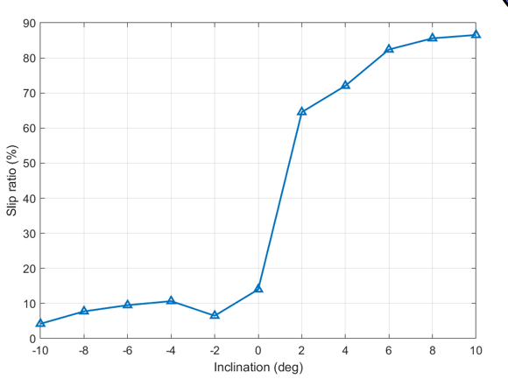
Average Slipratio for Wheel-v1
0 deg -> 0.135
2 deg -> 0.648
4 deg -> 0.724
6 deg -> 0.771
8 deg -> 0.806
10 deg -> 0.847

