Slide 1
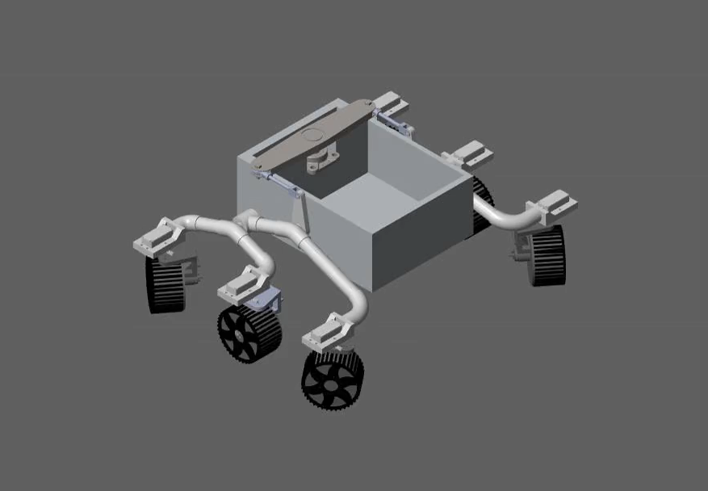
Rover Simulation in Simulink
This simulation illustrates the rover performing an in-place turn at an angular speed of 0.25 rad/s. The model was developed and executed in Simulink, where each wheel’s motion and steering were controlled based on the inverse kinematics equations derived in the previous update. This simulation validates the correctness of the kinematic model.

Slide 2
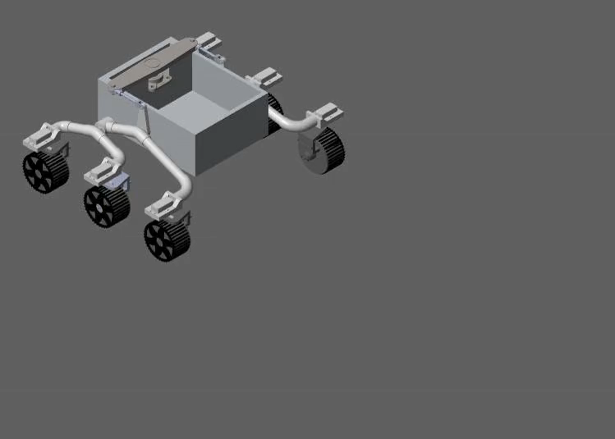
Rover Simulation in Simulink
This simulation illustrates the rover performing a forward motion at a linear speed of 0.1 m/s (10 cm/s).

Slide 3
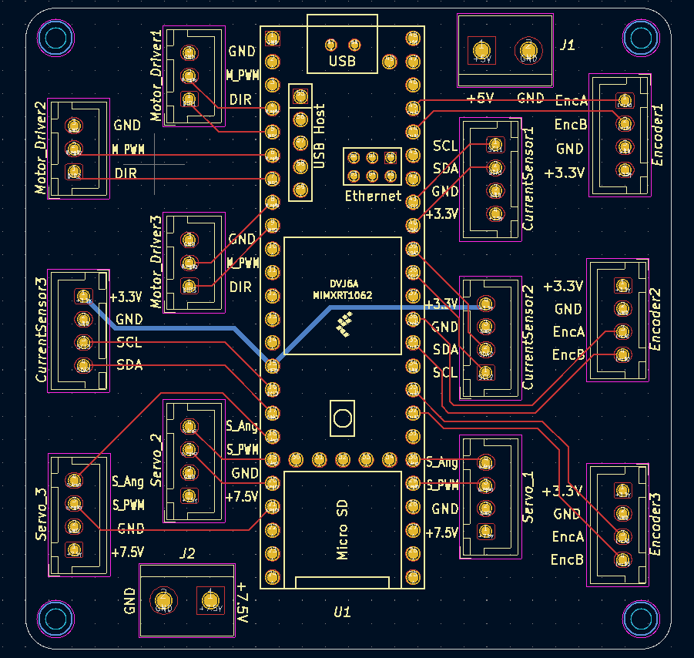
PCB Design
A custom interface PCB has been designed to connect the Teensy microcontroller with motor drivers, encoders, current sensors, and servo modules. This PCB is developed to simplify wiring, reduce connection errors, and provide a reliable centralized interface for the rover’s control system. The front layer is used for signal routing and traces, while the back layer is dedicated to power distribution. Copper pours are used for the main supply rails—3.3 V, 5 V, and 7.5 V—to ensure stable power delivery and minimize voltage drops. The design has been reviewed, and the PCB is ready for fabrication and integration with the rover system.

Slide 4
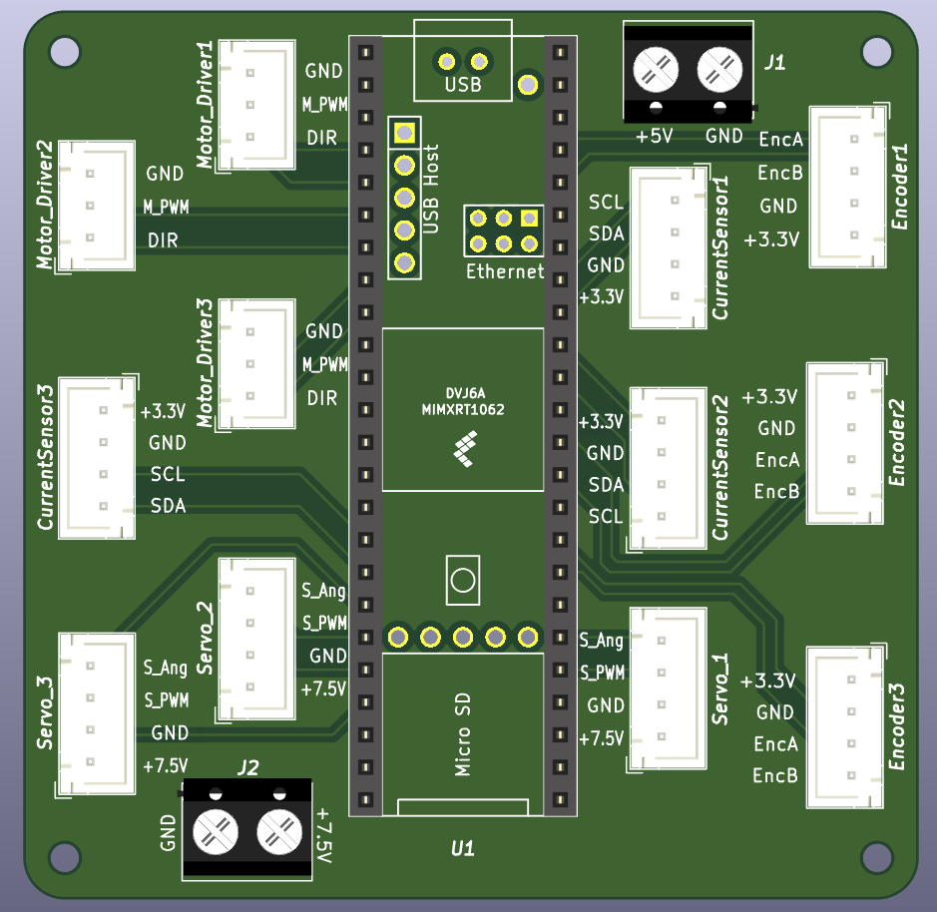
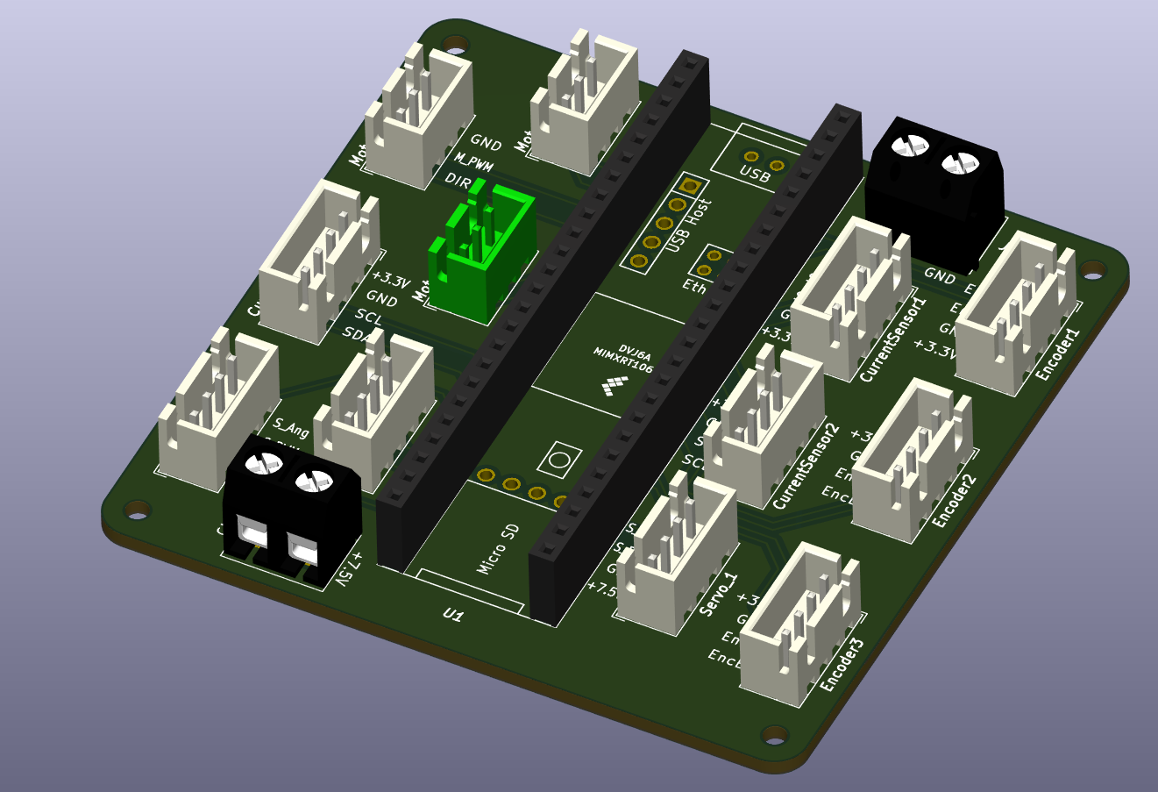
Front Layer
This view shows the front layer of the PCB where all signal traces are routed. It includes connections for motor driver control lines, encoder signals, current sensors (INA219), and servo lines. The layout ensures minimal interference and organized signal flow from the Teensy.

Slide 5
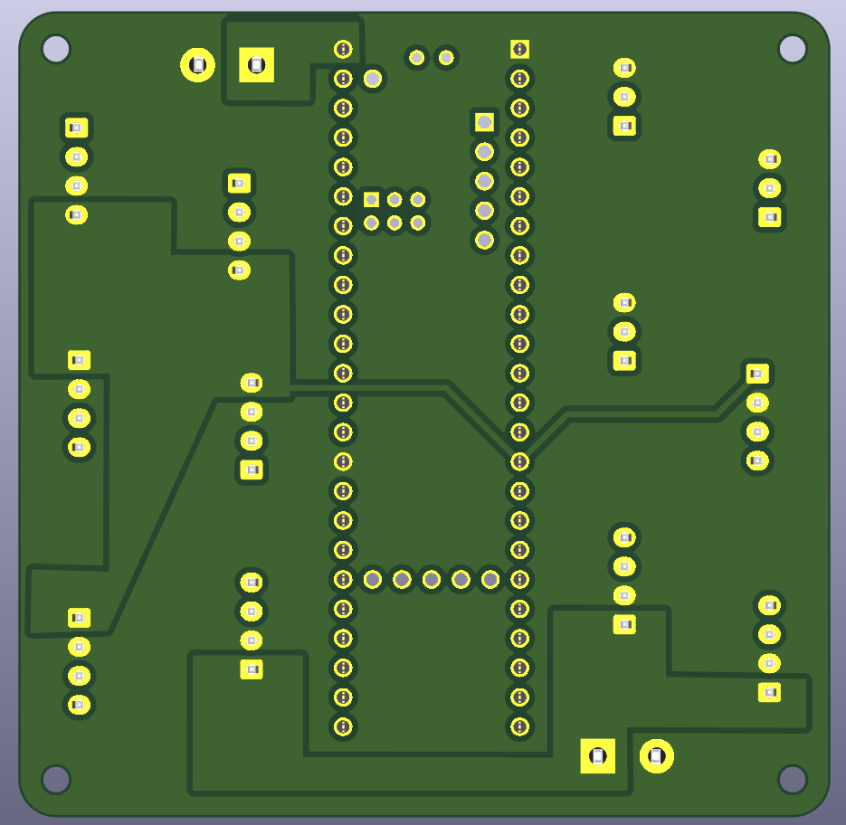
Bottom Layer
5V pour
3.3V pour
7.5V pour
This layer is dedicated to power routing with copper pours for the 3.3 V, 5 V, and 7.5 V rails. The 5 V and 7.5 V rails are supplied through screw terminals connected to external buck converters powered by the PDB or battery, while the 3.3 V rail for sensors is derived directly from the Teensy. This setup ensures stable voltage distribution and proper current handling for all components.

