Slide 1

Financial Sentiment Analysis
The business objective is get sentiment analysis of financial statements and gauge its impact i.e. positive,negative or neutral on the business and government.
Text procressing and data transformation using python
Model building and deployment using streamlit

Slide 2
TEAM-3
Team Members
Sujatha.E
Naga Lakshmi.K
Afreen Nikhat
Manisha Kranthi.D
Vamsi Krishna.P
Pavan Kumar shetty
Shanmukha Manikanta babu.C
Mentors
Neha Gupta
Hareesh

Slide 3
Sentiment Analysis
Feature Extraction
Model Building
EDA
Deployment
In the EDA, we did Sentiment analysis and emotion mining using barplots,wordcloud and pie chart.
Converted text features in vector features unsing TF-IDF and word embeddings.
Build different classifier models such as Decision tree,Random Forest,Support Vector,KNN and Logistic Regression.
Deployed the model using Streamlit.
01
02
03
04

Slide 4
EDA
In the EDA we looked at the shape of the data set, value counts of the sentiments and removed the duplicates.
Visualised the Sentiments using Barplot, Pie chart and wordclouds
Preformed text Pre-processing by removing both the leading and the trailing characters, removing the punctuations and stopwords, normalising the data,lemmatizing the text and converted them into tokens.
Perfomed the N-gram analysis for postive, neutral and negative seniments.

Slide 5
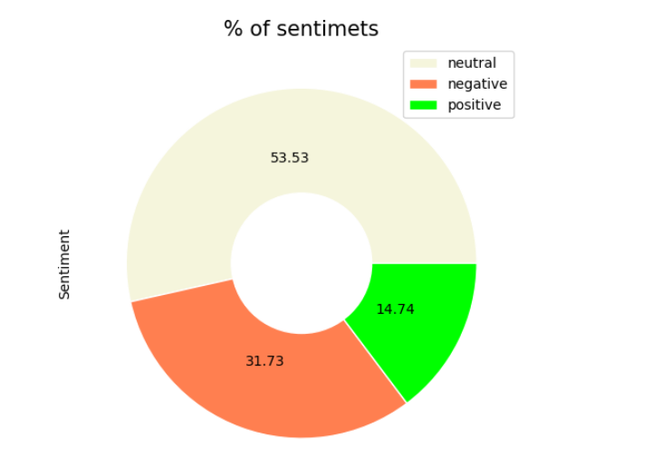
PIE CHART

Slide 6
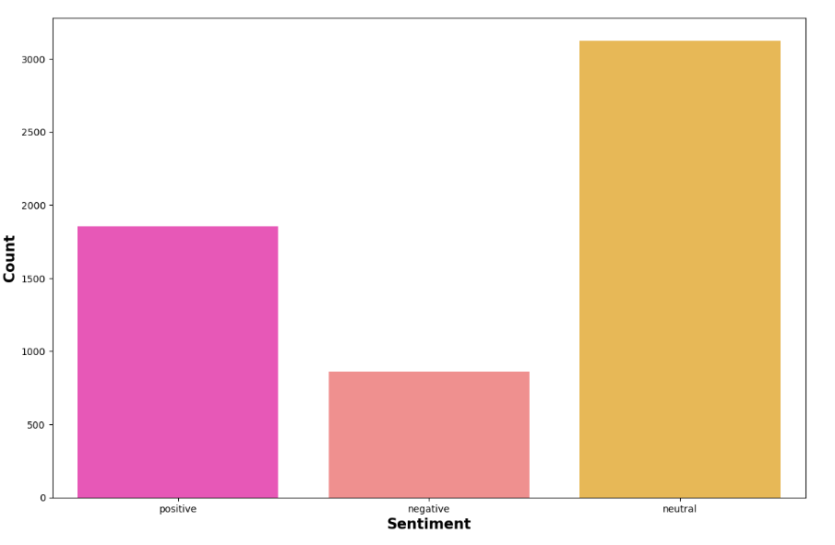
Count Plot

Slide 7
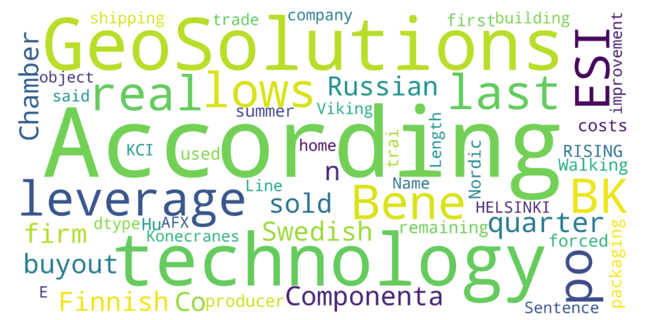
Word Cloud

Slide 8
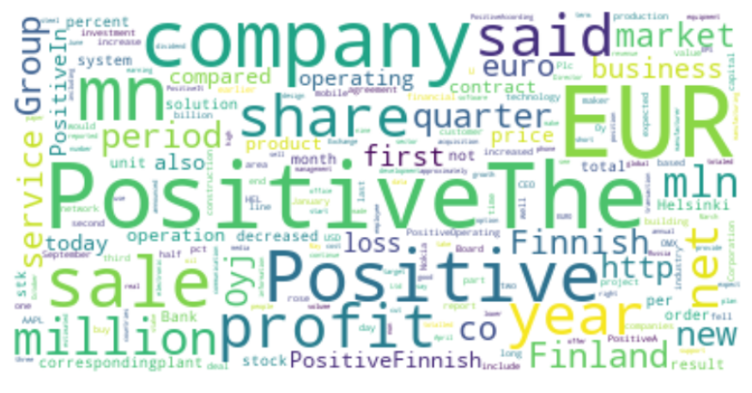
Word Cloud for positive Sentiment

Slide 9
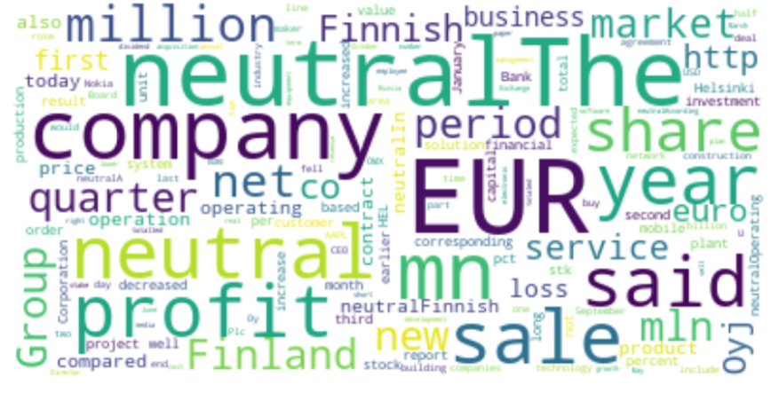
Word Cloud for Neutral Sentiment

Slide 10
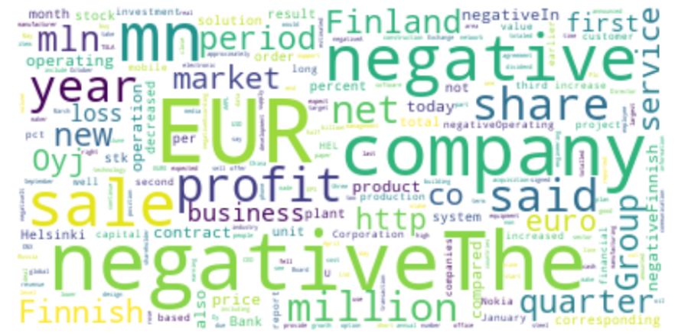
Word Cloud for Negative Sentiment

Slide 11
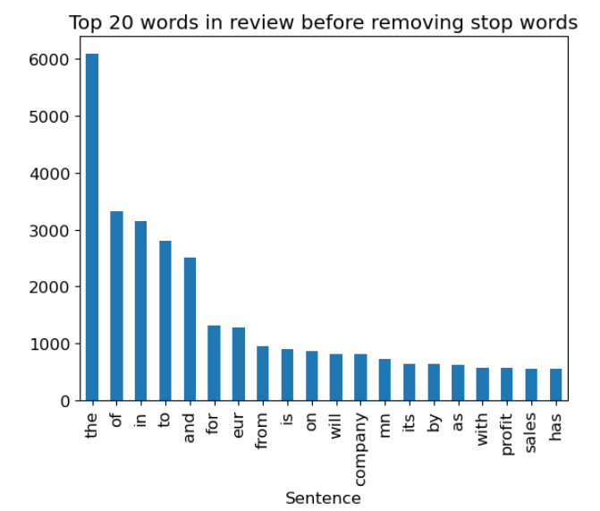
Top 20 words before removing Stopwords

Slide 12
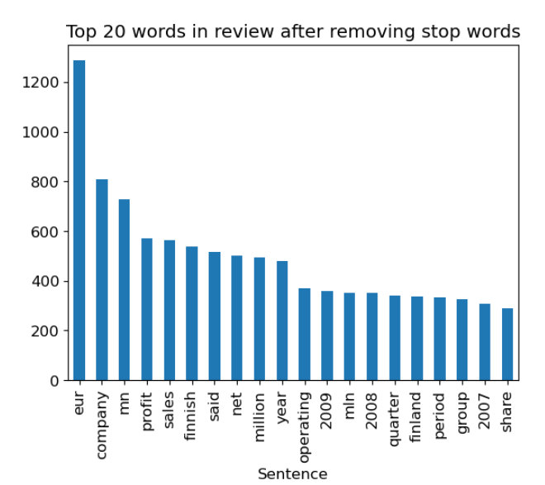
Top 20 words after removing Stopwords

Slide 13
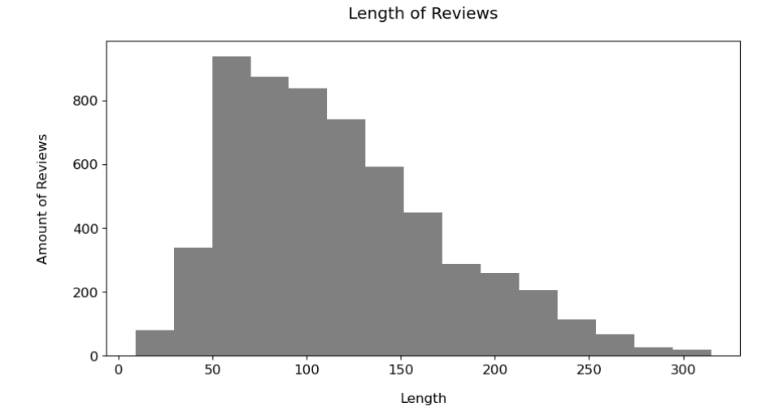
Length of the reviews

Slide 14
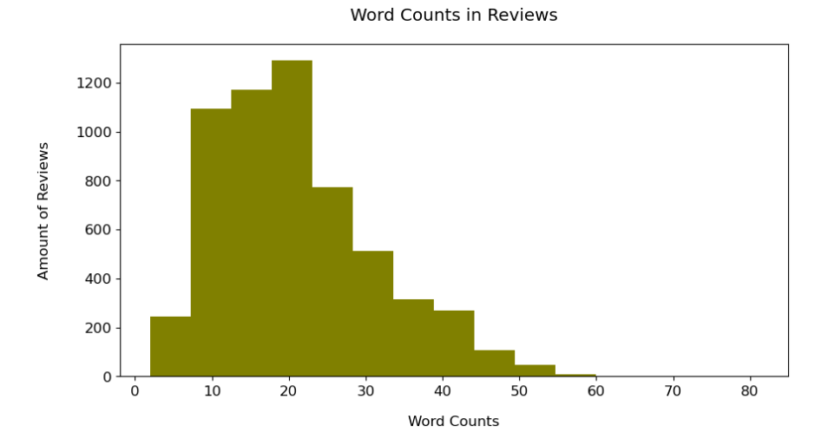
Word Counts

Slide 15
Feature Extraction
In the Feature Extraction we converted the text data in vectors using TF-IDF including uni-grams,bi-grams and tri-grams.
Converted the vectors into arrays.

Slide 16
Model Building
In the Model Building we built different models such as Naive bayes classifier, Decision tree classifer, Random Forest, Support Vectors classifier, KNN, Logistic regression and LSTM.
We balanced the classes using class_weights

Slide 17
Model Building
 | Precision |  |  | Recall |  |  | F1 scores |  |  | Accuracy
 | Positive | neutral | negative | positive | neutral | negative | positive | neutral | negative
Naive Bayes | 0.68 | 0.73 | 0.44 | 0.62 | 0.89 | 0.15 | 0.65 | 0.80 | 0.23 | 0.70
Random Forest | 0.72 | 0.70 | 0.23 | 0.59 | 0.81 | 0.17 | 0.65 | 0.75 | 0.20 | 0.69
SVC | 0.70 | 0.81 | 0.39 | 0.67 | 0.73 | 0.59 | 0.69 | 0.77 | 0.47 | 0.69
Logistic Regression | 0.70 | 0.81 | 0.41 | 0.68 | 0.74 | 0.56 | 0.69 | 0.78 | 0.47 | 0.70
KNN | 0.68 | 0.75 | 0.27 | 0.42 | 0.71 | 0.53 | 0.52 | 0.73 | 0.36 | 0.60
Decision tree | 0.53 | 0.69 | 0.22 | 0.59 | 0.66 | 0.21 | 0.56 | 0.67 | 0.22 | 0.57
LSTM | 0.67 |  |  | 0.57 |  |  |  |  |  | 0.64

Slide 18
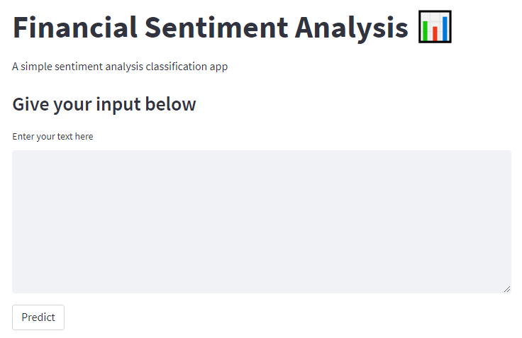
Deployment
Deployed the Logistic Regression model using streamlit

