Slide 1
MAJOR PROJECT
SUBJECT CODE : BCE-P861
DEPARTMENT OF CSE,
FET, GKV , HARIDWAR

Slide 2

REVEALING FRAUDLENT TRANSACTIONS USING MACHINE LEARNING
UNDER GUIDENCE OF :
Dr.Suyash Bhardwaj
Professor
Department Of CSE
FET, GKV, Haridwar
PRESENTED BY :
D.Revanth Naik (196301033 )
B.Shanmukha (196301028)
D.Sunil Kumar Reddy (196301038)
B.Vineeth (196301027)

Slide 3
CONTENTS
INTRODUCTION
TRADITIONAL APPROACH VS ML APPROACH
PROBLEM STATEMENT
SYSTEM SPECIFICATIONS
BLOCK DIAGRAM
ABOUT MACHINE LEARNING
ALGORITHMS(LR, KNN, NB, SVM)
DATASET
PERFORMANCE OF OUR ALGORITHMS
ADVANTAGES
METHOD TO REDUCE FRAUDLENT TRANSACTIONS
CONCLUSION & FUTURE SCOPE
REFERENCES

Slide 4
WHAT ACTUALLY FRAUD DETECTION.
FRAUD – Intentionally deceiving someone for their personal Gain.
Fraud detection is a topic which is applicable to many industries including banking and financial sectors, insurances, government agencies and more
Fraud detection is process of identifying fraudulent transaction
Credit card fraud detection technic used to recognize fraudulent credit card transactions so that customers are not charged for items that they did not purchases.

Slide 5
INTRODUCTION
Fraudulent transactions can cause financial losses, reputation damage, and legal consequences for businesses and financial institutions.
Machine learning algorithms can be used to detect and prevent fraudulent transactions by analyzing large amounts of data and identifying patterns and anomalies.
Our project focuses on the use of several machine learning models, including Logistic Regression, K-nearest neighbors (KNN), Naive Bayes, and Support Vector Machines (SVM).
By applying these models to a dataset of transactions, we aim to detect and prevent fraudulent activity, helping businesses and financial institutions to mitigate risk and protect their assets.

Slide 6
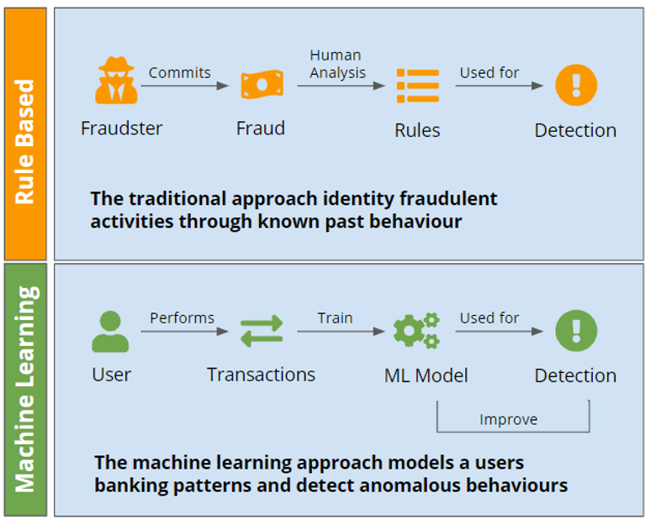
TRADITIONAL APPROACH vs ML APPROACH

Slide 7
PROBLEM STATEMENT
We can observe this from many financial reports. Such as (Bhattacharya et al.,2011) 10th annual online fraud report by Cyber Source shows that estimated loss due to online fraud is $4 billion for 2008 which is 11% increase than $3.6 billion loss in 2007 and in 2006, fraud in United Kingdom alone was to be £535 million in 2007 and now costing around 13.9 billion a year (Mahdi, 2010).
Traditional methods of fraud detection have limitations in their ability to accurately and efficiently detect fraudulent activity.
However, developing accurate and efficient machine learning Algorithm for fraud detection remains a challenge, so we had used multiple ML Algorithms.

Slide 8
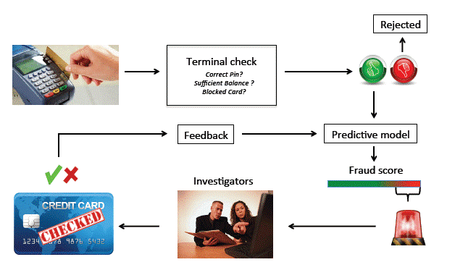
BLOCK DIAGRAM

Slide 9
SYSTEM SPECIFICATIONS
SOFTWARE REQUIREMENTS :
Operating System : Windows 7
Language : Python programming language
Editor : Jupyter Notebook
Modules like Streamlit(for Interface), Sk.learn , etc. must installed.
Streamlit :
Streamlit is a Python library that simplifies the process of building interactive web applications for data science and machine learning tasks.

Slide 10
HARDWARE REQUIREMENTS :
Processor : Intel i3 or above
Memory : 2GB or above
Hard Disk : 40GB or above
Monitor : 14’’ colour Monitor
Mouse : Optical Mouse , Touch pad.

Slide 11
MACHINE LEARNING
Machine learning involves developing algorithms that can learn from data, identify patterns and make predictions or decisions without being explicitly programmed for each task.
Machine learning algorithms are used in email filtering, face recognition, etc.
Types of ML
-Supervised Learning
-Unsupervised Learning
-Reinforcement Learning

Slide 12
Types of ML :
Supervised Learning : It is a type of ML, where the algorithm is trained on labeled data, meaning the desired output is already known, in order to predict future outcomes.
Unsupervised learning: It is a machine learning technique where the algorithm learns from data that is not labeled or classified and identifies patterns or structures within the data without any specific guidance or supervision.
Reinforcement learning: It is a type of machine learning technique that involves an agent learning to make decisions based on the environment it Interacts with, by receiving feedback in the form of rewards or punishments.

Slide 13
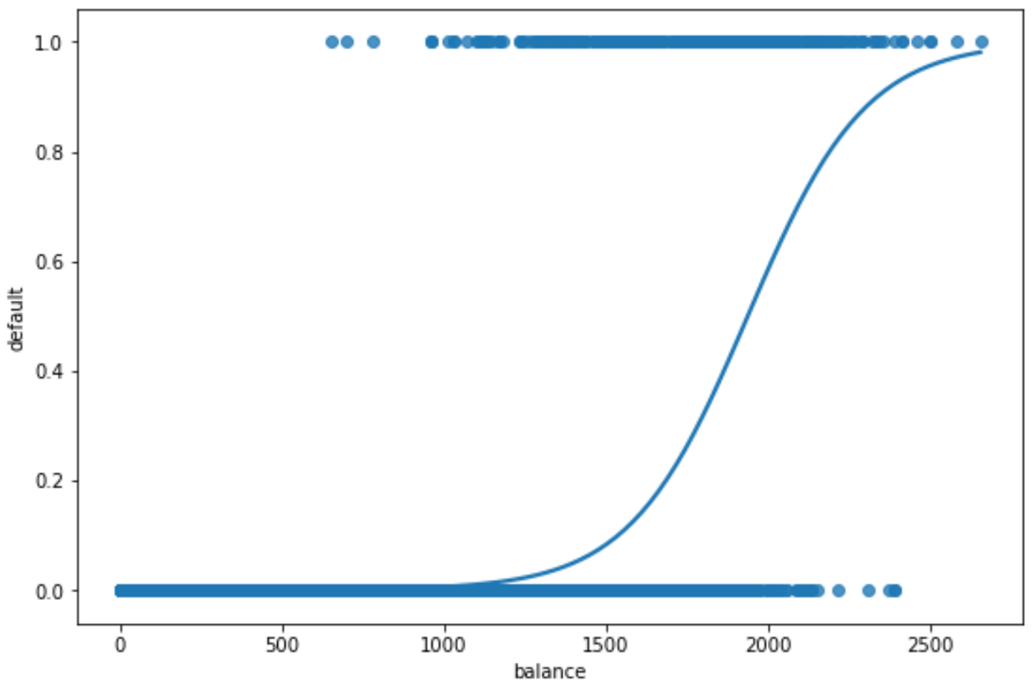
ALGORITHMS USED
Logistic Regression :
It is a statistical model used in ML that is used to predict the probability of a binary outcome based on one or more input variables.
In simple terms, it is a technique that can be used to predict a "yes" or "no" answer based on given input variables.
For example, it can use historical data on weather patterns, river water levels, and other environmental factors to predict the likelihood of a flood occurring in a certain area.

Slide 14
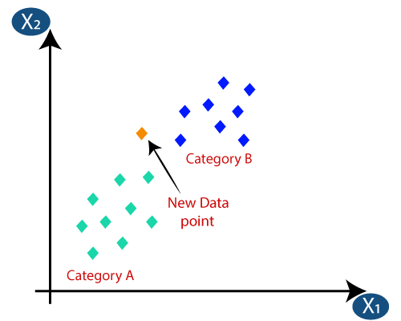
K-Nearest Neighbors(KNN) :
It is a ML algorithm used for classification or regression tasks, where the output is a class membership or a real value, respectively.
In simple terms, it works by finding the K closest data points in the training dataset to a new input data point, and then assigning the label of the majority class among those K nearest neighbors to the new data point.
For example, it can be used to classify whether an email is spam or not based on the similarity between its content and the content of previously labeled emails.

Slide 15
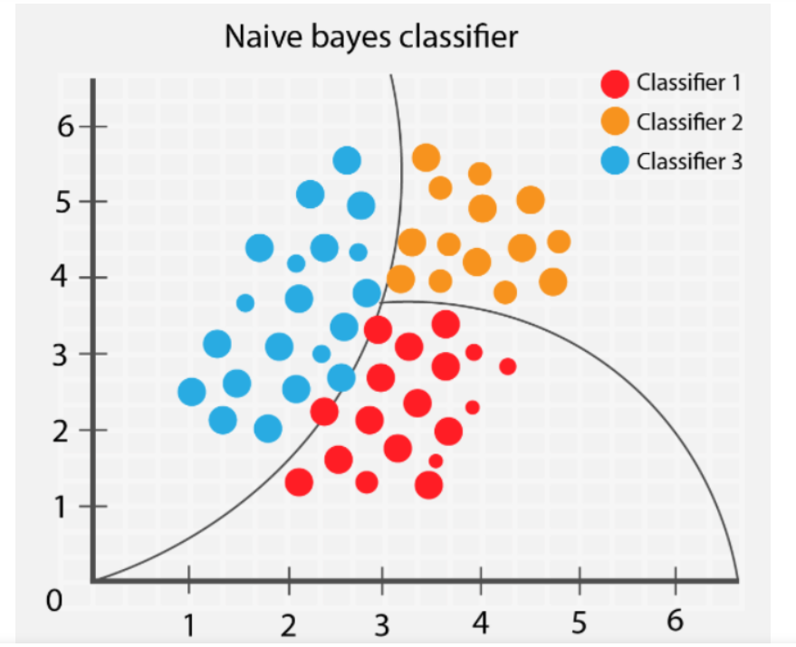
Naïve Bayes(NB) :
Naive Bayes is a machine learning algorithm based on Bayes' theorem that is commonly used for classification problems.
In simple terms, Naive Bayes works by calculating the probability of a new data point belonging to each possible class based on its input features, and then predicting the class with the highest probability.
For example, it can be used to classify an email as spam or not based on the frequency of certain words in the email.

Slide 16
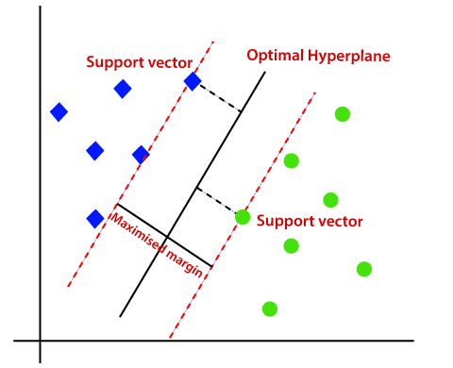
Support Vector Machine(SVM) :
SVM is a machine learning algorithm that can be used for both classification and regression tasks.
In simple terms, SVM works by finding the hyperplane that best separates the data into different classes. The hyperplane is chosen in such a way that the distance between it and the closest data points from each class is maximized
For example, it can be used to classify whether a tumor is benign or malignant based on the characteristics of the tumor such as size, shape, and texture.

Slide 17
ABOUT DATASET
The Dataset that is used for credit card fraud detection is derived from the Kaggle.
Kaggle is a data science platform that provides access to datasets, coding competitions, and a community of data scientists and machine learning practitioners
80% of the data was used for training the four different machine learning models( Logistic Regression, KNN, Naive Bayes, SVM).
The remaining 20% of the data was used for testing the performance of the trained models on unseen data. This approach allowed for a comparison of the performance of these models so that we known the best Model.

Slide 18
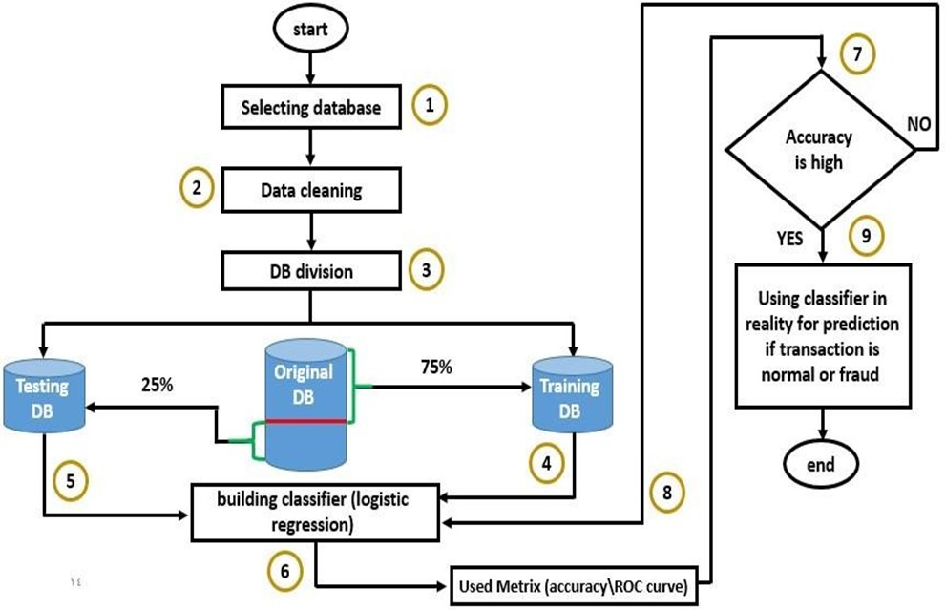
FLOW CHART :

Slide 19
Steps to Follow :
Collection of Data
Download Dataset from Kaggle
Import the libraries
Pandas, NumPy, Sk.learn, Streamlit(Interface) etc.
Process the data for analysis.
Perform the logistic regression, KNN, Naïve Bayes, SVM on data
Perform in-depth analysis. (INTERFACE)
Communicate results of the analysis.

Slide 20
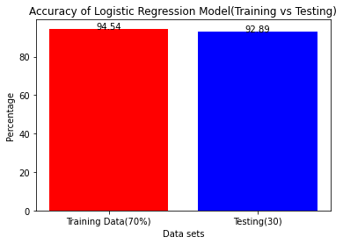
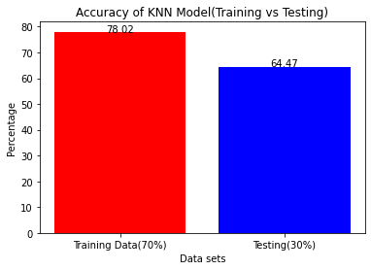
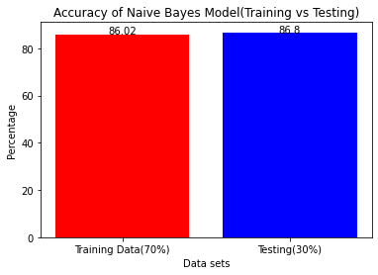
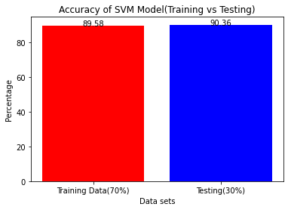
PERFORMANCE OF OUR ALGORITHMS
Logistic Regression Model gives more Accuracy(Train & Test) among All, so we choose LG for Interface

Slide 21
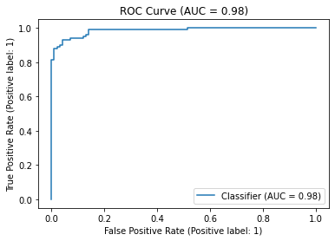
Receiver Operating Characteristic of LR:
An ROC curve is a graph that summarizes the performance of a binary classification model by plotting the true positive rate against the false positive rate at various threshold settings.
The AUC (Area Under the Curve) is a numerical measure of the ROC curve's performance, with a higher AUC indicating a better-performing model.
AUC of 0.98 suggests that the machine learning model has excellent performance in distinguishing between the positive and negative class labels

Slide 22
ADVANTAGES
Preventing further fraudulent activity by deterring potential fraudsters from attempting similar activities.
Protecting victims by making them aware of the situation and allowing them to take steps to protect themselves.
Promoting trust by demonstrating that security is taken seriously, and that action is taken to protect customers.
Ensuring legal compliance by reporting fraudulent activity as required by law.
Managing reputation by being transparent about fraudulent activity and taking swift action to address it.

Slide 23
METHODS TO REDUCE FRAUDULENT TRANSACTION
Implementing two-factor authentication to verify user identity and prevent unauthorized access.
Educating customers on how to detect and report fraudulent activity.
Implementing real-time monitoring to detect and respond to suspicious transactions.
Using machine learning algorithms to analyze patterns and detect anomalies in transactions.
Regularly reviewing and updating security measures to stay ahead of new fraud techniques.

Slide 24
CONCLUSION & FUTURE SCOPE
However, there is a lack of published literature on credit card fraud detection techniques, due to the unavailable credit card transaction dataset for researches. ➢
We designed a system to detect fraud in credit card transaction. This system can provide most of the essential features required to detect fraudulent and legitimate transactions.
The dataset available on the day-to-day processing may become outdated, it is necessary to have updated data for effective fraud behavior identification.

Slide 25
REFERENCES
Credit card fraud detection using Machine Learning Techniques John O. Awoyemi, Adebayo O. Adetunmbi , Samuel A. Oluwadare IEEE 2017
Real-time Credit Card Fraud Detection Using Machine Learning Anuruddha Thennakoon, Chee Bhagyani, Sasitha Premadasa,ShalithaMihiranga, Nuwan Kuruwitaarachchi IEEE 2019
Analysis of Machine Learning Techniques for Credit Card Fraud Detection Abrar Nadim , Ibrahim Mohammad Sayem , Aapan Mutsuddy ,Mohammad Sanaullah Chowdhury IEEE 2019

Slide 26
THANK YOU

